Slide 1
Replacement Theory
In optimization techniques

Slide 2
Replacement theory is concerned with the problem of replacement of machines electricity bulbs, men etc. due to their deteriorating efficiency, failure or breakdown. Replacement is usually carried out under the following situations:
(i) When existing items have outlived their effective lives and it may not be economical to continue with them anymore.
(ii) Items which might have been destroyed either by accident or otherwise.
The above replacement situations may be categorized into the following four categories.
(a) Replacement of items that deteriorates with time e.g., machine tools, vehicles equipment building etc.

Slide 3
(b) Replacement of items which do not deteriorate but fail completely after certain amount of use eg electric bulbs T.V. parts etc.
(c) Replacement of an equipment (or item) that becomes out of date due to new developments, e.g., ordinary weaving looms by automatic looms mechanized accounting system by computer system etc.
(d) The existing working staff in an organization gradually diminishes due to death retirement retrenchment and other reasons. The replacements are thus needed

Slide 4
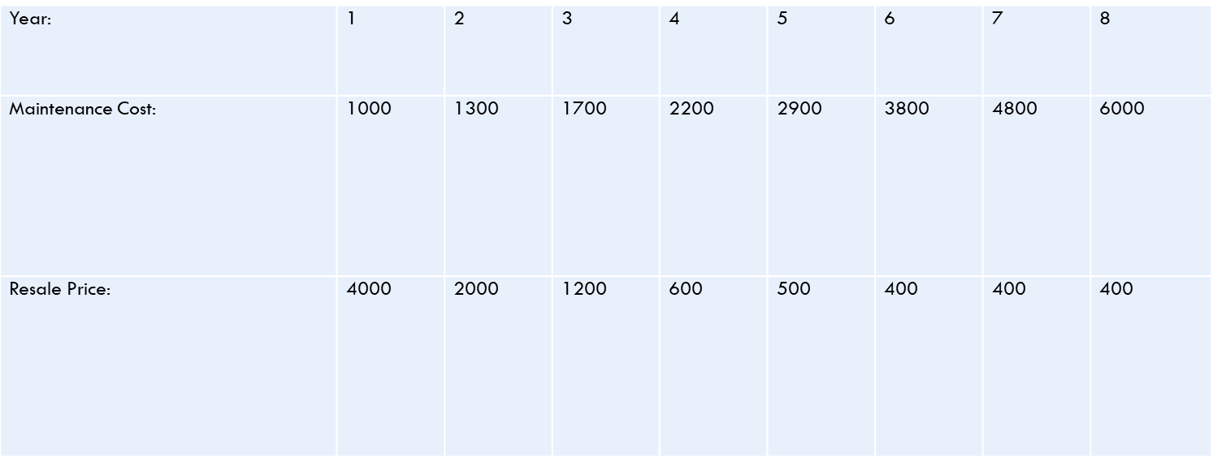
Example---
A Machine owner finds from his past records that the maintenance costs per year of a machine whose purchase price is Rs. 8000 are as given below:
Example ---
A Machine owner finds from his past records that the maintenance costs per year of a machine whose purchase price is Rs. 8000 are as given below:
Determine at which time it is profitable to replace the machine.

Slide 5
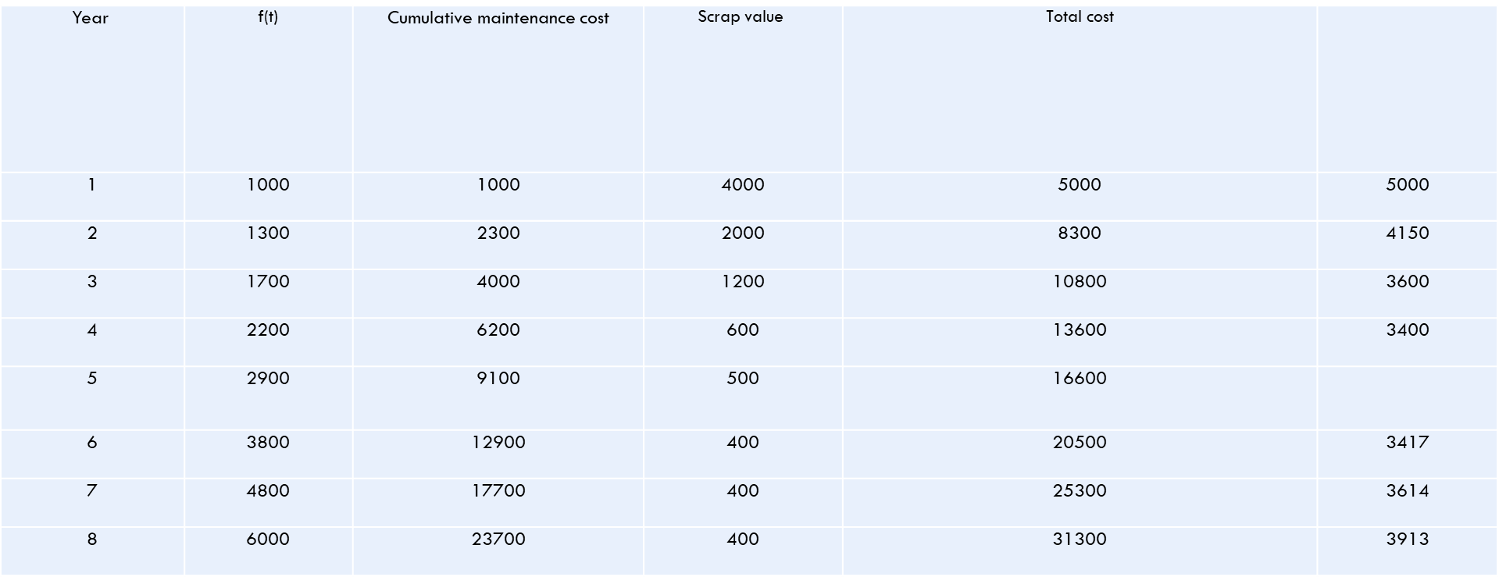
Solution C = Rs. 8000. Table 13.2 shows the average cost per year during the life of machine. Here, The computations can be summarized in the following tabular form:
Table 13.2 Calculations for average cost of machine
3200

Slide 6
The above table shows that the value of TA during fifth year is minimum. Hence the machine should be replaced after every fifth year.

