Slide 1
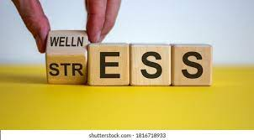
STRESS MANAGEMENT
Dr.PRITI PANDEY
ASSOCIATE PROFESSOR
PHYSICAL EDUCATION
S.N.SEN B.V.P.G.COLLEGE,KANPUR
12.10.2021

Slide 2
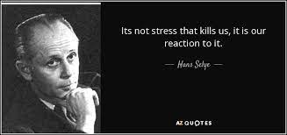
STRESS
stress is a feeling of emotional strain and pressure.
तनाव (Stress) मनःस्थिति से उपजा विकार है।
The word 'stress' is used in physics to refer to the interaction between a force and the resistance to counter that force, and it was Hans Selye who first incorporated this term into the medical lexicon to describe the “nonspecific response of the body to any demand “
The first and most generic definition of stress was that proposed by Hans Selye: "Stress is the nonspecific response of the body to any demand."

Slide 3
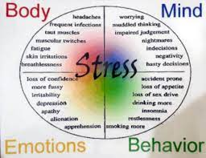
Origin of Stress
The Brain is the Central Organ of Stress and Adaptation. Experience tells us that the social and physical environments in which people live and work have a huge effect upon psychological states. The nature of these environments also affects physical and mental health and risk for disease.

Slide 4
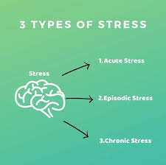
Type of Stress
Acute stress
Chronic
Episodic acute stress
Distress,
Eustress

Slide 5
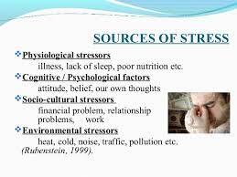
Source of Stress/Stressors
THREAT,
FRASTRATION ,
PRESSURE,
CONFLICT

Slide 6
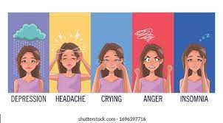
Sign of Stress
anxious
afraid
angry or aggressive
sad
irritable
frustrated
depressed.
cardiovascular disease.
depression.
high blood pressure.
a weakened immune system.

Slide 7
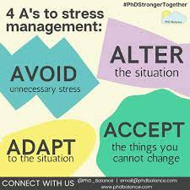
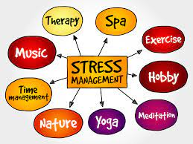
Ways to Deal With Stress

Slide 8
Ways to Deal With Stress in Sports
Deep breathing: Take a deep breath and hold it in for about 5 seconds, then release it slowly. Repeat five times.
Muscle relaxation: Contract (flex) a group of muscles tightly. Keep them flexed for about 5 seconds, then release. Repeat the exercise five times, then move to a different muscle group.
Going to a happy place: Picture a peaceful place or event. Imagine stress flowing away from the body.
Visualizing success: Imagine completing a pass, making a shot, or scoring a goal.
Mindfulness: Focus on the present instead of worrying about the future or the past.
Having a routine: Focus on the routine to keep stress in control.
Thinking positively and developing positive self-talk: Say "I learn from my mistakes," "I'm in control of my feelings," "I can make this goal!" to help keep the negative thoughts away.

Slide 9
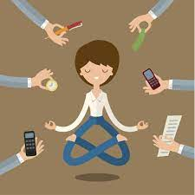
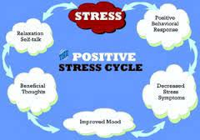

Slide 10
Steps of Stress management
Stress management
step 1 talk about your problem
step 2 set realistic expectations
step 3 learn to say no step
4 change your attitude look for positives
Step 5 take care of yourself
steps 6 slow down go slow
step 7 exercise yoga and meditation
step 8 organise yourself

