Slide 1
Subject Name: Information System: Analysis Design & Implementation Subject Code : BCA 602 (N) Topic : Software Quality
HIMANSHU SHUKLA
Department of Computer Application
UIET, CSJM University, Kanpur

Slide 2
Software Quality

Slide 3
Software Quality
Quality factor is a non-functional requirements which is not called up by customer’s contract. The attributes are specific to Project. Some quality factors are listed below :
Understandibility ( Easy to understand by novice user )
Completeness ( Fully developed and fully explained )
Conciseness ( To the point )
Portability ( Irrespective of architecture and platform )
Consistency ( Used uniform nomenclature or symbol )
Maintainability (Upgradtion of product as per user’s requirement)
Usability ( Easy to use )
Reliability ( Probability of free fail operation )
Structured ( Well defined structure )
Efficiency ( Performance in terms of throughput )
Security

Slide 4
ISO ( International Standard Organisation )
ISO has developed quality system for the management and to control the quality of product at every stage of design and development, planning, production, installation and service.
ISO 9000 quality systems guidelines the direction of selection and use of standards on quality system.
ISO 9001 models for quality assurance in design, development, production, installation and servicing.
ISO 9002 model for quality assurance in production and installation ( it deals with already established design )
ISO 9003 model for quality assurance during final inspection and test.
ISO 9004 model for quality system guidelines on eligance of quality management system (detection of customer need and satisfaction )

Slide 5
Features
Management Responsibility.
Quality System.
Contract Review.
Inspection and Testing.
Corrective Action.
Handling storage, preservation, packaging and delivery.
Quality Records.
Internal Quality Audit.
Training and Human Resource Development.
Servicing.
Statistical Technique.

Slide 6
CMM ( Capability Maturity model )
The Capability Maturity Model (CMM) is a procedure used to develop and refine an organization's software development process.
The model defines a five-level evolutionary stage of increasingly organized and consistently more mature processes.
CMM was developed and is promoted by the Software Engineering Institute (SEI), a research and development center promote by the U.S. Department of Defence (DOD).
Capability Maturity Model is used as a benchmark to measure the maturity of an organization's software process.
The higher the level, the better the software development process, hence reaching each level is an expensive and time-consuming process.

Slide 7
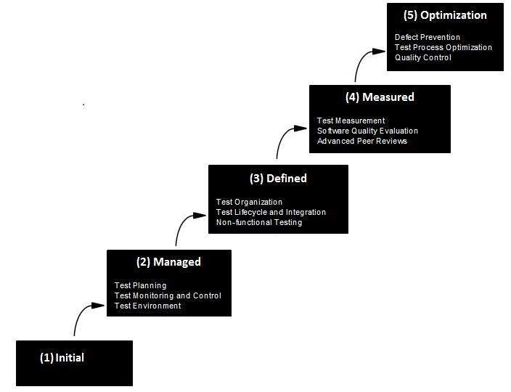
Capability Maturity model ( Level )
CMM categorized software development industries into the following five maturity levels. The various levels of SEI CMM have been designed so that it is easy for an organization to build its quality system starting from scratch slowly.

Slide 8
Level One :Initial - The software process is characterized as inconsistent, and occasionally even chaotic. Defined processes and standard practices that exist are abandoned during a crisis. Success of the organization majorly depends on an individual effort, talent, and heroics. The heroes eventually move on to other organizations taking their wealth of knowledge or lessons learnt with them.
Level Two: Repeatable - This level of Software Development Organization has a basic and consistent project management processes to track cost, schedule, and functionality. The process is in place to repeat the earlier successes on projects with similar applications. Program management is a key characteristic of a level two organization.

Slide 9
Level Three: Defined - The software process for both management and engineering activities are documented, standardized, and integrated into a standard software process for the entire organization and all projects across the organization use an approved, tailored version of the organization's standard software process for developing, testing and maintaining the application.
Level Four: Managed - Management can effectively control the software development effort using precise measurements. At this level, organization set a quantitative quality goal for both software process and software maintenance. At this maturity level, the performance of processes is controlled using statistical and other quantitative techniques, and is quantitatively predictable.
Level Five: Optimizing - The Key characteristic of this level is focusing on continually improving process performance through both incremental and innovative technological improvements. At this level, changes to the process are to improve the process performance and at the same time maintaining statistical probability to achieve the established quantitative process-improvement objectives.

