Slide 1
Example for unbalanced assignment problem
Ques-1 Find Solution of Assignment problem using Hungarian method (MIN case).
Solution-since the matrix is not square matrix the problem is unbalanced we add a dummy job 5 with corresponding entry zero(0).
Machines /Job | A | B | C | D | E
1 | 4 | 3 | 6 | 2 | 7
2 | 10 | 12 | 11 | 14 | 16
3 | 4 | 3 | 2 | 1 | 5
4 | 8 | 7 | 6 | 9 | 6

Slide 2
Modified matrix:
N X N , N=5
Machine /Jobs | A | B | C | D | E
1 | 4 | 3 | 6 | 2 | 7
2 | 10 | 12 | 11 | 14 | 16
3 | 4 | 3 | 2 | 1 | 5
4 | 8 | 7 | 6 | 9 | 6
5(Dummy) | 0 | 0 | 0 | 0 | 0

Slide 3
We subtract the smallest elements from all the elements from respective rows.
We get-
 | A | B | C | D | E
1 | 2 | 1 | 4 | 0 | 5
2 | 0 | 2 | 1 | 4 | 6
3 | 3 | 2 | 1 | 0 | 4
4 | 2 | 1 | 0 | 3 | 0
5 | 0 | 0 | 0 | 0 | 0

Slide 4
We subtract all the smallest elements from all the elements in the respective column.
We get-
✓
✓
✓
 | A | B | C | D | E
1 | 2 | 1 | 4 | 0 | 5
2 | 0 | 2 | 1 | 4 | 6
3 | 3 | 2 | 1 | 0 | 4
4 | 2 | 1 | 0 | 3 | 0
5 | 0 | 0 | 0 | 0 | 0

Slide 5
We will get the matrix after ticking method
Answer = 3 + 10 + 1 + 6 + 0 = 20//
 | A | B | C | D | E
1 | 1 | 0 | 3 | 0 | 4
2 | 0 | 2 | 1 | 5 | 6
3 | 2 | 1 | 0 | 0 | 3
4 | 2 | 1 | 0 | 4 | 0
5 | 0 | 0 | 0 | 1 | 0

Slide 6
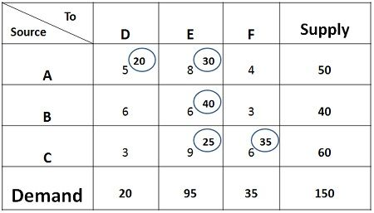
Once the demand and supply are equal, the following procedure is followed:

