Slide 1
Subject Name: Information System: Analysis Design & Implementation Subject Code : BCA 602 (N) Topic : Use Case Diagram
HIMANSHU SHUKLA
Department of Computer Application
UIET, CSJM University, Kanpur

Slide 2
Use Case Diagram
Use case diagrams are used to gather the requirements of a system including internal and external influences.
These requirements are mostly design requirements.
Hence, when a system is analysed to gather its functionalities, use cases are prepared and actors are identified.
Used to gather the requirements of a system.
Used to get an outside view of a system.
Identify the external and internal factors influencing the system.
Show the interaction among the requirements are actors.

Slide 3
Characteristics of use case diagram
Use case diagrams are considered for high level requirement analysis of a system. When the requirements of a system are analysed, the functionalities are captured in use cases
Actors can be a human user, some internal applications, or may be some external applications. When we are planning to draw a use case diagram, we should have the following items identified.
Functionalities to be represented as use case
Actors
Associations (Relationships among the use cases and actors).
System Boundary Boxes (Optional)
Packages ( Optional)

Slide 4
Draw a Use Case Diagram
Use case diagrams are drawn to capture the functional requirements of a system. After identifying the above items, we have to use the following guidelines to draw an efficient use case diagram
The name of a use case is very important. The name should be chosen in such a way so that it can identify the functionalities performed.
Give a suitable name for actors.
Show relationships and dependencies clearly in the diagram.
Do not try to include all types of relationships, as the main purpose of the diagram is to identify the requirements.
Use notes whenever required to clarify some important points.

Slide 5
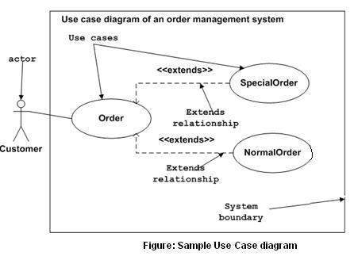
Use Case Diagram

Slide 6
References:
1. www.tutorialspoint.com
2. www.javatpoint.com
3. V. Raja Raman : Analysis and Design of Information Systems
4. Jeffrey L Whitten & Lonnie D Bently: System Analysis and Design Methods

