Slide 1
User Interface Design

Slide 2
User Interface
User interface is the front-end application view to which user interacts in order to use the software.
User can manipulate and control the software as well as hardware by means of user interface.
User interface is part of software and is designed such a way that it is expected to provide the user insight of the software.
UI provides fundamental platform for human-computer interaction.
UI can be graphical, text-based, audio-video based, depending upon the underlying hardware and software combination. UI can be hardware or software or a combination of both.

Slide 3
Software User Interface
The software becomes more popular if its user interface is:
Simple to use
Attractive
Responsive in short time.
Clear to understand .
Consistent on all interfacing screens.
User Interface is broadly divided into two categories:
Command Line Interface.
Graphical User Interface.

Slide 4
Command Line Interface (CLI)
CLI has been a great tool of interaction with computers until the video display monitors came into existence.
CLI provides a command prompt, the place where the user types the command and feeds to the system.
The user needs to remember the syntax of command and its use.
A command is a text-based reference to set of instructions, which are expected to be executed by the system.
CLI uses less amount of computer resource as compared to GUI.
CLI Elements:
1. Command Prompt. 2. Cursor. 3. Command.

Slide 5
Graphical User Interface ( GUI )
Graphical User Interface provides the user graphical means to interact with the system.
GUI can be combination of both hardware and software. Using GUI, user interprets the software.
With advancing technology, the programmers and designers create complex GUI designs that work with more efficiency, accuracy and speed.
GUI is more resource consuming than that of CLI.
GUI Elements:
1. Window. 2. Tabs. 3. Menu. 4. Icons. 5. Cursor.

Slide 6
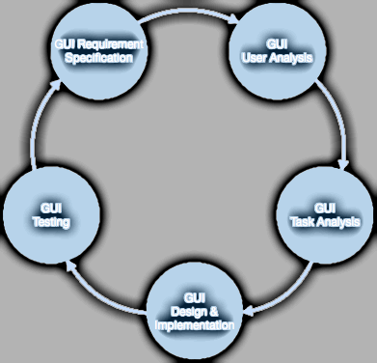
User Interface diagram
There are a number of activities performed for designing user interface.
A model used for GUI design and development should fulfill these GUI specific steps.

