Slide 1
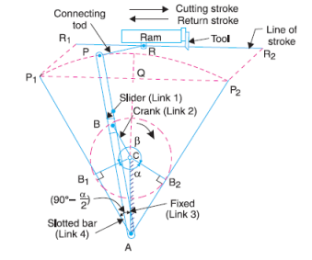
Quick return mechanism
Quick return mechanism : Crank and slotted lever quick return motion mechanism.
Application:
This quick return mechanism is mostly used in shaping machines, slotting machines and in rotary internal combustion engines.
Construction:
In this quick return mechanism, the link AC (i.e. link 3) forming the turning pair is fixed, as shown in fig. The link 3 corresponds to the connecting rod of a reciprocating steam engine. The driving crank CB revolves with uniform angular speed about the fixed centre C. A sliding block attached to the crank pin at B slides along the slotted bar AP and thus causes AP to oscillate about the pivoted point A. A short link PR transmits the motion from AP to the ram which carries the tool and reciprocates along the line of stroke R₁R₂. The line of stroke of the ram (i.e. R₁R₂) is perpendicular to AC produced.
Link-3

Slide 2
Velocity analysis of quick return mechanism

Slide 3
Velocity analysis of quick return mechanism
V_{P}
Velocity point P:
V_{P} = ω_{op} x OP
Direction: Perpendicular to OP
90⁰

Slide 4
V_{P}
Velocity component of point P perpendicular to AR
V_{P}
90⁰
Velocity component of point P parallel to AR
Velocity component of point P perpendicular to AR = Velocity of point Q ( point Q lie on link AR)
(Point P and point Q are called as coincident point)

Slide 5
V_{Q} = ω_{AR} x AQ (AQ=AP)
V_{R} = ω_{AR} x AR
V_{R}
V_{P}
90⁰
V_{Q}
V_{S}
90⁰
V_{S/R}

Slide 6
15
16
16
24
24
2 6
1
45
26
34 = infinifity
46
2 6
46
23
24
(6)
56
13
(2)
12
34 = infinifity
(1)
13 14 15 16
23 24 25 26
34 35 36
45 46
56
(4)
13
13
14
2 1 4
2 5 4
2 6 4
1 2 3 4 5 6
15

Slide 7
Q. What is position of crank OP for which velocity of slider S is 0?
Ans:
If OP is perpendicular to link AR.
There is two value of angular position of crank for which OP is perpendicular to AR
R
R
S
V_{S} = 0
V_{S} = 0
90⁰
90⁰

Slide 8
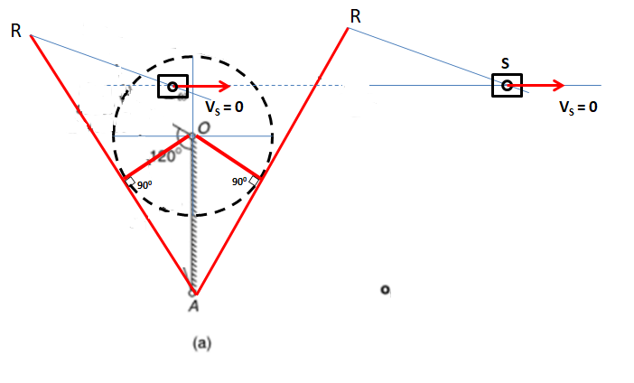
Q. What is position of crank OP for which velocity of slider S is 0?
Ans:
If OP is perpendicular to link AR.
There is two value of angular position of crank for which OP is perpendicular to AR
ω_{RS} = 0
ω_{RS} = 0
ω_{AR} = 0
P
P
ω_{AR} = 0

Slide 9
Quick return ratio

Slide 10
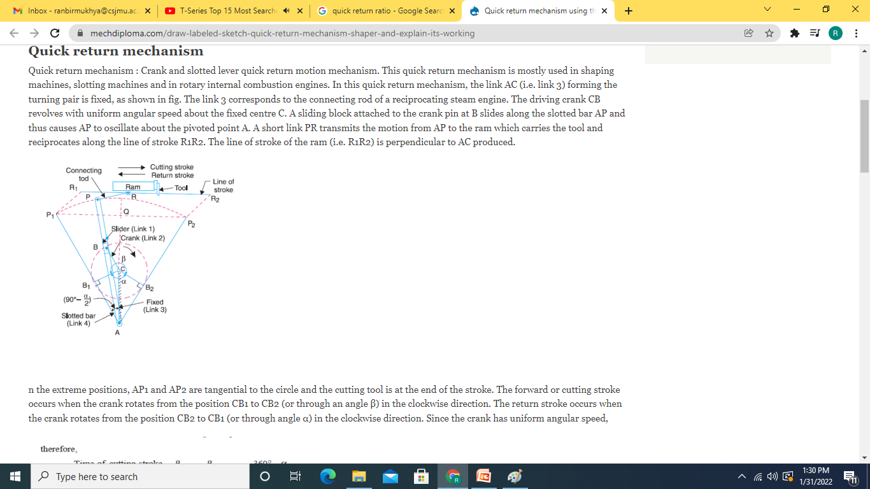

Slide 11
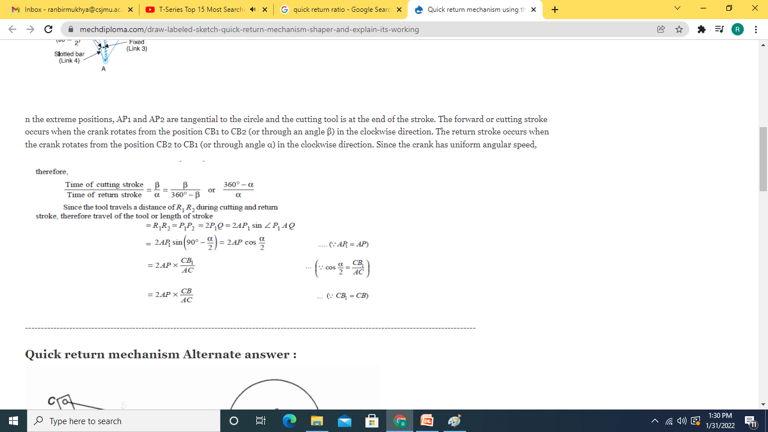

Slide 12
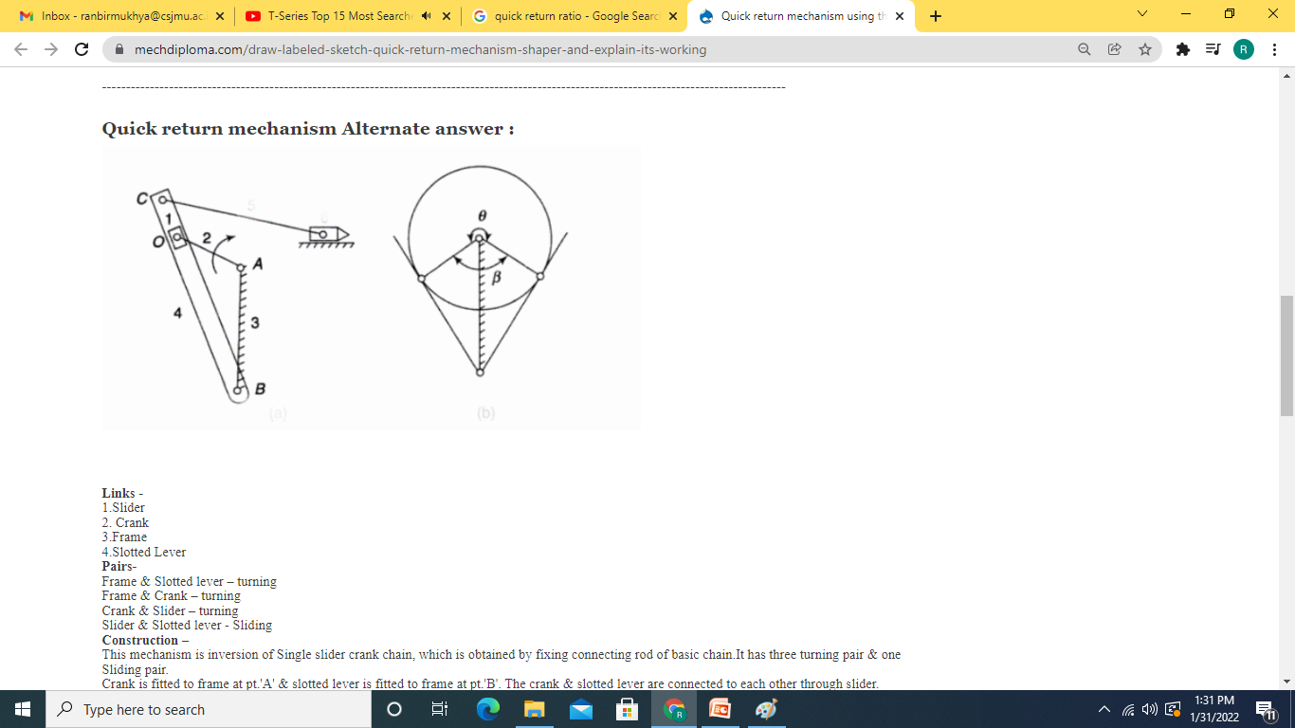

Slide 13
References: https://www.mechdiploma.com/draw-labeled-sketch-quick-return-mechanism-shaper-and-explain-its-working

Slide 14
45
56
23
OA = link-1
OP = link-2
12
Slider = link-3
AR = link-4
RS = link-5
Slider S = link-6
14
15

