Slide 1
Graphical method in optimization techniques
LLP by graphical method

Slide 2
Graphical optimization is a simple method for solving optimization problems involving one or two variables. For problems involving only one optimization variable, the minimum (or maximum) can be read simply from a graph of the objective function. For problems with two optimization variables, it is possible to obtain a solution by drawing contours of constraint functions and the objective function. The procedure is discussed in detail in the first section. After developing the procedure in detail with hand calculations, a Mathematica function called GraphicalSolution is presented that automates the process of generating the complete contour plots. The second section presents solutions of several optimization problems using this function.
We will first discuss the steps of the algorithm:
Step 1: Formulate the LP (Linear programming) problem
Step 2: Construct a graph and plot the constraint lines

Slide 3
Step 3: Determine the valid side of each constraint line
Step 4: Identify the feasible solution region
Step 5: Plot the objective function on the graph
Step 6: Find the optimum point
Step 7: Calculate the coordinates of the optimum point.

Slide 4
Examples:
Question 1. Solve the given linear programming problems graphically:
Maximize: Z = 8x + y
and the constraints are :
x + y ≤ 40,
2x + y ≤ 60,
x ≥ 0, y ≥ 0
Solution:

Slide 5
Step 1: Constraints are :
x + y ≤ 40,
2x + y ≤ 60,
x ≥ 0, y ≥ 0
Step 2: Draw the graph using these constraints

Slide 6
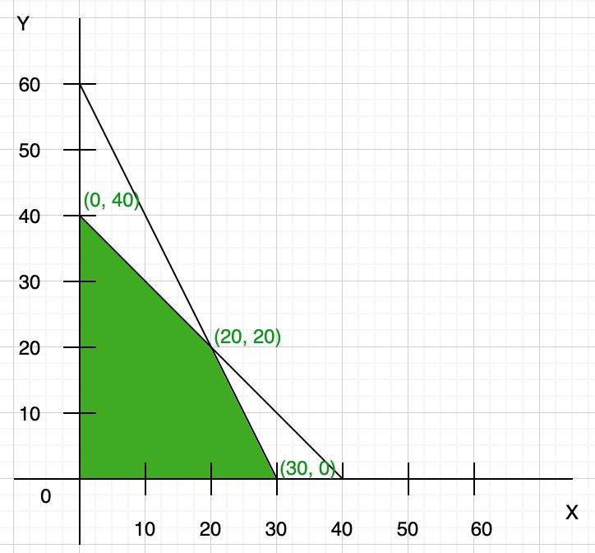

Slide 7
Here both the constraints are less than or equal to, so they satisfy the below region (towards origin). You can find the vertex of feasible region by graph, or you can calculate using the given constraints: x + y = 40 …(i) 2x + y = 60 …(ii)
Now multiply eq(i) by 2 and then subtract both eq(i) and (ii), we get
y = 20
Now put the value of y in any of the equations, we get
x = 20

Slide 8
So the third point of the feasible region is (20, 20) Step 3: To find the maximum value of Z = 8x + y. Compare each intersection point of the graph to find the maximum value
So the maximum value of Z = 240 at point x = 30, y = 0.

