Slide 1
WIRELESS COMMUNICATION

Slide 2
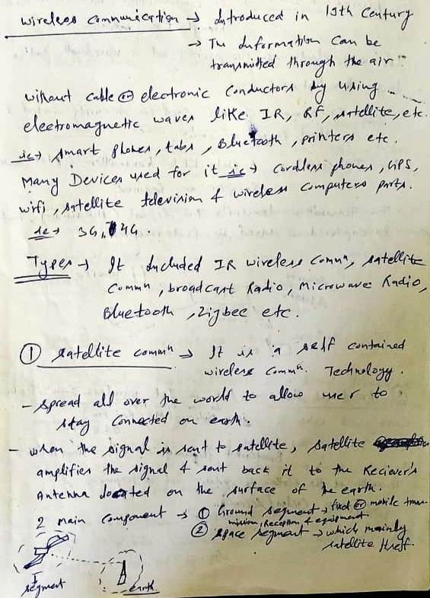

Slide 3
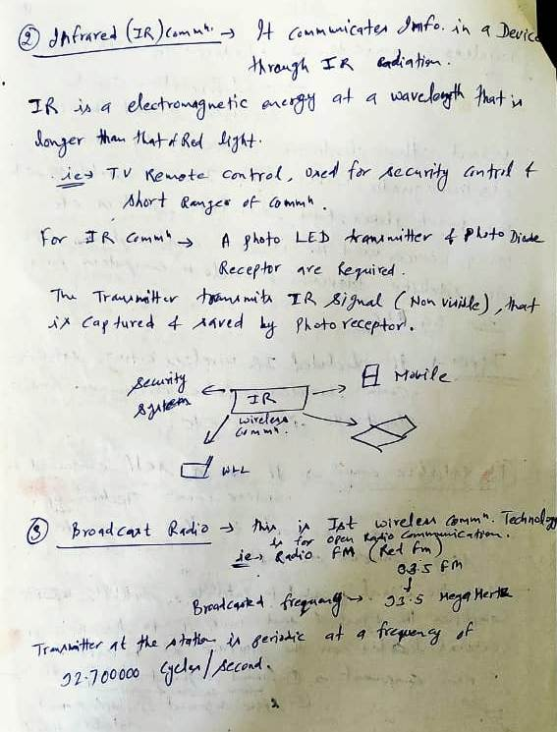

Slide 4
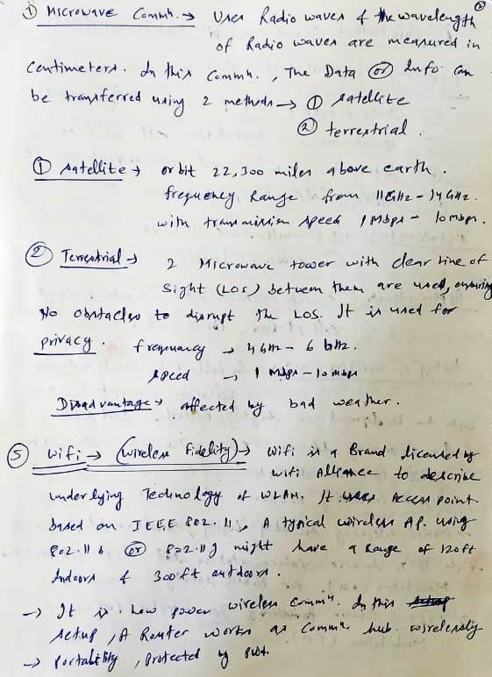

Slide 5
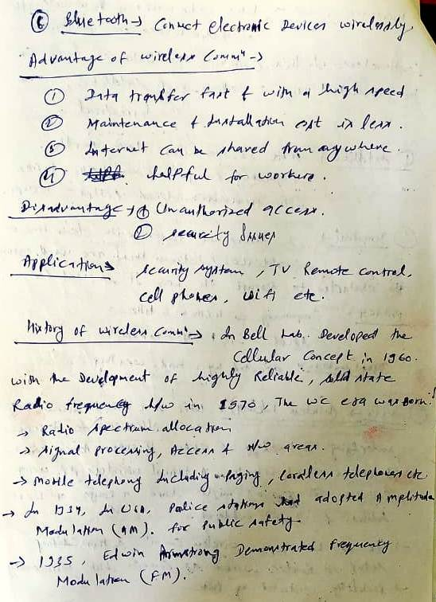

Slide 6
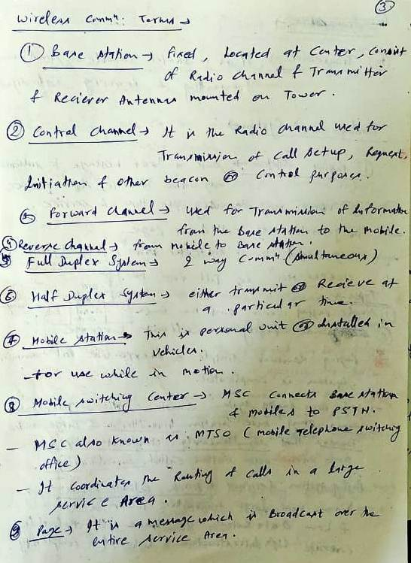

Slide 7
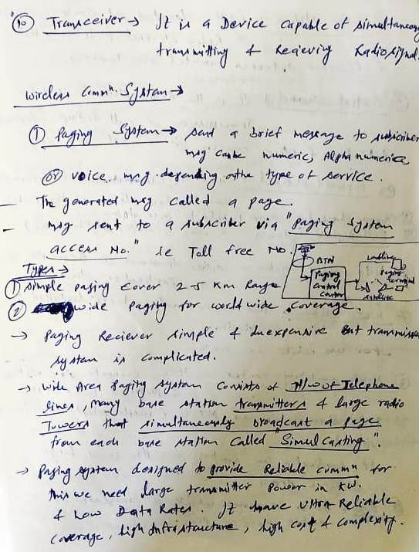

Slide 8
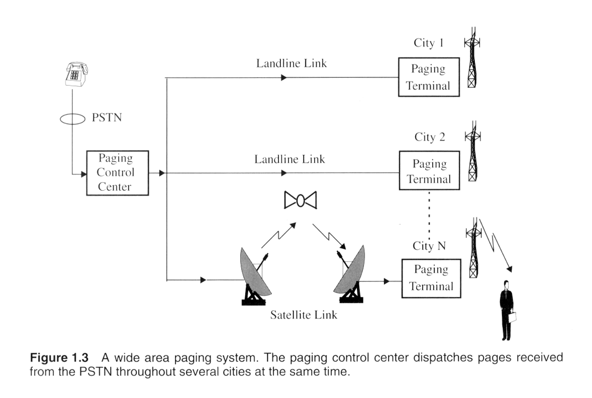
Paging system

Slide 9
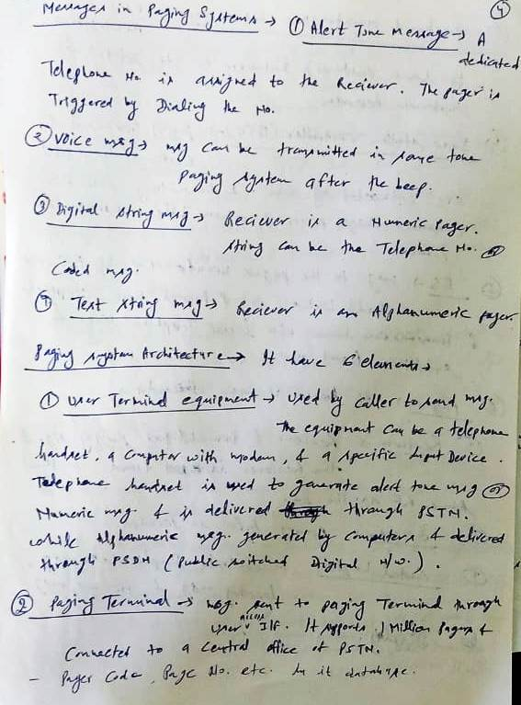

Slide 10
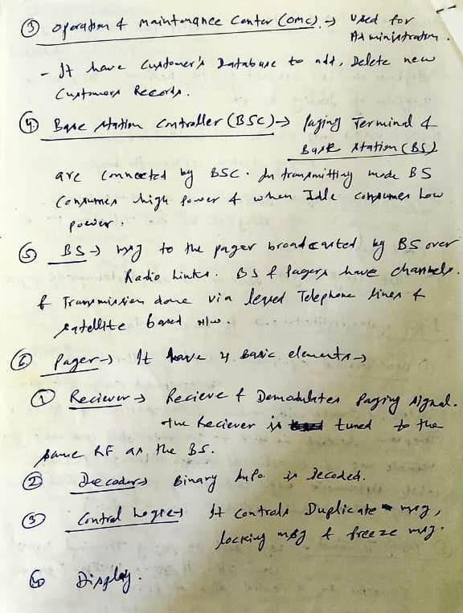

Slide 11
Cordless Telephones
PSTN
Telephone
Network
Cordless
Phone
Base unit

Slide 12
Cordless Telephones
Characterized by
Low mobility (in terms of range and speed)
Low power consumption
Two-way tetherless (wireless) voice communication
High circuit quality
Low cost equipment, small form factor and long talk-time
No handoffs between base units
Appeared as analog devices
Digital devices appeared later with CT2, DECT standards in Europe and ISM band technologies in USA

Slide 13
Cordless Telephones
Usage
At homes
At public places where cordless phone base units are available
Design Choices
Few users per MHz
Few users per base unit
Many base units are connected to only one handset
Large number of base units per usage area
Short transmission range

Slide 14
Cordless Phone
Some more features
32 Kb/s adaptive differential pulse code modulation (ADPCM) digital speech encoding
Tx power <= 10 mW
Low-complexity radio signal processing
No forward error correction (FEC) or whatsoever.
Low transmission delay < 50ms
Simple Frequency Shift Modulation (FSK)
Time Division Duplex (TDD)

