Slide 1
ANTIFUNGAL ANTIBIOTICS
An antifungal medication, also known as an anti-mycotic medication, is a pharmaceutical fungi-cide or fungi-static. They are used to treat in the treatment and prevention of mycosis such as athlete's foot, ringworm, candidiasis (thrush), serious systemic infections such as cryptococcal meningitis, and others.
Official drugs:
1. Amphotericin -B
2. Nystatin
3. Natamycin
4. Griseofulvin

Slide 2
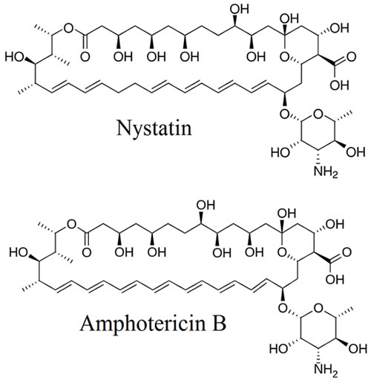
AMPHOTERICIN –B & NYSTATIN

Slide 3
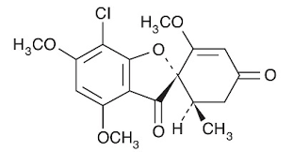
comparison
 | Amphotericin –B (Fungizone) | Nystatin A1
Source | Streptomyces nodosus [1965] | Streptomyces noursei [1950]
Chemical class | Polyene macrolide antibiotics B: C27-28; C=C bond present (Total 7 double bonds; 10-OH Groups present MF: C47 H73 N O17 | Polyene macrolide antibiotics [6 C=C Bonds, 10 OH groups present], =Tetraene+dienes system amino sugar= Mycosamine
MOA | Binds with ergosterol | Binds with ergosterol
 | Amphoteric in nature/Narrow spectrum | ----------------
preparation | Injection ( slow iv) 250mg every 6 hrs. | topical-ointment, pessaries (vaginal tablets)
Uses | Mucormycosis, Aspergillosis, Blasto-mycosis, Candidiasis, , and cryptococcosis, visceral leismaniasis | Vaginal yeast, candidiasis, diaper rash, used in AIDS patient with low CD4 cell count
Chemistry:Macrolide Polyenes antibiotics with 5 double bonds, and 5-OH groups present
Uses: -Conjunctivitis, fungal infection in eye lids, cornea [cream, eye drops, lozenge,
-Yeast infection and oral thrash
(Orally little/poor absorption)
-Preservative in food industry
Preparation: 5% ophthalmic suspension, eye drops
4. Griseofulvin IP
Nomenclature:
7-chloro- 2', 4, 6-trimethoxy- 6'-methyl- Spiro [1-benzofuran- 2,1'-cyclohex[2]-ene]- 3,4'-dione
MOA: Mechanism based on its ability to interfere with cell division (particularly mitosis) in fungal cells. Particularly, griseofulvin disrupts microtubule formation
It is naturally synthesized antifungal agent that is produced by Penicillium species (particularly P. griseofulvin). Griseofulvin is available both for topical and oral administration, but the drug is mainly used for topical treatment of superficial mycoses. The drug is poorly absorbed by the gastrointestinal tract (GIT), and this limits their usage for oral administration.
Preparation: 250mg, 500 mg tablets (orally)

Slide 4
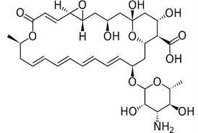
3. NATAMYCIN (PIMARICIN)
MOA: similar to other polyene antibiotics
Chemistry:
Macrolide- Polyenes- antibiotics with 5 Conjugated double bonds , and 5-OH groups present.
Uses: -Conjunctivitis, fungal infection in eye lids, cornea.
-Yeast infection and oral thrash
(Orally little/poor absorption)
-Preservative in food industry
Preparation: 5% ophthalmic suspension, eye drops, cream, and Lozenge

Slide 5
4. Griseofulvin IP
Isolated in 1939 through solvent extraction of Mycelium
Nomenclature:
7-chloro- 2', 4, 6-trimethoxy- 6'-methyl- Spiro [1-benzofuran- 2,1'-cyclohex[2]-ene]- 3,4'-dione
MOA: Mechanism based on it’s ability to interfere with cell division (particularly mitosis) in fungal cells. Particularly, griseofulvin disrupts microtubule formation
It is naturally synthesized antifungal agent that is produced by Penicillium species (particularly
P griseofulvin). Griseofulvin is available both for topical and oral administration, but the drug is mainly used for topical treatment of superficial mycoses. The drug is poorly absorbed by the gastrointestinal tract (GIT), and this limits their usage for oral administration.
Preparation: 250mg, 500 mg tablets (orally), particle size 5micron is required for enhance absorption as required by BP and USP

