Slide 1
ANTI FUNGAL DRUGS (Drugs used in the treatment of fungal infections)
Natural origin: Amphotericin B, Nystatin, Griseofulvin,
Natamycin (Pimaricin), Echinocandins
Synthetic agents: Antimetabolites-Flu cytosine,
Allylamines- Tolnaftate
Azoles-
Imidazole: Butaconazole, Clotrimazole
Econazole, ketoconazole, Micozazole,
Triazole: Intraconazole, fluconazole

Slide 2
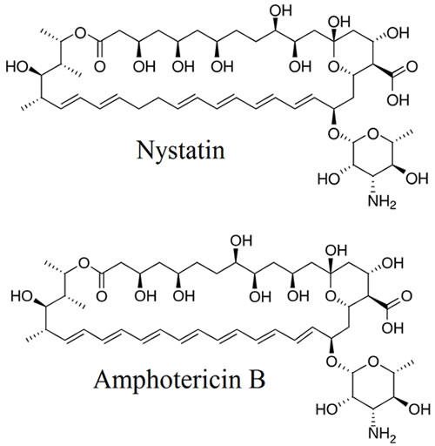
POLYENE-ANTIBIOTICS Polyenes work by inserting themselves into cell membranes. This results in a rise in membrane permeability and loss of cytoplasmic constituents which is detrimental to fungal cell viability.

Slide 3
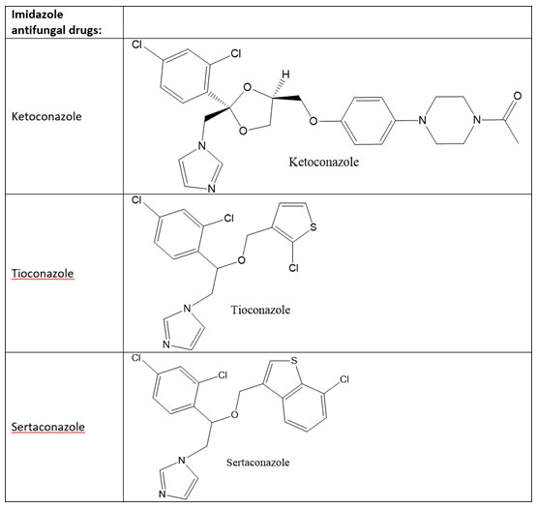
Azoles synthetic anti- fungal agents Azole antifungals are noncompetitive inhibitors that exert their antifungal effects by binding to lanosterol 14 α-demethylase, a key enzyme in the biosynthesis of ergosterol

Slide 4
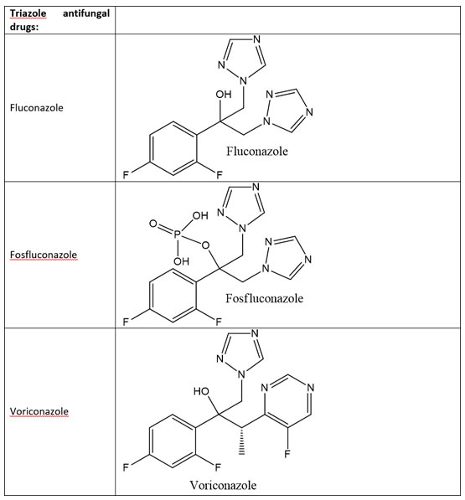
Triazole- antifungal agents

