Slide 1


MARKETING RESEARCH
Marketing Management
Dr Prabhat K Dwivedi, Associate Professor
School of Business Management

Slide 2
Topics to be covered
Meaning & definitions
Difference b/w Market Research ad Marketing Research
Process
Types
Importance
Role
Dr Prabhat K Dwivedi, Associate Professor

Slide 3

Dr Prabhat K Dwivedi, Associate Professor

Slide 4
Meaning & Definition
The systematic design, collection, analysis, and reporting of data relevant to a specific marketing situation facing an organization
Green and Tull have defined marketing research as follows:
"Marketing research is the systematic and objective search for, and analysis of, information relevant to the identification and solution of any problem in the field of marketing."
The Core Purpose:
-Bridges the gap between the business and its consumers.
-Minimizes financial risk in new ventures.
-Uncovers new market opportunities and operational threats.
Dr Prabhat K Dwivedi, Associate Professor

Slide 5
Market Research vs. Marketing Research
Market Research: Broad analysis of a specific market sector, industry trends, market size, and direct competitor behavior.
Marketing Research: A broader, more specific concept. It evaluates the entire marketing process, including consumer behavior, product performance, pricing elasticity, and promotional effectiveness.
Takeaway: Market research tells you where to sell; marketing research tells you how to sell
Dr Prabhat K Dwivedi, Associate Professor

Slide 6
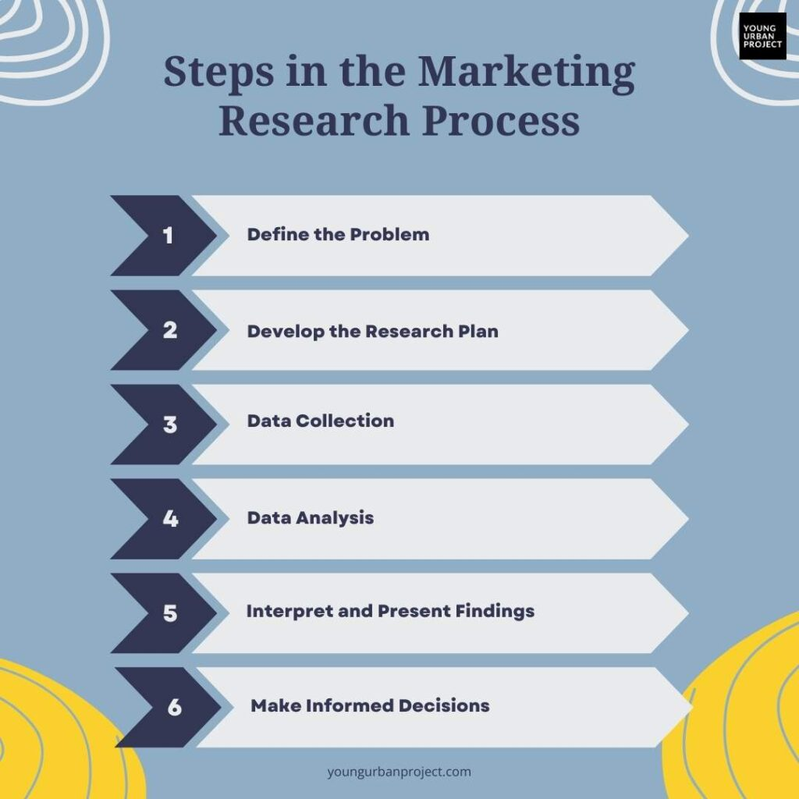
Marketing Research Process
Dr Prabhat K Dwivedi, Associate Professor

Slide 7
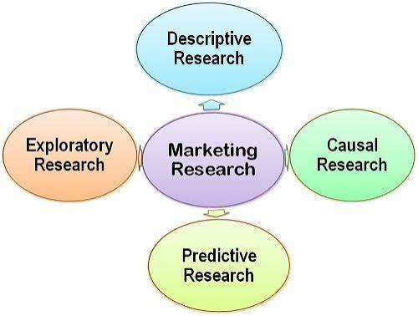
Key Types of Research (By Objectives)
Exploratory Research: Used to gather preliminary data to shed light on the real nature of a problem and suggest possible hypotheses.
Descriptive Research: Seeks to describe marketing variables or customer demographics (e.g., "Who buys our product?").
Causal Research: Tests hypotheses about cause-and-effect relationships (e.g., "Will a 10% price cut increase sales by 15%?")
Predictive research is a statistical and data-driven approach used to forecast future outcomes, behaviors, or trends by analyzing historical and current data. Instead of just explaining what happened in the past (descriptive research) or why it happened (diagnostic research), predictive research answers the question: "What is most likely to happen next?"
Dr Prabhat K Dwivedi, Associate Professor

Slide 8
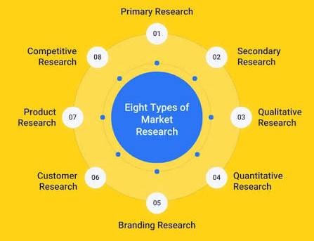
Dr Prabhat K Dwivedi, Associate Professor

Slide 9
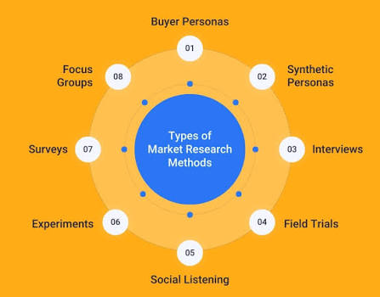
Dr Prabhat K Dwivedi, Associate Professor

Slide 10
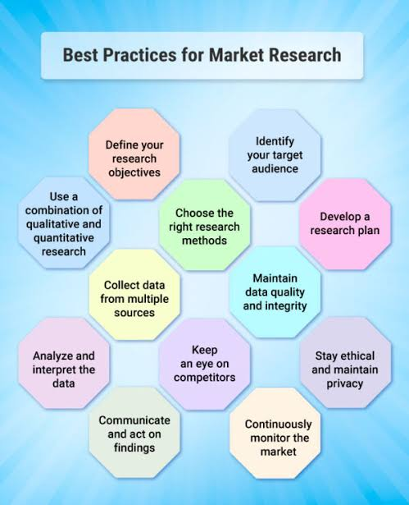
Best Practices for Market Research
Dr Prabhat K Dwivedi, Associate Professor

Slide 11
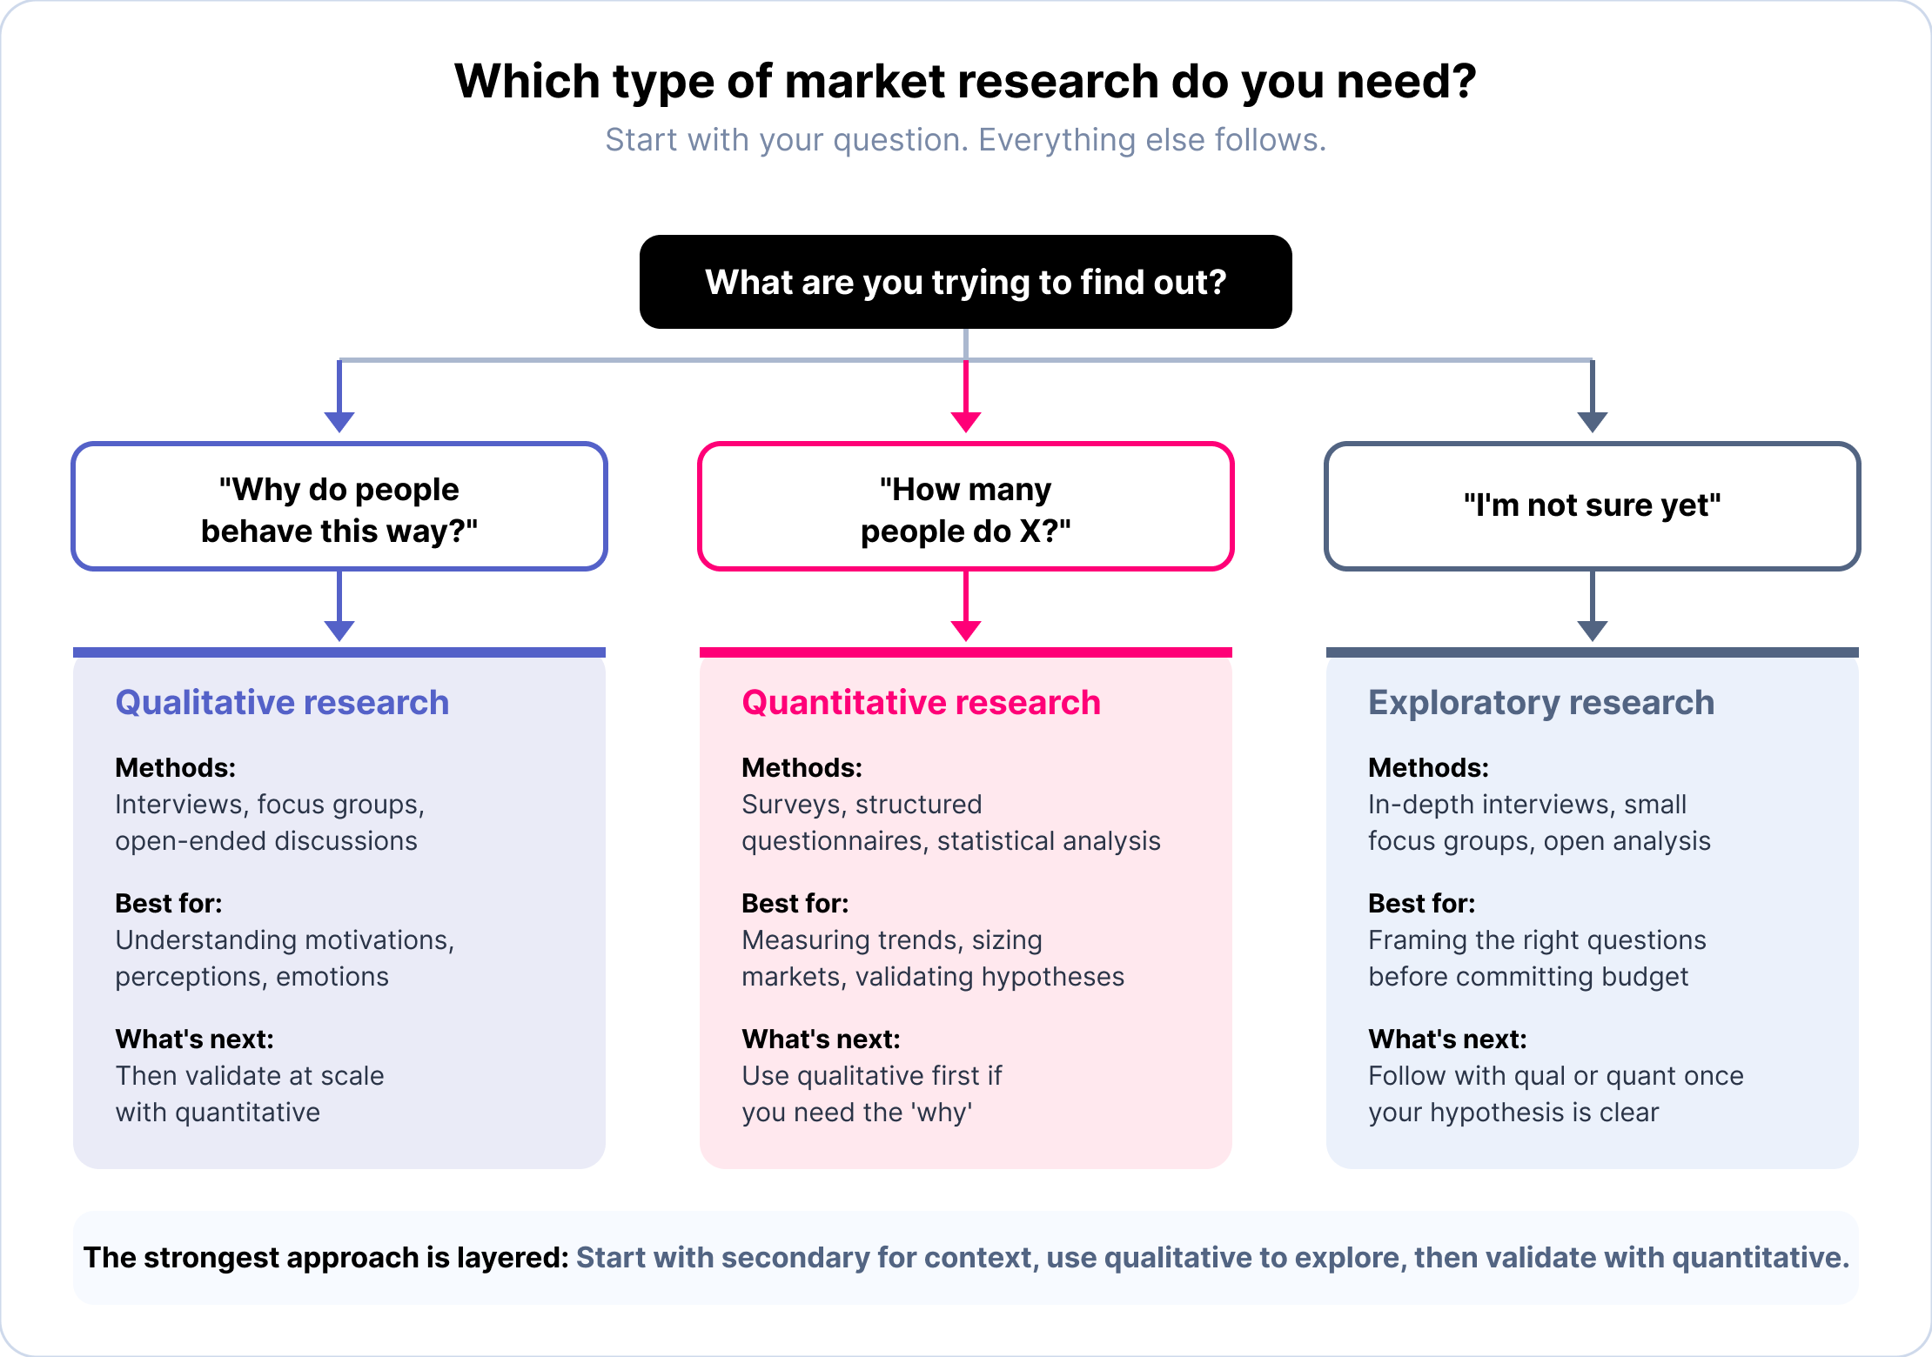
https://www.gwi.com/blog/types-of-market-research
Dr Prabhat K Dwivedi, Associate Professor

Slide 12
Key Reasons Why Marketing Research Matters
Understands the Audience: It uncovers buyer demographics, preferences, and daily purchasing habits.
Reduces Business Risk: Testing products or pricing before a launch prevents costly failures.
Tracks Competitors: It highlights competitor strengths, weaknesses, and market gaps you can exploit.
Guides Smart Decisions: Leaders use collected data to build realistic budgets and shape marketing campaigns.
Improves Satisfaction: Ongoing feedback helps companies refine their customer service and retain buyers.

Slide 13
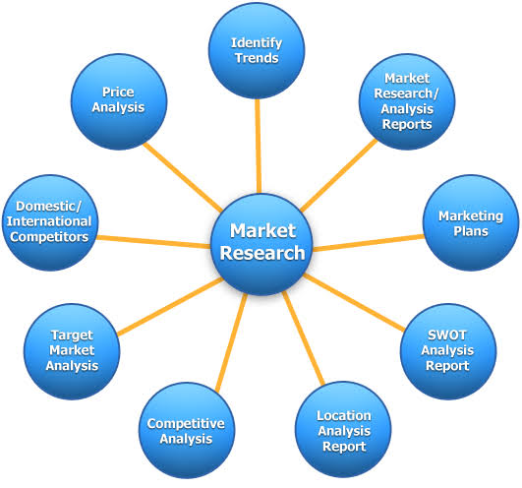
Role of Marketing Research

Slide 14

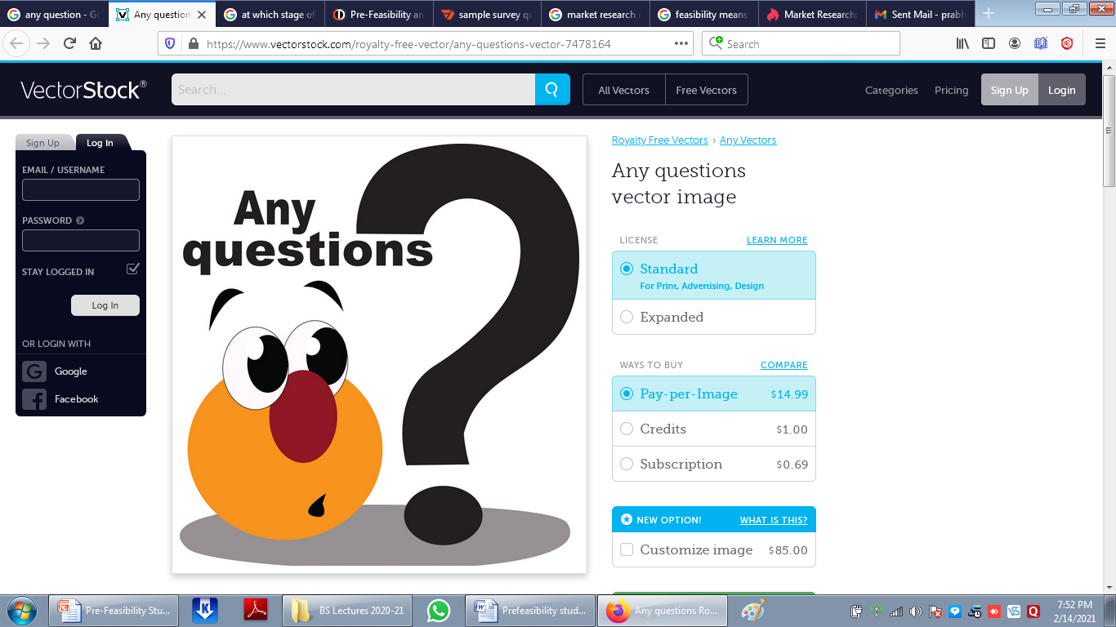
Dr Prabhat K Dwivedi, Associate Professor

Slide 15
References
https://www.fao.org/4/w3241e/w3241e02.htm
Green, P.E., Tull, D.S. and Albaum, G (1993), Research For Marketing Decisions, 5th edition, Prentice-Hall
Kerlinger, FN.(1994) Foundations of Behavioural Research, 1st edition, Holt, Rinehart and Winston, p. 174.
Dr Prabhat K Dwivedi, Associate Professor

Slide 16

Dr Prabhat K Dwivedi, Associate Professor

