Slide 1

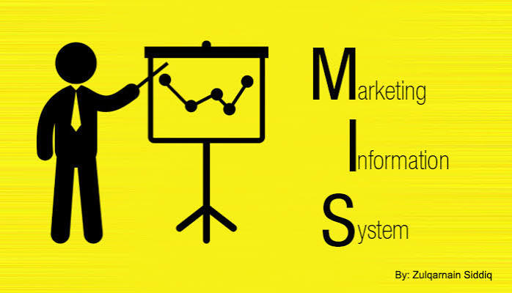
MARKETING INFORMATION SYSTEM (MkIS)
Marketing Management
Dr Prabhat K Dwivedi, Associate Professor
School of Business Management

Slide 2
Topics to be covered
Meaning & definitions
Model & Components
Functions
Implementation
Importance
Benefits
Dr Prabhat K Dwivedi, Associate Professor

Slide 3
Marketing Information System (MkIS)
A Marketing Information System (MkIS) is a strategic tool that enables the collection, processing, analysis, and distribution of key information about the market environment.
Its main goal is to support informed decision-making for companies that need to better understand their consumers, competitors, and industry trends.
Dr Prabhat K Dwivedi, Associate Professor

Slide 4
Dr Prabhat K Dwivedi, Associate Professor

Slide 5
Dr Prabhat K Dwivedi, Associate Professor

Slide 6
Dr Prabhat K Dwivedi, Associate Professor

Slide 7
Components of MkIS
Internal Records: These are the data generated within the company, such as sales, costs, stock and financial data. Internal information is essential for evaluating the company’s performance and making the necessary adjustments.
Marketing Intelligence: it is about collecting external data related to the marketing environment, including competitors, customers and market trends. Marketing intelligence helps companies stay up-to-date and competitive.
Market Research: this component focuses on collecting and analyzing specific data to solve specific marketing problems. Market research can include surveys, focus groups and market research.
Decision Support Systems(DSS): these systems use the information collected to help managers make informed decisions. Decision support systems usually include analysis and modeling tools that make it easier to interpret the data.
Dr Prabhat K Dwivedi, Associate Professor

Slide 8
Main Functions of MkIS
Dr Prabhat K Dwivedi, Associate Professor

Slide 9
Functions of a Modern MkIS
A modern MIS performs multiple functions, such as:
Monitoring the competitive landscape and consumer preferences.
Identifying shifts in consumer behavior.
Detecting high-potential market segments.
Optimizing data-driven marketing campaigns.
Enabling predictive analytics to forecast trends.
Improving communication between departments through shared data.
Dr Prabhat K Dwivedi, Associate Professor

Slide 10
Implementing a marketing information system
Main stages in setting up an MIS:
Accessing the needs: the first step is to identify the company’s specific information needs and define the system’s objectives.
System design: once the needs have been understood, the system can be designed by selecting the appropriate tools and technologies to collect, store and analyze the data.
Data collection: this phase involves collecting internal and external data.
It is essential to guarantee the quality and relevance of the data collected.
Data analysis: using analysis tools, data is processed and converted into useful information for decision-making.
Information distribution: finally, the information is distributed to marketers via reports, dashboards and other visualization tools.
Dr Prabhat K Dwivedi, Associate Professor

Slide 11
Main Benefits
Improves operational efficiency by reducing uncertainty.
Helps identify market opportunities and risks in advance.
Promotes a data-driven culture with actionable insights.
Essential for optimizing marketing and sales strategies.
Dr Prabhat K Dwivedi, Associate Professor

Slide 12

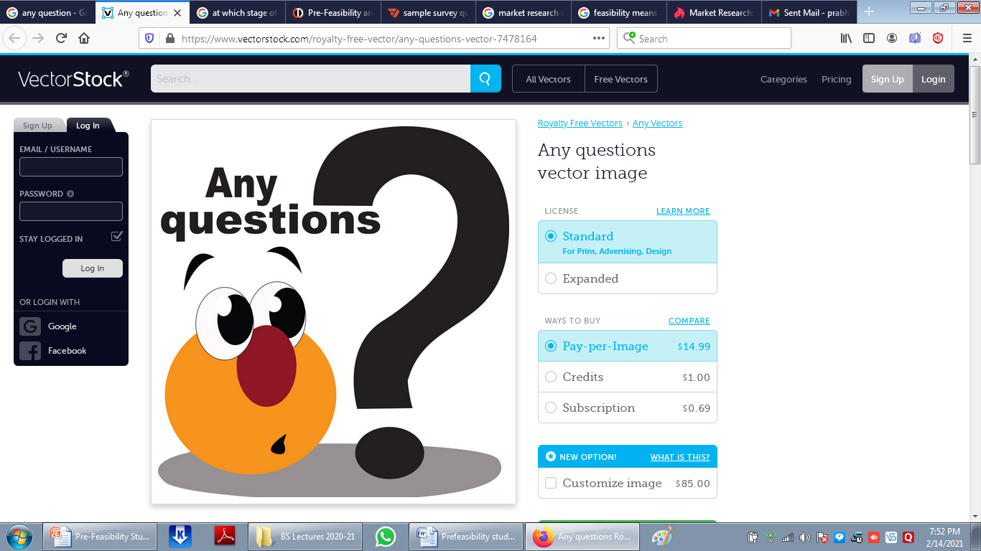
Dr Prabhat K Dwivedi, Associate Professor

Slide 13
References
https://www.slideserve.com/rodneyperez/marketing-information-system-fundamentals-of-mkis-powerpoint-ppt-presentation
Green, P.E., Tull, D.S. and Albaum, G (1993), Research For Marketing Decisions, 5th edition, Prentice-Hall
Kerlinger, FN.(1994) Foundations of Behavioural Research, 1st edition, Holt, Rinehart and Winston, p. 174.
https://www.netquest.com/en/blog/marketing-information-system-key-decision-making
https://mailrelay.com/en/glossary/marketing-information-system/
Dr Prabhat K Dwivedi, Associate Professor

Slide 14

Dr Prabhat K Dwivedi, Associate Professor

