Slide 1
Subject: Computer Graphics and Multimedia Applications Code: BCA401N Lecture 16
BY
Dr MAYUR RAHUL
(E762)
DEPARTMENT OF COMPUTER APPLICATION
UIET, CSJM UNIVERSITY, KANPUR

Slide 2
OUTLINE
Representing curves and surfaces
Polygonal meshes
Parametric curves and surfaces
Quadric surfaces

Slide 3
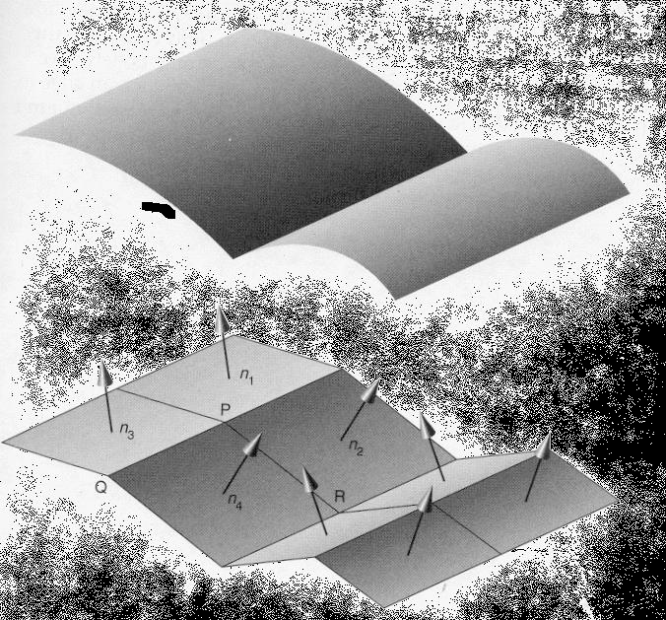
Polygon Mesh
A polygon mesh is a set of connected polygonally bounded planar surfaces.
A mesh can be used to represent polygonal objects in a natural manner.
A mesh can also be used to approximate a curved surface.

Slide 4
Parametric Curve
A parametric polynomial curve is used to represent a 3D curve.
Points (x, y, z) on the curve are defined by three polynomials, one each for x, y, z.
The polynomials are in one parameter, t.
Typically, a third degree polynomial is used which produces a cubic curve.
This figure depicts a Bezier curve.

Slide 5
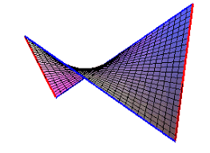
Parametric Patches (surfaces)
A parametric bivariate polynomial surface patch is used to represent a 3D curved surface.
Points on the patch are defined by three bivariate polynomials, one each for x, y, z.
The boundaries of the patch are parametric curves.
Typically, a third degree bivariate polynomial is used which produces a bicubic patch.
This is a much more efficient representation of a curved surface than a polygon mesh (fewer parametric patches needed for accuracy).
This figure depicts a Bezier surface.

Slide 6
REFERENCES
https://www.tutorialspoint.com/dbms/dbms_overview.htm
https://www.studytonight.com/dbms/database-model.php
https://www.geeksforgeeks.org/introduction-of-process-synchronization/\
https://www.javatpoint.com/os-process-synchronization-introduction

