Slide 1
Dr Prabhat K. Dwivedi
Associate Professor
Deptt. of Business Management,
CSJM University, Kanpur, India
Mob. 8795838165
Email: drprabhatkdwivedi@csjmu.ac.in

Slide 2
Definition of Marketing

Slide 3
WHAT IS MARKETING?
Social Definition of Marketing:-
Marketing is a social process by which individuals and groups obtain what they need and want through creating, offering and freely exchanging products and services of value with others. Managers sometimes think of marketing as “the art of selling product” but selling is only the tip of the Marketing iceberg.
Peter Drucker, a leading management theorist puts it as:-There will always, one can assume, be need for some selling. But the aim of marketing is to make selling superfluous. The aim of Marketing is to know and understand the customer so well that the product or service fits him and sells itself. Ideally, marketing should result in a customer who is ready to buy. All that should be needed then is to make the product or service available.

Slide 4
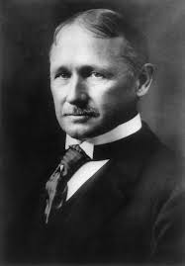
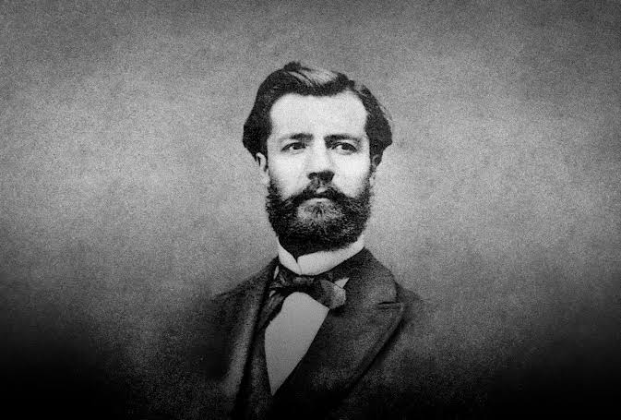
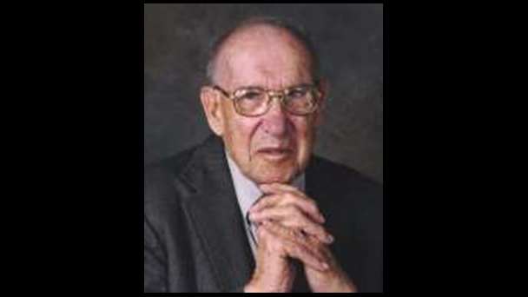
WHAT IS MANAGEMENT?
"Management is the art of knowing what you want to do and then seeing that they do it in the best and the cheapest may." Frederick Winslow Taylor (March 20, 1856 – March 21, 1915)
Henry Fayol – To manage is “to forecast and plan, to organize, to command, to coordinate, and to control.” (1841-1925)
“Management is a multi-purpose organ that manages business and manages managers and manages workers and work.” – Peter Drucker (1909-2005)

Slide 6
WHAT IS MARKETING MANAGEMENT?
Marketing management is the way to find out the opportunities which are profitable and create these opportunities by satisfying the customers. Marketing management is consumer-oriented. Therefore, the marketing manager has to find out the services that satisfy the consumers and the services that fail to meet the needs and expectations of consumers so that plus and delta can be developed to cover up the shortage.

Slide 7
WHAT IS MARKETED?
Marketing people market 10 types of entities:-
Goods:- cars, televisions etc.
Services:- Work of airlines, hotels, car rental firms, etc.
Events:- Time based events. Ex:- Major Trade shows, Artistic Performances, etc.
Experiences:- An amusement Park or a Water Park, Theme Restaurant that creates the ambience of a village of a state, etc.
Person:- Celebrity Marketing is a major business. Ex:- Artistes, Musicians, CEOs, Sportspersons etc.
Places:- Cities, States, Regions and even whole nations compete actively to attract tourists, factories, Company Head Quarters, etc. Ex:- Bangaluru:-Silicon Valley of India. Tourism industry:- Kerela- Marketed as ‘God’s own country. Govt. of India – Incredible India.
Properties:- Properties are Intangible rights of ownership of either real property (Real Estate) or Financial property (Stocks & Bonds)

Slide 8
8. Organizations:- Organizations also market themselves to build their image in the market. Ex:- Philips:-‘Sense the Simplicity’ campaign after research among the customers world– wide.
9. Information:- Information can be about anything and everything. Ex:- Schools, Colleges, Hospitals, Packaging.
10. Ideas:- Every market offering includes a basic idea. Ex:- Charles Revson of Revlon once observed – ‘ In the factory, we make cosmetics; in the store we sell hope’. Even social marketers are now busy promoting such idea by creating awareness about AIDS, encouraging family planning and discouraging smoking.

Slide 9
WHY MARKETING?
6 Reasons Why Marketing is so Important
Marketing Sells
Competitive Advantage
Business Expansion
Efficiency
Customer Satisfaction
Brand Image

Slide 11
TYPES OF DEMAND
Negative Demand:- Consumers dislike the product and may even pay a price to avoid it.
2.Nonexistent Demand:- Consumers may be unaware of or uninterested in the product.
3.Latent Demand:- Consumers may share a strong need that can not be satisfied with the existing product.
4.Declining Demand:- Consumers begin to buy the product less frequently or not at all.
5.Irregular Demand:- Consumer purchases vary on a Seasoned, monthly, weekly, daily or even hourly basis.
6.Full Demand:- Adequately buying all products put in the marketplace.
7.Over Full Demand:- More buyers than can be satisfied.
8.Unwholesome Demand:- Consumers may be attracted to products that have undesirable social consequences.

Slide 12
Philosophies/ Concepts of Marketing

