Slide 1
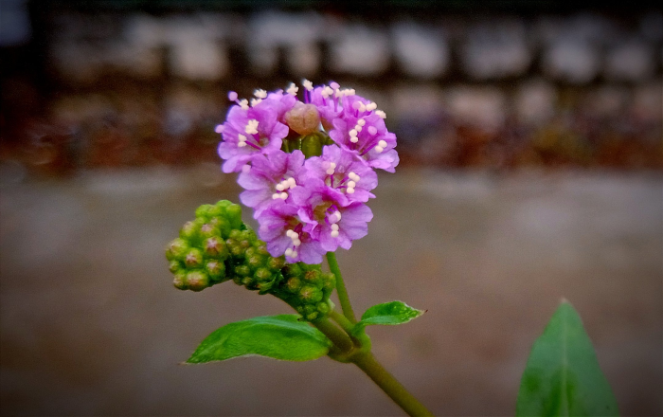
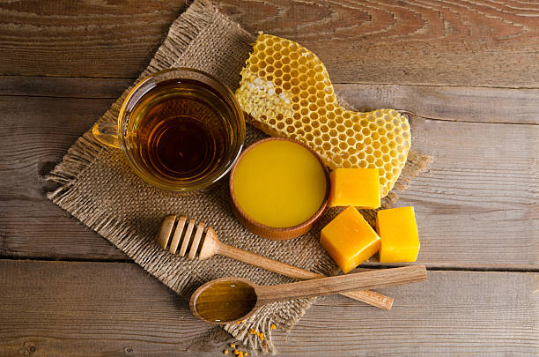
B.Pharm 4th sem Pharmacognosy and Phytochemistry-I TOPIC- BEES WAX
Anju Singh
Assistant Professor
SPS,CSJMU.

Slide 2
BIOLOGICAL SOURCE
Yellow bees wax is purified wax and obtained from the honey comb of the bees Apis mellifera and other species of Apis.

Slide 3
CHEMICAL CONSTITUENTS
Lipids like wax- myricyl palmitate (80%).
Wax -acid such as cerotic acid (15%). (iii) Aromatic substances: Cerolein.
Cholesteryl ester.
Lignoceric acid.
Myristolactone.
Myricyl alcohol and ceryl alcohol.
.

Slide 4
Collection and processing
The wax is formed by worker bees, which secrete it from eight wax-producing mirror glands on the inner sides of the sternites (the ventral shield or plate of each segment of the body) on abdominal segments 4 to 7. The sizes of these wax glands depend on the age of the worker, and after many daily flights, these glands gradually begin to atrophy.

Slide 5
The new wax is initially glass-clear and colorless,becoming opaque after chewing and being contaminated with pollen by the hive worker bees, becoming progressively yellower or browner by incorporation of pollen oils and propolis.
The wax scales are about three millimetres (0.12 in) across and 0.1 mm (0.0039 in) thick, and about 1100 are needed to make a gram of wax.^{[2]}
Worker bees use the beeswax to build honeycomb cells.

Slide 6
CHARACTERISTICS
Beeswax is a fragrant solid at room temperature.
The colors are light yellow, medium yellow, or dark brown and white.
Beeswax is a tough wax formed from a mixture of several chemical compounds.
An approximate chemical formula for beeswax is C₁₅H₃₁COOC₃₀H₆₁.

Slide 7
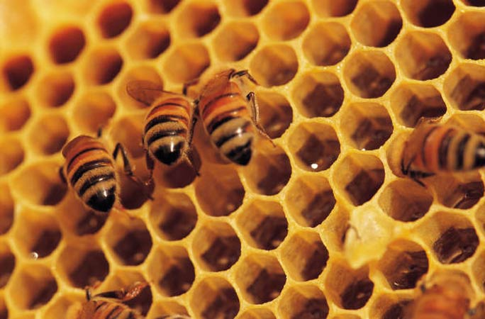
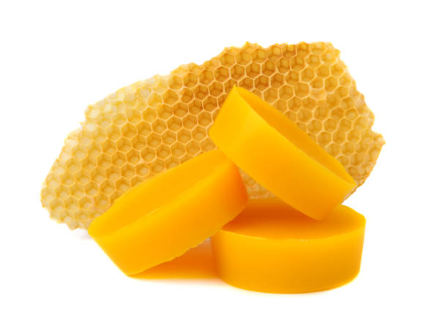

Slide 8
USES
Candle-making has long involved the use of beeswax, which burns readily and cleanly.
Refined beeswax plays a prominent role in art materials both as a binder in encaustic paint and as a stabilizer in oil paint to add body.
Beeswax is an ingredient in surgical bone wax, which is used during surgery to control bleeding from bone surfaces.

