Slide 1
CASTOR OIL
Dr. ANJU SINGH
Assistant Professor
SPS, CSJMU, Kanpur

Slide 2
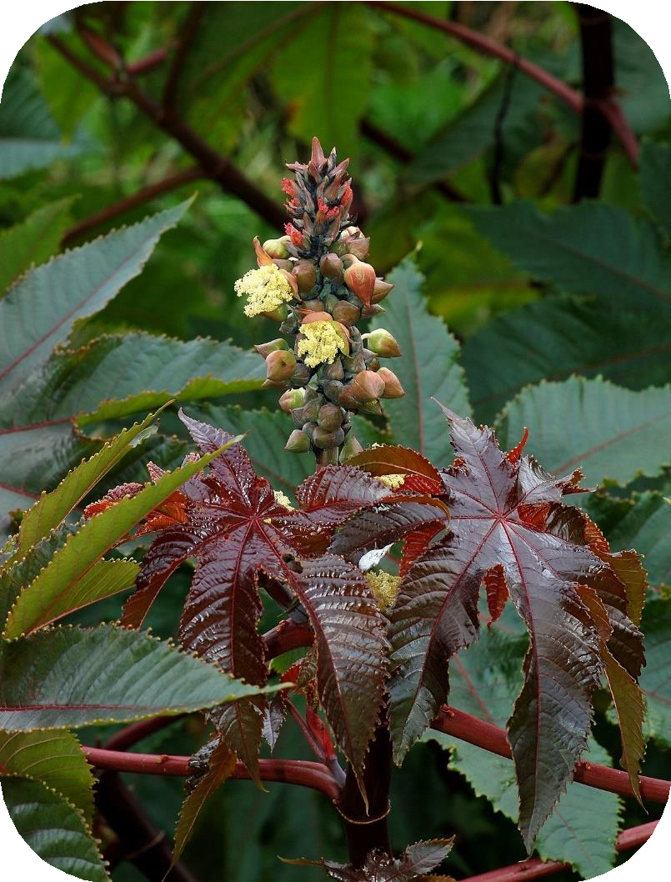
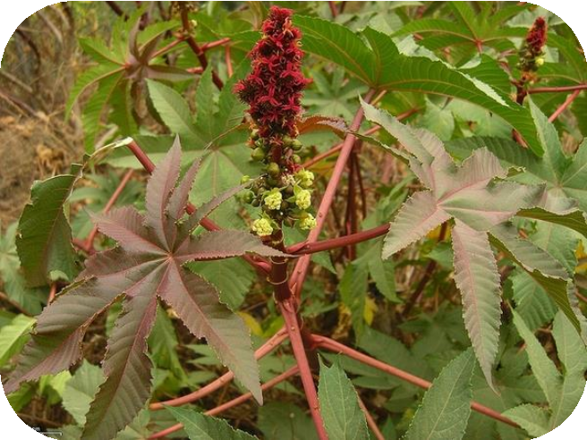
RICINUS COMMUNIS

Slide 3
CASTOR OIL PLANT
Kingdom: Plantae Order: Malpighiales Family: Euphorbiaceous Genus: Ricinus Species: R. Communis

Slide 4
SYNONYMS
Castor bean oil, castor oil seed, oleum ricini, ricinus oil, oil of palma christi, cold-
drawn castor oil.
BIOLOGICAL SOURCE
Castor oil is the fixed oil obtained by cold expression of the seeds of Ricinus communis linn; belonging to family euporbiaceae.
GEOGRAPHICAL SOURCE
It is mainly found in India, Brazil, America, China, Thailand. In India it is cultivated in Gujarat, Andhra Pradesh And Karnataka.

Slide 5
PREPARATION
Castor oil is obtained from castor seeds.
The oil is obtained by two ways - either after the removal of the seed coat or with the seed coat.
Seed coats are removed by crushing the seeds under the grooved rollers and then they are subjected to a current of air to blow the testas.
The kernels are fed in oil expellers and at room temperature they are expressed with 1 to 2 tons pressure per square inch till about 30% oil is obtained.
The oil is filtered , steamed 80 – 100˚ C to facilitate the coagulation and precipitation the coagulation and precipitation of poisonous principle ricin, proteins and enzyme lipase present in it. Oil is then filtered and this oil with 1% acidity is used for medical purpose.

Slide 6
EVALUATION
About 5 ml of light petroleum (50 to 60%) when mixed with 10 ml of castor oil shows a clear solution but if the amount of light petroleum is increased to 15ml , the mixture becomes turbid. This test is not shown by other oils.

Slide 7
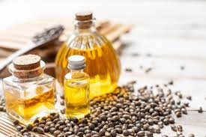
PRESERVATION AND STORAGE
Castor oil is stored in cool and dry place, away from sunlight. Direct exposure to sunlight can degrade the oil.
The normal shelf-life of castor oil is around 1-5 years.

Slide 8
CHARACTERISTICS
Medicinal or the first grade or pale pressed castor oil is colourless or slightly yellow coloured it is a viscous liquid which has slight odour with slightly acrid taste.
Castor oil is soluble in absolute alcohol in all proportions ;
specific gravity is 0.958 to 0.969 , refractive index at 40˚ C is 1.4695 to 1.4730, acid value not more than 2, saponification value 177 to 187 , and acetyl value is about 150.

Slide 9
CHEMICAL CONSTITUENTS
Castor oil consists of glyceride of ricinoleic acid , isoricinoleic , stearic and dihydroxy stearic acids . ricinoleic acid is responsible for laxative property . castor oil also contains vitamin f. 90% of the fatty acid content is ricinoleic acid. The ricinoleic acid is an 18- carbon acid having a double bond in the 9- 10 position and a hydroxyl group on the 12th carbon . this combination of hydroxyl group and unsaturtion occurs in castor oil.

Slide 10
USES
Castor oil is mild purgative fungisatic used as an ointment base as plasticizer wetting agents as a lubricating agent . ricinoleic acid is used as an emollient in the prepation of lipsticks in tooth formulation as an ingredient in hair oil the dehydrated oil is used in the manufacture of linoleum and alkyl resin . the main use of castor oil is the industrial production of coatings also employed to make pharmaceuticals and cosmetics in the textile and leather industries and for manufacturing plastics and fibres.

