Slide 1
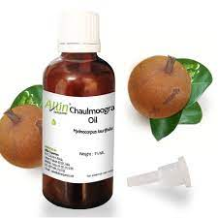
Chaulmoogra oil
Dr. Anju Singh
Assistant Professor
SPS, CSJMU, Kanpur

Slide 2
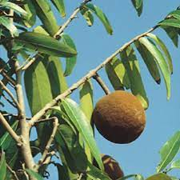
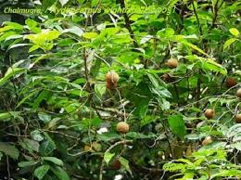
Chaulmoogra plant and fruits

Slide 3
description
Colour: Yellow to brownish-yellow coloured liquid
Odour: Characteristic
Taste: Some what acrid
Solubility: Slightly soluble in alcohol, soluble in chloroform, ether, benzene and carbon disulphide.
It is soft white solid below 25°C.

Slide 4
Source
Synonyms: Hydnocarpus oil, Gynocardia oil.
Biological Source: Hydnocarpus oil is the fixed oil obtained by cold expression method from ripe seers of the plant Taraktogenos Kurzii King, and Hydnocarpus anthelmintic Pierre, Hydnocarpus heterophylla Kurz and other species of the Hydnocarpus, family Flacourtriaceae, prepared by cold expression method.
Geographical Source: Chaulmoogra plant is native of Myanmar, Thailand, and Este India. It is also found in Sri Lanka and Bangladesh. In India, it is grown in Assam and Tripura.

Slide 5
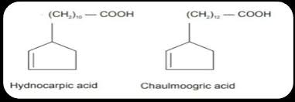
Chemical constitutent
It contains chemically esters of unsaturated fatty acids of chaulmoogric acid (27%) and hydnocarpic acid (48%) and glycerides of palmitic acid.

Slide 6
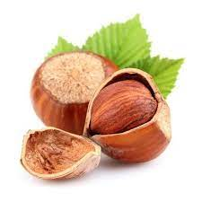
Preparation
Seeds are sub-ovoid, obtusely angular and 2 cm in length. Chaulmoogra seeds contain 40 - 45% fixed oil. Seeds are decorticated by machine after grading the kernels are pressed with the hydraulic press and the oil obtained is filtered.

Slide 7
Evaluation/Standard
Weight per ml - 0.935 to 0.960 g
Acid value not more than 10
Saponification value - 195 to 213
lodine value - 93 to 104
Specific rotation not less than + 48° and not more than +60°
Refractive index - 1.472 to 1.476

Slide 8
Storage & adulteration
It is stored in closed containers away from light and in cool place.
The plant is substituted in India by Hydnocarpus wightiana found abundantly in West Bengal, (Fig. 10.4) Kerala and Western ghats and also by Hydnocarpus alpine occurring in Karnataka, Kerala and Tamil Nadu. During 1995-96, India has exported chaulmoogra oil of Rs. 18 lakhs.

Slide 9
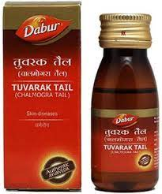
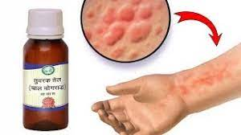
Uses
The unsaturated fatty acids of chaulmoogra oil possess strong bactericidal effect, against Mycobacterium leprae, and M. tuberculosis. It is found to be useful in the treatment of T.B., leprosy, psoriasis and rheumatism. It is intended only for external use.

Slide 10
THANK YOU

