Slide 1

Consumer Buying Behaviour
Marketing Management
BBA 3rd sem
School of Business Management
CSJM University Kanpur
Dr Prabhat K Dwivedi

Slide 2
What is Consumer Behavior?
Consumer behavior is an analysis of the selections, purchases, usage, and dispositions individuals or organizations make to fulfill their needs and wants.
From products, services, and ideas to experiences – consumer behavior offers a deep understanding of what drives decisions in the marketplace.
It involves researching how individuals and groups make decisions when it comes to purchasing, using, and disposing of products or services that satisfy their wants and needs.

Slide 3
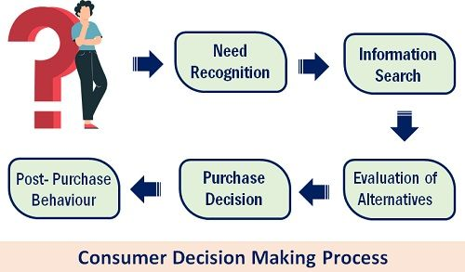

Slide 4
Factors Influencing Consumer Buying Behaviour
Psychological factors
Social factors
Cultural factors
Personal factors
Economic factors

Slide 5
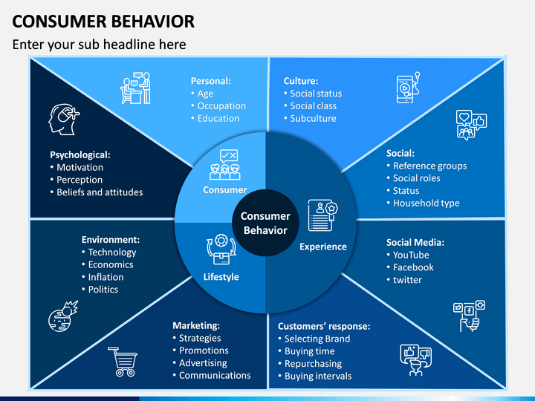

Slide 6
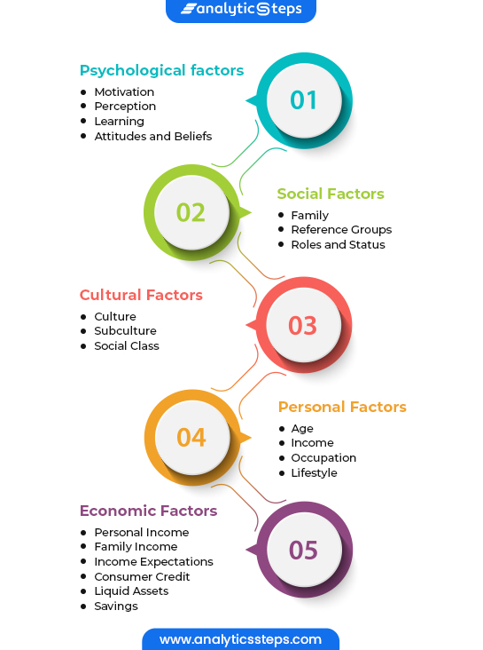

Slide 7
References
https://www.marketing91.com/factors-affecting-consumer-buying-behavior/

