Slide 1
Currency Future and Options
Unit II Types of Foreign Exchange Markets
Dr. Pravin Kumar Agrawal
Assistant Professor
Department of Business Management
CSJMU

Slide 2
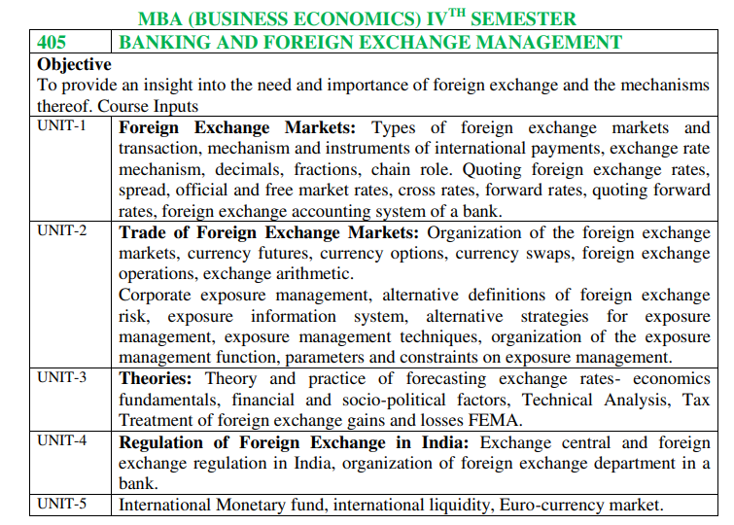

Slide 3
Currency Derivatives: A History
Globally, Currency derivatives were first introduced on Chicago Mercantile Exchange (CME) in 1972
CME is the largest regulated FX market and offers 41 individual FX futures & 31 options contracts on 19 currencies

Slide 4
Currency Derivatives: A History
In India, NSE introduced Currency Derivatives on August 29, 2008 with the launch of USDINR Currency Futures
NSE launched trading in other currency pairs like Euro-INR, Pound Sterling-INR and Japanese Yen-INR in March 2010

Slide 5
Currency Derivatives: A History
NSE introduced Interest Rate futures trading in Aug 2009 on same platform while Currency Options was introduced in Oct 2010
NSE introduced Interest Rate futures trading in Aug 2009 on same platform while Currency Options was introduced in Oct 2010
Notes:
Source: https://www.bseindia.com/downloads/Training/file/NISM-Series-I%20Currency%20Derivatives%20(new%20workbook%20effective%2021-Feb-2012).pdf

Slide 6
Currency Derivatives: A History
BSE launched Currency and Interest Rate Derivatives Trading on November 28, 2013
The total turnover on NSE in last ten years, increased from 1.6 Trillion in FY 2009 to 100 Trillion in FY 2020

Slide 7
Understanding Currency Appreciation & Depreciation

Slide 8
Appreciation & Depreciation
Currency appreciation mean, increase in value of domestic currency against foreign currency. In other words it can buy more units of foreign currency than earlier.
On the other side Currency depreciation mean, fall in the value of domestic currency against foreign currency and can buy less units of foreign currency than earlier.

Slide 9
Example
If the price of USD/INR falls from 76 to 75, then INR would be said to have appreciated in value as you would now need less INR to buy the same number of USD.
On other side, in same case USD would have depreciated as less INR would be remitted with same number of USD.

Slide 10
Options – Basic terms
As the word suggests, option means a choice or an alternative. To explain the concept though an example, take a case where you want to a buy a house and you finalize the house to be bought. On September 1st 2010, you pay a token amount or a security deposit of Rs 1,00,000 to the house seller to book the house at a price of Rs 10,00,000 and agree to pay the full amount in three months i.e., on November 30th • The right to buy the asset is called call option and the right to sell the asset is called put option. 2010. After making full payment in three months, you get the ownership right of the house. During these three months, if you decide not to buy the house, because of any reasons, your initial token amount paid to the seller will be retained by him.

Slide 11
Options – Basic terms…
In the above example, at the expiry of three months you have the option of buying or not buying the house and house seller is under obligation to sell it to you. In case during these three months the house prices drop, you may decide not to buy the house and lose the initial token amount. Similarly if the price of the house rises, you would certainly buy the house. Therefore by paying the initial token amount, you are getting a choice/ option to buy or not to buy the house after three months.

Slide 12
…Options – Basic terms
The above arrangement between house buyer and house seller is called as option contract. We could define option contract as below:

Slide 13
Options – Basic terms
To make these terms more clear, let us refer to the earlier example of buying a house and answer few questions.

Slide 14
1. Does the above example constitute an option contract? If yes,
2. Is it a call option or put option?
3. What is the strike price?
4. What is the expiration date?
5. What is the time to maturity?
6. Who is the option buyer and who is the option seller?
7. What is the option premium?
8. What is the underlying asset?

Slide 15
Answer
1. Does the above example constitute an option contract?
The above example constitutes an option contract as it has all the properties – two parties, an underlying asset, a set price, and a date in future where parties will actually transact with right without obligation to one party.
2. Is it a call option or put option?
It is a call option as you are paying the token amount to buy the right to buy the house
3. Who is the option buyer and who is the option sellers?
You are the option buyer and house seller is option seller
4. What is the strike price?
Rs 10,00,000
5. What is the expiration date?
November 30th 2010
6. What is the time to maturity?
Three months
7. What is the option premium?
Rs 1,00,000
8. What is the underlying asset?
The house is an underlying asset

Slide 16
Important Terms relating to Options

Slide 17
Basic Things To Know About Currency Options
Option: It is a contract between two parties to buy or sell a given amount of asset at a pre- specified price on or before a given date.
Like in the case of options on equities and indices, currency options are also a right (without an obligation) to buy or sell a currency pair. In terms of rupee currency pairs, there are options on USDINR, GBPINR, EURINR and JPYINR. Let us look at 5 basics of currency options.

Slide 18
Basic Things To Know About Currency Options
The right to buy the currency pair is called call option and the right to sell the currency pair is called put option
The pre-specified price is called as strike price and the date at which the strike price is applicable is called expiration date
The gap between the date of entering into the contract and the expiration date (in number of days) is called time to maturity
The price which option buyer pays to option seller to acquire the right is called as option price or option premium

Slide 19
Basic Things To Know About Currency Options
The party which buys the rights but not obligation and pays premium for buying the right is called as option buyer and the party which sells the right and receives premium for assuming such obligation is called option seller/ writer
The asset which is bought or sold is also called as an underlying or underlying asset and in case of currency options it is the currency pair

Slide 20
Basic Things To Know About Currency Options
Buying an option is also called as taking a long position in an option contract and selling is also referred to as taking a short position in an option contract.

Slide 21
Options
Currency option (also known as a forex option) is a contract that gives the buyer the right, but not the obligation, to buy or sell a certain currency at a specified exchange rate on or before a specified date. For this right, a premium is paid to the seller.
Notes:
https://www.bseindia.com/downloads/Training/file/NISM-Series-I%20Currency%20Derivatives%20(new%20workbook%20effective%2021-Feb-2012).pdf

Slide 22
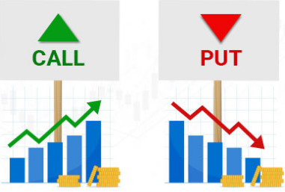

Slide 23
Call/Put
Call options provide the holder the right (but not the obligation) to purchase currency pair at a specified price (the strike price), for a certain period of time.
Buying a call option gives the holder the right to buy a currency pair for the strike price on or before the expiry date
If the currency fails to meet the strike price before the expiration date, the option expires and becomes worthless. Investors buy calls when they think the share price of the underlying security will rise or sell a call if they think it will fall. Selling an option is also referred to as ''writing'' an option.

Slide 24
Put option
It is the type of option that gives its holder a right to sell a currency at a pre-specified rate on or before the maturity date.
buying a put option gives the holder the right to sell a currency pair for the strike price on or before the expiry date.

Slide 25
If the expiry arrives and the market price of a currency pair is above the strike price when buying calls, or below the strike price when buying puts, a trader can choose to exercise it.

Slide 26
But if this doesn’t happen, a trader can let their option expire, and they’ll only lose the value of the premium. As a result, buying call or put options means that a trader’s upside is potentially unlimited, and their downside is capped at the premium.

Slide 27
Key take away
No delivery of dollar happens — only the difference is exchanged in rupees. If the dollar strengthens against rupee by or before expiry the call buyer makes money. If it weakens he loses. Similarly a put buyer makes money if the dollar weakens against the rupee, but loses if the dollar strengthens. The seller of call and put receives a premium from the buyer, which he pockets if the bet goes his way. Invariably, sellers make money while option buyers lose.

Slide 28
Premium
It is the initial amount that the buyer (also called the option holder) of the option pays up-front to the seller (also called the option writer) of the option.
By paying this premium, the holder acquires a right for himself and by receiving it, the writer takes an obligation upon himself to fulfill the right of the holder.
Generally, it is a small percentage of the amount to be bought or sold under the option. We use notation, c, to denote premium on call option and notation, p, to denote premium on put option.

Slide 29
Exercise/Strike Price (Rate)
It is the exchange rate at which the holder of a call option can buy and the holder of a put option can sell the currency under the deal, irrespective of the actual spot rate at the time of exercise of option.
We use "X" to denote exercise price.

Slide 30
Maturity Date or Expiration Date
The date on or up to which an option can be exercised. After this date, it becomes defunct and loses its validity.

Slide 31
American option
When the option has the possibility of being exercised on any date up to maturity, it is called American type.

Slide 32
European option
When an option has the possibility of being exercised only on the maturity date, it is called European type.

Slide 33
Value of an option
An option (whether call or put) has either a positive value or zero value. This can be explained with examples. Suppose a American call option has an exercise price (X) of Rs 55/. On the date of maturity, the spot rate (ST) may be more than or equal to or less than Rs 55/.

Slide 34
Value of an option
(a) Possibility I: Spot rate = Rs 56/ In this case; call option will be exercised by the holder of the option as he can obtain USD at Rs 55/ while spot price is higher. Here, the call option is said to have a positive value of Re 1 (Rs 56 - Rs 55) or (S,- X)
(b) Possibility II Spot rate = Rs 55/ In this scenario, the holder has no specific advantage in buying USD either from spot market or by exercising his call option; He is indifferent between the two choices. The value of the option is zero.

Slide 35
Value of an option
(c) Possibility III: spot rate = Rs 53/. In this case, the holder of the option will buy USD directly from the spot market by abandoning his call option. Here also, the call option has no value or zero value.
Notes:
https://egyankosh.ac.in/bitstream/123456789/6392/1/Unit-7.pdf

Slide 36
Example of Currency Options
Larsen International is undertaking a project in the United States of America and will receive revenue in Foreign Currency, which in this case, will be in US Dollars. The company wishes to protect itself against any adverse movement in the currency rate.
To protect itself from any adverse moment which can arise on account of appreciation of local currency INR against the US Dollar, the company decided to purchase Currency Options. Larsen expects to receive the payment in the next three months, and the current USD/INR spot rate is 73, which means one dollar is equivalent to 73 rupees.

Slide 37
Example of Currency Options
By entering into an option with strike price 73 and expiry of three months, Larsen has covered its risk of fall in the price of foreign currency against the local currency Indian Rupee.
Now, if the overseas currency US Dollar strengthens in the interim period, the company will benefit from stronger currency when translating its profits in Indian Rupee and will suffer the loss of the premium paid to purchase the option.

Slide 38
Example of Currency Options
However, on the contrary, if the foreign currency got weaker compared to the local currency INR (which means INR getting stronger against US Dollar), the currency option purchased by Larsen will ensure that it can translate its profit in India Rupee at the pre-specified rate, i.e., Strike Price.

Slide 39
Example 2
Assume August 28 call option with strike 72 (to rupee) costs 9 paise. Each contract is worth $1,000 so the seller receives Rs 90 (0.09×1,000) per contract. The maximum position limit for the client is the higher of $10 million or 6 per cent of marketwide open interest. Assume a buyer takes a position of $10 million . He pays the seller premium of Rs 9 lakh (0.09×10 million). This means by expiry the dollar should quote above 72.09 for the buyer to breakeven .

Slide 40
Example 2
However, the problem is each passing day erodes the price of an option — theta. The option’s delta —change in option price relative to change in underlying dollar -rupee rate — has to overcome the theta for a buyer to gain. So the call seller charges higher premia to factor this in.
Now, if the dollar expires at 72.09 or below on August 28, the price of the option is zero. This means a loss of Rs 9 lakh unless a stop loss is placed at say 6 or 5 paise.

Slide 41
Example 2
But if there is a sharp appreciation of dollar (depreciation of rupee ) to say 72.20, the gross gain for the call buyer is 11 paise per dollar. So on a $10 million position, the gain (exclusive of taxes, brokerage etc.) is Rs 11 lakh (0.11×10 million).
Similar logic applies to USD-INR puts except here the buyer believes the dollar will slip below the strike purchased minus premium paid while the seller expects the dollar to quote at or above the strike sold minus the premium received .

Slide 42
Option Option-in-money
An option is said to be in-money if its immediate exercise will give a positive value. So a call option is in-money if ST > X. The value of such a call option is ST - X.
For Call Option it is ITM if the (Spot Price > Strike Price)
E.g. If USDINR call option of Rs.72 strike is having spot price of Rs.72.50, it is ITM
Likewise, a put option is in-money if ST< X. The value of such a put option is X - ST. Here ST means the spot rate at the time of the exercise of the option.
For Put Option it is ITM if the (Strike Price > Spot Price)
E.g. If USDINR put option of Rs.72 strike is having spot price of Rs.71.50, it is ITM

Slide 43
Option-at-money
When ST = X, an option is said to be at-money
For Call Option and put options it is ATM if the (Market Price = Strike Price)

Slide 44
Option-out-of-money
An option is said to be out-of-money when it has no positive value (knowing that an option can have either a positive or a zero value). So a call option is out-of-money if S_{T}>X.
For Call Option it is OTM if the (Strike Price > Spot Price)
E.g. If USDINR call option of Rs.72 strike is having spot price of Rs.71.50, it is OTM
For Put Option it is OTM if the (Spot Price > Strike Price)
E.g. If USDINR put option of Rs.72 strike is having spot price of Rs.72.50, it is OTM

Slide 45
Factors Affecting the Price of an Option

Slide 46
Factors Affecting the Price of an Option
Time to maturity
Volatility
Type of option
Forward premium or discount
Other Factors

Slide 47
Time to Maturity
Longer is the time to maturity, higher is the
price of an option (whether call or put).
If the maturity is farther in time, it means there is greater uncertainty and possibility of currency rates fluctuating in wider range is more.
Hence the probability of the option being exercised increases. So the writer would demand higher premium.

Slide 48
Volatility of the exchange rate of underlying currency
Greater volatility increases the probability of the spot rate going above exercise price for call or going below exercise price for put. That is, the probability of exercise of option increases with higher volatility.
Therefore, the price of an option - whether call or put - would be higher with greater volatility of exchange rate.

Slide 49
Type of option
Typically an American type option will have greater price since it gives greater flexibility of exercise than European type.

Slide 50
Forward premium or discount
When a currency is likely to harden (greater forward premium), call option on it will have higher price.
Likewise, when a currency is likely to decline (greater forward discount), higher will be price of a put option on it.

Slide 51
Exercise Price
The call price will decrease with higher exercise price since its probability of use will be less.
On the contrary, put premium will decrease with higher exercise price since the probability of its use will increase.
Notes:
https://www1.nseindia.com/invest/resources/download/prs_optcur_eng_br.pdf

Slide 52
Other Factors
RBI Interventions
Capital Flows
Uncertain Events
Political Factors
Performance of Equity Markets
Performance of Other Asian Currencies

Slide 53
Currency Options Hedging Strategies
Currency Option Strategy for Import Transactions

Slide 54
On August 1, 2021 xyz buys a USD call option for covering its import transactions at a strike rate of 45.50 the expiry date is 31st October 2021. The premium is 30 paisa on the call. Gain or loss on expiry at various levels of exchange rate is demonstrated below vide pay off table and graph.
When spot exchange rates Rises above the strike price there are gains and when it falls below the strike price there are lossess which are maximum to the extent of premium paid.

Slide 55
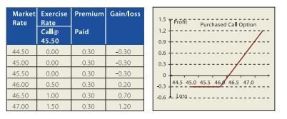

Slide 56
How MNCs Use Currency Call Options
Notes:
By jeff madura

Slide 57
Using Call Options to Hedge Payables
MNCs can purchase call options on a currency to hedge future payables.

Slide 58
Example
When Company X placed orders for Australian goods, it makes a payment in Australian dollars to the Australian exporter upon delivery.
An Australian dollar call option locks in a maximum rate at which Company X can exchange INR for Australian dollars.
This exchange of currencies at the specified strike price on the call option contract can be executed at any time before the expiration date.
In essence, the call option contract specifies the maximum price that Company X must pay to obtain these Australian imports.
If the Australian dollar’s value remains below the strike price, then Company X can purchase Australian dollars at the prevailing spot rate to pay for its imports and simply let the call option expire.

Slide 59
Example
Intel Corp. uses options to hedge its order backlog in semiconductors. If an order is canceled, then Intel has the flexibility to let the option contract expire. With a forward contract, the company would be obligated to fulfill its obligation even though the order was canceled.

Slide 60
Currency Option Strategy for Export Transactions

Slide 61
On August 1, 2021 xyz buys a USD put option for covering its export transactions at a strike rate of 45.50 the expiry date is 31st October 2021. The premium is 30 paisa on the call. Gain or loss on expiry at various levels of exchange rate is demonstrated below vide pay off table and graph.
When spot exchange rates fall below the strike price there are gains and when it rise above the strike price there are losses which are maximum to the extent of premium paid.

Slide 62
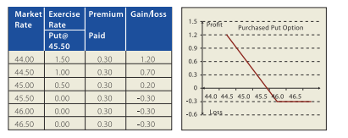

Slide 63
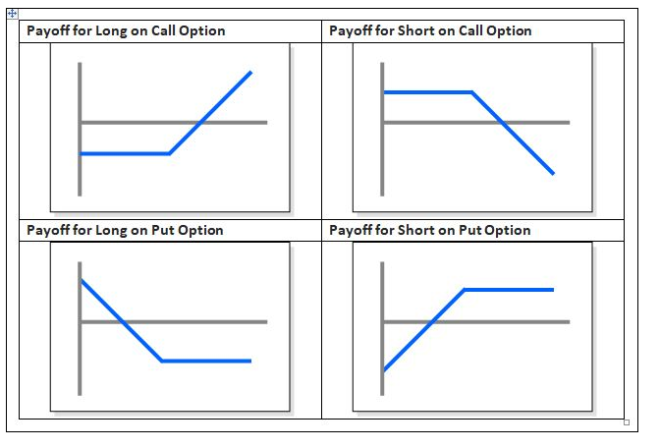

Slide 64
Impact of market economics on currency prices
Notes:
https://www.bseindia.com/downloads/Training/file/NISM-Series-I%20Currency%20Derivatives%20(new%20workbook%20effective%2021-Feb-2012).pdf

Slide 65
Impact of market economics on currency prices
There are multiple factors impacting the value of the currency at any given point of time. Some of the factors are of the local country while others could be from global markets.

Slide 66
Impact of market economics on currency prices
For example, the value if INR against USD is a function of factors local to India like gross domestic product (GDP) growth rate, balance of payment situation, deficit situation, inflation, interest rate scenario, policies related to inflow and outflow of foreign capital.
It is also a function of factors like prices of crude oil, value of USD against other currency pairs and geopolitical situation.

Slide 67
Impact of market economics on currency prices
All the factors are at work all the time and therefore some factors may act towards strengthening of currency and others may act towards weakening. It becomes important to identify the dominating factors at any point of time as those factors would decide the direction of currency movement. For example, economic factors in India might be very good indicating continued inflow of foreign capital and hence appreciation of INR.

Slide 68
Impact of market economics on currency prices
However, in global markets USD is strengthening against other currency pairs (on account of multiple factors). In this situation local factors are acting towards strengthening and global factors towards weakening of INR. One needs to assess which factors are more dominating at a point of time and accordingly take decision on likelihood of appreciation or depreciation of INR.

Slide 69
Impact of market economics on currency prices
In the very short term, demand supply mismatch would also have bearing on the direction of currency’s movement. The extent of impact of demand supply mismatch is very high on days when market is illiquid or on currency pairs with thin trading volumes. For USDINR, demand supply factors have considerable impact on the currency movement. For example, on some day INR may appreciate on account of large USD inflow (ECB conversion/ large FDI/ or any other reason) despite the trend of weakness driven by economic factors. Once the USD inflow is absorbed by the market, INR may again depreciate. Therefore it is important to keep track of such demand supply related news.

Slide 70
Impact of market economics on currency prices
To assess the impact of economic factors on the currency market, it is important to understand the key economic concepts, key data releases, their interpretation and impact on market.
Some of the important economic factors that have direct impact on currency markets are inflation, balance of payment position of the country, trade deficit, fiscal deficit, GDP growth, policies pertaining to capital flows and interest rate scenario.

Slide 71
Economic indicators

Slide 72
Gross Domestic Product (GDP)
GDP represents the total market value of all goods and services produced in a country during a given year. A GDP growth rate higher than expected may mean relative strengthening of the currency of that country, assuming everything else remaining the same.

Slide 73
Retail Sales
It is a leading indicator and it provides early guidance on the health of the economy. The retail-sales report measures the total receipts of all retail stores in a given country. This measurement is derived from a diverse sample of retail stores throughout a nation. The report is particularly useful because it is a timely indicator of broad consumer spending patterns that is adjusted for seasonal variables. It can be used to predict the performance of more important lagging indicators, and to assess the immediate direction of an economy. A retail sales number higher than expected may mean relative strengthening of the currency of that country.

Slide 74
Industrial Production
The Index of Industrial Production (IIP) shows the changes in the production in the industrial sector of an economy in a given period of time, in comparison with a fixed reference point in the past. In India, the fixed reference point is 1993-94 and the IIP numbers are reported using 1993-94 as the base year for comparison. A healthy IIP number indicates industrial growth and which could result in relative strengthening of the currency of that country.

Slide 75
Consumer Price Index (CPI)
CPI is a statistical time-series measure of a weighted average of prices of a specified set of goods and services purchased by consumers. It is a price index that tracks the prices of a specified basket of consumer goods and services, providing a measure of inflation.

Slide 76
Consumer Price Index (CPI)
A rising CPI means a rising prices for goods and services and is an early indicator of inflation. Assessing the impact of CPI on value of currency is difficult. If rising CPI means likely increase in interest rate by the central bank, the currency may strengthen in the short term but may start weakening in the long run as rising inflation and rising interest may start hurting the growth of the economy.

Slide 77
Central bank meetings and key decisions
Market also tracks minutes of the central bank meetings and the key policy decisions. Some of the important announcements from central bank meetings are their interest rate decisions, CRR (cash reserve ratio) %. Market also actively looks forward to central bank’s perspective on state of the economy.

Slide 78
Central bank meetings and key decisions
In India, RBI is responsible for making key decisions about interest rates and the growth of the money supply. Currency market actively looks forward to RBI meeting minutes and its perspective on the interest rate.

Slide 79
Central bank meetings and key decisions
It is important to keep in mind, however, that the indicators discussed above are not the only ones that affect a currency's price. It is suggested that you keep track of all the important economic indicators and be aware which indicators are getting most of the attention of market any given point in time.
For example, sometimes market will give lot of importance of crude price and commodity prices while at other times may not give too much importance to it and rather focus on employment numbers and interest rate situation.

Slide 80
Central bank meetings and key decisions
Given below are some suggestions that may help you when conducting fundamental analysis in the foreign exchange market:

Slide 81
Central bank meetings and key decisions
1. Keep an economic calendar on hand that lists the indicators and when they are due to be released.
2. Keep an eye on the data release expected in next few days; often markets will move in anticipation of a certain indicator or report due to be released at a later time.
3. Know the market expectations for the data, and then pay attention to whether or not the expectations are met. That is far more important than the data itself. Occasionally, there is a drastic difference between the expectations and actual results and, if there is, be aware of the possible justifications for this difference.
4. Take some time to analyze the data release and not react too quickly to the news. Sometime, along with the data release the reporting authorities announce revision in the previous numbers. At times such revisions could be quite large and may significantly impact the markets. Therefore pay attention to these revisions.
Notes:
https://www.bseindia.com/downloads/Training/file/NISM-Series-I%20Currency%20Derivatives%20(new%20workbook%20effective%2021-Feb-2012).pdf

Slide 82
Difference between futures and options
Let us first highlight the similarities between two types of derivative contracts – Futures and Options. The similarities are as follows:
Both the contracts have a buyer and seller
Both the contract have a set price for the underlying asset
Both the contracts have a set settlement date

Slide 83
Difference between futures and options
The difference between two contracts is that in futures both the parties are under right as well as obligation to buy or sell and therefore face similar risk.
Whereas in options, the buyer has only rights and no obligation and therefore he faces only the risk of premium paid and option seller is under obligation to buy or sell (depending on whether put option is sold or a call option is sold, respectively) and therefore faces unlimited risk.
At the same time, the option buyer has chances to get unlimited upside and the option seller has limited upside equal to the premium received.

Slide 84
Difference between futures and options
The call option buyer would exercise the option only if the price of underlying asset is higher than the strike price and premium paid. Similarly the put option buyer would exercise the option if the price of the underlying asset is less than the strike price and the premium paid.
Just like futures, options can be used for hedging, or to generate returns by taking a view on the future direction of the market, or for arbitrage.

Slide 85
References
https://www.bseindia.com/downloads/Training/file/NISM-Series-I%20Currency%20Derivatives%20(new%20workbook%20effective%2021-Feb-2012).pdf

