Slide 1
DATA MODELS
ENTITY RELATIONSHIP MODEL
RELATIONAL MODEL
HIERARICHAL MODEL
NETWORK MODEL

Slide 2
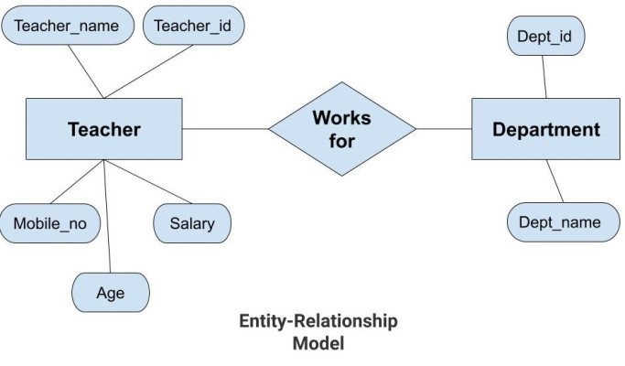
E-R model
The entity relationship model consits of a collection of basic objects called entities and relationship among these entities.
E-R model has the following three components:
Entities: Entity is a real-world thing. It can be a person, place, or even a concept.
Attributes: An entity contains a real-world property called attribute. This is the characteristics of that attribute.
Relationship: Relationship tells how two attributes are related.

Slide 3
RELATIONAL model
The relational model represents data and relationship among data by a collection of tables, each of which has a number of column with a unique name.
In this model, the data is maintained in the form of a two-dimensional table. All the information is stored in the form of row and columns.
EMP_ID | EMP_NAME | MOBILE | SALARY | JOB NAME
A001 | JOHN | 9155456551 | 70000 | ENGINEER
A002 | ADAM | 2145863245 | 80000 | ANALYST
A003 | CANDY | 4559663214 | 89000 | MANAGER

Slide 4
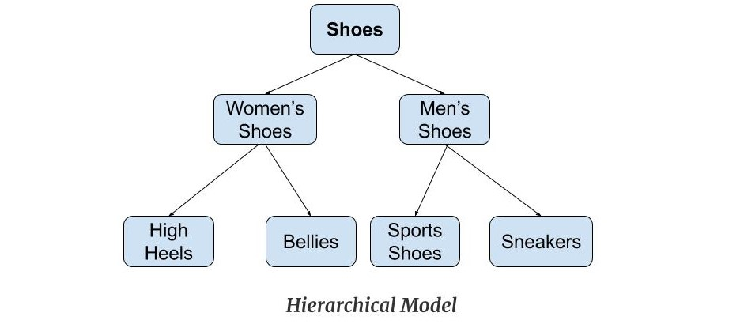
Hierarchical model
Hierarchical Model was the first DBMS model. This model organizes the data in the hierarchical tree structure. The hierarchy starts from the root which has root data and then it expands in the form of a tree adding child node to the parent node.

Slide 5
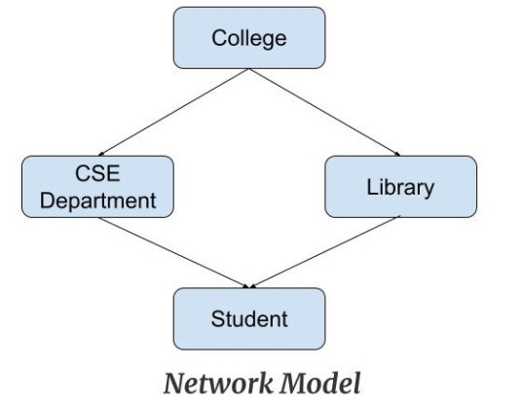
Network model
This model is an extension of the hierarchical model.
This model is the same as the hierarchical model, the only difference is that a record can have more than one parent. It replaces the hierarchical tree with a graph.

Slide 6
“Schema”
“The overall design of a database is known as schema.”
External level
External level
Conceptual level
Internal level
Database

