Slide 1
Digestive System

Slide 2
Digestion
Phases Include
Ingestion
Movement
Mechanical and Chemical Digestion
Absorption
Elimination

Slide 3
Digestion
Types
Mechanical (physical)
Chew
Tear
Grind
Mash
Mix
Chemical
Enzymatic reactions to improve digestion of
Carbohydrates
Proteins
Lipids

Slide 4
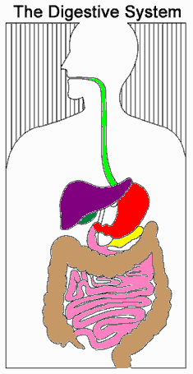
Digestive System Organization
Gastrointestinal (Gl) tract
Tube within a tube
Direct link/path between organs
Structures
Mouth
Pharynx
Esophagus
Stomach
Small intestine
Large Intestine
Rectum
4
Notes:
4

Slide 5
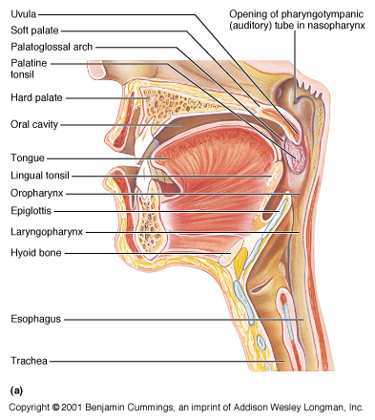
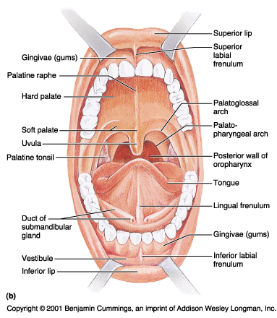
Mouth
Teeth mechanically break down food into small pieces. Tongue mixes food with saliva (contains amylase, which helps break down starch).
Epiglottis is a flap-like structure at the back of the throat that closes over the trachea preventing food from entering it. It is located in the Pharynx.

Slide 6
Esophagus
Approximately 20 cm long.
Functions include:
Secrete mucus
Moves food from the throat to the stomach using muscle movement called peristalsis
If acid from the stomach gets in here that’s heartburn.
Mouth, Pharynx and Esophagus Video
Notes:
A good way to describe peristalsis is an ocean wave moving through the muscle.
These diagrams don’t separate the esophagus from the mouth functions, you might want to talk about what happens in the mouth too.

Slide 7
Stomach
J-shaped muscular bag that stores the food you eat, breaks it down into tiny pieces.
Mixes food with Digestive Juices that contain enzymes to break down Proteins and Lipids.
Acid (HCl) in the stomach Kills Bacteria.
Food found in the stomach is called Chyme.
Notes:
The stomach takes around 4 hours to do it’s job on the food, depending on what kinds of food are digested.

Slide 8
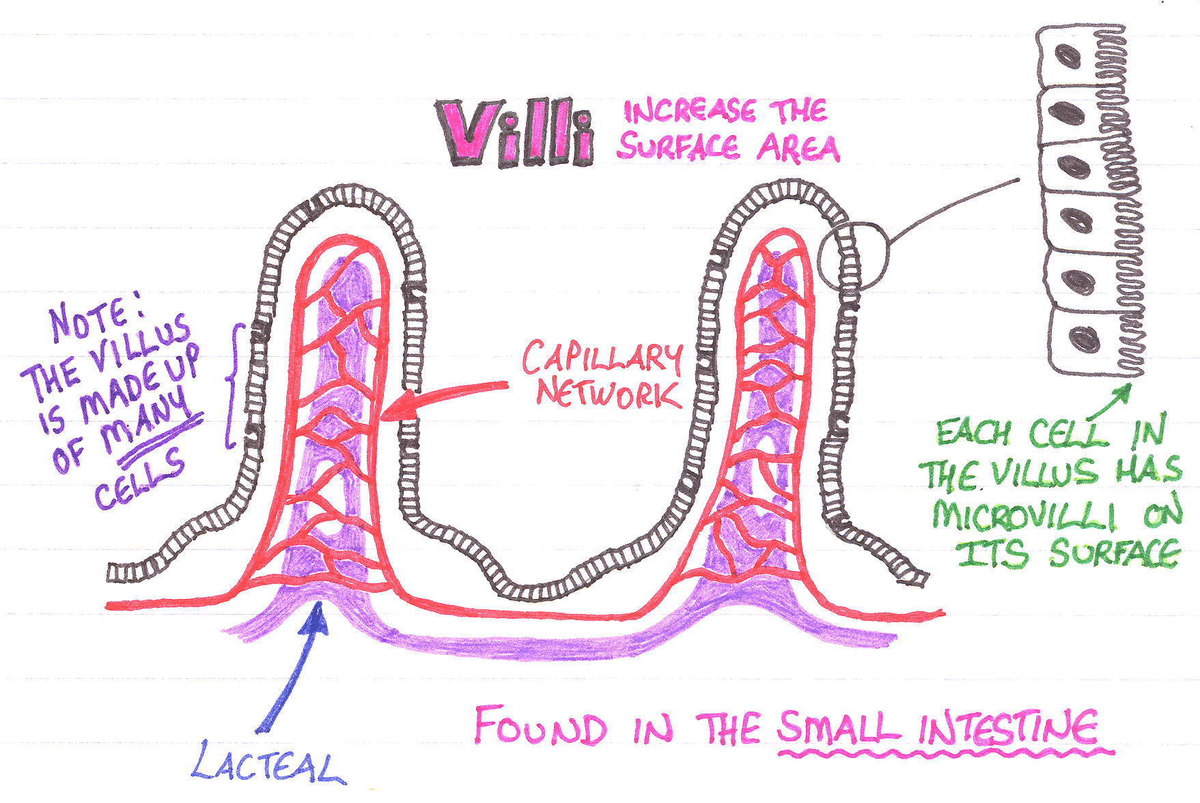
Small Intestine
Small intestines are roughly 7 meters long
Lining of intestine walls has finger-like projections called villi, to increase surface area.
The villi are covered in microvilli which further increases surface area for absorption.
Crash Course Review

Slide 9
Small Intestine
Nutrients from the food pass into the bloodstream through the small intestine walls.
Absorbs:
80% ingested water
Vitamins
Minerals
Carbohydrates
Proteins
Lipids
Secretes digestive enzymes

Slide 10
Large Intestine
About 1.5 meters long
Accepts what small intestines don’t absorb
Rectum (short term storage which holds feces before it is expelled).
Notes:
Depending on the maturity of the group, you can talk about the feces leaving via the anus.
Mention the appendix at the bottom of the ascending colon and that it might have been used long ago but is not today
Mention the portions of the large intestine, ascending, transverse, descending, sigmoid, and rectum (last one if the audience is mature enough)

Slide 11
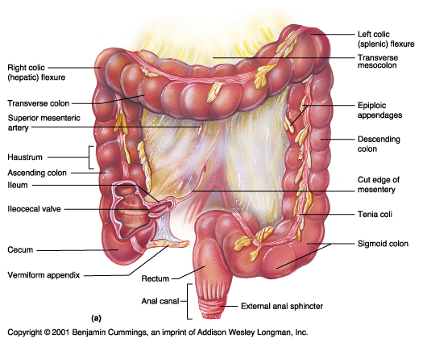
Large Intestine
Functions
Bacterial digestion
Ferment carbohydrates
Absorbs more water
Concentrate wastes

Slide 12
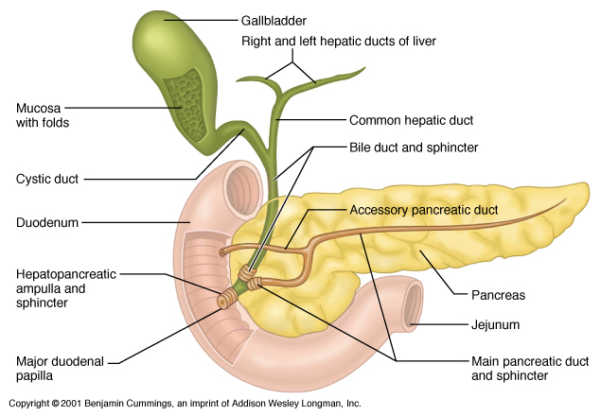
Accessory Organs The Glands
Not part of the path of food, but play a critical role.
Include: Liver, gall bladder, and pancreas

Slide 13
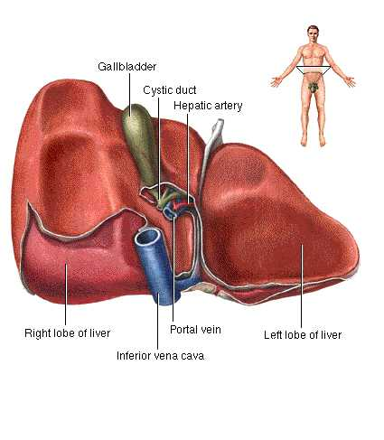
Liver
Directly affects digestion by producing bile
Bile helps digest fat
filters out toxins and waste including drugs and alcohol and poisons.
Notes:
Livers can regenerate missing pieces if necessary. Is one of the largest organs in the body.

Slide 14
Gall Bladder
Stores bile from the liver, releases it into the small intestine.
Fatty diets can cause gallstones
Notes:
Explain to students that removing the stones typically means removing the gallbladder, but that the body eventually adjusts to not having the bile stored.

Slide 15
Pancreas
Produces digestive enzymes to digest fats, carbohydrates and proteins
Regulates blood sugar by producing insulin
Web Page Reinforcement Video
Notes:
Explain the difference between the two types of diabetes. In type 1, the pancreas fails to produce enough insulin. In type 2, the body stops responding properly to the insulin it creates.

Slide 16
THANK YOU

