Slide 1
EVALUATION OF HERBAL DRUGS
.

Slide 2
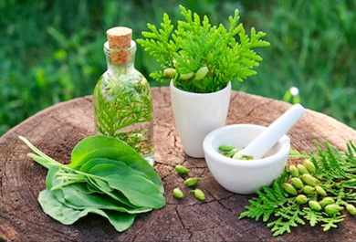
What are herbal drugs?
Herbal drugs are derived
from plants or their
parts by converting them
into phytopharamaceuticals
through simple processes like
harvesting, drying, and storage.

Slide 3
Quality control of herbal drugs
Quality Control of Herbal drugs involves the process of identification and determination of the purity of raw material, and maintaining the quality and validity of the manufactured drug

Slide 4
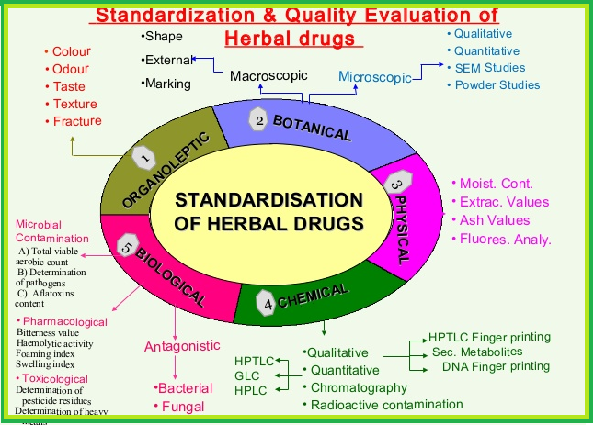

Slide 5
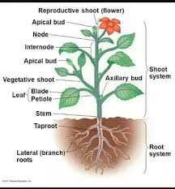
Macroscopic Examination
Microscopic identity of herbal drug is based on colour, odour, size, shape, taste & special features including touch, texture etc.
These observation are of primary importance before any further testing can be carried out.
This is the simplest and quickest means to establish the identity of a particular sample.

Slide 6
Microscopic examination
Microscopic Examination
Involve microscopic analysis of the plant structures like stomatal number, vein islet no. palisade ratio etc.
Histochemical detection like starch grain, aleurone grains, calcium oxalate crystals, lignified cell wall etc.
Detail of cell structure & arrangement of the cells useful for differentiating similar species.

Slide 7
Foreign Organic Matter
Refers to any other part of the plant or animals except that constituting the drug.
The permissible percentage of foreign matter in a drug is usually specified in its official monograph.
Foreign matter: NMT 2% w/w

Slide 8
Determination of Ash value
Total ash is the measure of the total amount of material left after burning.
Total ash usually consist of carbonates, phosphates, silicates and silica.
High ash value is indicative of adulteration contamination, or carelessness in preparing the drug.

Slide 9
Determination of extractive value
Amount of the active constituents present in crude drug material when extracted with specific solvent.
Eq.
Alcohol solube extarctive vlaue

Slide 10
Determination of swelling index
The swelling index is the volume in ml taken up by the swelling of 1 g of plant material under specified condition.
Its determination is based on the addition of water or a swelling agent as specified in the test procedure for each individual plant material (either whole, cut or pulverized).

Slide 11
Determination of foaming index
Many medicinal plant materials contain saponins that can cause a persistent foam when an aqueous decoction is shaken.
The foaming ability of an aqueous decoction of plant materials and their extracts is measured in terms of a foaming index.
Calculate the foaming index using the following formula: Foaming index=1000/a
where a = the volume in ml of the decoction used for
preparing the dilution in the tube where foaming to a
height of 1 cm is observed.

Slide 12
Determination of heavy metals
Contamination of plant materials with arsenic and heavy metals can be attributed to many causes including environmental pollution and harmful to health of the user and should therefore be limited.
The heavy metals may be determined by atomic absorption spectrophotometry.
The following maximum amounts in dried plant materials, which are based on the ADI values, are proposed:
lead, 10 mg/kg;
cadmium, 0.3 mg/kg.

Slide 13
Determination of microbial contaminants & aflatoxins
Involves determination of microbial contaminants like E. coli, S. aureus, P. aeruginosa and Salmonella spp.
Aflatoxins are naturally occuring mycotoxins produced mainly by Aspergillus flavus and Aspergillus parasiticus.
Aflatoxins in herbal drugs can be dangerous to health even if they are absorbed in minute amounts.
The presence of aflatoxins can be determined by chromatographic methods using standard aflatoxins B1, B2, G1, G2 mixtures.
IP method: NMT 2 μg/kg of aflatoxins B1& Total aflatoxins 4 μg/kg
USP method: NMT 5ppb of aflatoxins B1& Total aflatoxins 20ppb

Slide 14
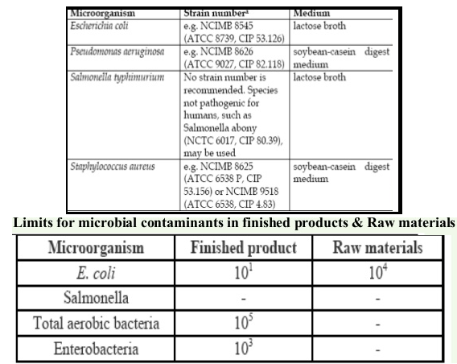
Test strains and culture media for use in validating the tests for specific microorganisms

Slide 15
Determination of pesticide residue
Involves determination of unsafe levels of harmful pesticides in herbal drugs, especially the pesticides that contain chlorine and phosphates.
Pesticide residues accumulate from agricultural practices, such as spraying, treatment of soils during cultivation, and fumigation during storage.
An ARL (in mg of pesticide per kg of plant material) can be calculated on the basis of the maximum acceptable daily intake of the pesticide for humans (ADI), as, recommended WHO, and the mean daily intake (MDI) of the medicinal plant material.
Not more than 1%

Slide 16
Analytical methods
The quantitative determination of constituents has been made easy by recent developments in analytical instrumentation.
HPTLC, HPLC, GC, GC/MS and LC/MS are powerful tools, often used for standardization and to control the quality of both the raw material and the finished product.
The results from these sophisticated techniques provide a chemical fingerprint as to the nature of chemicals or impurities present in the plant or extract.

