Slide 1
Functions in C++

Slide 2
What is function?
A function contains group of statements that perform a specific task.
Every Program in C++ contain at least one function that is main().
It divide a program into number of small modules.
Save the time.
Reduce the size of the program.
Reduce the chances of error.

Slide 3
Types of function
Built in types or predefined function
User defined function

Slide 4
Built in type or predefined
These are also called library functions.
Examples:
getch()
gets()
puts() ……
They perform only limited task.
Programmer has no control over these functions.

Slide 5
User defined functions
These are user created functions.
User has full control over it.
User can designed any number of functions to perform a task which he want.
These functions are created as per the requirements of the program.

Slide 6
Parts of the functions
An user defined function has the following components:
Prototype declaration
Function definition
Function call

Slide 7
Function prototype declaration
A function prototype is a declaration of a function that tells the program about the type of value returned by the function, name of function, number and type of arguments.
Syntax:
Return_type function_name (parameter list/argument);
Exp:
int add(int,int);
void add(void);
int add(float,int);
Contain 4 parts:
Return type
Function name
Argument list
Terminating semicolon

Slide 8
Function definition
Complete task is defined
Syntax is:
return_type fun_name(argument list/parameter list)
{
body of the function
}
Function header
Example:
int add(int x,int y)
{
return (x+y);
}
Contain the complete description about the task

Slide 9
Function call
Each function is called by its calling function.
Only name of the function along with the actual arguments are used.
Synatx:
fun_name(actual arguments);
Example:
add(x,y); or add(3,6);

Slide 10
Example
void add(int,int);
main()
{
statement1;
statement2;
add(4,5);
statement;
}
void add(int x,int y)
{
function body;
}
Funtion prototype declaration
Function call
Calling function
Called function
Function definition

Slide 11
Relation between calling function and called function
Functions are communicated through sending values to each other.
Calling function can send nothing or values as an actual parameter to the called function which receives these values in formal parameter .
Called function can communicate with calling function through returning either nothing or the result of calculation of the function.

Slide 12
Categories of functions
Function with no return value and no argument. void add(void);
Function with arguments passed and no return value. void add(int,int);
Function with no arguments but returns a value. int add(void);
Function with arguments and returns a value. int add(int,int);

Slide 13
Function with no return value and no argument
In this situation calling function and called function do not communicate through any value.
Example:
main()
{
statement1;
statement2;
add(void);
statement;
}
No communication between these two functions
void add(void)
{
code of adding two numbers.
}

Slide 14
Function with arguments passed and no return value.
In this situation calling function provide the value to the called function but called function does not return any value to its calling function.
One way communication is accomplished.
main()
{
statement1;
statement2;
add(4,7);
statement;
}
void add(int x,int y)
{
code of adding two numbers.
}
One way communication between these two functions

Slide 15
Function with no arguments but returns a value
In this situation calling function does not pass any value to its called function but called function return the result of the task to its calling function.
Again one way communication.
main()
{
statement1;
statement2;
int c=add(void);
cout>>c;
}
int add(void)
{
int a,b;
cin>>a>>b;
return (a+b);
}
One way communication between these two functions

Slide 16
Function with arguments and returns a value
In this situation both function can send and receive the value.
Two way communication is accomplished.
main()
{
statement1;
statement2;
int c=add(4,8);
cout>>c;
}
int add(int a,int b)
{
cin>>a>>b;
return (a+b);
}
Two way communication between these two functions

Slide 17
Formal parameter and actual parameter
The parameters passed in function definition is called formal parameter.
And the parameter passed in the function call is called actual parameter.
main()
{ statements;
int c=add(4,8);
cout>>c;
}
Actual parameters
int add(int a,int b)
{
cin>>a>>b;
return (a+b);
}
Formal parameters

Slide 18
Arguments passed in functions
Two possibilities
Pass by value
Pass by Reference

Slide 19
Pass by value
Here the called function creates a new set of variables and copies the values of the arguments into them.
The called function does not have the access to the actual variables in the calling program and can only work on the copies of the values.
In this case if any change done on the formal parameters then it does not affect on the actual parameters of the calling program.

Slide 20
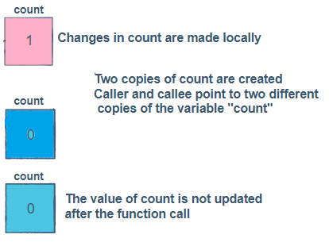
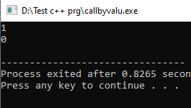
Example
void incCount(int count)
{
count =count+1;
cout<<count;
}
main()
{
int count=0;
incCount(count);
cout<<count;
}

Slide 21
Pass by reference/Pass by Address
It means the reference of an argument in the calling function is passed to the corresponding formal parameter of the called function so that a copy of the address of the actual parameter is made in memory,.
The caller and the callee use the same variable for the parameter.
If the called function modifies the parameter variable, the effect is visible to the actual parameter of the calling program.
Overview:
Passes an argument by reference.
Callee gives a direct reference to the programming element in the calling code.
The memory address of the stored data is passed.
Changes to the value have an effect on the original data.

Slide 22
Example
void fun1(int &x)
{
x = 50;
cout << "Value of x from fun1: " << x << endl;
}
main()
{
int x = 10;
fun1(x);
cout << "Value of x from main function: " << x;
}
Here both calling function and called function use the same memory space

Slide 23
Inline function
Normally, a function call transfers the control from the calling program to the called function.
This process of jumping to the function, saving registers, passing a value to the argument, and returning the value to the calling function takes extra time and memory.
The work also done by the compilers when the size of the function is small.
C++ provides the solution of this problem.

Slide 24
Definition of inline function
An inline function is a function that is expanded inline when it is invoked, thus saving time.
The compiler replaces the function call with the corresponding function code, which reduces the overhead of function calls.
To inline a function, place the keyword inline before the function name and define the function before any calls are made to the function.
The compiler can ignore the inline qualifier in case defined function is more than a line.

Slide 25
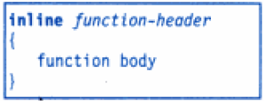
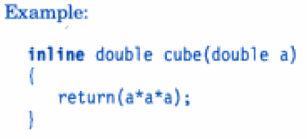
The inline function is defined as follows:

Slide 26
Inline function are not beneficial in following situation:
If a function contain more than 2 lines of code
If a function contain loop , switch or go to statements.
If function contains static variables.
If function recursive.

Slide 27
Example
#include<iostream>
using namespace std;
inline int Max(int x, int y)
{
return (x > y)? x : y;
}
int main()
{
cout << "Max (20,10): " << Max(20,10) << endl;
cout << "Max (0,200): " << Max(0,200) << endl;
cout << "Max (100,1010): " << Max(100,1010) << endl;
return 0;
}

Slide 28
Default arguments
A default argument is a default value provided for a function parameter.
If the user does not supply an explicit argument for a parameter with a default argument, the default value will be used.
If the user does supply an argument for the parameter, the user-supplied argument is used.
Default values are specified when function is declared.

Slide 29
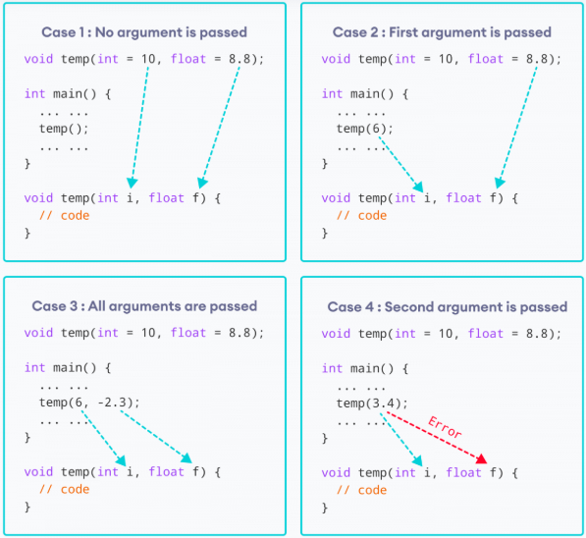
Consider the following cases

Slide 30
Important rule
A default argument is
checked for type at the time of declaration and
evaluated at the time of call.
Only the trailing arguments can have default values and therefore we must add defaults from right to left.
Default value to a particular argument can not be provided at the middle of the argument list.

Slide 31
For example
int add(int x=10,int y=2,int z=9)
int add(int x,int y=2,int z)
int add(int x=10,int y=2,int z)
int add(int x,int y,int z=9)
int add(int x=2,int y,int z=9)
correct
incorrect
incorrect
correct
incorrect

Slide 32
Int mul(int x,int y=20,int z=30);
main()
{
int rs;
rs = mul(5);
cout<<"The mul is : "<<rs<<endl;
rs = mul(4,8);
cout<<" The mul is : "<<rs<<endl;
rs = mul(7,3,4);
cout<<" The mul is : "<<rs;
}
int mul(int x, int y, int z)
{
return x * y * z;
}
X contain 5 and y contain 20, z contain 30
X contain 4, y contain 8 and z contain 30
X contain 7, y contain 3 and z contain 4
OUT PUT

Slide 33
Thank You
Any Question??

