Slide 1
HERBAL EXCIPIENTS-1

Slide 2
PHARMACEUTICAL EXCIPIENT
Pharmaceutical excipients can be defined as non-active ingredients that are mixed with therapeutically active compound(s) to form medicines.
The ingredient which is not an active compound is regarded as an excipients.
Excipients affect the behavior and effectiveness of the drug product more and more functionality and significantly.

Slide 3
SIGNIFICANCE OF NATURAL EXCIPIENTS
These polymers such as natural gums and mucilage are biocompatible, cheap and easily available and are preferred to semi synthetic and synthetic excipients because of their lack of toxicity, low cost, availability, soothing action and non irritant nature

Slide 4
CLASSIFICATION OF EXCIPIENTS
.
Excipients are commonly classified according to their application and function in the drug products:
Binders, Diluents
Lubricants, Glidants, Disintegrants
Polishing Film formers and coatings agents
Plasticizers, Colorings
Suspending agents Preservatives, antioxidants
Flavorings, Sweeteners, Taste improving agents

Slide 5
ADVANTAGE OF HERBAL EXCIPIENTS
Biodegradable: Naturally occurring polymers produced by all living organisms. They show no adverse effects on the human being.
Biocompatible and non-toxic
Economic - They are cheaper and their production cost is less than synthetic material.
Safe and devoid of side effects – They are from a natural source and hence, safe and without side effects.
Easy availability

Slide 6
DISADVANTAGE OF HERBAL EXCIPIENTS
Microbial contamination
Variation
The uncontrolled rate of hydration: Due to differences in the collection of natural materials at different times, as well as differences in region, species, and climate conditions the percentage of chemical constituents present in a given material may vary.
Slow Process: As the production rate is depends upon the environment and many other factors, it can’t be changed. So natural polymers have a slow rate of production.
Heavy metal contamination

Slide 7
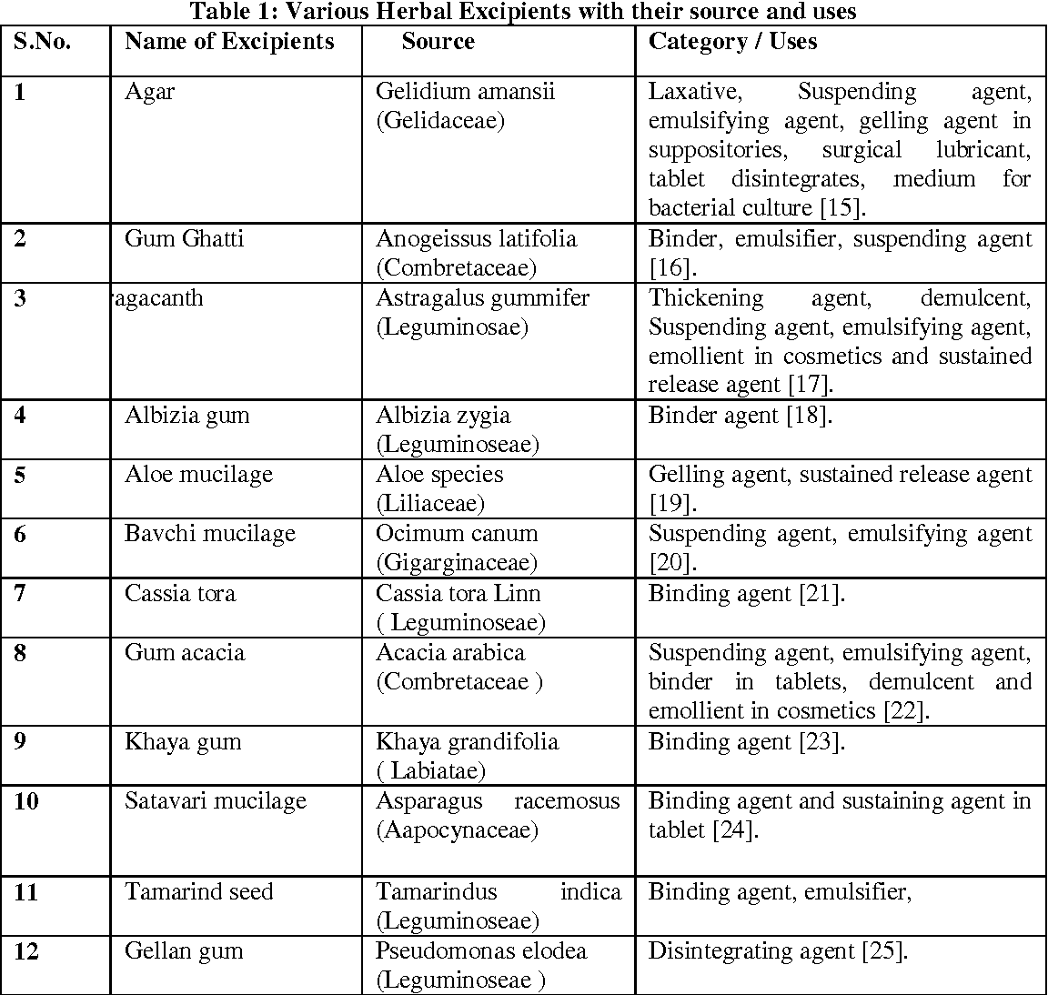

Slide 8
Colorants
Impart aesthetic appearance to dosage form.
It should be non toxic & no physiological activity
Should be free from harmful impurities
Unaffected by oxidizing/reducing & pH changes
Compatible with medicament & not interfere with them
Free from objectionable taste and odour
Should be appreciably adsorbed on to the suspended matter

Slide 9
.
.
Highly coloured substances found in plants and animals.
A dye and pigment differ in respect that, dye is actually absorbed by the material when applied to fibres to give it a permanent colour which is resistant to the action of light, water or soap. A pigment on other hand is only applied to the surface.
The coloured compounds are known as chromogen and bear chromophore group and/or auxo chrome capable of absorbing light in the near UV regions and appears as coloured substance.

Slide 12
Sweetners
Sweeteners, any of various natural and artificial
substances that provide a sweet taste.
Ideal properties of sweetening agent
They are required to be effective when used in small quantity.
Stable at wide range of temperature
Have very low or non-calorific value
Compatible with other ingredients
Should be readily available and inexpensive
Should not show batch to batch variation

