Slide 1
UNIT-1
Unit 1: Economic Development in an Emerging Economy, Urbanisation and Economic Growth
Meaning, basic characteristics, major issues.

Slide 2
Economic growth and development
Economic development is a broader concept than economic growth
Until 1960s, development and economic growth were used as synonyms, the measure of the latter being the rise in the real per capita income
According to Kindleberger, “Whereas economic growth refers to rise in output, economic development implies changes in institutional and technological organization of production as well as distributive pattern of income”
While there can be growth without development, development without growth is unconceivable

Slide 3
The concept of economic development
Economic development means economic growth plus progressive changes in certain crucial variables which determine the well-being of the people
According to Mahbub ul Haq “ The problem of development must be defined as a selective attack on the worst forms of poverty.
Development goals must be defined in terms of progressive reduction and eventual elimination of malnutrition, disease, illiteracy, squalor, unemployment and inequalities”

Slide 4
The traditional approach
A sustained annual increase in GDP at rates varying from 5% to 7% or more
An alternative economic index of development is the ability of a nation to expand it’s output faster than the growth of population
It is the real per capita GNP which measures the economic wellbeing of population
Real per capita GNP= Monetary per capita GNP- rate of inflation
The policy measures suggest industrialization at the expense of agricultural development

Slide 5
The new view of economic development
In 1970,economic development was redefined in terms of reduction or elimination of poverty, inequality and unemployment in the context of a growing economy.
Redistribution of growth became the popular slogan.
During 1980s, World Bank championed ‘Economic growth as a goal of development’
It says, the challenge of development is to improve the quality of life….

Slide 6
Three basic questions
What has been happening to poverty?
What has been happening to unemployment?
What has been happening to inequality?
A decline of the above three from the high level is an indicator of development

Slide 7
Three core values of development
Sustenance: Food, shelter, health and protection
Self-esteem: A sense of worth and self respect
Freedom from servitude: To be able to choose
This includes political freedom, freedom of expression, political participation and equality of opportunity

Slide 8
The millennium development goals
In September 2000, 189 countries of the United Nations adopted eight millennium development goals (MDG)to make substantial progress towards the eradication of poverty and achieving other human development goals by 2015
They are the following.
1. Eradication of poverty and hunger
Reduce by half the proportion of people who suffer from hunger
2. Achieve universal primary education
All boys and girls' complete education –a full course of primary schooling

Slide 9
Continued
3. Promote gender equality and empower women
Eliminate gender disparity in primary and secondary education, preferably by 2005, and at all levels by 2015
4. Reduce child mortality rate by two third among children under 5

Slide 10
MDG continued
5. Improve maternal health
Reduce by three quarters the maternal mortality ratio
6. Combat HIV/AIDS, malaria and other diseases
Halt and begin to reverse the spread of HIV/AIDS
Halt and begin to reverse the incidence of malaria and other major diseases

Slide 11
MDG continued
Ensure environmental sustainability
Integrate the principles of sustainable development into country policies and programs, reverse loss of environmental recourses
8. Develop global partnership for development
Develop an open, rule-based, predictable, non- discriminatory, trading and financial system. Include commitment to good governance, development and poverty reduction-both nationally and internationally

Slide 12
Characteristics of development
1. Lower level of living and productivity
Low levels of living are manifested in the form of low income, inadequate housing, poor health , low education, high mortality and low life expectancy.
Labor productivity depends on the health and skill of workers, motivation for work, institutional set-up etc.
Capital and managerial skill combined with labor in the required quantity raise labour productivity

Slide 13
Productivity of wheat in India is about 35% of the productivity of wheat in France
It is 66% of the productivity of wheat in China
India’s production of rice is 46% of the productivity in china
Productivity of cotton is one third of the productivity in China
Productivity of ground nut is 40% of that of China
The low productivity is mainly due to low level of technology

Slide 14
2. Low GNP per capita
GNP per capita in under developing countries is very low.
India’s GNP per capita has been estimated to be $2,120 in 2019.
The average GNP per capita income of high-income countries was $44,354 in the same year.
All third world countries are not equally under -developed in terms of GNP per capita income
Brazil, Malaysia, Mexico are far more affluent than India, Bangladesh, Myanmar, Pakistan

Slide 15
3. Scarcity of capital
The rate of capital formation is relatively low due to widespread poverty
Saving rate in Malaysia, China and Singapore was 40% or more than 40% of GDP on an average during 1997-2003
Saving rate continues to be very low i.e less than 20% of GDP in many developing countries

Slide 16
4. Rapid population growth rate and rapid dependency burden
Fast growing population is both cause and effect of underdevelopment in third world countries
Population has been increasing at the rate of 2% per annum in most of the under- developed countries for the past several decades due to poverty, ignorance and religious orthodoxy
The case of India
Number of dependents aged between 0-14 and over the age of 65
Dependency ratio fell from 81.2% in 1965 to 75.2% by 1980. 70.6% in 1990, 54.4% in 2010 and 49% by 2020

Slide 17
5. Technological backwardness
Over a wide range of industrial activities, production techniques are backward in underdeveloped countries
Under-developed countries willingly opt for labour intensive technology
In the absence of social security against unemployment, workers union often oppose introduction of labour displacing technology in industries

Slide 18
6. High incidence of poverty
The extent of absolute poverty is an important dimension of the problem of income inequality in under -developed countries.
According to the international poverty line, in 1990, in south Asia 44.6% of people were below the poverty line and 15.2% in 2018
The figures for Sub-Saharan Africa was 54.3% in 1990 and 40.2% in 2018

Slide 19
7. Wide income inequality
For any given level of national per capita income, the more the inequality in the distribution, the greater will be the incidence of poverty
Greater social fractionalization
Ethnic, linguistic and other forms of social divisions sometimes known as fractionalization lead to divert considerable energies to working for political accommodations if not national consolidation

Slide 20
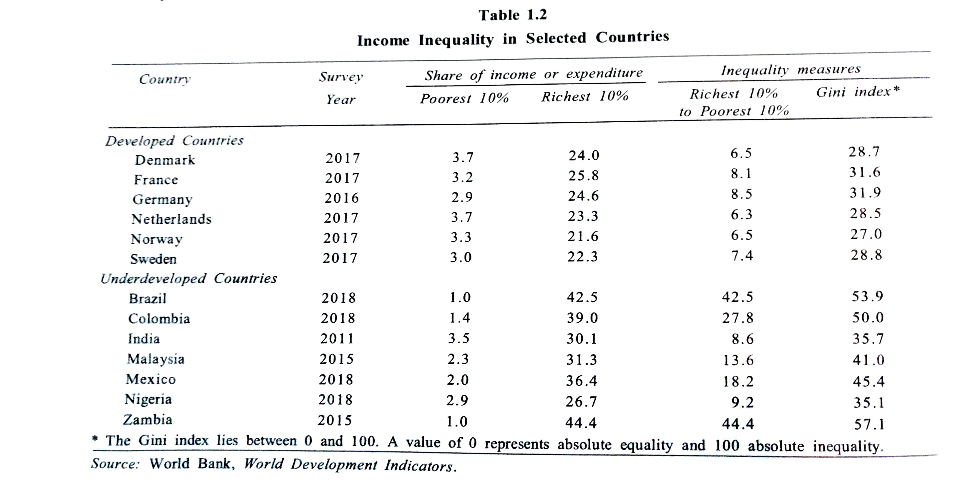

Slide 21
8. High dependency on agriculture
About 30% to 70% of the population in under-developed countries depend upon agriculture.
The share of income in agriculture is lower than the share of employment in agriculture.
Technologically, agriculture is much more backward in under- developed countries then in developed countries
In 1951, the contribution of agriculture to India’s GDP was 57% and in 2020 it has come down to 20.2%

Slide 22
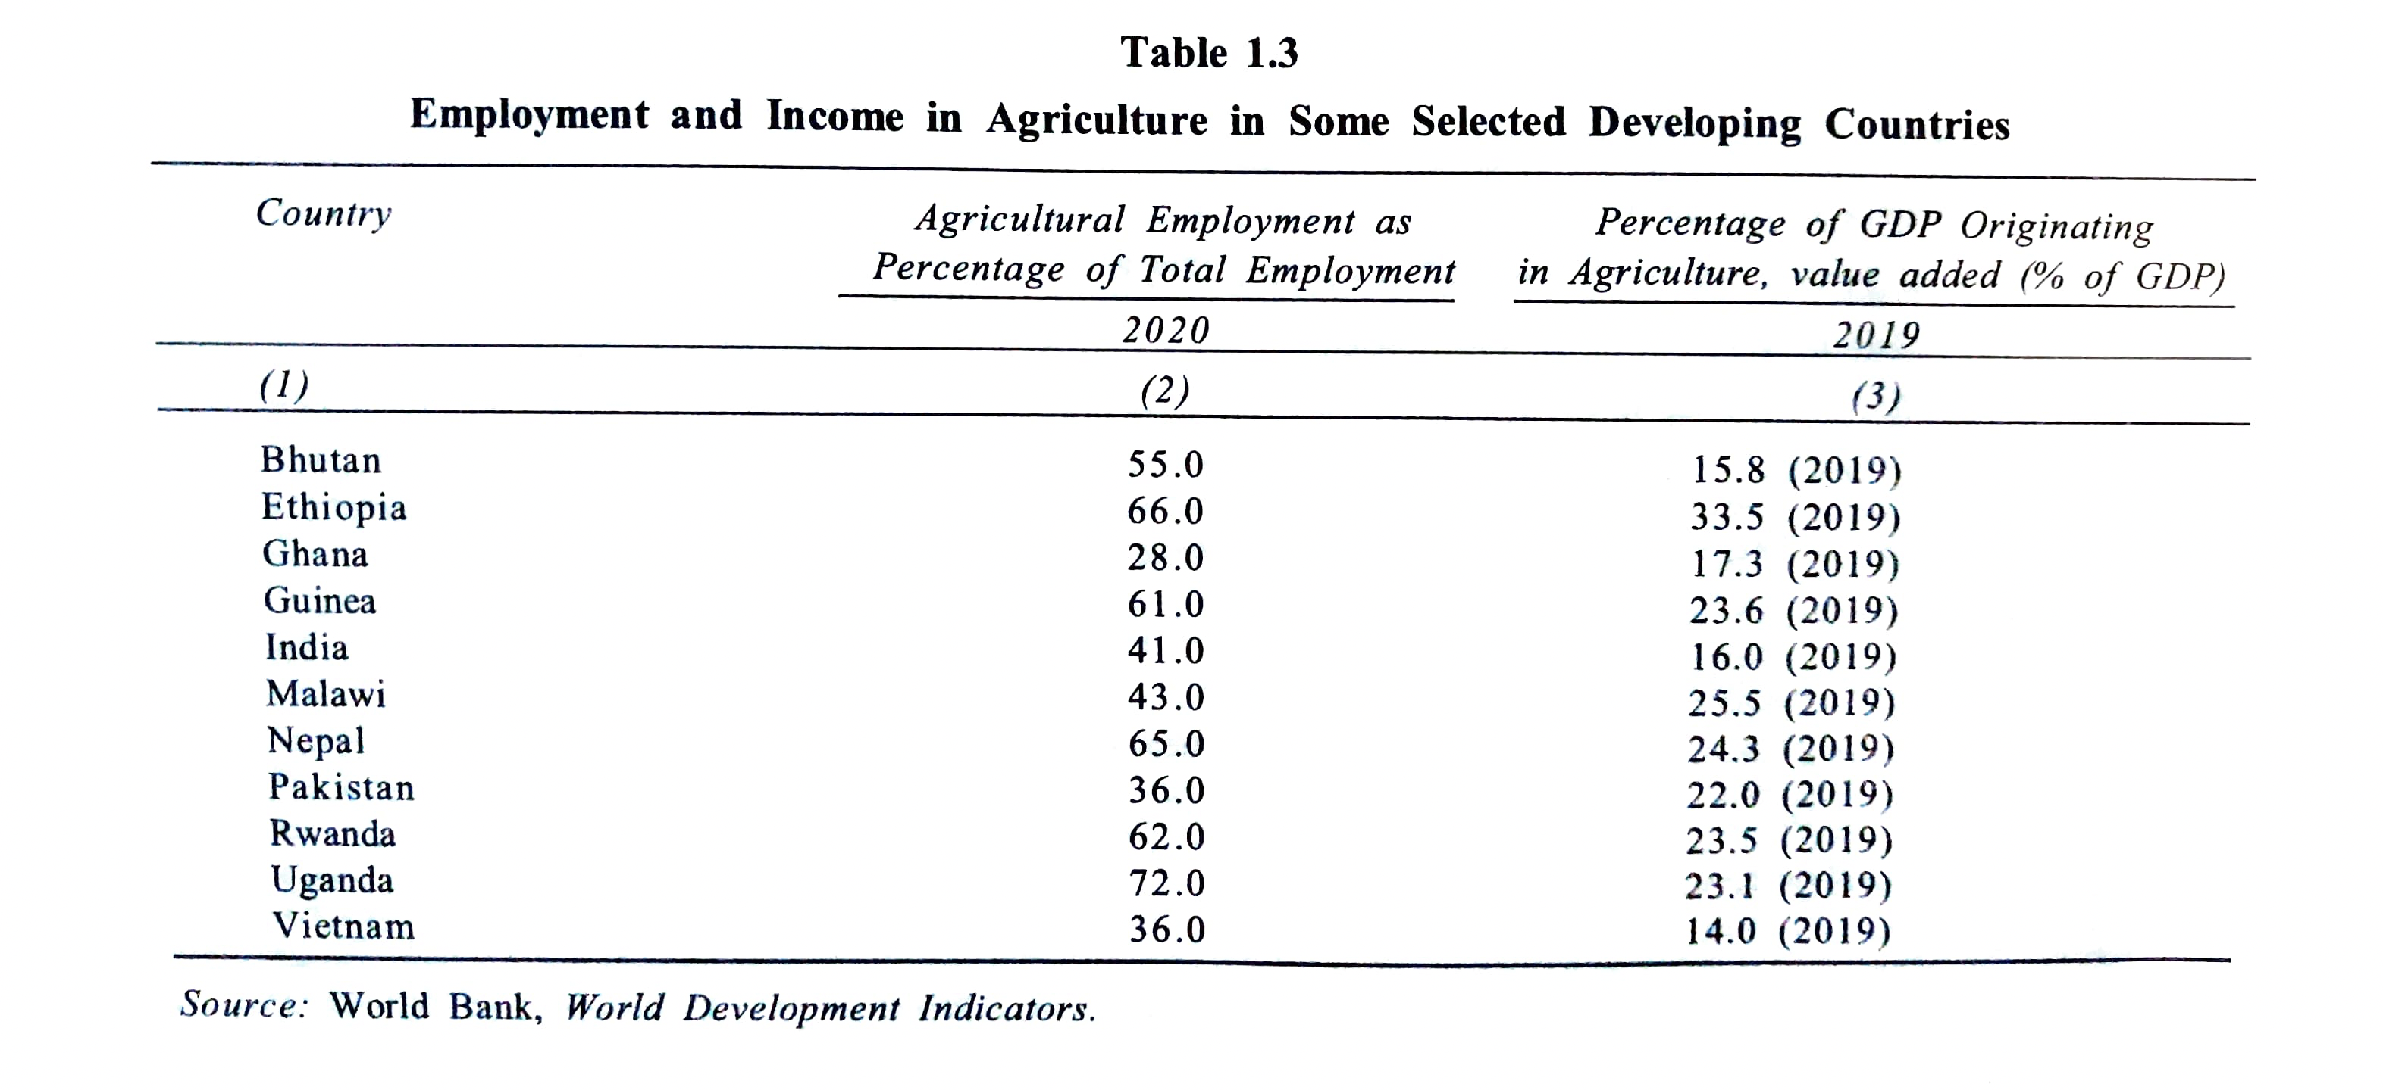

Slide 23
Other factors
The extent of participation of under- developed countries in foreign trade is much lower than the developed countries
Larger rural population and rural- urban migration
Substantial dependency on agricultural production and lower level of industrialization and manufactured exports
Underdeveloped financial and other markets
External Dependency

Slide 24
Urbanization and Economic Development
Urbanization is a process of concentration of population in the urban areas.
It refers to an increase in the number of towns and cities and their population.
Currently 54% of the world population live in the urban areas.
India’s contribution to world’s urban population is 10.6% and that of China is 19.54%
India’s urban population is fairly low in comparison to many countries in the world.

Slide 25
Continued….
As per the UNDP (2014) report in the year 2011 the urban population of India was 31.6%.
China’s 52%
Indonesia's 54%
Brazil’s 87%
South Africa’s 61%
In 1981, India was ranked 91 among 124 countries in terms of urbanization
In 2011, India ranked 159 out of 195 countries

Slide 26
The economic reforms initiated in 1991brought about various essential changes in urban development in India. The new economic reforms known as neoliberal and neo industrial policy of 1991 formed the core of the policy.
The rapid urban growth in the neoliberal policy is indicated by the increase in the number of million plus cities from 23 in 1991 to 53 in 2011.
This has resulted in many issues such as urban spread, inadequate urban infrastructure and deterioration in the quality of urban living conditions.

Slide 27
India’s urban population was 10.84 in 1901 and reached 31.2% in 2011.
Between 2001 and 2011, growth rate of urban population increased by 3.38%
There was an increase of 92 million urban population due to globalization, larger employment opportunities and technological progress.
India’s urban population in the 20th century predominantly grew after 1931.
1951 recorded massive increase in urban population due to displacement owing to partition in 1947

Slide 28
After 1947, the growth rate of urbanization shows a steady upward trend till 1981.
This exponential growth rate has been explained by the introduction of 782 new cities in 1981 census.
Between 1981-91 due to slow growth of economic development, urbanization slowed down.
Contrary to the expectation, there is a steep decline in the urbanization rate between 1991-2001.

Slide 29
However, the pattern of urbanization in India from 2001 to 2011 shows that urbanization growth rate increased from 31.3% to 31.8% in 2011.
A significant feature of India’s urbanization is that most of the urban population lived in class -1 cities. These are also called million plus cities or metropolitan cities.

Slide 30
Emerging Pattern of Urban Growth in India
Decade %of urban population in class-1 cities
1901 26
1951 44.5
2001 68.5
2011 60.4

Slide 31
Level of urbanization is closely linked to economic development
Urbanization is not only an outcome of industrialization, but also a consequence of modernization
Urban growth in the post liberalization period came to be determined by
1. substantial growth of of urban population
2. Changes in the proportion of employment in manufacturing and service sector

Slide 32
In India there exist no clear relationship between urbanization and per capita GDP for the period 1991-2001
In 1991, Punjab and Haryana were among the wealthiest states and were less urbanized
By 2011, there was a definite positive relationship observed between urbanization and economic growth
More urbanized states like Maharashtra, T.N . Gujarat and Kerala accounted for high level of per capita income

Slide 33
Economic reforms in India have not been uniform because of faulty national economic policies.
This has discouraged growth of urban employment.
Economic reforms for accelerating the urbanization process are necessary through the promotion of small and medium sized urban areas, human capital, socio-cultural mobility and the formulation of effective plans for promoting eco friendly green cities in India.

