Slide 1
ECE-S- 204
Electrical Machines
Induction Motor
Atul kumarAgnihotri
Asst.prof/ECE
UIET CSJMU KANPUR,

Slide 2
Content
Introduction
Why induction motor (IM)?
Classification of Motor
Rotating Magnetic Field
Principle of operation
Induction motor speed
Induction Motors and Transformers
Disadvantages
References

Slide 3
Introduction
Three-phase induction motors are the most common and frequently encountered machines in industry
simple design, rugged, low-price, easy maintenance
wide range of power ratings: fractional horsepower to 10 MW
run essentially as con•s_{in}ta_{d}n_{uc}t_{ti}s_{o}p_{n}e_{m}ed_{ot}f_{o}r_{r}om no-load to full load
Its speed depends on the frequency of the power source
not easy to have variable speed control
requires a variable-frequency power-electronic drive for optimal speed control

Slide 4
••Why induction motor (IM)?
–Robust; No brushes. No contacts on rotor shaft
–High Power/Weight ratio compared to Dc motor
–Lower Cost/Power
–Easy to manufacture
–Almost maintenance-free, except for bearing and other mechanical parts

Slide 5
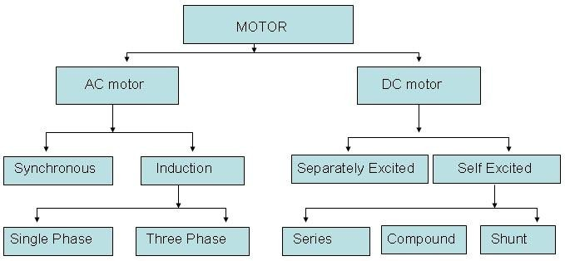
Classification of Motor

Slide 6
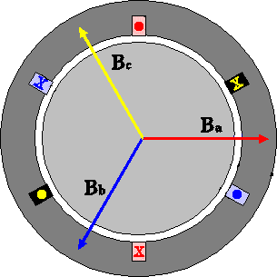
Rotating Magnetic Field
Balanced three phase windings, i.e. mechanically displaced 120 degrees form each other, fed by balanced three phase source
A rotating magnetic field with constant magnitude is produced, rotating with a speed
Where f_{e} is then su_{sy}p_{n}p_{c}ly requency and
P is the no. of poles and n sync called the
synchronous speed in rpm (revolutions per
minute)

Slide 7
Synchronous speed
P | 50 Hz | 60 Hz
2 | 3000 | 3600
4 | 1500 | 1800
6 | 1000 | 1200
8 | 750 | 900
10 | 600 | 720
12 | 500 | 600

Slide 8
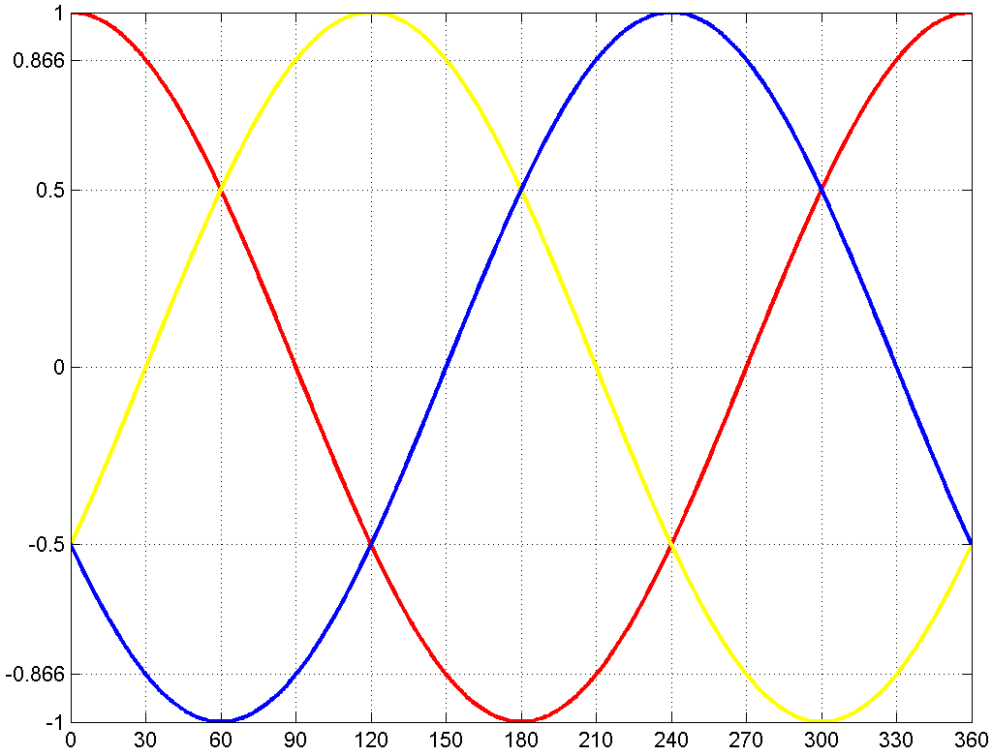
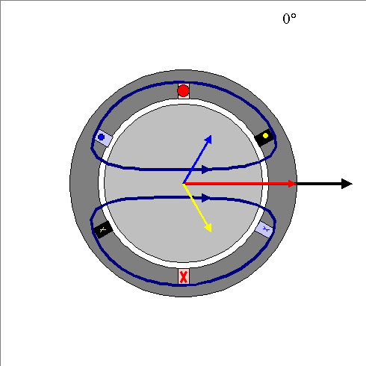
Rotating Magnetic Field

Slide 9
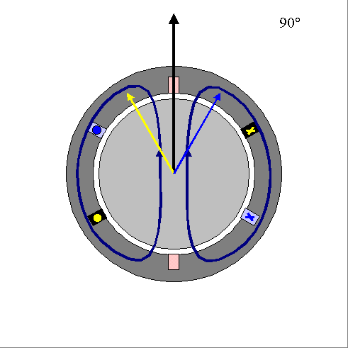
Rotating Magnetic Field

Slide 10
Rotating Magnetic Field
B_{net} (t) = B_{a} (t) + B_{b} (t) + B_{c} (t)
= B_{M} sin(ωt)∠0° + B_{M} sin(ωt −120°)∠120° + B_{M} sin(ωt − 240)∠240°
= B_{M} sin(ωt)xˆ
3 _{B}
−[0.5B sin(ωt −120°)]xˆ −[
sin(ωt −120°)]yˆ
M
2
M
3 _{B}
−[0.5B sin(ωt − 240°)]xˆ +[
sin(ωt − 240°)]yˆ
M
2
M

Slide 11
Rotating Magnetic Field
3 _{B}
3 _{B}
B (t) = [B sin(ωt) + ¹ B sin(ωt) +
cos(ωt) + ¹ B sin(ωt) −
cos(ωt)]xˆ
net M
M
M
M
M
4 4
4 4
3 _{B}
3 _{B}
+[−
sin(ωt) − ³ B cos(ωt) +
sin(ωt) − ³ B cos(ωt)]yˆ
4
M
4
M
4
M
4
M
= [1.5B_{M} sin(ωt)]xˆ −[1.5B_{M} cos(ωt)]yˆ

Slide 12
Rotating Magnetic Field

Slide 13
Principle of operation
This rotating magnetic field cuts the rotor windings and produces an induced voltage in the rotor windings
Due to the fact that the rotor windings are short circuited, for both squirrel cage and wound-rotor, and induced current flows in the rotor windings
The rotor current produces another magnetic field
A torque is produced as a result of the interaction of those two magnetic fields
^{τ}ind
= kB_{R} × B_{s}
Where τ_{ind} is the induced torque and B_{R} and B_{S} are the magnetic flux densities of the rotor and the stator respectively

Slide 14
Induction motor speed
At what speed will the IM run?
Can the IM run at the synchronous speed, why?
If rotor runs at the synchronous speed, which is the same speed of the rotating magnetic field, then the rotor will appear stationary to the rotating magnetic field and the rotating magnetic field will not cut the rotor. So, no induced current will flow in the rotor and no rotor magnetic flux will be produced so no torque is generated and the rotor speed will fall below the synchronous speed
When the speed falls, the rotating magnetic field will cut the rotor windings and a torque is produced

Slide 15
Induction motor speed
So, the IM will always run at a speed lower than the synchronous speed
The difference between the motor speed and the synchronous speed is called the Slip
^{n}slip ^{= n}sync ^{− n}m
Where n_{slip}= slip speed
n_{sync}= speed of the magnetic field
n_{m} = mechanical shaft speed of the motor

Slide 16
The Slip
_{s =} ^{n}sync ^{− n}m
^{n}sync
Notice that : if the rotor runs at synchronous speed
s = 0
if the rotor is stationary
s = 1
Slip may be expressed as a percentage by multiplying the above
eq. by 100, notice that the slip is a ratio and doesn’t have units
Where s is the slip

Slide 17
Induction Motors and Transformers
Both IM and transformer works on the principle of induced voltage
Transformer: voltage applied to the primary windings produce an induced voltage in the secondary windings
Induction motor: voltage applied to the stator windings produce an induced voltage in the rotor windings
The difference is that, in the case of the induction motor, the secondary windings can move
Due to the rotation of the rotor (the secondary winding of the IM), the induced voltage in it does not have the same frequency of the stator (the primary) voltage

Slide 18
Disadvantages
–Essentially a “fixed-speed” machine
–Speed is determined by the supply frequency
–To vary its speed need a variable frequency supply

Slide 19
Thanks

