Slide 1
C++
C++ is language.
C++ was
an object-oriented programming
developed by Bjarne Stroustrup at
AT&T Bell Laboratories in Murray Hill, New Jersey, USA.
C++ is an extension of C with a major addition of the class construct feature.
Since the class was a major addition to the original C language, Stroustrup called the new language 'C with Classes'.

Slide 2
C++
However later in 1983 the name was changed to C++.
The idea of C++ comes from the C increment operator ++ thereby suggesting that C++ is an incremented version of C
C++ is a superset of C.
The three most important facilities that C++ adds on to C are classes, function overloading, and operator overloading.

Slide 3
Simple C++ Program
#include<iostream> using namespace std; main()
{
cout<<"Hello C++ Programmer";
}

Slide 4
C++
Above example contains only one main().
Execution begins at main().
Every C++ program must have a main().
fucntion,

Slide 5
Comments
// - (Single Line comment)
/*
*/ -( Multiline comment)
for(j=0;j<10;/* hello */ j++) //Multiline only allowed
{
}

Slide 6
C++ Output Operator
The Statement:
cout<<”C++ is better than C”;
This causes the string in quotation marks to be displayed on the screen.
This statement introduces two new C++ features, cout and <<.
cout: Is a predefined object that represents the
standard output stream in C++.
Here the standard output stream screen.
represents the

Slide 7
C++ Output Operator
It is also possible to redirect the output to other output devices.
<< : Is called the insertion or put to operator.
It inserts the contents to the variable on its right to the object on its left.
It is important to note that we can still use the printf() for displaying an output.
You may recall that the operator << is the bit-wise left-shift operator and it can still be used for this purpose. (Operator Overloading)

Slide 8
C++ iostream File
#include <iostream>
This directive causes the preprocessor to add the contents of the iostream file to the program.
It contains declarations for the identifier cout and the operator <<.
The header file iostream should be included at the beginning of all programs that use input/output statements.
The header files with .h extension are ”old style” files which should be used with old compilers.

Slide 9
Return Type of main()
In C++ main() returns an integer type value to the operating system.
Therefore every main() in C++ should end with a return 0; statement otherwise a warning or an error might occur.
Since main() returns an integer type value, return type for main() is explicitly specified as int.
Note that the default return type for all functions in C++ is int.

Slide 10
Average of Two numbers
#include<iostream>
using namespace std;
int main()
{
float num1,num2,sum,avg; cout<<”Enter number 1”; cin>>num1;
cout<<”Enter number 2”; cin>>num2;

Slide 11
Average of Two numbers
sum=num1+num2; avg=sum/2;
cout<<”Sum =” <<sum <<”\n”; cout<<”Average =”<<avg <<”\n”;
return 0;
}

Slide 12
C++ Input Operator
cin>>num1;
Is an input statement and causes the program to wait for the user to type in a number.
The number keyed in is placed in the variable num1.
The operator >> is known as extraction or get from operator.
It extracts the value from the keyboard and assigns it to the variable on its right

Slide 13
C++ Input Operator
Cout<<” Sum =” <<sum <<”\n”;
First sends the string ”Sum =” to cout and then send the value of sum. Finally it sends the newline character so that the next output will be in the new line.
The multiple use of << in one statement is called casading.
Cin>>num1>>num2;
The vlaues are assigned from left to right. 10 & 20 entered then num1=10 & num2=20

Slide 14
Structure of C++ Program
Include Files
Class declaration
Class functions definitions
Main function program

Slide 15
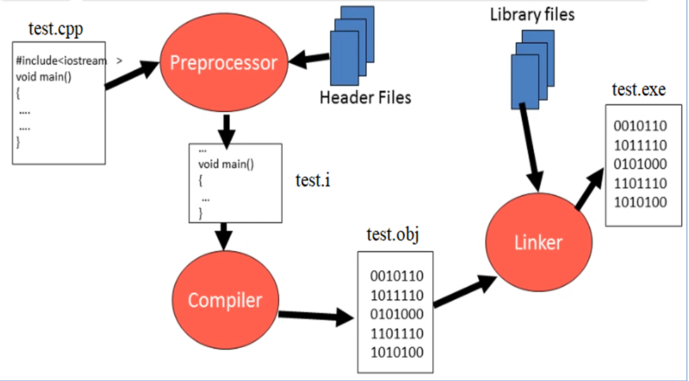
Process of executing a C++ file

Slide 16
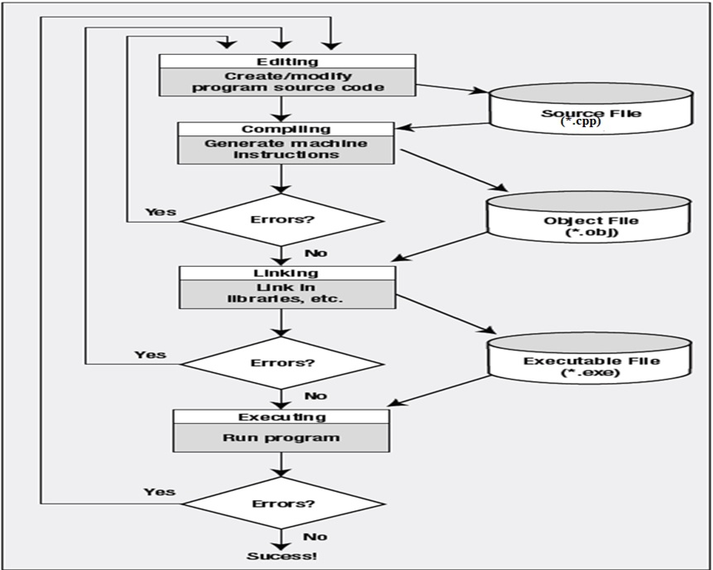
Flow chart of C++ execution process

Slide 17
#include<iostream.h>
using namespace std;
#include<conio.h>
class person
{
int roll; int marks;
public :
void getdata(void)
{
cout<<“Roll No:"; cin>>roll;
cout<<“Marks"; cin>>marks;
}

Slide 18
void display(void)
{
cout<<"Roll No"<<roll;
cout<<"Marks "<<marks;
}
};
int main()
{
person per1; per1.getdata(); per1.display();
getch(); return 0;
}

Slide 19
Difference between C and C++

