Slide 1
Object Oriented Programming Using C++

Slide 2
Procedure Oriented Programming(POP)
Conventional programming language such as COBOL, FORTRAN and C is
commonly known as Procedure-oriented programming
.
The primary focus is on functions.
Main Function
Function-1
Function-2
Function-3
Function-4
Function-5

Slide 3
Procedure Oriented Programming(POP)
Procedure oriented programming basically consists of writing a list of instructions for the computer to follow and organizing these instructions into groups known as functions
More importance to Functions very little attention to data that are being used by the functions.
Global Data
Global Data
Function-1
Data
Function-2
Data
Function-3
Data
Relationship of data and functions in Procedural Programming

Slide 4
Procedure Oriented Programming(POP)
Data is not secure.
Global data are more vulnerable to the changes by the function.
In large programs , it is very difficult to identify what data is used by which function.
Does not model real world problems very well.

Slide 5
Procedure Oriented Programming(POP)
Characteristics of POP:
Emphasis is on doing things
Large programs are divided into smaller programs known as functions.
Functions share global data.
Work on top- down approach.

Slide 6
#include<stdio.h> #include<conio.h>
int data; // Global Data main()
fun_1()
{
data++; printf("%d",data);
}
fun_2()
{
data++; printf("%d",data);
}
{
clrsrcr(); printf("%d",data); fun_1();
fun_2();
getch();
}

Slide 7
Object Oriented Programming
Invention of Object Oriented Approach is to remove flaws of Procedural approach.
OOP treats data as a critical element and does not allow to move freely.
It ties data more closely to the functions data operate on data and protect it from accidental modification from outside functions called objects.
OOP decompose a problem into a number of entities called objects and build data and functions around these objects.
The data of an object can be accessed only by the functions.
Functions can communicate with functions of other objects.

Slide 8
Object Oriented Programming
Object A
Object B
Data
Data
Communication
Functions
Functions
Object C
Functions
Data
Organization of data and functions in OOP

Slide 9
Object Oriented Programming
Characteristics of OOP
Emphasis is on data rather than procedure.
Programs are divide into objects.
Data is hidden and cannot be accessed by external functions.
Objects can communicate with each other through functions.
New data and functions can be easily added whenever necessary.
Follows bottom-up approach in program design.

Slide 10
Features of Object Oriented Programming(OOP)
Objects
Classes
Data Abstraction and Encapsulation
Inheritance
Polymorphism
Dynamic Binding
Message Passing

Slide 11
Objects:
This is the basic run-time entities in an object oriented programming.
That is both data and function that operate on data are bundled as a unit called as
object.
Program objects should be chosen such that they match closely with the real- world objects.
Objects take up space in the memory and have an associated address like structure in C.
Object: STUDENT
DATA Name DOB Marks
FUNCTIONS Total Average Display
 | STUDENT
T | otal
Av | erage
Dis | play
Two ways of representing an object

Slide 12
Classes
The entire set of data and code of an object can be made a user- defined data type with the help of a class.
Objects are variable of type class.
Once a class has been defined we can create any number of objects belonging to that class.
A class is thus a collection of objects of similar type.
Classes are user-defined data types and behave like the built-in types of a programming language.
e.g: Fruits mango , apple.

Slide 13
Data Abstraction and Encapsulation
The wrapping up of data and function into a single unit (called class) is known as
encapsulation.
Data and encapsulation is the most striking feature of a class.
The data is not accessible to the outside world, and only those functions which are wrapped in the class can access it.
Functions provide the interface between the object’s data and the program.
Insulation of the data is called data hiding or information hiding.
Abstraction refers to the act of representing essential features without including the
background details or explanation.
Classes use the concept of abstraction
The attributes are some time called data members and The functions that operate on these data are sometimes called methods or member function.

Slide 14
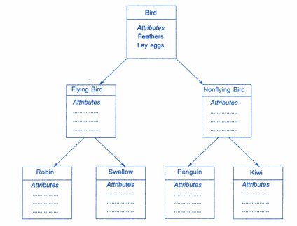
Inheritance
This is the process by which a class can be derived from a base class with all features of base class and some of its own.
This increases code reusability.

Slide 15
Types of Inheritance
In C++, we have 5 different types of Inheritance. Namely,
Single Inheritance
Multiple Inheritance
Hierarchical Inheritance
Multilevel Inheritance
Hybrid Inheritance (also known as Virtual Inheritance)

Slide 16
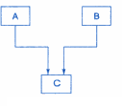
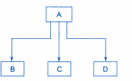
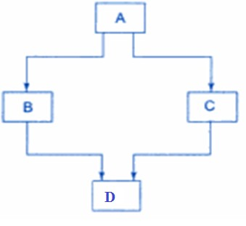
Types of Inheritance
Multiple Inheritance
Multilevel Inheritance
Hierarchical Inheritance
Hybrid Inheritance

Slide 17
Polymorphism
Polymorphism is another important OOP concept .
Polymorphism means the ability to take more than one form.
An operation may exhibit different behavior is different instances.
The behavior depends upon the types of data used in the operation.
The process of making an operator to exhibit different behaviors in different instances is known as operator overloading.
Using a single function name to perform different type of task is known as function overloading.

Slide 18
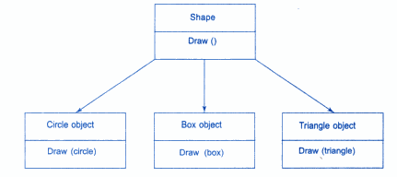
Polymorphism
Example of Polymorphism

Slide 19
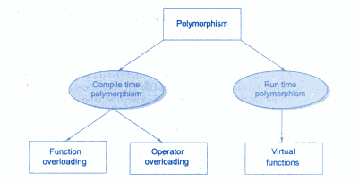
Polymorphism
Types of Polymorphism

Slide 20
Dynamic Binding
Binding refers to the linking of a procedure call to the code to be executed in response to the call.
Dynamic binding also known as late binding, means that the code associated with a given procedure call is not known until the time of the call at Run-Time.

Slide 21
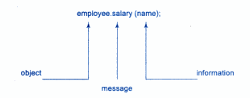
Message Passing
A message for an object is a request for execution of a procedure .
Invoke a function(procedure) in the receiving object that generates the desired result.
Message passing involves :
Specifying name of the object.
Name of the function(message).
Information to be sent.

Slide 22
Object Oriented Language
object-oriented languages into the following two categories:
Object-based programming languages, and
Object-oriented programming languages.

Slide 23
Object Oriented Language
1. Object-based programming is the style of programming that primarily supports encapsulation and object identity. Major feature that are required for object based programming are:
Data encapsulation
Data hiding and access mechanisms
Automatic initialization and clear-up of objects
Operator overloading
Languages that support programming with objects are said to the objects-based programming languages. They do not support inheritance and dynamic binding. Ada is a typical object-based programming language.

Slide 24
Object Oriented Language
2. Object-oriented programming language incorporates all of object-based programming features along with two additional features
1. inheritance and 2.dynamic binding.
Object-oriented programming can therefore be characterized by the following statements:
Object-based features + inheritance + dynamic binding

Slide 25
Applications of OOP
The promising areas of application of OOP include:
Real-time system
Simulation and modeling
Object-oriented data bases
Hypertext, Hypermedia,
AI and expert systems
Neural networks and parallel programming
Decision support and office automation systems
CIM/CAM/CAD systems

