Slide 1
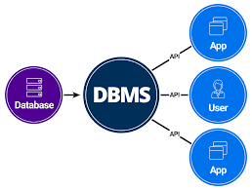
Introduction to DMBS

Slide 2
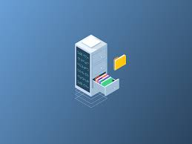
Database
Database is a collection of interrelated data which helps in efficient retrieval, insertion and deletion of data from database and organizes the data in the form of tables, schemas and reports.

Slide 3
Database Management System
DBMS= DATABASE + MANAGEMENT SYSTEM
“DBMS is a collection of interrelated data and set of programs to store and access those data in an easy and efficient manner.”
DBMS provide storage, retrieval, updation and deletion of data in an organized manner,

Slide 4
Need of DBMS
Database system are basically developed for large amount of data.
When dealing with huge amount of data, there are two things that require optimization:
Storage of data
Retrieval of data

Slide 5
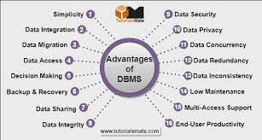

Slide 7
Difference between File management system and DBMS
FILE MANAGEMENT SYSTEM
DATABASE MANAGEMENT SYSTEM
It is a software that manage and organize the file in a storage medium in a computer.
Redundant data can be managed.
It doesn’t provide backup and recovery.
It is less complex when compared to DBMS.
It is less expensive.
DBMS is a software that manage the database.
There is no redundant data present in DBMS.
It provide backup and recovery of data even if it is lost.
It is more complex.
It is expensive.

Slide 8
DATA ABSTRACTION
A major purpose of database system is to provide users with an abstract view of data i.e. the system hides certain details of how the data are stored and maintained.
Levels of Data Abstraction
Physical level- it is the lowest level of data abstraction that describe how the data is actually stored.
Logical level- it is the next higher level of abstraction that describe what data are stored and what relationship exists among data.
View level- it is the highest level of abstraction that describe only part of the entire database.

