Slide 1
Inheritance in C++

Slide 2
What is Inheritance?
Inheritance is a technique of OOPs where a class inherits some or all properties of another class.
Allows us to define a class in terms of another class.
Makes it easier to create and maintain an application.
Provides an opportunity to
reuse the code functionality and
fast implementation time.

Slide 3
Base Class:
whose properties are inherited
derived class:
inherit the features of base class
Syntax for inheritance:
class derived-class : access-specifier base-class
Access specifier may be public, private or protected.
Colon indicates that the derived class name is derived from base class name.

Slide 4
Access specifiers used in C++
Public:
Public members of a class are accessed by member functions of its class itself and member functions of its derived classes.
Private:
Private members of a class are accessed only by the member functions of its class in which these are declared.
other class members can not access private members of a class.
Protected:
Protected members are accessed by member functions within its class and any class immediately derived from it.
It cannot be accessed by the functions out side these two classes.

Slide 5
Modes of Inheritance
Modes of Inheritance
Private
Public
Protected

Slide 6
Modes of Inheritance
Private Mode:
When a base class is privately inherited by the derived class, then
Public and protected members of the base class become private members of the derived class and therefore they can be accessed only by member functions of derived class.
They are inaccessible to the objects of the derived class
Private members of the base class are not inherited.

Slide 7
Public Mode:
When a base class is publically inherited, then
Public members of the base class become public members of the derived class.
Protected members of base class become protected members of derived class.
Therefore they are accessible to the objects of the derived class.
Private members are not inherited.

Slide 8
Protected Mode:
When a base class is inherited in protected mode, then
Public and protected members of base class become protected members in the derived class too and therefore they are accessible by the members functions of derived class.
A private member is not inherited.

Slide 9
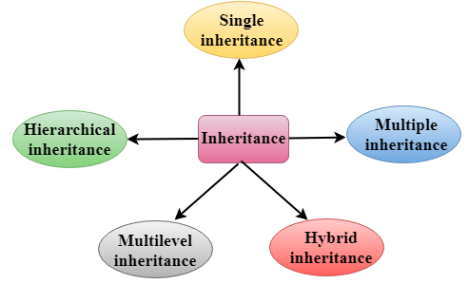
Types of Inheritance
It is of 5 types
Single level inheritance
Multilevel Inheritance
Multiple Inheritance
Hierarchical Inheritance
Hybrid Inheritance

Slide 10
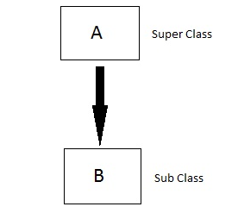
Single level Inheritance
In this type of inheritance one derived class inherits from only one base class.
It is the most simplest form of Inheritance.

Slide 11
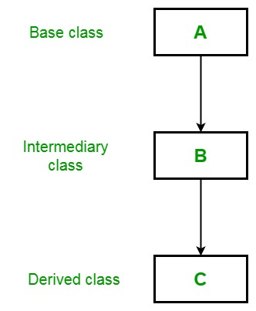
Multilevel Inheritance
In this type of inheritance the derived class inherits from a class, which in turn inherits from some other class.
The Super class for one, is sub class for the other.

Slide 12
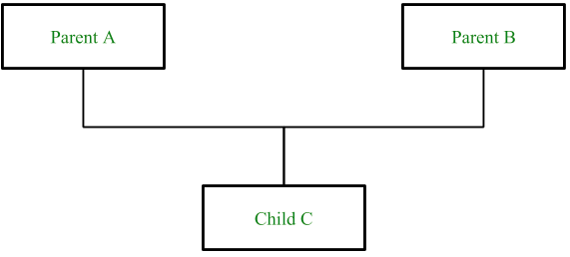
Multiple inheritance
In this type of inheritance a single derived class may inherit from two or more than two base classes.

Slide 13
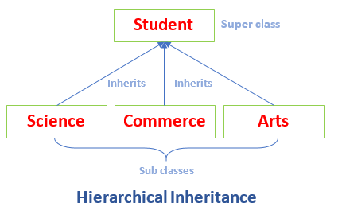
Hierarchical Inheritance
In this type one class is inherited by multiple classes.

Slide 14
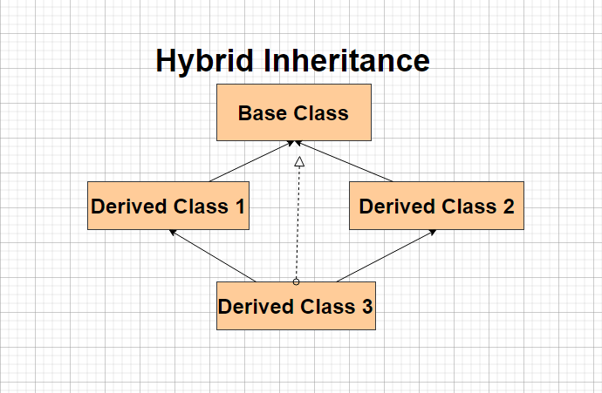
Hybrid Inheritance
It is a mixture of 2 or more of above types of inheritance. There is no pattern of deriving from classes.

