Slide 1
JOURNAL
Journal is the basic book of original entry. In this book, transactions are recorded in the chronological order, as and when they take place. Afterwards, transactions from this book are posted to the respective accounts. Each transaction is recorded separately after determining the particular account to be debited or credited (with the help rules of debit and credit ).

Slide 2
FORMAT OF JOURNAL
DATE | PARTICULARS | L.F. | DEBIT ( Dr.) Rs. | CREDIT (Cr.) Rs.
(1) | (2) | (3) | (4) | (5)

Slide 3
JOURNAL
First column in a journal is Date on which the transaction took place. In the Particulars column, the account title to be debited is written on the first line beginning from the left hand corner and the word ‘Dr.’ is written at the end of the column. The account title to be credited is written on the second line with 'To’. Below the account titles, a brief description of recorded transaction is written which is called Narration. Having written the Narration a line is drawn in the Particulars column, which indicates the end of recording the specific journal entry.

Slide 4
JOURNAL
It may be noted that, the number of transactions is very large and these are recorded in number of pages in the journal book. Hence, at the end of each page of the journal book, the amount columns are totaled and carried forward (c/f) to the next page where such amounts are recorded as brought forward (b/f) balances.
The journal entry is the basic record of a business transaction. It may be simple or compound. When only two accounts are involved to record a transaction, it is called a simple journal entry and When more than two accounts are involved ,it is called compound entry.

Slide 5
JOURNAL
ON 1ST APRIL 2021 XYZ STARTED BUSINESS WITH CASH Rs. 50,00,000.
DATE | PARTICULARS | L.F. | DEBIT ( Dr.) Rs. | CREDIT (Cr.) Rs.
2021 APRIL 1ST | CASH A/C Dr. TO CAPITAL A/C ( BEING STARTED BUSINESS WITH CASH ) |  | 50,00,000 | 50,00,000

Slide 6
RULES REGARDING SPECIAL TRANSACTIONS AN ACCOUNTS
In case of personal account the word account is not necessary
When owner introduce money or money ‘s related (assets or goods) in the business then the account with his name will not be opened instead a capital account will be opened and it is credited with the total amount while other account to be debited will be cash a/c for cash, stock a/c for goods, and individual asset A/c for each assets bought by the owner.
Cash or goods withdrawn by the owner for his personal use is known as Drawings for which drawing a/c will be debited while cash or purchase a/c will be credited.
The goods purchase/ sale in business for earning profit is known as goods and owner purchased for operating business are known as assets . Purchase a/c, Sales a/c, Purchase return a/c , Sales return a/c are opened for Purchase ,Sales and return respectively .

Slide 7
RULES REGARDING SPECIAL TRANSACTIONS AN ACCOUNTS
The Sales and Purchase of an assets will be adjusted in assets a/c with the name of particular assets and not in sales and purchase a/c .
Cash and credit Transactions- When goods or assets are purchased in cash then Cash a/c will be opened and for credit transaction , the account with the name of party /person will be opened. The cash/credit transactions are identified as follows.
i) If name of person/ party/cash is not mentioned in the purchase or sale then the transaction then the transaction will be treated as cash. e.g. purchase goods for Rs. 10,000 or sold goods for Rs. 5000
ii) If name of party / person mentioned with word cash in the sale or purchase , then this transaction will be treated as cash transaction. e.g. Purchased goods from Cyrus Rs. 7000 in cash.
If name of party / person mentioned without word cash in the sale or purchase , then this transaction will be treated as credit transaction. e.g. Purchased goods from Cyrus Rs. 7000.

Slide 8
RULES REGARDING SPECIAL TRANSACTIONS AN ACCOUNTS
NOTE- The above rule will not applicable in case of nominal Account . In such case no account with the name of person will opened . E.g. salary paid to Samuel , Rent paid to abhinav. In this Samuel , abhinav account will not be opened.

Slide 9
BANKING TRASACTIONS
(i) When cash is deposited into bank:
Bank A/c Dr.
To Cash A/c
In the above transaction bank is receiver of money and cash going out of the business. If cash is deposited in fixed deposit account the “fixed deposit account is debited.
(ii) When cheque is received from the debtors:
If any cheque received from the customer and deposited in bank on same day then.
Bank A/c Dr.
To customer personal a/c
If any cheque received from the customer and deposited in bank not on same day then.
Cash A/c Dr.
To Debtors’ Personal A/c
When this cheque deposited in the bank some other day then.
Bank A/c Dr.
To Cash A/c

Slide 10
BANKING TRASACTIONS
(iii) When amount is withdrawn from bank for official /Personal use: When for business purpose the businessman , withdraw money through cheque then.
Cash A/c Dr.
To Bank A/c
When for Personal use the businessman , withdraw money from bank then.
Drawings A/c Dr.
To Bank A/c

Slide 11
BANKING TRASACTIONS
On Payment of trading expenses through cheque then:
Expenses a/c Dr.
To Bank a/c
If goods or assets are purchase through cheque then:
Purchase/ Assets a/c Dr.
To Bank a/c
Loan from bank: The businessman taken loan for the necessity of business. Inthis case separate separate “Bank loan account “ is opened then.
Cash a/c Dr.
To Bank Loan a/c
In case of Bank Overdraft: When withdraw excess amount( because of proprietor goodwill )then his deposits then it is called as Bank Overdraft then.
Cash a/c Dr.
To bank a/c

Slide 12
BANKING TRASACTIONS
Interest allowed by the bank: Bank provide interest on deposits in the bank .On receipt of the information by account holder then.
Bank a/c Dr.
To Interest a/c
Interest charged by the bank: When Bank charge interest on bank Loan then.
Interest a/c Dr.
To Bank a/c
Bank Charges: Bank provide various services to its customer and in lieu of that charges some fees then.
Bank Charges a/c Dr.
To Bank a/c

Slide 13
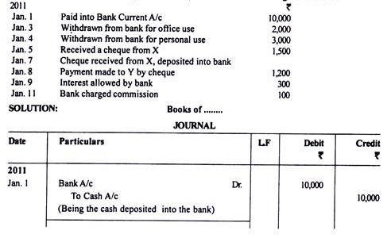

Slide 14
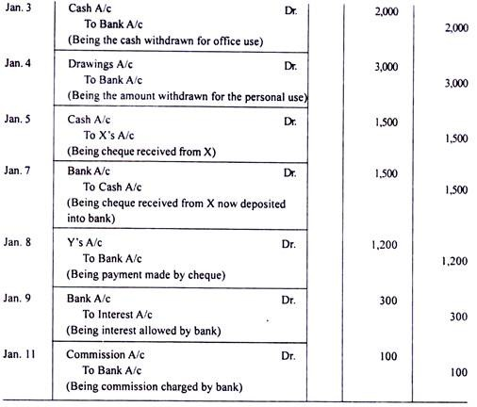

Slide 15
OTHER ENTRIES
BAD DEBTS- When the amount is irrecoverable:
Bad Debts A/c Dr.
To Customer personal A/c
When a part of the debt is recoverable:
Cash/Bank A/c Dr.
Bad Debts A/c Dr.
To Customer personal A/c
BAD DEBTS RECOVERED- When debtor pay some amount which had been earlier written off as Bad Debts then:
Cash/Bank A/c Dr.
To Bad Debts Recovered A/c
Cash withdrawn or goods taken by the owner for personal use then:
Drawings A/c Dr.
To Cash A/c
To Purchase A/c

