Slide 1
Microarray Data Analysis
Shilpa Kaistha
Department of Microbiology
Institute of Biosciences & Biotechnology
CSJM University, Kanpur

Slide 2
Microarrays can be used in many types of experiments including
Genotyping
epigenetics
translation profiling and
gene expression profiling

Slide 3
The process of analysing gene expression data is similar for microarray data and involves :
feature extraction;
quality control;
normalisation;
differential expression analysis;
biological interpretation of the results;
submission of data to a public database.

Slide 4
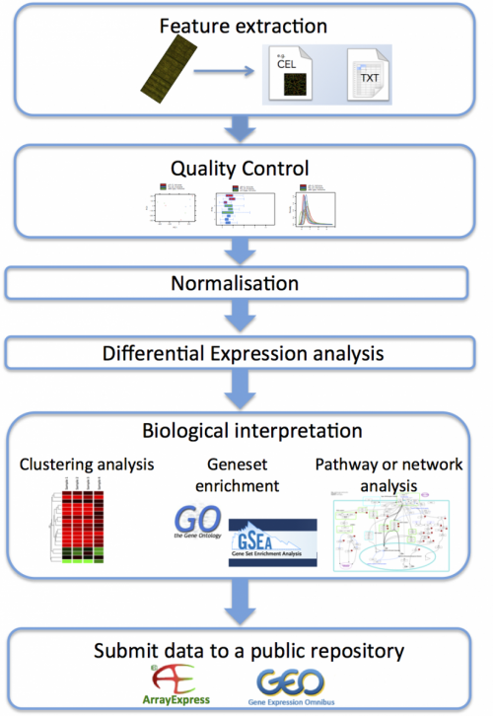

Slide 5
Feature Extraction
Feature extraction is the process of converting the scanned image of the microarray into quantifiable (computable) values and annotating it with the gene IDs, sample names and other useful information
Figure 5 Feature extraction involves the conversion of the scanned microarray image to quantifiable values that are saved in binary (e.g. CEL) or text format.
This process is often performed using the software provided by the microarray manufacturer. The output of this process is raw (i.e. unprocessed) data files that can be in binary or text format (Table 1).
After the feature extraction process, the data can be analysed. Array manufacturers often provide software to open and analyse their raw data files. Examples are the Galaxy platform, GenePattern, GeneSpring (licence required) and the statistics software R.
The functional genomics team at EMBL-EBI uses the R packages 'oligo' and 'limma' (5) to analyse Affymetrix and Agilent microarray data for the Expression Atlas.

Slide 6
Feature extraction
Manufacturer | Typical raw data format | How to open / Analysis software examples
Affymetrix | .CEL (binary) | R packages (affy, limma, oligo…)
Agilent | feature extraction file (tab-delimited text file per hybridisation) | Spreadsheet software (Excel, OpenOffice, etc.)
GenePix (scanner) | .gpr (tab-delimited text file per hybridisation) | Spreadsheet software (Excel, OpenOffice, etc.)
Illumina | .idat (binary) | R packages (e.g. illuminaio)
 | txt (tab-delimited text matrix for all samples) | Spreadsheet software (Excel, OpenOffice, etc.)
Nimblegen | NimbleScan, .pair (tab-delimited text matrix for all samples) | Spreadsheet software (Excel, OpenOffice, etc.)

Slide 7
Quality Control
Quality control of microarray data begins with the visual inspection of the scanned microarray images to make sure that there are no obvious splotches, scratches or blank areas.
After feature extraction, the data analysis software packages can be used to make diagnostic plots (for example of background signal, average intensity values and percentage of genes above background) to help identify problematic arrays, reporters or samples
Background correction or spot filtering
Multiple testing: 5 or more replicate statistics
Exchange control and test dyes (2 way data)

Slide 8
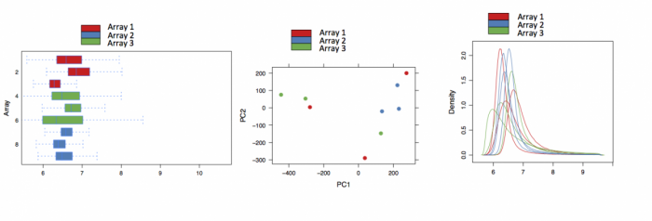
Examples of quality control plots made when analysing differential expression data in Expression Atlas. Left to right: Array intensity distributions, PCA plot, density plots represents.

Slide 9
Normalisation
Normalisation of microarray data is used to control for technical variation between assays, while preserving the biological variation . There are many ways to normalise the data, and the methods used depend on:
the type of array;
the design of the experiment;
assumptions made about the data (e.g. 'the majority of genes represented on the microarray are not expected to be differentially expressed in the test group relative to controls');
and the Normalisation package being used to analyse the data.
For Expression Atlas, Affymetrix microarray data is normalised using the 'Robust Multi-Array Average' (RMA) method within the 'oligo' package.
Agilent microarray data is normalised using the 'limma' package: 'quantile normalisation' for one-colour microarray data; 'Loess normalisation' for two colour microarray data.
The current Affymetrix MAS5 algorithm, which uses both perfect match and mismatch probes, continues to enjoy popularity and do well in head to head tests

Slide 10
Biological Interpretation of Microarray data
Fold change assessment (minimum 2 fold)plus a non-stringent p-value cutoff
Clustering: Data mining technique used to group genes having similar expression patterns. Widely used statistical alogorithmic techniques in microarray analysis.
Hierarchical clustering: clustering into homogenous groups. First Pair wise sequence alignment between genes followed hierarchical clustering algorithm either (A) joins iteratively the two closest clusters starting from single data points (agglomerative, bottom-up approach, which is fairly more commonly used), or (B) partitions clusters iteratively
Methods include Neighbour Joining, Maximum Parsimony, UPGMA (average linkage) Used in phylogenetic analysis
k-means clustering : based on a pattern into K groups ( eg. similar expression)… more popular for Microarrays

Slide 11
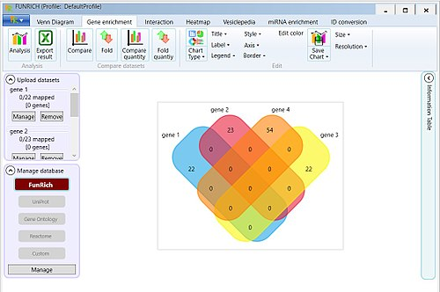
Pattern Recognition
visual representations of differentially expressed genes. Example of FunRich tool output. Image shows the result of comparing 4 different genes.

Slide 12
Pattern recognition
Non-commercial tools such as FunRich,^{[20]} GenMAPP and Moksiskaan also aid in organizing and visualizing gene network data procured from one or several microarray experiments. A wide variety of microarray analysis tools are available through Bioconductor written in the R programming language.
The frequently cited SAM module (Significance analysis of microarrays (SAM) 2001 Stanford University. Distributed as R package

Slide 13
Microarray analysis software
ArrayExplorer - Compare microarray side by side to find the one that best suits your research needs
FARMS - Factor Analysis for Robust Microarray Summarization, an R package —software
StatsArray - Online Microarray Analysis Services —software
ArrayMining.net - web-application for online analysis of microarray data —software
FunRich - Perform gene set enrichment analysis —software
Comparative Transcriptomics Analysis in Reference Module in Life Sciences
SAM
GeneChip® Expression Analysis-Data Analysis Fundamentals (by Affymetrix)

Slide 14
Submission of microarray data to databases
A microarray database is a repository containing microarray gene expression data. The key uses of a microarray database are to store the measurement data, manage a searchable index, and make the data available to other applications for analysis and interpretation (either directly, or via user downloads).
Once you have finished generating microarray data (e.g. raw data files and processed/normalised data files are ready), it is important that you submit the data files together with metadata to a public database such as ArrayExpress. This helps to ensure the reproducibility of your experiment and is now a requirement of many journals and funding bodies.

Slide 15
MIAME: Minimum information about a microarray experiment (MIAME) is a standard created by the FGED Society (Functional GEnomics Data Society ) for reporting microarray experiments.] It is intended to specify all the information necessary to interpret the results of the experiment unambiguously and to potentially reproduce the experiment.
The standard revolves around six key components; raw data, normalized data, sample annotations, experimental design, array annotations, and data protocols.

Slide 16
Two types of MdB
Peer reviewed, public repository that adheres to academic or industry standards and is designed to be used by many analysis applications and groups. A good example of this is the Gene Expression Omnibus (GEO) from NCBI or ArrayExpress from EBI.
A specialized repository associated primarily with the brand of a particular entity (lab, company, university, consortium, group), an application suite, a topic, or an analysis method, whether it is commercial, non-profit, or academic.

Slide 17
rrayExpress at EBI | Any curated MIAME or MINSEQE compliant transcriptomics data
ArrayTrack | ArrayTrack hosts both public and private data, including MAQC benchmark data, with integrated analysis tools
caArray at NCI | Cancer data, prepared for analysis on caBIG
Gene Expression Omnibus - NCBI | any curated MIAME compliant molecular abundance study
GeneNetwork system | Open access standard arrays, exons arrays, and RNA-seq data for genetic analysis (eQTL studies) with analysis suite
Genevestigator | Gene expression search engine based on manually curated, well annotated public and proprietary microarray and RNA-seq datasets
ImmGen database | Open access across all immune system cells; expression data, differential expression, coregulated clusters, regulation
MUSC database | The database is a repository for DNA microarray data generated by MUSC investigators as well as researchers in the global research community.
NCI mAdb | Hosts NCI data with integrated analysis and statistics tools
Stanford Microarray database | private and published microarray and molecule abundance database (now defunct)
The Cancer Genome Atlas (TCGA) | collection of expression data for different cancers
UNC Microarray database | provides the service for microarray data storage, retrieval, analysis, and visualization
UNC modENCODE Microarray database | Nimblegen customer 2.1 million array
UPenn RAD database | MIAME compliant public and private studies, associated with ArrayExpress
UPSC-BASE | data generated by microarray analysis within Umeå Plant Science Centre (UPSC).

Slide 18
Microarray databases

Slide 20
Limitations of microarrays
Hybridisation-based approaches are high throughput and relatively inexpensive, but have several limitations which include (6):
reliance upon existing knowledge about the genome sequence;
high background levels owing to cross-hybridisation;
limited dynamic range of detection owing to both background and saturation signals;
comparing expression levels across different experiments is often difficult and can require complicated normalisation methods.

Slide 21
https://discover.nci.nih.gov/microarrayAnalysis/Experimental.Design.jsp
https://www.ebi.ac.uk/training/online/course/functional-genomics-ii-common-technologies-and-data-analysis-methods/analysis-microarray-data
https://bitesizebio.com/webinars/
https://en.wikipedia.org/wiki/Microarray

