Slide 1
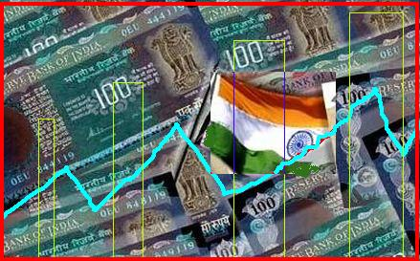
NATIONAL INCOME
M.B.E. ( 4th Sem.) Macro Economics

Slide 2
National Income
By
Dr.Sharad dixit
Assistant Professor
Dept. of Economics
C.S.J.M. University,Kanpur

Slide 3
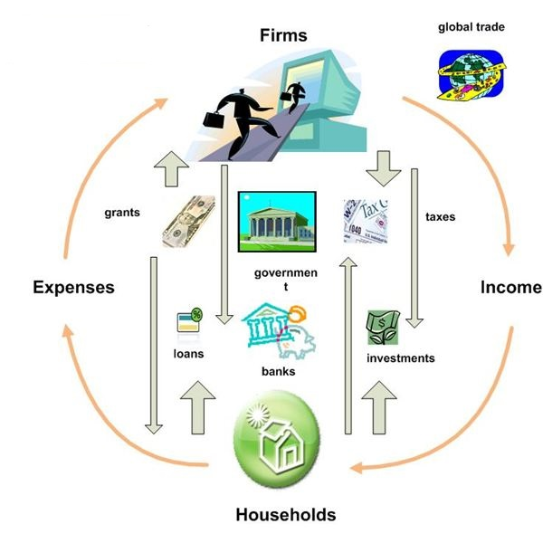
National Income
Outline of Presentation
Introduction
Meaning of National Income
Nature of National Income
Different Concepts of National Income
Methods of Measurement of National Income
Important Considerations in the Measurement of National Income
Problems in Estimation of National Income
Importance of National Income
Limitations of National Income
References

Slide 4
National Income
Introduction (Meaning and Definition)
The labour and capital of a country acting on its natural resources produce annually a certain net aggregate of commodities material and immaterial including services of all kinds- (Marshall)
A national income estimate measures the volume of commodities and services turned out during a given period counted without duplication- (National Income Committee of India, 1951)
National income is a collection of goods and services reduced to a common basis by being measured in terms of money (Hicks)
Is defined as the total market value of all the final goods and services produced in an economy in a given period of time. Thus it measures the monetary value of the flow of output of final goods and services produced in an economy over a period of time.
Notes:
Therefore, all the above definitions make it clear that national income is the monetary measure of- · The net value of all products and services · In an economy during a year · Counted without duplication · After allowing for depression · Both in the public and private sector of products and services · In consumption and capital goods sector · The net gains from international transactions.

Slide 5
National Income
Nature of National Income
Therefore, all the above definitions make it clear that national income is a monetary measure of:
The net or final value of all products and services
In an economy during a time period (usually a year)
Counted without duplication
Both in the public and private sector of products and services
In consumption and capital goods sector
The net gains from international transactions.

Slide 6
National Income
Nature of National Income .......
NI can be estimated at current or constant prices.
If NI is estimated on the basis of the prevailing prices it is called NI at current/Nominal price (i.e. not adjusted for inflation). If NI is measured on the basis of some fixed price, that is price prevailing at a point of time or in some base year it is known as NI at constant or real price (adjusted for inflation).
NI can also be estimated at factor cost or market prices
NI at factor cost is estimated as the sum of net value added by the different producing units and the consumption of fixed capital. The contribution of each producing unit to the current flow of goods and services is known as the net value added.
Conceptually, the value of NI whether estimated at market price or factor cost must be identical. This is because the final value of goods and services must be equal to the cost involved in their production. (NB: NI at market price less indirect taxes is equal to NI at factor cost)
Notes:
Intermediate goods: Goods or services purchased for use as input in the production of final goods or services
Value added: The increase in the market value of a product that takes place at each stage of the production process
What is Indirect Tax ?
Indirect taxes are the charges that are levied on goods and services. Some of the significant indirect taxes include Value Added Tax, Central Sales Tax, Central Excise Duty, Customs Duty, stamp duties and expenditure tax.
Unlike Direct Taxes, Indirect Taxes are not levied on individuals, but on goods and services. Customers indirectly pay this tax in the form of higher prices. For example, it can be said that while purchasing goods from a retail shop, the retail sales tax is actually paid by the customers. The retailer eventually passes this tax to the respective authority. The indirect tax, actually raises the price of a good and the customers purchase by paying more for that product.
Meaning of Indirect Taxes:
The term indirect tax can be defined from different views. In the colloquial sense, an indirect tax is the charge that is collected by intermediary (like retail store) from the individual who holds the actual economic burden of the tax ( like customer). The intermediary files a tax return and eventually passes to the government.
The indirect tax can be alternatively defined as the charge that is paid by one individual at the beginning, but the burden of which will be passed over to some other individual, who eventually holds the burden.
In colloquial sense, one example of indirect tax includes VAT (Value Added Tax).

Slide 7
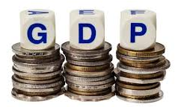
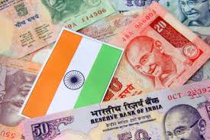
National Income
Concepts of National Income
There are various concepts of National Income. The main concepts of National Income are:
Gross Domestic Product (GDP),
Net Domestic Product (NDP)
Gross National Product (GNP),
Net National Product (NNP),
Personal Income (PI),
Disposable Income (DI), and
Per Capita Income (PCI).
These different concepts explain the phenomenon of economic activities of the various sectors of the economy.

Slide 8
National Income
Concepts of National Income….
Gross Domestic Product (GDP)
Gross domestic product is the money value of all final goods and services produced by the factors of production within the domestic territory / borders of a country during an accounting year .
GDP is geographically focused, It includes only output produced within a nation’s borders regardless of whose factors are used. Thus factors of production (labour, capital, land, management, entrepreneurship*) may be owned by any one (citizens or foreigners).
Net Domestic Product (NDP)
While calculating GDP no provision is made for depreciation allowance (also called capital consumption allowance). In such a situation GDP will not reveal complete flow of goods and services through various sectors.
When depreciation allowance is subtracted from NDP we get Net Domestic Product.
Notes:
Domestic territory Means
a. Territory lying within the political frontiers, including territorial waters of the country.
b. Ships and aircrafts operated by the residents of the country between two or more countries.
c. Fishing vessels, oil and natural gas rigs, and floating platform operated by the residents of the country in the international waters or engaged in extraction in areas in which the country has exclusive rights of exploitation.
d. Embassies, consulates and military establishment of the country located abroad.
Depreciation means the wear and tear of the machinery and other fixed capital during the process of production. (which is a loss to the economy)
Depreciation: The consumption of capital in the production process; the wearing out of plant and equipment
Depreciation represents the values of fixed capital consumed during the process of production.
Depreciation: what is required to maintain the value of its capital stock.
The word Gross has significance. We do not deduct the depreciation or replacement of the fixed assets. In the process of production there is wear and tear of fixed assets.

Slide 9
National Income
Concepts of National Income….
Gross National Product (GNP)
GNP refers to all final goods and services produced by the nationals/citizens of a country regardless of where they produce it. Thus Output produced by a nation’s factors of production no matter where it takes place.
GNP includes the economic activities of all the citizens of a nation whether operating within the country or outside it.
GNP is estimated by summing GDP and Net Factor Income from Abroad(NFIA).
NFIA is the aggregate income that a country’s citizens and companies earn abroad, less the aggregate income that foreign citizens and overseas companies earn in that country. It is also known as Net foreign factor income (NFFI)
Notes:
Net foreign factor income (NFFI) is the difference between the aggregate amount that a country’s citizens and companies earn abroad, and the aggregate amount that foreign citizens and overseas companies earn in that country. In mathematical terms, NFFI = GNP - GDP.
Net Foreign Factor Income (NFFI)'
Note that GDP refers to all economic output that occurs domestically or within a nation’s boundaries, regardless of whether production is owned by a local company or foreign entity. GNP, on the other hand, measures output from the citizens and companies of a particular nation, regardless of whether they are located within its boundaries or overseas. For example, if a Japanese company has a production facility in the U.S., its output will count toward U.S. GDP, but Japan’s GNP. While GDP is the most widely accepted measure of economic output, having supplanted GNP around 1990, it is criticized by some economists for providing a somewhat misleading picture of an economy's true health and the well-being of its citizens. This is because GDP does not take into account the profits earned in a nation by overseas companies that are remitted back to foreign investors. If these remitted profits are very large compared with earnings from the nation’s overseas citizens and assets, the NFFI figure will be negative, and GNP will be significantly below GDP. NFFI may assume increasing importance in a globalized economy, as people and companies move across international borders more easily than they did in the past.
Income from outside can be earned mainly in two ways, namely (1) income from work and (2) income from property and enterpreneurship. NfIa=factor income earned from abroad by residents - factor income of non residents in domestic territory components of net factor income from abroad: (1)net compensation of employees (2)net income from property and enterpreneurship (rent, interest, profit) (3)net retained earning of resident companies abroad The NFFI level is generally not substantial in most nations, since factor payments earned by their citizens and those paid to foreigners more or less offset each other. However, the NFFI's impact may be significant in smaller nations with substantial foreign investment in relation to their economy and few assets overseas, since their GDP will be quite high compared to GNP.

Slide 10
National Income
Concepts of National Income….
Net National Product (NNP)
NNP is the market value of all final goods and services after allowing for depreciation and/or replacement). It is also called National Income at market price. When charges for depreciation are deducted from the GNP, NNP is obtained. Thus,
It can also be found out by adding the net factor income from abroad to the net domestic product.
If NFIA is positive then NNP will be more than NDP, If the NFIA is negative then NNP will be less than NDP. However, if NFIA is zero NNP and NDP would be equal.

Slide 11
National Income
Concepts of National Income….
National Income (NI*)
National Income is also known as National Income at factor cost.
National income at factor cost means the sum of all incomes earned by resources suppliers for their contribution of land, labor, capital, and organizational ability which go into the years net production.
Hence, the sum of the income received by factors of production in the form of rent, wages, interest and profit is called National Income.
Mathematically:

Slide 12
National Income
Concepts of National Income….
Personal Income (PI) [Before-Tax Income]…...
PI is the total income which is actually received by individuals or households in a country during the year from all sources (such as salaries, wages, and bonuses received from employment or self-employment; dividends and distributions received from investments; rental receipts from real estate investments; profit-sharing from a business, transfer payment and etc.) before direct taxes.
It is the sum of all the incomes actually received by all the individuals or households of a country from all possible sources during a given period before direct taxes. PI is generally computed on a pre-tax basis. Therefore, personal income can be expressed as follows:
Y_{re} =Net income received but not earned (e.g., interest on gov. debt, transfer payments)
Y_{er}=Net income earned but not received (e.g., retained corporate earnings, corporate income tax, social security contributions )
Personal income is not a measure of production.
Notes:
Corporate income taxes and payment towards social security measured will not be available for individuals, so these have to be deducted from what is earned. Payments such as old age pensions, widow pensions, etc. that accrue to people have to be added.
Personal Income (PI) = National Income + Net income received but not earned (e.g., interest on gov’t debt, transfer payments like social security)- net income earned but not received (e.g., retained corporate earnings, Corporate income taxes and payment towards social security).

Slide 13
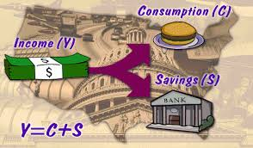
National Income
Concepts of National Income….
Disposable Personal Income (DPI)
The whole of personal income is not available for consumption as personal direct taxes have to be paid. Income left after payment of personal direct taxes (including property taxes, insurance payments) from personal income is call disposable personal income.
The disposable personal income may be spent fully or save. Thus, it is not the entire DPI spent on consumption. A part of it may be saved Therefore disposable income is equal to consumption and savings.
What remains after saving is called the personal outlay, which represents the community’s demand for goods and services.
Notes:
Outlay: The act of spending or disbursing money

Slide 14
National Income
Concepts of National Income….
Per Capita Income (PCI)
Per Capita Income (PCI)
Per Capita Income of a country is derived by dividing the national income of the country by the total population of a country. Thus

Slide 15
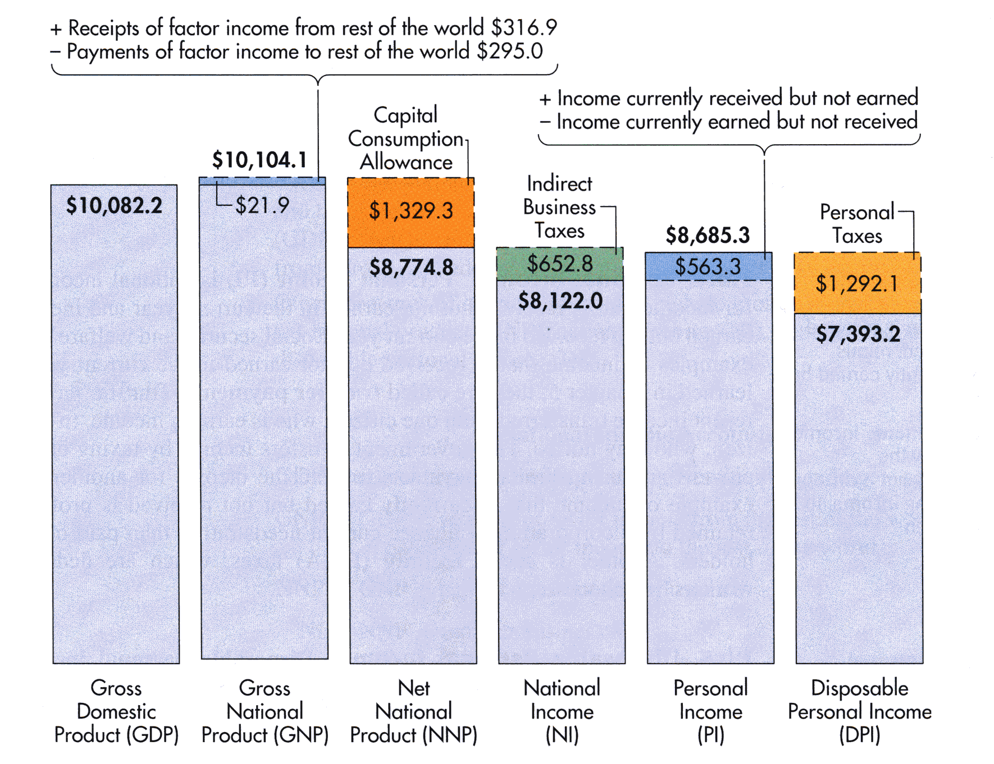
National Income
Concepts of National Income (Summary)….
Notes:
Indirect business taxes include: corporate income taxes, social security contributions, undistributed corporate profits

Slide 16
National Income
Methods of Measurement of National Income
Instead of looking at who’s buying the output (the demand side), we can look at who’s being paid to produce it (the supply side) and monetary value that exist in between sides
The total value of market incomes must equal the total value of final output, as well as the expenditure made in acquiring the output
Income (Y) = Expenditure(E) = Output (O)
Why is output equal to expenditure? Firms purchase their unsold output
There are three common approaches to the measurement of national income:
Product/Output Method ( sometimes it employs the value added method)
Income Method
Spending / Expenditure
Value added Method
Mixed Method
Notes:
Why output = expenditure
Unsold output goes into inventory, and is counted as “inventory investment”…
….whether the inventory buildup was intentional or not.
In effect, we are assuming that firms purchase their unsold output.

Slide 17
National income
Methods of Measurement of National Income….
Output/Product/Production Approach
This approach is also called the output method/ the inventory method/Goods Flow Method/the census method.
The method measures NI by considering the total sum of the market value of all final goods and services produced in the production units in an economy in a given period.
The product approach, classifies the economy into major sectors which includes:
Industrial sector: e.g.: Agriculture Industry, Mining, Manufacturing, Processing ,
Services / Direct sector : In this sector the value of services of such professions like doctors, dramatics, soldiers, politicians, etc., are taken by equating to their services.
International transaction sector: in this sector, the value of goods exported and imported, payment from abroad, are accounted

Slide 18
National income
Methods of Measurement of National Income….
Output/Product/Production Approach ........
The production approach looks at NI from the standpoint of value added by each input in the production process (in order to avoid double counting).
The product approach gives a comparative idea of the importance of the various activities in the economy like agriculture, manufacturing, trade, etc.
The approach is popular and successful in developed economies (especially in U.S.A) as it is very easy to get data from government records. However in under developed countries this method may give rise to various problems like imputation of money values to non- monetized sector.
Mathematically the Product Approach is
Where S= market value of output in sector
Q= Quantity of output in the sector
P= Market price of output in the sector
i= different sectors in the economy i.e. 1,2,3,...n
n= total number of sectors in the economy

Slide 19
National income
Methods of Measurement of National Income….
Income Approach
A method of computing NI that measures the income (wages [W], rents[R], interest[I], and profits[P]) earned by all factors of production in producing final goods and services in a given period.
Profit can be Owners Income and Corporate profits (Corporate income tax, Dividends, Retained earnings)
A summation all the factor incomes over a period of time is known as NI (e.g. GDP) at factor cost.

Slide 20
National income
Methods of Measurement of National Income….
Expenditure Approach (Flow of Product[Samuelson] / Outlay Approach)
A method of computing NI that measures the amount spent on all final goods and services during a given period.
The Expenditure in the Economy can be broadly divided into four types, such as,
Households (Consumption Expenditure) [C]
Business (Investment Expenditure) [I]
Government (Government Expenditure) [G]
Foreigners (Export (X) and Imports (IM) of Goods and Services)-Trade Balance: [X-IM]
A summation of all the expenditures over a period of time is known as NI (e.g. GDP in an open economy).
Notes:
Outlay: The act of spending or disbursing money

Slide 21
National income
Methods of Measurement of National Income….
Expenditure Approach (Flow of Product[Samuelson] / Outlay Approach)
For a close economy, Net Export/ Trade balance (TB) is equal to zero, thus there is no international participation. EX = IM
Notes:
Outlay:The act of spending or disbursing money

Slide 22
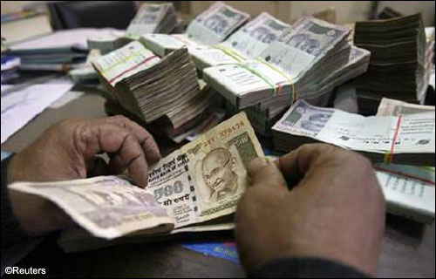
National income
Methods of Measurement of National Income….
Some Limitations of Methods of Measurement of NI
Income approach only ascertains income (wages, rents, interest, and profits) made by factors of production. However, depreciation is not initially factored into the equation, leading to some degree of estimation error.
The expenditure approach measures the amount of money used in an economy to make purchases or expenses of goods and services; however things such as charity work do not not show up, and can therefore skew the figures.
Finally, the product approach is used to measure the amount of product produced by an economy, but is vulnerable to miscalculation due to service industries or industries that do not create an actual, physical product.
Notes:
Outlay:The act of spending or disbursing money

Slide 23
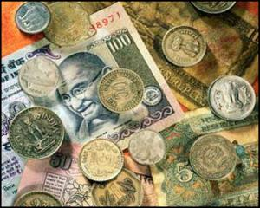
National Income
Problems of Estimation of National Income
Conceptual difficulties
Overlapping of occupations
Difficulty in value estimation
Non- monetized sector
Problems in Industrial sector
Foreign Firm income.
Inefficient data collection
Illiteracy of masses
Second hand sale
Unaccounted Environmental cost
Incomplete government records
Problems in agricultural sector
Inadequate statistical required information.
Double counting and Transfer payment problems
Unpaid services (Household and Social Services)
Uncaptured Market (Black Money market)
Non-applicability of a uniform formula
Increase in the service sector
Notes:
The measurement of national income is beset with difficulties. In under developed countries these difficulties are more prominent. The difficulties in calculation of national income can be discussed as follows:
Unpaid services (Household and Social Services: Housewife, sewing, house painting, Volunteering, etc..)
Inefficient data collection :-Untrained people of work of data collection.
· Conceptual difficulties: there has been a difference of opinion regarding the term ‘nation’ in the concept of national income. It has to define exactly, whether it is geographical entity of the country or the nationals including those residing abroad. Since national income constitutes a quantitative measure of economics activity rather than verbal description. Since everything has to be equated to the money value, services produced in economy for love of humanity, affection and philosophy could not be taken into consideration in calculating national income. · Overlapping of occupations: in backward economies there is an overlapping of occupation in rural sector which makes it difficult to know the income by origin. A worker in a peak season works in a farm, drives a country cart in off season. Takes up unskilled work, etc. similarly, the village money lender combines his profession with the cultivating of his farm. · Difficulty in value estimation: in backward areas, the cultivators, artisans and cottage industry workers do not have a fair idea of the expenses of their occupation. Hence the net value of their products cannot be estimated precisely. · Non- monetized sector: barter dealing and non-monetized sector creates the problem of inputting the value of their produce and services and by guess work and approximation. · Incomplete government records: due to ignorance and illiteracy in backward areas, the data may not be available and if available, may be unreliable. Also, the figures furnished by government officials may not be from reliable sources and data is not current. · Problems in agricultural sector: in agricultural activities there is a good deal of guess work in data relating to cropwise production and in figures relating to animals and forest products. · Problems in industrial sector: data relating to output, cost, etc. are available only in big units. The small units do not maintain these figures correctly. The village money lenders and indigenous bankers maintain absolute secret of their and they do not furnish correct information. · Non-applicability of a uniform formula: in a big country where wide disparities and regional differences, a uniform formula cannot be applied. The data of one region cannot be applied to another region with minor modification. Every region would be a separate entity requiring specialized approach suited only to that region. · Double-counting: the error of double-counting is another obstacle to be avoided in the calculation of national income. · Inefficient data collection: the machinery for collecting statistical data may not be efficient. The investigators, preparation of adhoc figures, making sample surveys, etc.

Slide 24
National Income
Important Considerations in the Measurement of National Income
NI (GNP) is not limited to the territorial boundaries of a country. It includes income of all the residents of a country even if they are abroad (Simon Kuznets).
Income earned through illegal activities is not included in national income
Services rendered free of charge are not included in NI. By leaving out these service, national income will work out to be less
Transfer payments are not included in NI as they do not contribute to national product.
Capital gains and losses are not included in NI (NDP/NNI) as they are not the result of current economic activities
In the calculation of NI leisure foregone in the process of production is not included.
NI ignores all transactions in which money or goods change hands since no new goods and services are produced in the process.

Slide 25
National Income
Importance of National Income
National income helps governments in planning, policy making, preparation of budgets and forecasting the level of economic activity
Helps to check the level of production of a country from time to time.
Explain the immediate causes of level of production.
Share the long run course which the economy is following
Provides basis of formulating and application of public and economic policies to improve the performance of economy
Indicator of Economic Growth
Indicator of Economic Welfare
Ease in Planning
Making Inter- sectoral comparisons
Formation of Budget
Making international comparisons
Contribution to international institutions
Notes:
Importance of National Income Computation in Modern Economic Analysis
The computation of national income is one of the very important statistics for a country. IT has several important uses and therefore there is a great need for there regular preparation. The following are some of the important uses of national income statistics:
Level of Economic Welfare
The national income estimate reveals the overall performance of the country during a given financial year. With the help of this statistics the per capita income i.e. the income earned by every individual is calculated. It is obtained by dividing the total national income by the total population. With this we come to the level of economic welfare in terms of its standard of living.
Rate of Economic Growth
With the help of national income statistics we can know whether the economy is growing or declining. In simple words it helps us to know the conditions of a country economy. If the national income is growing over a period of year it means that the economy is growing and if the national income has reduced as compares to the previous it reveals that the economy is detraining. Similarly the growing per capita income shows an increasing standard o living of the people which is a positive sign of a nations growth and vice versa.
Distribution of Wealth
One of the most important objectives that is achieved after calculating national income is to check its distribution among different categories of income such as wages, profits, rents and interest. It helps to understand that how well the income is distributed among the various factors of the economy and their distribution among the people as well.
Ease in Planning
Since the national income estimates also contain the figures of saving, consumption and investment in the economy so it proves to be a valuable guide to economic policy relating to planning and active government intervention in the economy. The estimates are used as a data for future planning also.
Formation of Budget
Budget is an effective tool for planning and control. It is prepared in the light of the information regarding consumption, saving, and investment which are all provided by the national income estimates. Further we can asses and evaluate the achievements or otherwise of the development targets laid down in the plans from the changes in national income and its various components.
Formulation of economic policies: national income statistics are valuable instruments of economic analysis and a guide to economic policies to be pursued. It is more useful in context of planning and formulation of realistic plans. Studying economic structure: it gives an idea of the structure of the economy. It helps to make inter- sectoral comparisons and to study the rate of growth of the economy. The growth of national income is an index of the growth of the productive capacity of an economy. Inter- sectoral comparisons: it helps to study inter-sectoral growth. Such comparisons are useful. Share of various sectors can be studied to find out structural defects and weaknesses of the economy. Indicator of economic welfare: it enables us to study per capita income or per capita consumption which are general indicators of economic growth. But it is not helpful in revealing distribution of income in the society. Making international comparisons: national income estimates enables us to make international comparisons and standard of living of people. Contribution to international institutions: it shows the capacity of a country to bear some common burden of international institutions like the U.N.O.

Slide 26
National Income
Limitations of National Income
Wealth distribution - NI does not take disparity in incomes between the rich and poor into account.
Non-market transactions - GDP excludes activities that are not provided through the market, such as household production and volunteer or unpaid services. As a result, NI is understated.
Underground economy - NI estimates may not take into account the underground economy, in which transactions contributing to production, such as illegal trade and tax-avoiding activities, are unreported, causing GDP to be underestimated.
Non-monetary economy - NI omits economies where no money comes into play at all, resulting in inaccurate or abnormally low NI figures.
Sustainability of growth - NI does not measure the sustainability of growth. A country may achieve a temporarily NI by over-exploiting natural resources or by misallocating investment
Notes:
Importance of National Income Computation in Modern Economic Analysis
The computation of national income is one of the very important statistics for a country. IT has several important uses and therefore there is a great need for there regular preparation. The following are some of the important uses of national income statistics:
Level of Economic Welfare
The national income estimate reveals the overall performance of the country during a given financial year. With the help of this statistics the per capita income i.e. the income earned by every individual is calculated. It is obtained by dividing the total national income by the total population. With this we come to the level of economic welfare in terms of its standard of living.
Rate of Economic Growth
With the help of national income statistics we can know whether the economy is growing or declining. In simple words it helps us to know the conditions of a country economy. If the national income is growing over a period of year it means that the economy is growing and if the national income has reduced as compares to the previous it reveals that the economy is detraining. Similarly the growing per capita income shows an increasing standard o living of the people which is a positive sign of a nations growth and vice versa.
Distribution of Wealth
One of the most important objectives that is achieved after calculating national income is to check its distribution among different categories of income such as wages, profits, rents and interest. It helps to understand that how well the income is distributed among the various factors of the economy and their distribution among the people as well.
Ease in Planning
Since the national income estimates also contain the figures of saving, consumption and investment in the economy so it proves to be a valuable guide to economic policy relating to planning and active government intervention in the economy. The estimates are used as a data for future planning also.
Formation of Budget
Budget is an effective tool for planning and control. It is prepared in the light of the information regarding consumption, saving, and investment which are all provided by the national income estimates. Further we can asses and evaluate the achievements or otherwise of the development targets laid down in the plans from the changes in national income and its various components.
Formulation of economic policies: national income statistics are valuable instruments of economic analysis and a guide to economic policies to be pursued. It is more useful in context of planning and formulation of realistic plans. Studying economic structure: it gives an idea of the structure of the economy. It helps to make inter- sectoral comparisons and to study the rate of growth of the economy. The growth of national income is an index of the growth of the productive capacity of an economy. Inter- sectoral comparisons: it helps to study inter-sectoral growth. Such comparisons are useful. Share of various sectors can be studied to find out structural defects and weaknesses of the economy. Indicator of economic welfare: it enables us to study per capita income or per capita consumption which are general indicators of economic growth. But it is not helpful in revealing distribution of income in the society. Making international comparisons: national income estimates enables us to make international comparisons and standard of living of people. Contribution to international institutions: it shows the capacity of a country to bear some common burden of international institutions like the U.N.O.

Slide 27
National Income
References
http://seminarprojects.com/Thread-national-income#ixzz3ApSuIiX0
Central Intelligence Agency (CIA)
https://www.cia.gov/library/publications/the-world-factbook/geos/in.html
Wikipedia: http://en.wikipedia.org/wiki/Gross_domestic_product
India In Business: http://www.indiainbusiness.nic.in

Slide 28
THANK YOU FOR YOUR ATTENTION

