Slide 1
The Nervous System
Millions of interconnected neurons form the nervous system
Human nervous system two major parts: central nervous system and peripheral nervous system

Slide 2
Nervous System Organization
Central Nervous System
Brain
Spinal cord

Slide 3
Nervous System Organization
All neurons outside the CNS
31 pairs spinal nerves
12 pairs of cranial nerves
Peripheral Nervous System

Slide 4
The Brain - 3 Major Areas
Cerebrum (telencephalon, diencephalon,)
Cerebellum
Brainstem (midbrain, pons, medulla oblongata)

Slide 5
Cerebrum
Composed of Telencephalon (Cerebral Cortex) and Diencephalon
Cerebral Cortex is gray matter because nerve fibers lack white myelin coating

Slide 6
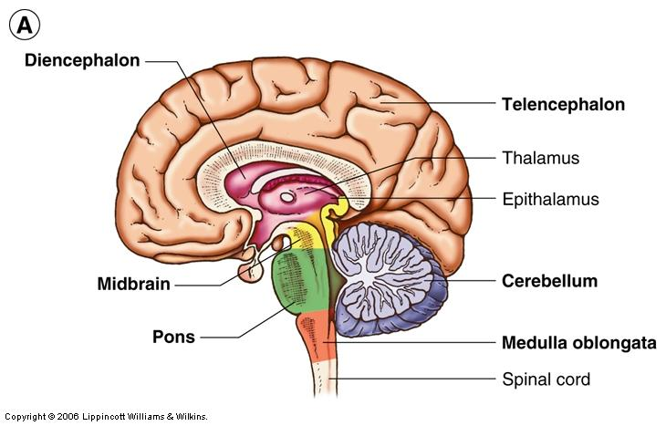

Slide 7
Cerebral Cortex - 4 Major Lobes
Parietal
Frontal
Temporal
Occipital

Slide 8
Functions of the Cerebral Cortex
Intellectual processes: thought, intelligence.
Processes sensory information and integrates with past experience to produce appropriate motor response.

Slide 9
Diencephalon - 2 Major Parts
Thalamus
Relays stimuli received from all sensory neurons to cortex for interpretation
Relays signals from the cerebral cortex to the proper area for further processing
Hypothalamus
Monitors many parameters
temperature, blood glucose levels, various hormone levels
Helps maintain homeostasis
Signals the pituitary via releasing factors
Signals the lower neural centers

Slide 10
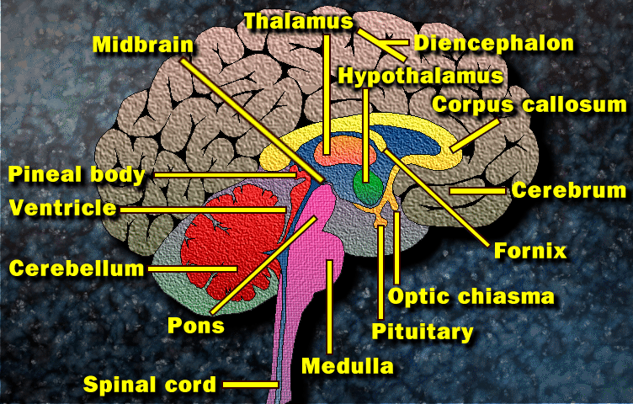
Diencephalon

Slide 11
Cerebellum
Located behind the brainstem
Helps monitor and regulate movement
Integrates postural adjustments, maintenance of equilibrium, perception of speed, and other reflexes related to fine tuning of movement.

Slide 12
Brainstem
Composed of midbrain, pons, and medulla oblongata
Maintains vegetative functioning
Where is respiratory control center?
Where is cardiovascular control center?
Reflexes

Slide 13
Brain Stem

Slide 14
Spinal Cord
Contains both gray and white matter
Gray matter is H-shape in core of cord

Slide 16
Gray Matter
Regions of brain and spinal cord made up primarily of cell bodies and dendrites of nerve cells
Interneurons in spinal cord
small nerves which do not leave the spinal cord
Terminal portion of axons

Slide 17
White Matter
Contains tracts or pathways made up of bundles of myelinated nerves
Carry ascending and descending signals
Ascending nerve tract from sensory receptors through dorsal root, up cord to thalamus, to cerebral cortex
Pyramidal tract transmits impulses downward eventually excites motoneurons control muscles.
Extrapyramidal originate in brain stem descend to control posture.

Slide 18
Descending Nerve Tracts
Ascending: dorsal
Descending: lateral, ventro-medial tracts
Notes:
Meninges: three membranes that cover the brain and spinal cord (sing. Meninx)

Slide 19
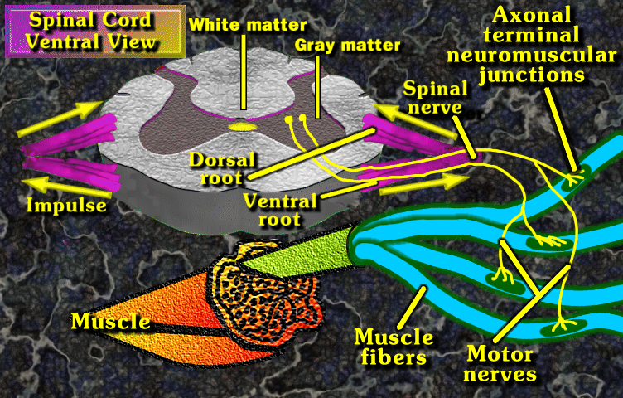

Slide 20
Peripheral Nervous System
Thirty-one pairs of spinal nerves & 12 pairs of cranial nerves.
Each spinal nerve is a mixed nerve containing:
Somatic afferent
Visceral afferent
Somatic efferent
Visceral efferent
Which is a motor fiber?

Slide 21
Somatic Nervous System
Somatic afferent (sensory): carry sensations from periphery to spinal cord. Includes exteroceptive (pain, temperature, touch) & proprioceptive.
Somatic efferent (motor): communicate from spinal cord to skeletal muscles.

Slide 22
Autonomic Nervous System Subdivisions
Sympathetic
responsible for increasing activity in most systems (except GI)
adrenergic fibers release epinephrine
Parasympathetic
responsible for slowing activity in most systems (except GI)
cholinergic fibers release acetylcholine

Slide 23
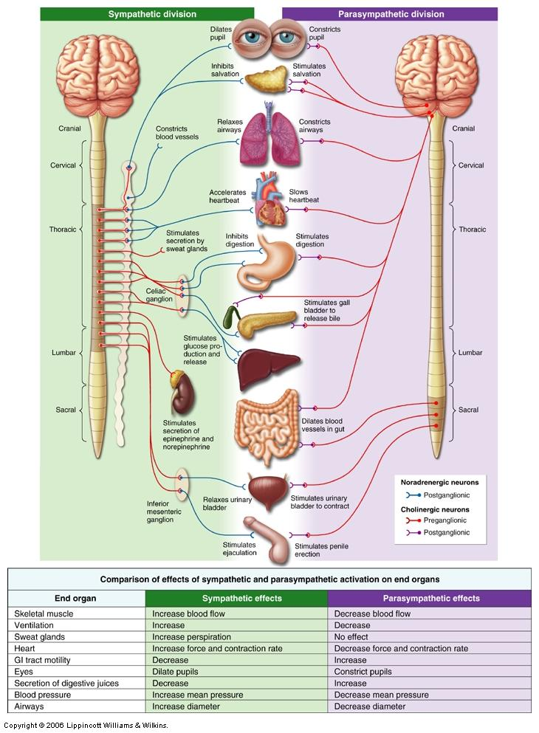

Slide 24
Autonomic Reflex
Monosynaptic reflex arc
Knee jerk response

Slide 25
Complex Reflexes
Involve multiple synapses
Crossed extensor reflex

Slide 26
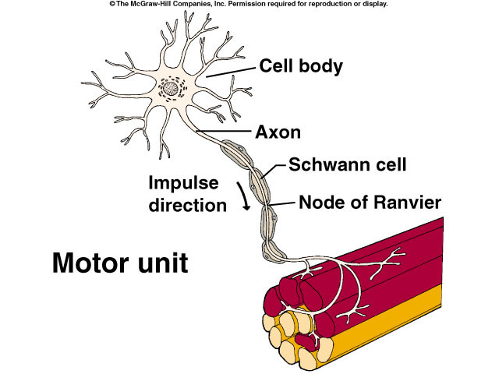
Motor Unit
A single motor neuron and all of the muscle fibers which it innervates. Represents functional unit of movement.
Ratio of muscle fibers to nerve relates to muscle’s movement function.

Slide 27
Neurons
Two basic types
Motor
Sensory
Three basic parts
Axons
Dendrites
Soma or Cell Bodies

Slide 28
Sensory Nerves
Enter the spinal cord on the dorsal side
Cell bodies lie outside the spinal cord in Dorsal Root Ganglia

Slide 29
Motor Nerves
Exit the spinal cord on the ventral side
Cell bodies lie within grey matter of spinal cord
Somatic
innervates skeletal muscle
Autonomic (visceral)
innervates organs / smooth muscle

Slide 30
Neuron Part: Axons
Carry impulses away from the cell body

Slide 31
Myelin
Schwann cells wrapped around the axon of some neurons
appear as multiple lipid-protein layers
are actually a continuous cell
increase the speed of action potential conduction

Slide 32
Nodes of Ranvier
Gaps between Schwann Cells
impulse jumps from node to node
saltatory conduction

Slide 34
Neuron Parts: Dendrites and Cell body
Dendrite: receives stimuli and carry it to the cell body
Cell body: site of cellular activity

Slide 35
Synapse
Junction between the dendrites of one neuron and the axon of a second neuron
Nerves communicate by releasing chemical messenger at synapse

Slide 36
Synapse
Important neurotransmitters:
Monoamines
Neuropeptides
Nitric oxide

Slide 37
Motor Nerves - Size
Alpha motor nerves
Larger fibers
Conduct impulses faster
Innervate regular muscle fibers
Gamma Motor nerves
smaller fibers
conduct impulses more slowly
Innervate proprioceptors such as muscle spindles

Slide 38
Nerve Properties Related to Function
Irritability
able to respond to stimuli
Conductivity
able to transmit electrical potential along the axon

Slide 39
Resting Membrane Potential
Difference in charge between the inside and outside of the cell
sodium in greater concentration outside
potassium in greater concentration inside
anions in greater concentration inside
membrane permeability greater for potassium than sodium
Na⁺ / K⁺ pump moves sodium out, potassium in

Slide 41
Generating Action Potentials
Voltage gated ion channels
sodium channels open --- sodium rushes in
sodium channels close --- stops inward flow of sodium
potassium channels open --- potassium rushes out
Net effect - Depolarization then Repolarization
electrical flow created by ionic flow, not electron flow

Slide 42
Na⁺ / K ⁺ Pump
Membrane bound proteins
Utilizes ATP
Maintains resting membrane potential
Establishes sodium & potassium concentration gradients

Slide 43
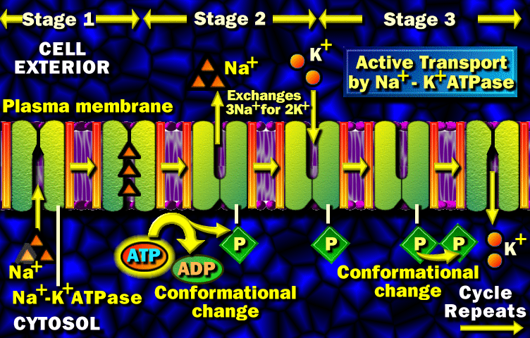

Slide 44
Neuromuscular Junction
Motor neuron cell body and dendrites in gray matter of spinal cord
Axons extend to muscle
Axon’s terminal end contains a synaptic knob
Synaptic knob has synaptic vesicles containing acetylcholine

Slide 45
Neuromuscular Junction
Axon leaves spinal cord.
Extends to skeletal muscle.
Terminal branches end in synaptic knob.

Slide 46
Motor End Plate
Area beneath the terminal branches of the axons
Contains acetylcholine receptor complexes
Acetylcholine binding opens the receptor complex
Cholinesterase degrades acetylcholine into acetate and choline

Slide 47
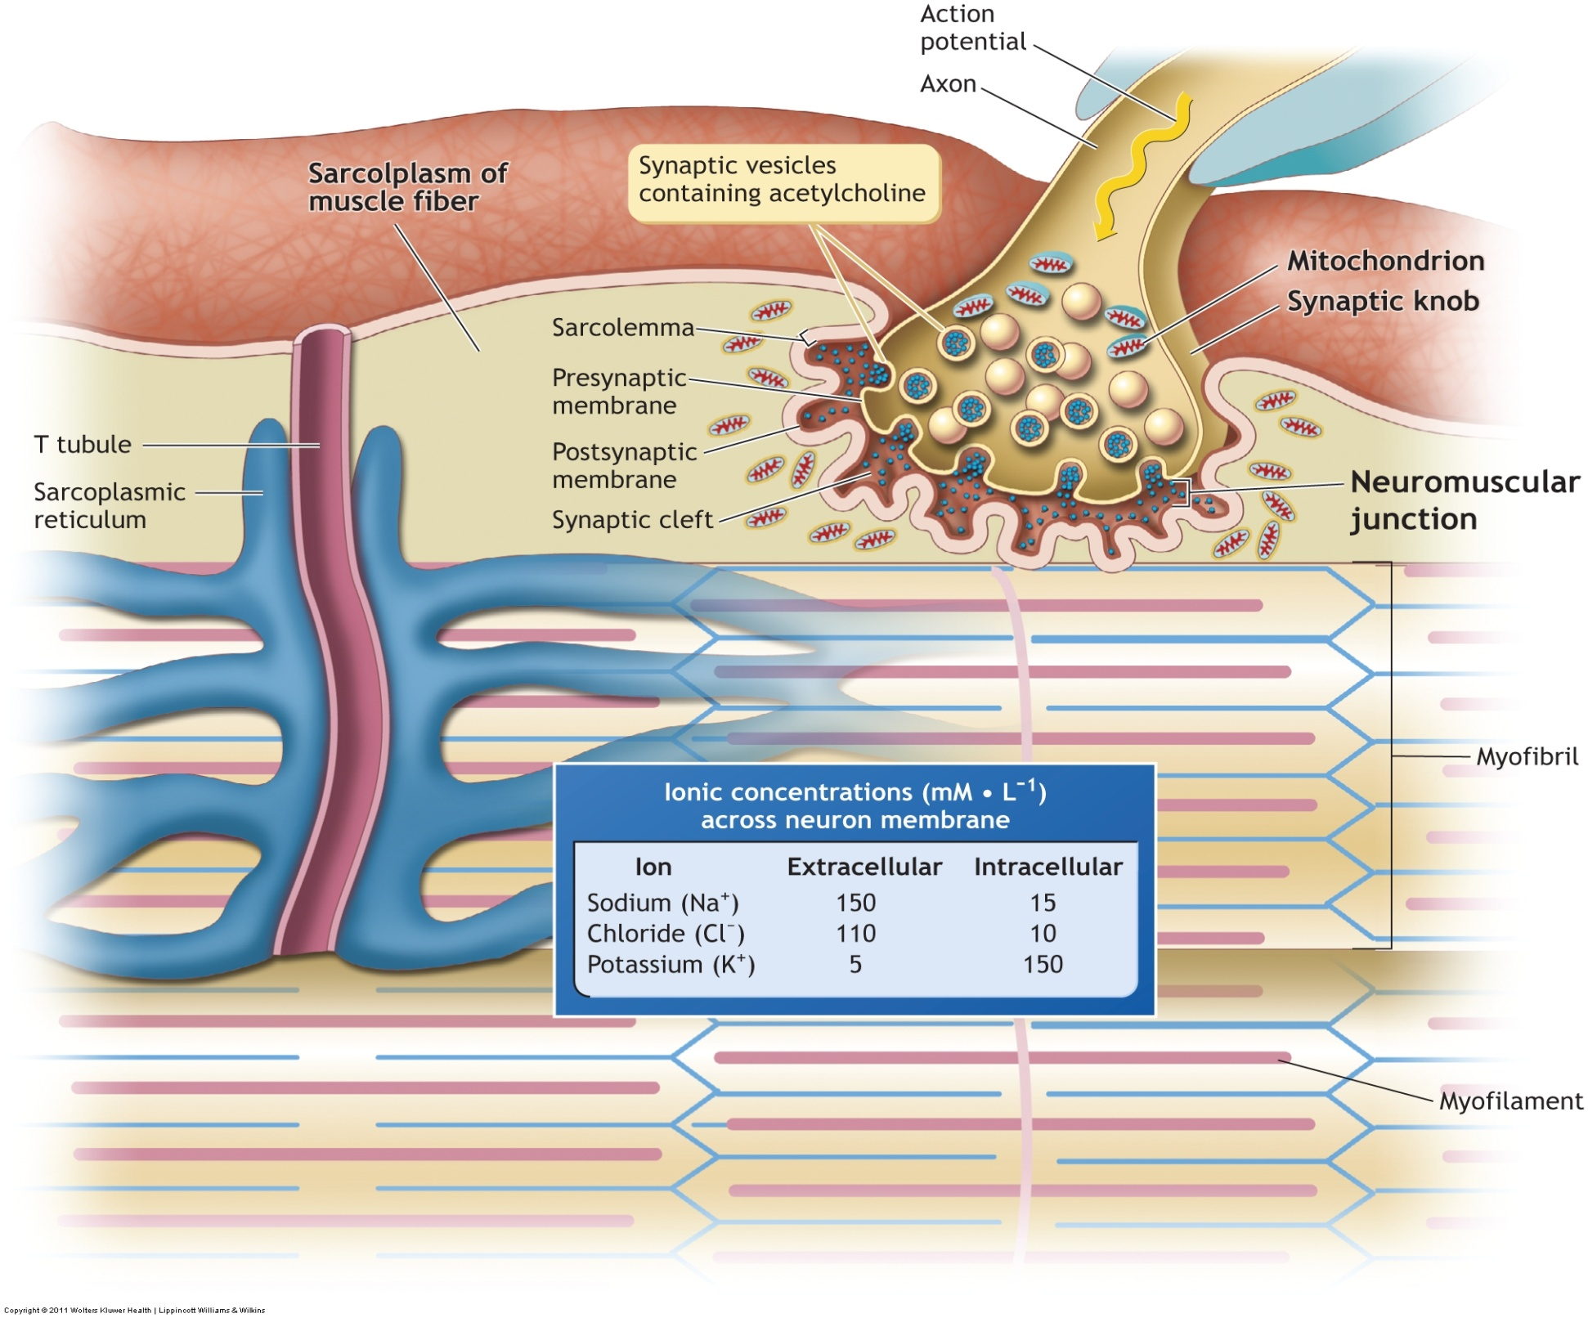

Slide 48
Tension Generating Characteristics
All or None Law
when a neuron reaches threshold it generates an action potential which is conducted the length of the axon without any voltage change
when the nerve fires, all the muscle fibers it innervates contract

Slide 49
Summation of Local Graded Potentials
Temporal Summation
additive effect of successive stimuli from an axon
Spatial Summation
additive effect of stimuli from various axons

Slide 50
Gradation of Force
Force of muscle varies from slight to maximal:
Increase number of motor units recruited
Increase frequency of motor unit discharge.

Slide 51
Proprioceptors
Muscle Spindles
Golgi Tendon Organs
Pacinian Corpuscles
Ruffini Endings

Slide 52
Muscle Spindles
Encapsulated fibers within the muscle belly
Monitor changes in muscle length
Monitor the rate of change in muscle length
Respond by causing muscle contraction

Slide 53
Golgi Tendon Organs
Encapsulated receptors
Located at the musculotendinous junction
Monitor tension within the tendon
Respond by causing the muscle to relax

Slide 54
Pacinian Corpuscles & Ruffini Endings
Encapsulated receptors
Located near joints, in muscle, tendon, and bone

