Slide 1
RELATIONAL ALGEBRA
Relational algebra is a procedural query language that consist of a set of operation that take one or two relations as input and result into a new relation as an output.
In other words, relational algebra is a collection of operations to manipulate relation.

Slide 2
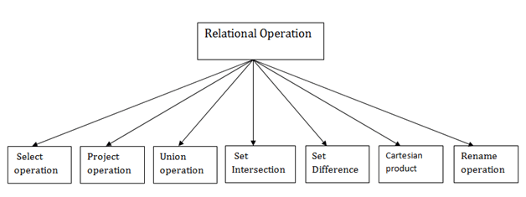
Relational algebra opertions:

Slide 3
Relational algebra is divided into two types of operations:
Unary operations: The operations operating on single relations are known as unary relation.
Select operation
Project operation
Rename operation
Binary operations: The operations operating on two or more than two relations are known as binary relation.
Union
Cartesian product
Set difference
Intersection
Join

Slide 4
Select operation
The select operation retrieves all tuples from a relation that satisfy a specific condition and also be considered as a filter that display only those tuples that satisfy a given condition.
The select operation can be viewed as a horizontal subset of a relation.
The Greek letter sigma (σ) used to denote select operation.

Slide 5
Project operation
The project operation is used to select some required attributes from a relation while discarding the other attributes.
It can be viewed as the vertical subset of a relation.
The Greek letter ‘π(pi)’ can be used as project operator.

Slide 6
Rename operation
When relational algebra operations are performed, the resultant relations are unnamed, hence cannot be used for later reference.
In addition, it might be required to apply more operations on the relations obtained from other relation. In such situations, rename operator proves to be useful.
The Greek letter “ (ρ)rho” is used as rename operator.
The rename operator is also known as assignment operator.

Slide 7
Union operation
The union of two sets combine all data i.e., appearing either one or both relation.
The set which results from the union must not contain duplicate elements.
It is denoted by ∪.

Slide 8
Intersection operation
The intersection of two sets which contain all elements that are common in both the sets.
It is denoted by intersection ∩.

Slide 9
Cartesian product
The Cartesian product of two relation is the concatenation of tuples belonging to the two relations. It is denoted by X.

