Slide 1
Role of Nutraceuticals in Ailments

Slide 2
Role of nutraceutical in Cancer:
Major health problem due to enhanced expectancy, change in life style and diet pattern. As per research 1/3rd of all cancer death can be prevented by change in life style including diet.
Cancer treatment in very expensive so nutraceutical having chemo preventive effects can be employed.
Chemopreventive means the substances which are used to prevent, suppress or reduce the process of carcinoginosis.

Slide 3
.
Nutraceuticals also helpful in reducing toxicity of drugs, chemotherapy, radiation and assist to live better life.
Research reported that use of carotene rich food, vit. E,C and many more comp. in food benefit to fight cancer. Several studies shows that phytoconstituents as curcumin (turmeric), capsacin, resveratol (garpes), gingerol, genistein 9soya bean) lycopene, emodin, anetole, quercetin have anticancer activity.

Slide 4
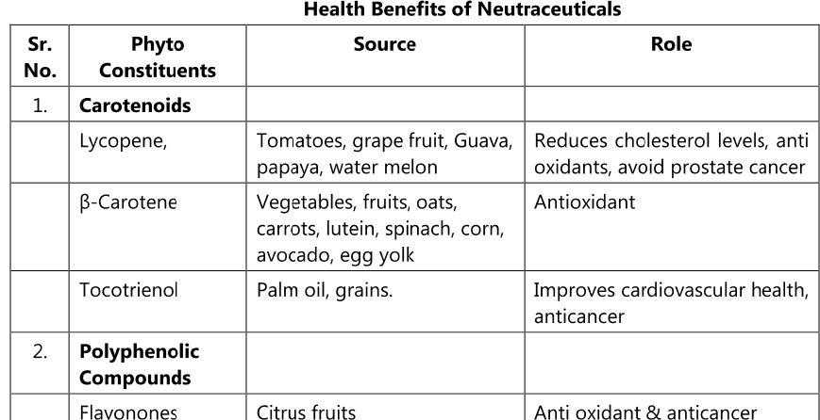

Slide 5
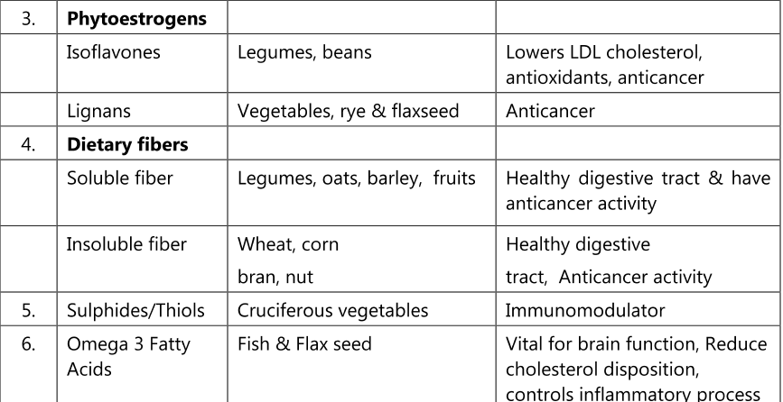

Slide 6
Mecahnism of action of nutraceutical against cancer
Act by different mechanism and may have overall synergy effect.
Nutraceuticals act as antioxidant and anti-inflammatory. They inhibit the signaling pathway related to redox mediated transcription factors.
Some nutraceuticals like ascorbic acid, tocopherol, phenols are inhibitors of carcinogen formation.
They protect against lipid peroxidation.
They suppress mutagenic activity of carcinogens, suppress cell proliferation and induce cancer cell apoptosis.

Slide 7
Phytochemical effective against cancer:
Polyphenoic compound: They act by inhibition of carcinogenesis process and supress progression of cancer. Eq.
Epigallocatechin: present in green tea, have antitumor properties.
Resveratrol: It is used in treatment of cancer because 9f its antiproliferative action. Present in grapes, Blueberries, peanuts.
Flavonoid: It can affect the mRNA level of genes important in cell cycle controll and apoptosis. Some favonoid like genistien modulate topoisomerase II activity. It has strong estrogen agonist activity and inhibit growth activity of breast cancer cells.
Curcumin: Chemopreventive in nature. It act as antineoplastic agent causing cell cycle arrest and induces apoptotic signals.

Slide 8
.
Vitamins and mineral: Vitamin A, C, E and trace elements like selenium can prevent cancer. Ascorbic acid is reported to induce apoptosis through cell cycle arrest. Appropriate dose of supplements like vit. C, E and zinc, calcium reduces the chance of thyroid, bladder and breast cancer.
capsacin: Use in treatment of ovarian carcinoma. It inhibit growth and induces apoptosis of cancer cells.
lycopene: It inhibit proliferation of cells, use in t/t of prostate , gastric and lung cancer.
Chestnut: Antioxidant in nature, used to treat gastric and mild prostate cancer.
Ginseng: Used to treat various cancer such as colon, liver, lung and breast being antioxidant in nature.

Slide 10
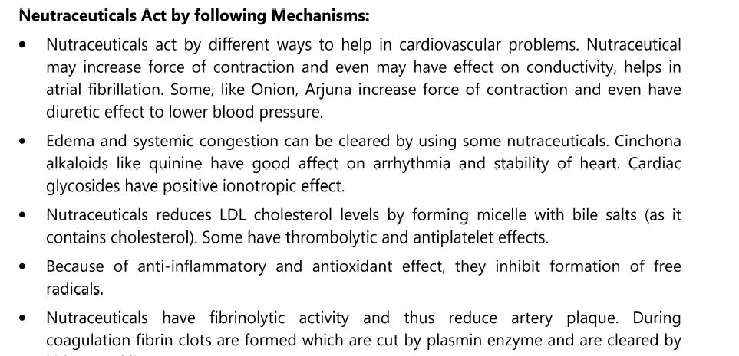

Slide 11
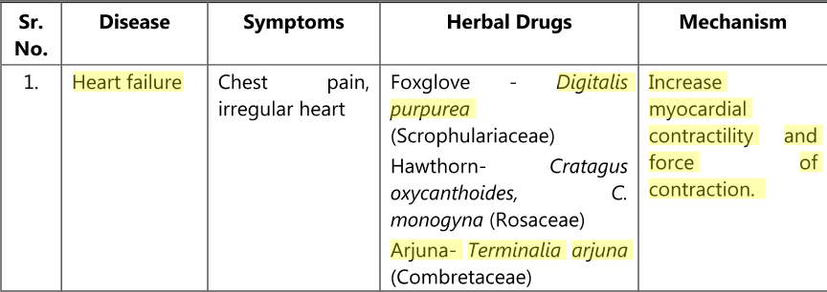
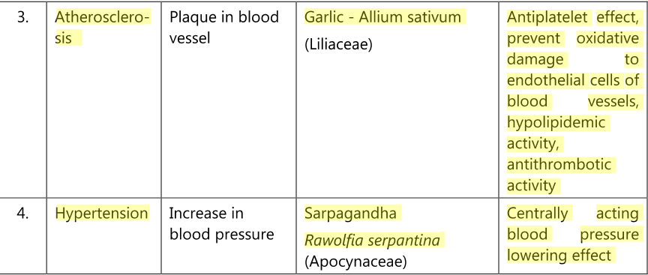

Slide 13
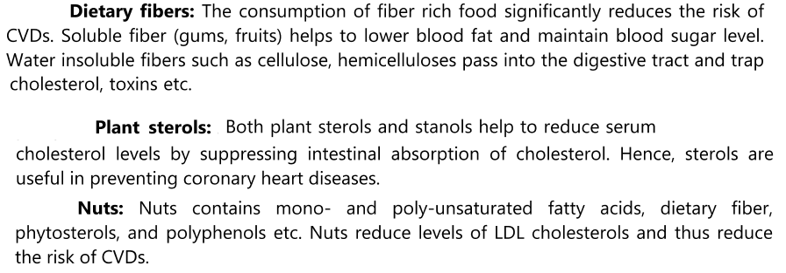

Slide 15
.
Phenols have been shown to reduce cholesterol levels and LDL oxidation. Polyphenolic cathechin which is present in Green tea (Camellia sinensis) reduces the CVD by enhancing antioxidant activity by improving endothelial dysfunction, preventing cardiac hypertrophy and protects mitochondria.
Oxyphyte is now a days available products of polyphenolic extracts of green tea, apple, pomegranate and red grape

Slide 16
.
Tocotrienols
Tocotrienols are members of a subgroup of the vitamin E family, which includes tocopherols. Both tocotrienols and tocopherols are antioxidants, but only tocotrienols have been shown to reduce cholesterol, inhibit certain cancers and manage diabetes.
The positive effects of tocotrienols on cholesterol levels result from their ability to down-regulate a liver enzyme involved in cholesterol synthesis i.e. 3- hydroxy-3methyl-glutaryl-CoA (HMG-CoA reductase). This down-regulation results in a suppression of the activity of the enzyme.
Sources: Annatto, Palm oil, cereal grain and rice bran.

Slide 17
Role of nutraceutical in Diabetes :
Diabetes is a metabolic syndrome where a person suffers from high blood glucose.
It is caused due to lack of insulin production or the body cells do not respond properly to insulin or both.
The most common forms of diabetes are type 1 diabetes (5%), an autoimmune disorder, and type 2 diabetes (95%).

Slide 18
.
Nutraceutical roles
Omega-3 fatty acids have been suggested to reduce glucose tolerance in patients predisposed to diabetes.
Lipoic acid is a universal antioxidant, now used in Germany for the treatment of diabetic neuropathy. It is possible that lipoic acid may be more effective as a long-term dietary supplement aimed at the prophylactic protection of diabetics from complications.
Dietary fibers from psyllium have been used extensively both as pharmacological supplements, food ingredients, in processed food to aid weight reduction, for glucose control in diabetic patients and to reduce lipid levels in hyperlipidemia.

Slide 19
.
α- Lipoic acid increases insulin sensitivity by approximately 18–20% in patients with type 2 diabetes mellitus.
Phytoestrogens are structurally similar to estradiol and mimic its effects.
In animal studies, soy and phytoestrogens are effective at reducing adipose tissue and improving glucose uptake.
Chromium supplements may increase insulin sensitivity and improve glucose tolerance in patients with type 2 diabetes mellitus

Slide 20
.
Good magnesium status reduces diabetes risk and improves insulin sensitivity; chromium picolinate, calcium and vitamin D appear to promote insulin sensitivity and improve glycemic control in diabeties.
Extracts of bitter melon and of cinnamon have the potential to treat and possibly prevent diabetes.
Emblica officinalis, fenugreek, green tea anti-oxidant vitamins like vitamin C and E are act by affecting insulin sensitivity and also prevent insulin resistance.

