Slide 1
1. ACETIC ACID
CH₃COOH
MF: C2 H4 O2; M Wt: 60.04 g/mol BP: 118 0C
IUPAC : Ethanoic acid
Prepared from both ethanol & methanol
Properties: pungent odor, liquid, sour taste
Ethanoic acid, ethylic acid, vinegar acid, and methane carboxylic acid; f CH₃COOH. Acetic acid is a byproduct of fermentation, and gives vinegar its characteristic odor. Vinegar is about 4-6% acetic acid in water.
USES: used as a reagent, polar-protic-solvent, starting material for the preparation of many acetyl derivatives: (acid chloride/ anhydride/esters)
As an acetylating agent, etc.
Glacial acetic acid (GAA) is anhydrous form of acetic acid

Slide 2
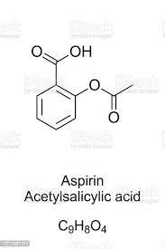
2. Acetyl salicylic acid (ASPIRIN)
IUPAC: 2-Acetoxybenzoic acid
MF: C9 H 8 O4, MM:180.158 g/mole ; MP: 135 0C
Uses: Aspirin (Prodrug), also known as acetylsalicylic acid, is a medication used to reduce pain, fever, or inflammation. Specific inflammatory conditions which aspirin is used to treat include Kawasaki disease, pericarditis, and rheumatic fever also used as an anti thrombotic agent in myocardial infarction (Low dose Aspirin)

Slide 3
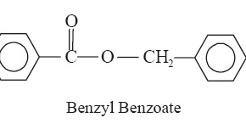
3. BENZYL BENZOATE
It is a ester of benzyl alcohol and benzoic acid, Oily liquid with aromatic smell
Mf : C₁₄H₁₂O₂ M Wt.: 212.248 g·mol⁻¹ MP: 18 °C (
Used as scabicidal agent (lotion), repellent for ticks, lice/and mosquitoes, as vasodilating agent; organic reagent for synthesis of many other compound

Slide 4
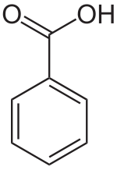
4. Benzoic acid
Benzoic acid is a white (or colorless) solid with the formula C₆H₅CO₂H. It is the simplest Aromatic carboxylic acid
IUPAC: Benzene carboxylic acid
MF: C₇H₆O₂ ; M M:122.123 g/mole
MP: 122 °C
USES: Food preservative, anti fungal agents; starting material for the synthesis of many organic compounds/ derivatives.
Used as a topical anti septic agents

