Slide 1
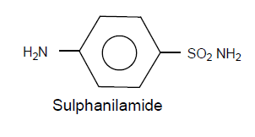
SAR- SULPHONAMIDE
Sulphanilamide skeleton is the minimum structural requirement for antibacterial activity.
The -amino and -sulphonyl-groups on the benzene ring are essential and should be in C4 and C1 position.
The –NH2 group at C4= is basic and the –NH2 Group at C1-Acidic due to Sulfonyl group
The -SO2NH2 group is separated by benzene ring yield a new class sulphones with specific activity against leprosy
Example DDS, acetapsone, solapsone

Slide 2
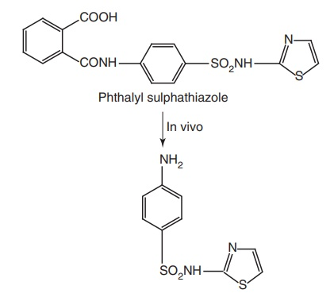
6. Sulphur atom should be directly linked to the benzene ring 7. The active form of Sulphonamide is the ionized, maximum activity that is observed between the pKa values between 6.6–7.4. 8. The N-4 amino group could be modiﬁed to be pro-drugs, which are converted to free amino function in vivo. Phthalyl sulfathiazole belongs to the group of drugs called sulfonamides. The drug is a broad-spectrum antimicrobial that can treat different types of infections Including intestinal infection
.

Slide 3
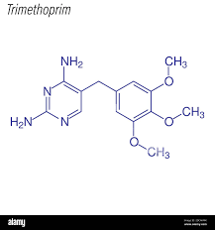
1.TRIMETHOPRIM
2,4—diamino-pyrimidine derivative antibacterial agents
Nomenclature:
5-(3,4,5-Tri-methoxy phenyl methyl)-2,4- diamino pyrimidine
It has synergetic anti bacterial activity with Sulpha drugs
Example: Sulphamethoxazole

Slide 4
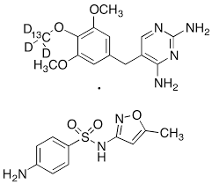
2. Co-trimoxazole
Mixture of Sulpha-methoxazole and Trimethoprim at the ratio of 5:1
USES: Co-trimoxazole is used to treat certain bacterial infections, such as pneumonia (a lung infection), bronchitis (infection of the tubes leading to the lungs), and infections of the urinary tract, ears, and intestines. It also is used to treat 'travelers' diarrhea
Dosage form: Tablets, Syrup (Bactrim DS, Septron etc..)
Ratio: 800/160; 400/80 (SMO+TMP)

Slide 5
3. SULPHA METHOXAZOLE (Sulpha-isoxazole)
Nomenclature 4-amino-N-(5-methyl-3-isoxazolyl) benzene sulphonamide
Properties: White ,odorless crystals, having bitter tastes; very slightly soluble in water and in ether,
Usual Dose: 500 mg
Uses: Antibacterial agent for mainly UTI Caused by susceptible micro-organism
Preparations: Sulpha methoxazole Tablets, syrup

Slide 6
OFFICIAL DRUG SYNTHESIS
1. TRIMETHOPRIM
2. SULPHA-METHOXAZOLE
3. DAPSONE
4. SULPHACETAMIDE

Slide 7
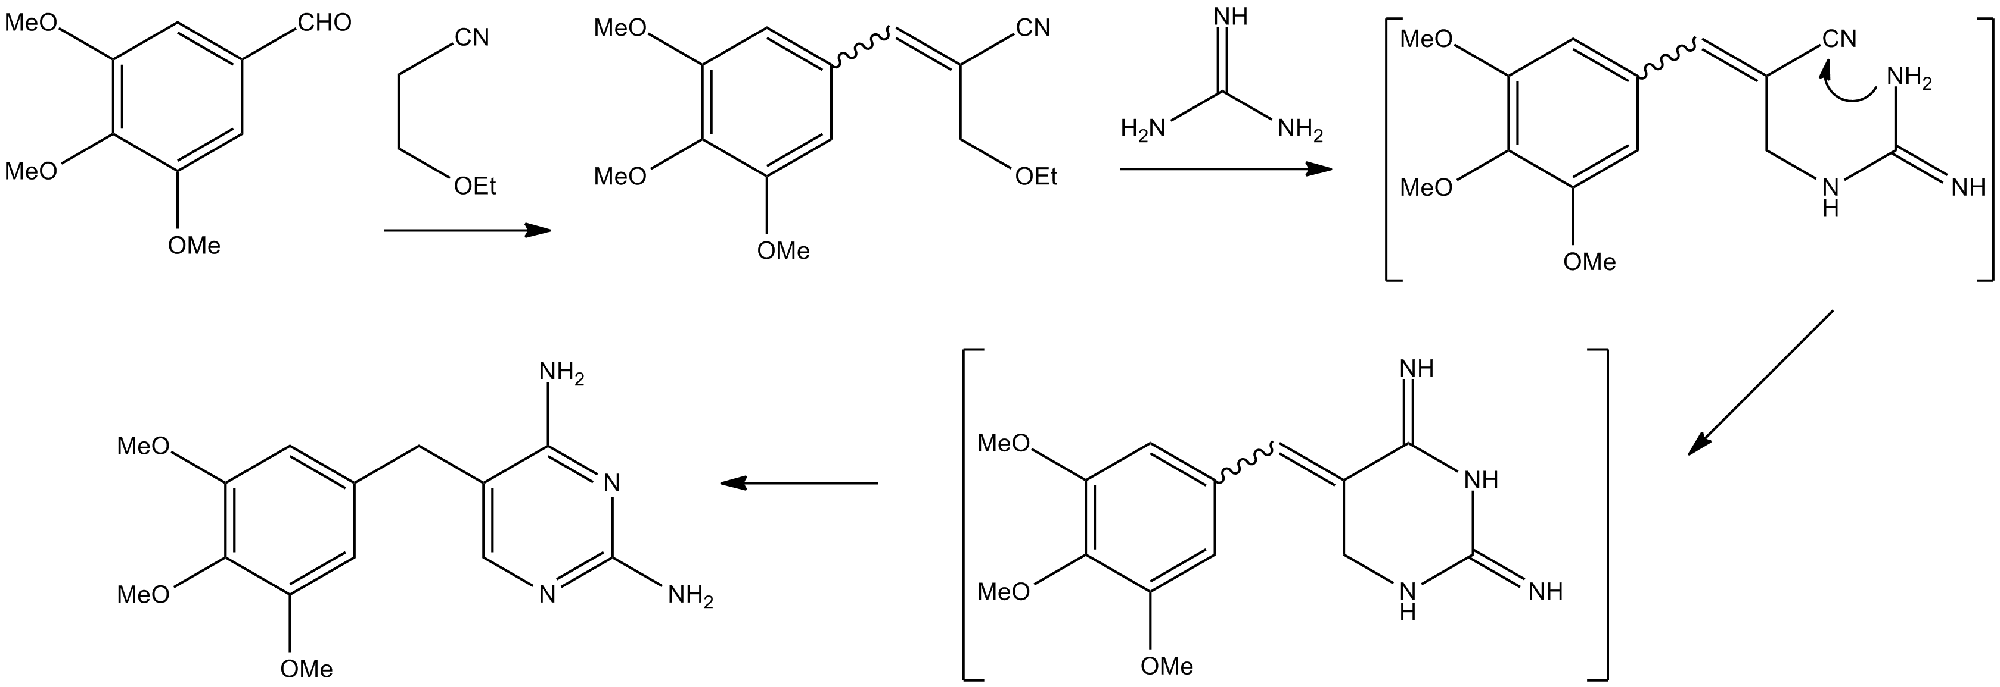
1. TRIMETHOPRIM (TMP) Synthesized from 3,4,5-trimethoxy benzaldehyde and Ethoxy-ethyl cyanide (ethoxy propio nitrile), further reacts with Guanidine yield intermediate, finally TMP obtained

Slide 8
3. SULPHA-METHOXAZOLE
sulfamethoxazole can be prepared by reacting 3-amino-5-methylisoxazole with para-acetamidobenzenesulfonyl chloride (made by treating acetanilide with chloro- sulfonic acid). the acetyl group is then cleaved to yield sulfamethoxazole

Slide 9
3. DAPSONE (DDS) 2 mole of P-chloro-nitro-benzene reacts with sodium sulphide to yield 4,4-dinitro diphenyl sulphide upon oxidation and reduction gives amino derivative Diamino-Diphenyl-Sulphone (DDS)

Slide 10
4. SULPHACETAMIDE Acetylation with acetamide and p-amino- benzene sulphonyl chloride more water soluble SODIM salt can also be prepared by the reaction with NaOH

