Slide 1
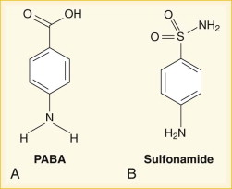
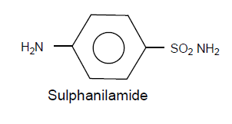
SULPHONAMIDES (SULPHA DRUGS) are group of synthetic chemical agents derived from Para amino benzene sulphanilamide (PABS=B), is also known as sulphanilamide which contain –SO₂NH₂ group. Discovered in 1939 by Domagk in Germany, these agents opened the Morden era of chemotherapy. Official drugs: S. diazine, S. Guanidine, S . Dimethoxazine. S. Methoxypyridazine, S Methoxazole, cotrimoxazole, S. acetamide, Phthalyl sulfathiazole, succinyl sulfathiazole
The chemical structure of PABS is isosteric with Para amino benzoic acid (PABA=A).

Slide 2
CLASSIFICATION
I. Sulpha drugs:
S. Acetamide S. Diazine, S. Guanidine, S Dimethoxazine. S. Methoxypyridazine S. Methoxazole, Phthalyl Sulfathiazole, Succinyl Sulfathiazole, Cotrimoxazole,
II. Folate reductase inhibitors-Trimethoprim,
Co-trimoxazole
III.Sulphones: Dapsone,
Acetapsone,
Solapsone

Slide 3
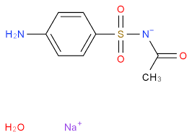
1. SULPHACETAMIDE (Albucid, isoptocetamide)
Nomenclature: N-[(4-aminophenyl)-sulphonyl]-acetamide
properties: white or yellowish white prisms, acidic, slightly saline taste; soluble in water, alcohol, acetone, soluble in mineral acids and alkali hydroxides and carbonated, slightly soluble in ether, very soluble in chloroform.
Uses: It is topically approved in the treatment of acne and Seborrheic dermatitis; orally for urinary tract infection (UTI).
preparations: Sulphacetamide 10% topical lotion; Sulphacetamide sodium salt powder, eye drops 10%; 20%; 30% w/v and eye ointment 5% and 10% w/v.
Sulphacetamide Eye Drops IP, BP

Slide 4
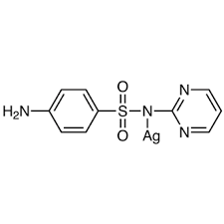
2. SULPHADIAZINE (Diazin, Debenal)
Nomenclature: 4-amino-N-2-pyrimidinyl benzene sulphonamide
Properties: White or slightly yellow powder; sparingly soluble in water, alcohol, acetone, freely soluble in dilute mineral acids, soluble in potassium and sodium hydroxides MP: 252-256ºC
Uses: Commonly used to treat UTI, in combination with pyrimethamine used to treat toxoplasmosis infection.
Dose: Initial oral dose, 3 gram and subsequently, up to 4 gram daily in divided doses.
Preparations: Sulphadiazine tablets IP, Sulphadiazine injection, BP
[NOTE]: Silver Sulphadiazine is a silver salt, effective topical anti-microbial agents used in pseudomonas infection for burn therapy

Slide 5
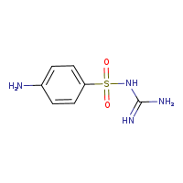
3. SULPHAGUANIDINE (Guanicil)
Nomenclature: N-(P-aminobenzenesulphonyl) guanidine
Properties: white, fine crystalline powder. It is very slightly soluble in water and in alcohol it dissolves in dilute mineral acids. It should be protected from light.
MP: 185-189^{O} C
Dose: orally, 6-12gram daily divided doses
Uses: it is poorly absorbed orally. Used in combination with other drugs, usually in the treatment of GI tract infection Such as intestinal infection, especially for bacillary dysentery, it is also used externally to the skin and throat.
Preparations: Suphaguanidine IP, Suphaguanidine Tablet IP

Slide 6
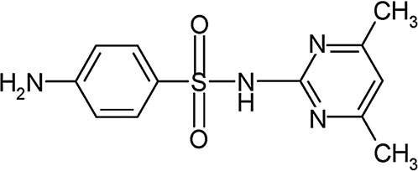
4. SULPHA DIMETHIAZINE (Sulphadimidine)
Nomenclature 4-amino-N-(4, 6 dimethyl-2-pyrimidinyl) benzene sulphonamide
Properties: White to yellowish odorless crystals, having bitter tastes; very slightly soluble in water and in ether, slightly soluble in alcohol and soluble in acetone. Affected as darken on exposure to light.
Dose: 5-10 gram/daily in divided doses
Uses: Antibacterial agents for mainly UTI caused by susceptible microorganisms
Preparations: Sulphamethiazine Tablets

