Slide 1
Schedule-T
GMP of Indian System of Medicine
Part-1st

Slide 3
Good Manufacturing Practice
GMP is a production and testing practice that helps to ensure a quality product. GMP guideline are not prescriptive instructions on how to manufacture product. These are a series of principles that must be observed during manufacture.
“GMP” A set of principles & procedures which, when followed by manufacturers for therapeutic goods, helps ensure that the products manufactured will have the required quality
It is the company responsibility to determine the most effective and efficient quality process.
The GMP for Ayurveda, Sidha, & Unani drugs as prescribed in Rule 157 of Drug & Cosmetics rules 1945 with conditions as specified in schedule T.

Slide 5
Component of GMP GMP schedule for ISM manufacturing unit is quite elaborative and broadly covers each and every component of manufacturing process. Different component of GMP are given below in order of appearance in Schedule T

Slide 17
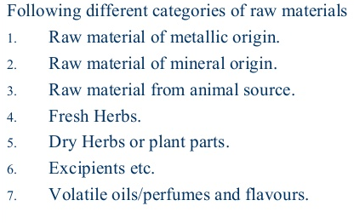

Slide 18
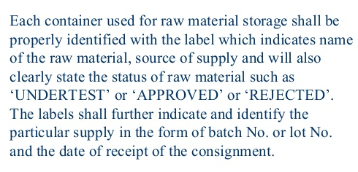

Slide 19
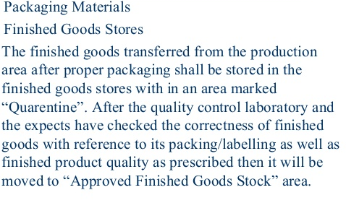

Slide 20
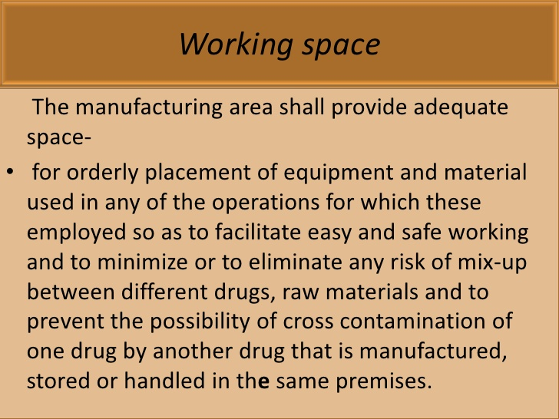

Slide 27
Requirements for Ayurveda, Sidha and Unani Quality Control Section:
Every Ayurvedic, Sidha, & Unani manufacturing unit is required to set-up own quality control section or testing should be done through govt. approved testing laboratory.
Quality control section will have a minimum of :
Expert in Ayurveda or Sidha or Unani medicine who possesses a degree qualification recognized under Schedule II of Indian Medicine Central Council Act 1970;
Chemist, who shall possess at least Bachelor Degree in Science or Pharmacy or Pharmacy (Ayurveda), awarded by a recognized University; and
Botanist (Pharmacognosist), who shall possess at least Bachelor Degree in Science (Medical) or Pharmacy or Pharmacy (Ayurveda) awarded by a recognized University

Slide 28
The quality control section shall have the following facilities:

Slide 30
.

Slide 31
