Slide 1
1. Citric acid
CH2COOH-C(OH)COOH-CH2COOH
Occur naturally from citrus fruits lemon, orange, lime
MF: C6H8O7; MM: 192 g/m; MP: 156 0C
IUPAC: 2-hydroxy-propane-1,2,3-tricarboxylic acid
Uses: as an edible acids
-in soft drinks, candies
-cleaning agent and chelating agents (sodium citrate is preferred)
-dietary supplements
- As an alternative to vinegar

Slide 2
2. LACTIC ACID (Milk acid)
CH3CH(OH)COOH 2isomers: [D – Lactic acid and L+ lactic acid in muscle]
MF: C3H6O3 ; MM 90.01 g/m; MP: 18 0C
Produced in muscles and in RBC, Carbohydrate breakdown in to lactic acid during metabolism
Uses: keratolytic and disinfectant
As a cleaning agent
As a food additives
Dish detergent (anti bacterial agent)
Preparation of ester/also salts

Slide 3
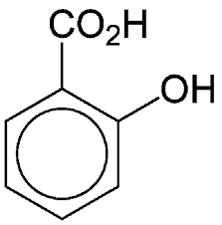
3. Salicylic acid:.
Salicylic acid belongs to a class of drugs known as salicylates. When applied to the skin, salicylic acid may work by helping the skin to shed dead cells ...
MF: C7H6O3; MM: 138.122 g/m ; MP: 159 0C
IUPAC: 2-Hydroxy benzoic acid
USES: Preparation of aspirin (Acetyl salicylic acid), methyl salicylate (Oil of winter green)
As a local anesthetic agent (in pain balm)
As a antifungal agent to treat ring worm, and in psoriasis, in dandruff (as a shampoo)
As a keratolytic agent

Slide 4
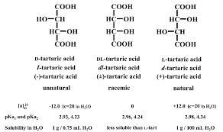
4. TARTARIC ACID
Naturally found in banana, grapes, tamarind etc.
MF: C4 H6 O6 ; MM:150.087 g/m; MP:169 0C
IUPAC: 2,3-DIHYDROXY BUTANE 1,4-DIOIC ACID
USES: Preparation of efferervessent tablets,
In cough syrup as expectorant (sodium salt is used)
Tartar emetic as (sodium potassium tartrate)
Cleaning agent,
Chelating agent

