Slide 1
1. Oxalic acid
Oxalic acid is an organic acid with formula HO₂C−CO₂H. It is the simplest di carboxylic acid. It is found in many plants, including leafy greens, vegetables, fruits, cocoa, nuts, and seeds
IUPAC: Ethane dioic acid.
MF: C₂H₂O_{4;} MM: 90.03 g/mole
MP: 189 to 191 °C anhydrous
Uses: 1.cleaning and bleaching agent, (to remove rust)
2. Oxalic acid is an ingredient in some tooth whitening products
3. Oxalic acid is used by some beekeepers as a miticide against the parasitic varroa mite.
4. Oxalic acid is used to clean minerals

Slide 2
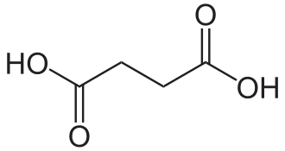
succinic acid is a carboxylic acid with the formula (ch₂)₂(co₂h)₂. IUPAC: butane dioic acid MF: C₄H₆O_{4;} MM: 118.088 g mol⁻¹ MP: 184–190 °C uses:. 1. Food additives and Dietary supplements 2. precursors for some polyesters, alkyl resins 3. Precursor for the synthesis of 1, 4- butane diol synthesis
2. SUCCINIC ACID

Slide 3
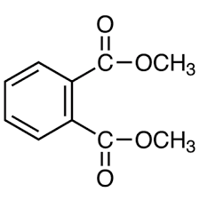
Dimethyl phthalate is a phthalate ester, a diester and a methyl ester. dimethyl phthalate is a carboxylic acid with the molecular formula . C₁₀H₁₀O₄ IUPAC: dimethyl benzene-1,2-dicarboxylate ; MM: 194.184 g/mole MP: 2 °C USES: 1. it has many uses, including in solid rocket propellants, plastics 2. insect repellent as ectoparasiticide for mosquitos, and house flies
3. DIMETHYL PHTHALATE

