Slide 1
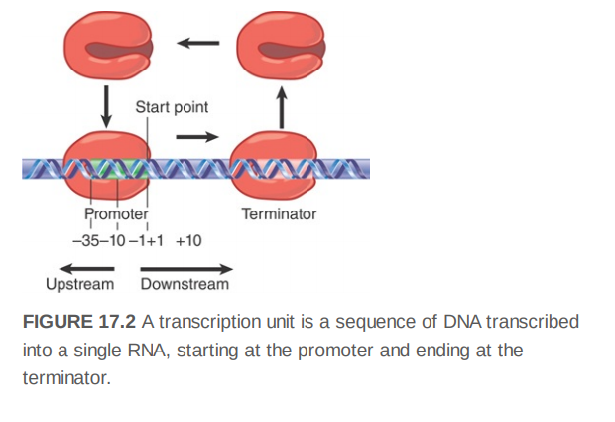
Transcription
RNA synthesis is catalyzed by the enzyme RNA polymerase. Transcription starts when RNA polymerase binds to a special region, called the promoter, at the start of the gene. The promoter includes the first base pair that is transcribed into RNA (the start point), as well as surrounding bases. From this position, RNA polymerase moves along the template, synthesizing RNA until it reaches a terminator sequence, where the transcript ends. Thus, a transcription unit extends from the promoter to the terminator.

Slide 2
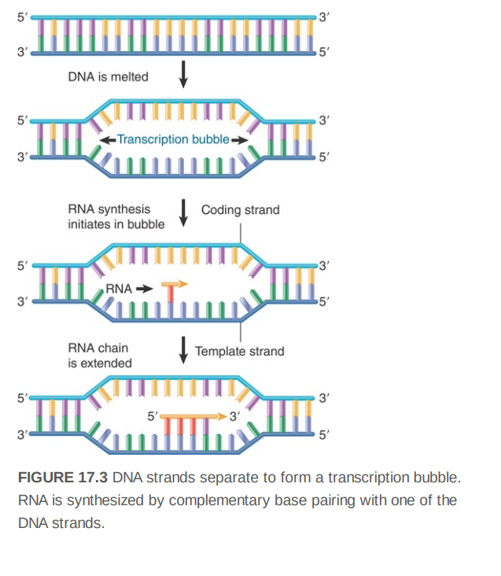
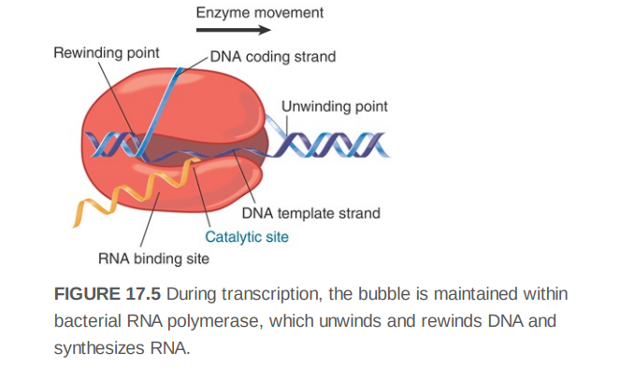
The length of the transcription bubble is about 12 to 14 bp, but the length of the RNA–DNA hybrid within the bubble is only 8 to 9 bp. As the enzyme moves along the template, the DNA duplex reforms

Slide 3
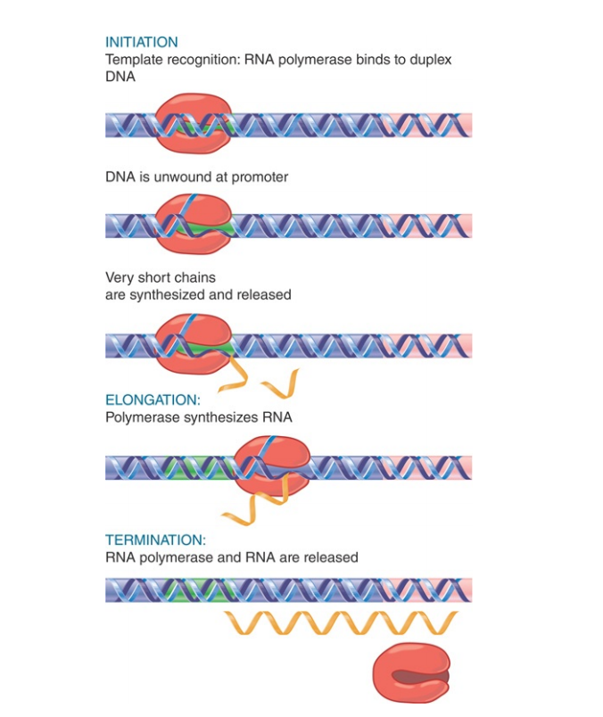

Slide 4
Prokaryotic transcription
Initiation
Template recognition begins with the binding of RNA polymerase to the double-stranded DNA at a DNA sequence called the promoter. The enzyme first forms a closed complex in which the DNA remains double stranded. Next the enzyme locally unwinds the section of promoter DNA that includes the transcription start site to form the open complex.
Separation of the DNA double strands makes the template strand available for base pairing with incoming ribonucleotides and synthesis of the first nucleotide bonds in RNA. The initiation phase can be protracted by the occurrence of abortive events, in which the enzyme makes short transcripts, typically shorter than about 10 nucleotides, while still bound at the promoter. The initiation phase ends when the enzyme finally succeeds in extending the chain and clearing the promoter.
Elongation
Elongation involves processive movement of the enzyme by disruption of base pairing in double-stranded DNA, exposing the template strand for nucleotide addition and translocation of the transcription bubble downstream. As the enzyme moves, the template strand of the transiently unwound region is paired with the nascent RNA at the point of growth. Nucleotides are added covalently to the 3′ end of the growing RNA chain, forming an RNA– DNA hybrid within the unwound region. Behind the unwound region, the DNA template strand pairs with its original partner to reform the double helix, and the growing strand of RNA emerges from the enzyme.
Termination
Termination involves recognition of sequences that signal the enzyme to halt further nucleotide addition to the RNA chain. In addition, long pauses can lead to termination. The transcription bubble collapses as the RNA–DNA hybrid is disrupted and the DNA reforms a duplex.

Slide 5
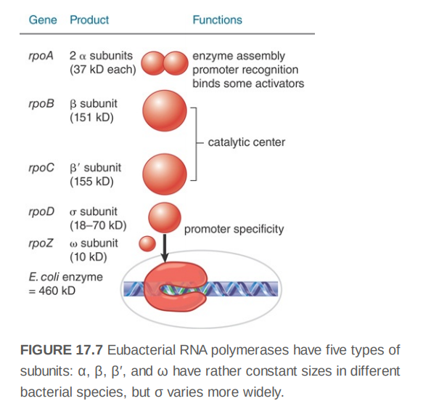
RNA polymerase
The complete enzyme, or holoenzyme, in E. coli has a molecular weight of about 460 kD. The holoenzyme (α ββ′ωσ) can be separated into two components: the core enzyme (α ββ′ω) and the sigma factor (the σ polypeptide), which is concerned specifically with promoter recognition. Its subunit composition is summarized in FIGURE .The β and β′ subunits together account for RNA catalysis and make up most of the enzyme by mass.

Slide 6
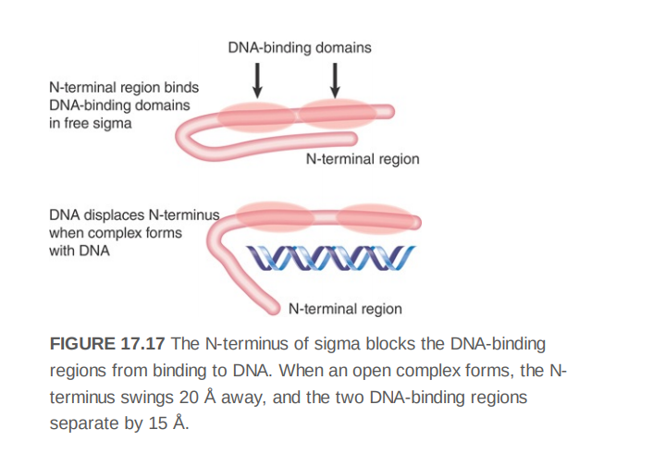
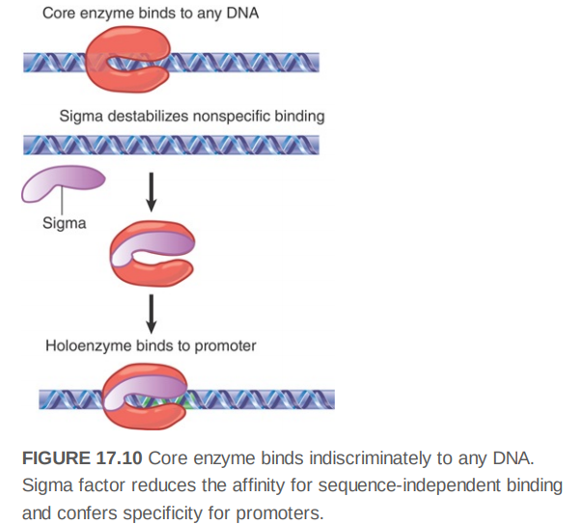
Reference:Lewin’s GeneXII

Slide 7
Several elements in bacterial promoters contribute to their recognition by RNA polymerase holoenzyme. Two 6-bp elements, referred to as the −10 element and −35 element (as well as the length of the “spacer” sequence between them), are usually the most important of these recognition sequences.
A 6-bp region is recognizable centered approximately 10 bp upstream of the start point in most promoters (the actual distance from the start site varies slightly from promoter to promoter). This hexameric sequence is usually called the −10 element, the Pribnow box, or sometimes the TATA box (though the latter name is preferentially applied to a similar consensus sequence in eukaryotic promoters). Its consensus, TATAAT
The conserved hexamer, TTGACA, centered at approximately 35 bp upstream of the start point is called the −35 element.
The distance separating the −35 and −10 sites is between 16 bp and 18 bp in about 90% of promoters.
The start point is usually (more than 90% of the time) a purine, usually adenine.
Certain base pairs in the region between the start point and the −10 element are contacted by region 1.2 of the sigma factor

Slide 8
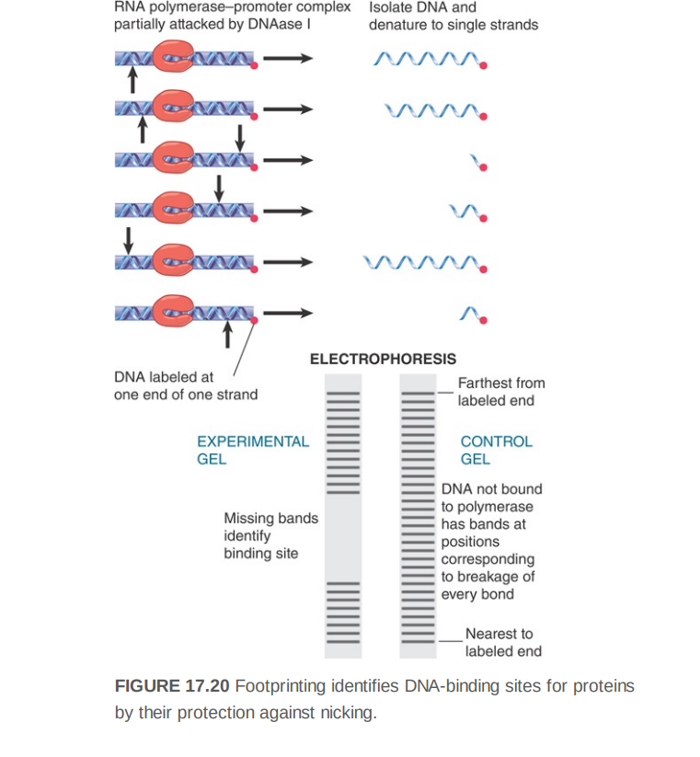

Slide 9
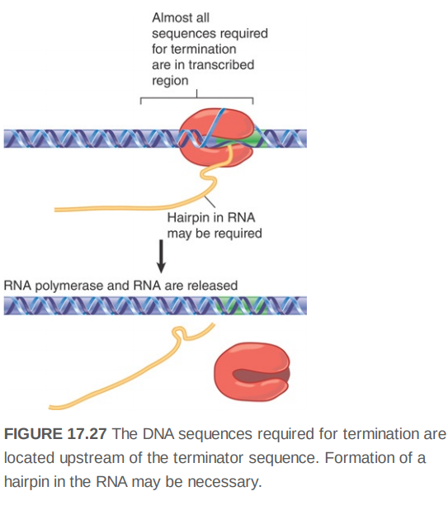
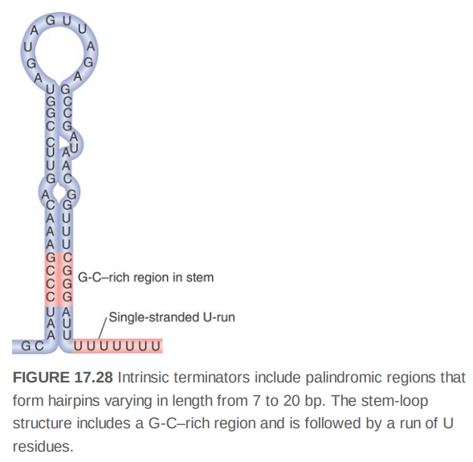
Termination

Slide 10
Two classes of terminators have been identified
1.Those recognized solely by RNA polymerase itself without the requirement for any cellular factors are usually referred to as intrinsic terminators.
2. Others require a cellular protein called rho and are referred to as rho-dependent terminators.
Intrinsic termination requires recognition of a terminator sequence in DNA that encodes a hairpin structure in the RNA product. The signals for termination lie mostly within sequences already transcribed by RNA polymerase, and thus termination relies on scrutiny of the template and/or the RNA product that the polymerase is transcribing.

Slide 11
