Slide 1
UNIT V
SYNCHRONOUS GENERATOR
Constructional details – Types of rotors – EMF equation – Synchronous reactance – Armature reaction – Voltage regulation: EMF, MMF, ZPF and ASA methods – Synchronizing and parallel operation – Synchronizing torque – Change of excitation and mechanical input – Two reaction theory – Determination of direct and quadrature axis synchronous reactance using slip test – Operating characteristics – Capability curves.

Slide 2
UNIT – v
SYNCHRONOUS GENERATOR
AC Machines
Synchronous Machines
Asynchronous Machines
(Induction Machine)
Induction
Generator
Induction
Motor
Synchronous
Generator
Synchronous
Motor
Due to lack of a separate field excitation, these machines are rarely used as generators.
A primary source of electrical energy
Used as motors as well as power factor compensators (synchronous condensers)
Most widely used electrical motors in both domestic and industrial applications

Slide 3
SYNCHRONOUS GENERATOR
Types of Synchronous Machine
According to the arrangement of the field and armature
windings, synchronous machines may be classified as
Stationary Armature - Rotating Field (Above 5 kVA)
(b) Stationary Field – Rotating Armature (Below 5 kVA)

Slide 4
Advantages of stationary armature - rotating field:
The High Voltage ac winding and its insulation not subjected to centrifugal forces.(11kV - 33 kV) (BETTER INSULATION)
Easier to collect large currents from a stationary member.
Rotating field makes overall construction simple.
Problem of sparking at the slip ring can be avoided.
Ventilation arrangement for HV can be Improved.
The LV(110 V – 220V) dc excitation easily supplied through slip rings and brushes to the rotor field winding.
Noiseless running is possible.
Air gap length is uniform
Better mechanical balancing of rotor

Slide 5
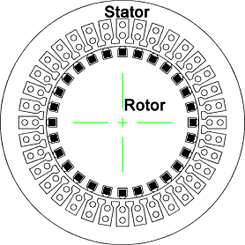
CONSTRUCTION OF ALTERNATOR
Stationary Armature - Rotating Field
An alternator has 3 phase winding on the stator and
DC field winding on the rotor.
STATOR
Stationary part of the machine.
It is built up of Sheet-Steel Lamination Core (Stampings) with slots
to hold the armature Conductor
Armature winding is connected in STAR

Slide 6
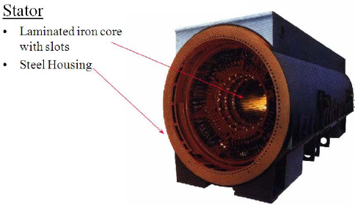

Slide 8
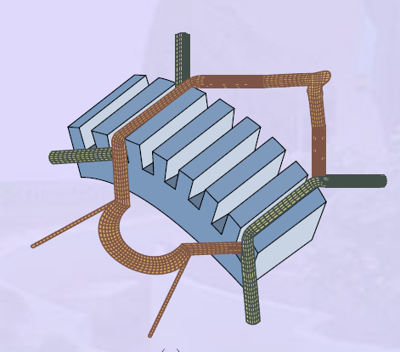
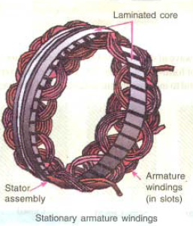

Slide 9
ROTOR:
There are two types of rotor
i) Salient Pole type {Projected Poles}
ii) Non - Salient Pole type {Non – Projected Poles} Smooth Cylindrical Type

Slide 10
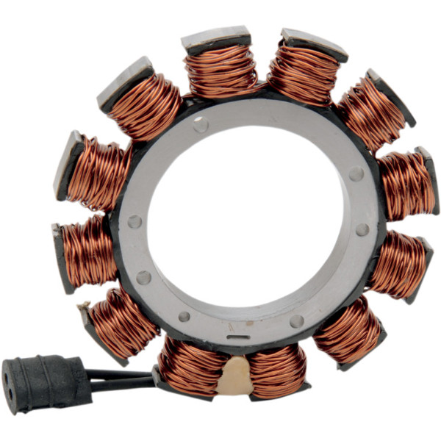
Salient Pole type {Projected Poles}
It is also called Projected Poles.
Poles are mounted on the larger circular frame.
Made up of Thick Steel Laminations.
Field Winding are connected in series.
Ends of the field winding are connected to the DC Supply through Slip Rings
Features
Large Diameter and short Axial Length.
Poles are Laminated to reduced
Eddy Current Losses
Employed for Low and Medium Speed
120 RMP to 500 RPM
(Diesel & Hydraulic Turbines)
This cannot be used for Large speed

Slide 11
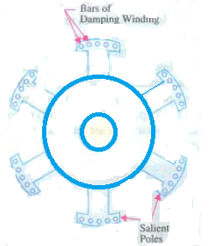
DAMPER WINDING
Pole faces are provided with damper winding
Damper winding is useful in preventing Hunting
EMF generated will be sinusoidal
Copper Bar

Slide 12
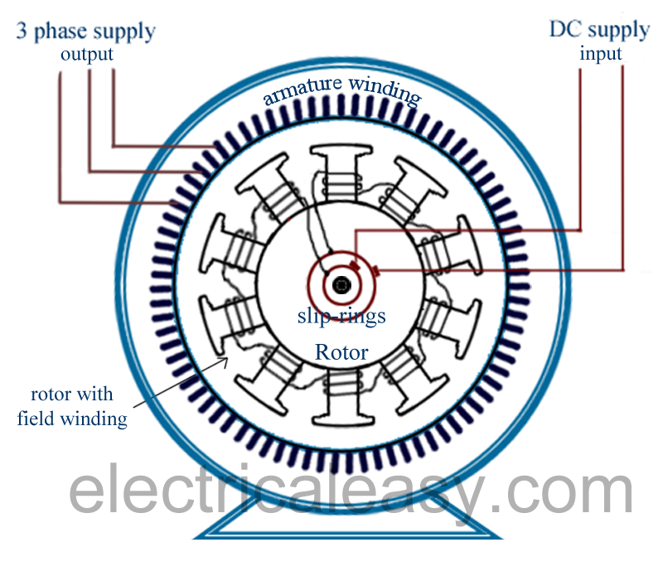

Slide 13
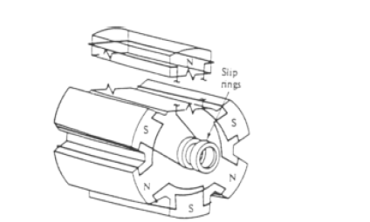

Slide 14
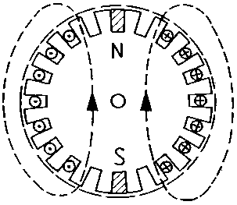
II) NON SALIENT POLE TYPE
Smooth cylindrical rotor or TURBO ALTERNATOR
field winding used in high speed alternators driven by steam turbines .
Features
Smaller diameter and larger axial length compared to salient pole type machines, of the same rating.
Less Windage loss.
Speed 1200 RPM to 3000 RPM.. Better Balancing..
Noiseless Operation
Flux distribution nearly sine wave
Frequency 50 Hz
Ns = 120 F / P
Poles | 2 | 4 | 6
Speed | 3000 | 1500 | 1000

Slide 15
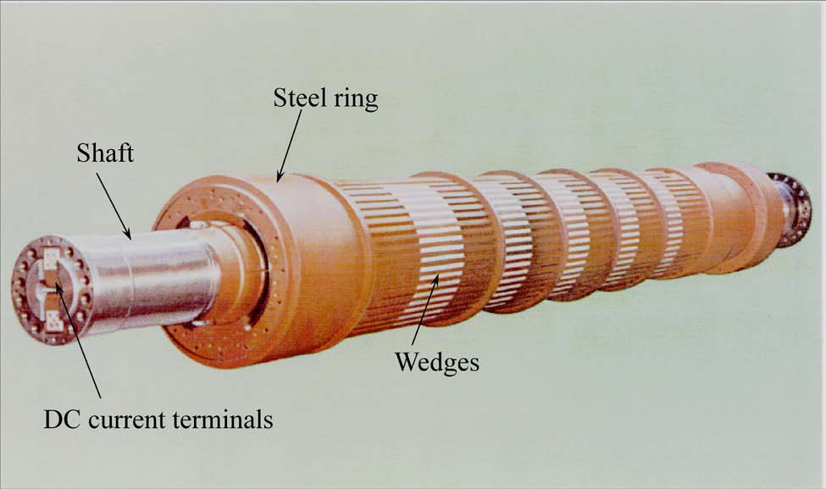

Slide 16
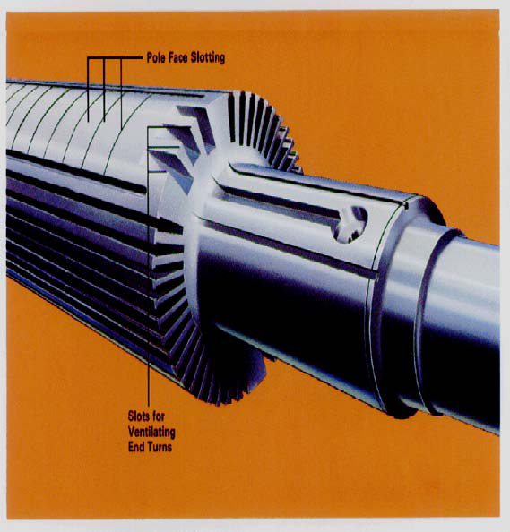

Slide 17
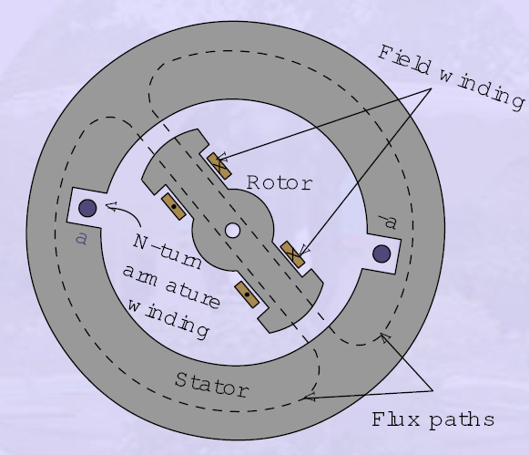

Slide 19
EMF Equation
Where,K
c
= cos
(α/
2),
K
d
= {sin
(mβ/
2)} / {m sin
(β/
2)}
f = PNs/120, Hz;
Φ
= flux per pole, Wb
T
ph
= Turns in series per phase
= (
No. of slots * No. of cond. per slot) / (2 x 3)
phd c ph
T f K K E

44.4

EMF Equation of an Alternator
Let
Φ = Flux per pole, Wb
P = Number of Poles
Ns = Synchronous Speed in RMP
Z = Total Number of Conductors or coil sides in series / Phase
Z = 2T
T = Number of coils or Turns per phase
Tph = Turns in series per phase
= ( No. of slots * No. of cond. per slot) / (2 x 3)
Zph = Conductor per phase
Zph = Z / 3. No. of phase 3
Kc or Kp = Pitch factor or coil span factor
Kd = Distribution factor
Kp = Cos (α / 2 )
Kd = Sin (mβ / 2)
m Sin(β / 2)

Slide 20
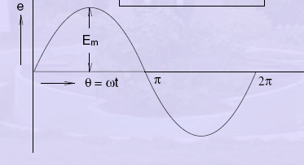

Slide 24
ARMATURE WINDING
3 Phase alternator carry 3 sets of winding arranged in slots
Open circuited
6 terminals
Can be connected in Star or Delta
Armature Winding Classification
Single Layer and Double Layer Winding
Full Pitch and Short Pitch Winding
Concentrated and Distributed Winding

Slide 25
Single Layer and Double Layer Winding
Single- layer winding
• One coil-side occupies the total slot area
• Used only in small ac machines
Double- layer winding
• Coil-sides in two layers
• Double-layer winding is more common used above about 5kW machines
The advantages of double-layer winding over single layer winding:
a. Easier to manufacture and lower cost of the coils
b. Fractional-slot winding can be used
c. Chorded-winding is possible
d. Lower-leakage reactance and therefore , better performance of the machine
e. Better emf waveform in case of generators

Slide 26
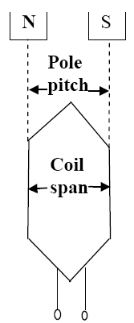
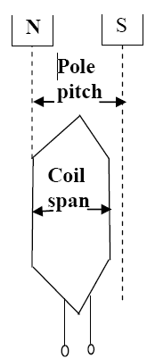
POLE – PITCH
It is the distance between the centres of pole
faces of two adjacent poles is called pole pitch.
Pole pitch = 180 Phase angle
COIL :
A coil consists of two coil sides.
Placed in two separate slots
SLOT PITCH:
It is the phase angle between two adjustment slots
COIL SPAN OR COIL PITCH
It is the distance between two coil sides of a coil

Slide 27
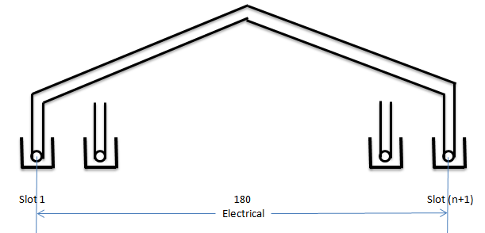
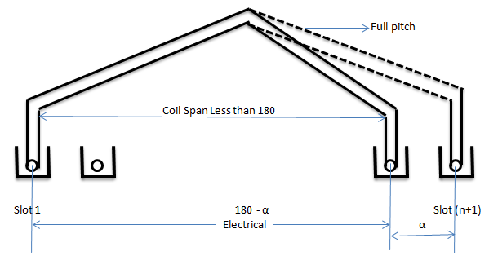
Full Pitch and Short Pitch Winding
Full Pitch Winding
If the coil span is equal to pole pitch then the winding is called Full Pitch Winding
Coil Span = Pole Pitch
e1 V
e2 V
Short Pitch Winding
If the coil span is less than Pole
Pitch is called Short pitch
winding
e2 V
e1 V
e2 V

Slide 28
Advantages of Short Chorded winding or Chorded Pitch Winding
Copper is saved
Mechanical strength of the coil is increased
Induced EMF in improved
Slot Angle : The angular displacement between any two
adjacent poles in electrical degree
Slot angle (β) = 180
(Number of slots / Pole)
CONCENTRATED AND DISTRIBUTED WINDING

Slide 29
PITCH FACTOR OR COIL SPAN FACTOR OR SHORT CHORDED FACTOR
Kp OR Kc
Pitch factor is defined as the ratio EMF induced in the Short pitch winding to the EMF induced in the full pitch winding
Vector Sum EMF = AB
= AC + CB
Kp = AC + CB
AD + DB
B
C
α/2
E V
AD = BD
α/2
α
A
E V
D
E V
2E
Kp = Cos (α / 2)

Slide 30
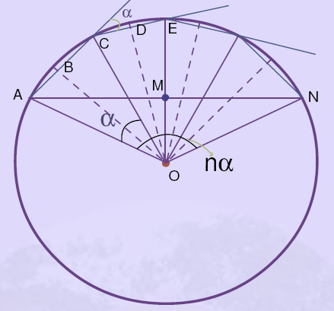
DISTRIBUTION FACTOR OR BREATH FACTOR (Kd)
β
E in coil 1
β
E in coil 2
E in coil 3

Slide 31
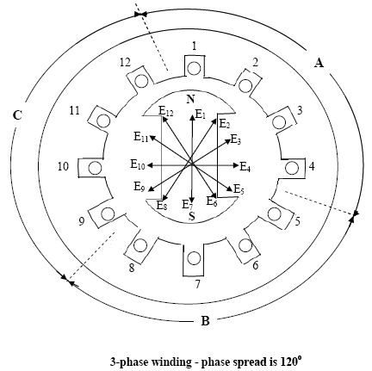
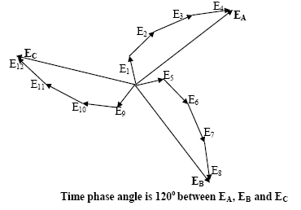

Slide 32
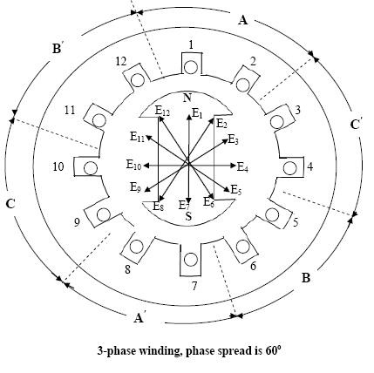
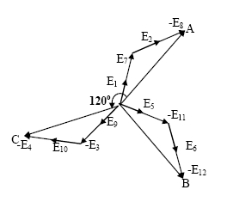

Slide 33
B
C
e2
β
r
x
e1
e3
m(β/2)
A
E
D
β
β
β/2
β/2
r
β
Vector Sum
β/2
mβ
O

Slide 34
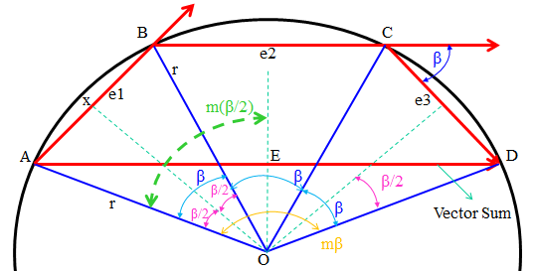
Arithmetic Sum of EMF = AB + BC + CD
From Vector diagram AB = Ax + xB
= r Sin (β/2) + r Sin (β/2)
AB = 2 r Sin (β/2)
AB = BC = CD = 2 r Sin (β/2)
Arithmetic Sum of EMF = 3 x (2 r Sin (β/2) )
If there are ‘m’ slots for distribution, then
Arithmetic Sum /phase of the EMF = m x (2 r Sin (β/2) )
Vector Sum of EMF AD = AE + ED
Vector Sum of EMF AE = ED = r Sin (mβ/2)
Vector Sum of EMF = 2r x (Sin (mβ/2))

Slide 35
Causes of Voltage drop in Alternator
Armature Effective Resistance (R_{eff} )
Armature Leakage Reactance (X_{L} )
Armature Reactance

Slide 36
Armature Leakage Reactance(XL)
Three major components -Slot leakage reactance, end winding leakage reactance and tooth tip leakage reactance.
Synchronous reactance / phase
Xs = X_{L} + Xa
, where
Xa is the fictitious armature reaction reactance.
Synchronous impedance/phase
Zs = (Ra + jXs).

Slide 37
Armature Reaction
Effect of the armature flux on the main field flux.
Armature Reaction effect depends upon the PF of the Load
UPF - cross magnetizing.
Lag PF - demagnetizing.
Lead PF - magnetizing

Slide 38
UPF (Pure Resistive Load)
cross magnetizing
Main Flux Φ_{f}
Armature Flux Φa
N
S
Main Flux
Φ_{f}
Iaph
Φ_{a}
Eph
Induced EMF due to Main Flux Φ_{f}

Slide 39
Lagging PF (Purely Inductive Load)
Demagnetizing
Main Flux Φ_{f}
Armature Flux Φa
N
S
Armature Flux
Φa
Main Flux
Φ_{f}
Ia
Load current
Lag the Voltage by
90
Main Flux
Decreases
DC excitation
Eph
Induced EMF due to Main Flux Φ_{f}

Slide 40
Lead PF (Purely Capacitive Load)
Magnetizing
Main Flux Φ_{f}
N
S
Armature Flux Φa
Armature Flux
Φa
Main Flux
Φ_{f}
Load current
Lead the Voltage by
90
Ia
Main Flux
Increases
DC excitation
Eph
Induced EMF due to Main Flux Φ_{f}

Slide 41
VOLTAGE REGULATION
Voltage Regulation of an alternator is defined as the change in terminal voltage from NO load to full load divided by full-load voltage.
% Voltage Regulation = E₀ – V x 100
V
There are different methods available to determine the voltage regulation of an alternator,
1.Direct loading method
2. Synchronous impedance method or E.M.F. method
3. Ampere-turns method or M.M.F. method
4. Zero power factor method or Potier triangle method
5. ASA modified from of M.M.F. method
6. Two reaction theory

Slide 42
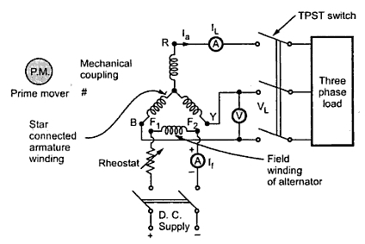
Direct loading method

Slide 43
The star connected armature is to be connected to a three phase load
The field winding is excited by separate d.c. supply.
To control the flux i.e. the current through field winding, a rheostat is inserted in series with the field winding.
The prime mover drives the alternator at its synchronous speed.
E_{ph} α Φ
..... (From e.m.f. equation)
For high capacity alternators, that much full load can not be simulated or directly connected to the alternator. Hence method is restricted only for small capacity alternators.

Slide 44
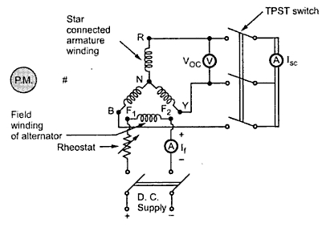
Synchronous Impedance Method or E.M.F. Method

Slide 45
The method is also called E.M.F. method
The method requires following data to calculate the regulation.
The armature resistance per phase (R_{a}).
2. Open circuit characteristics which is the graph of open circuit voltage against the field current. This is possible by conducting open circuit test on the alternator.
3. Short circuit characteristics which is the graph of short circuit current against field current. This is possible by conducting short circuit test on the alternator.
Zs is calculated.
Ra measured and Xs obtained.
For a given armature current and power factor, Eph determined - regulation is calculated.

Slide 46
(Ia)_{SC}
(Voc)_{ph}
OCC
C
D
SCC
Full
Load
I_{asc}
E
B
O
A
field current. I_{f} in Amps

Slide 47
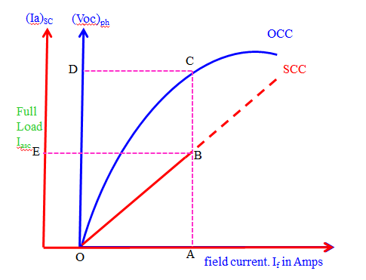
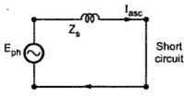
Synchronous Impedance
Regulation Calculation
Zs = √(Ra)² + (Xs)²
Xs
Xs = √(Zs)² - (Ra)²
Eph = √ (Vph Cos Φ + Ia Ra)² + (Vph Sin Φ ± Ia Xs)²

Slide 48
Phasor Diagram of a loaded Alternator
Unity PF Load
C
Eph
IaZ_{S}
IaXs
O
Ia
Vph
A
IaRa
B
Reference as Voltage (V)
Consider Δ OBC
OA – Vph
AB – IaRa
(OC)² = (OB)² + (BC)²
BC – IaXs
(Eph)² = (OA + AB)² + (BC) ²
AC – IaZs
OC – Eph
(Eph)² = (Vph + IaRa)² + (IaXs) ²
Eph = √ (Vph + IaRa)² + (IaXs) ²

Slide 49
Phasor Diagram of a loaded Alternator
Lagging PF Load
C
IaZ_{S}
Eph
IaXs
Vph
IaRa
Vph Sin Φ
Φ
Ia
O
Vph Cos Φ
A
IaRa
B
Eph = √ (Vph Cos Φ + Ia Ra)² + (Vph Sin Φ + Ia Xs)²

Slide 50
Phasor Diagram of a loaded Alternator
Leading PF Load
C
IaZ_{S}
Eph
IaXs
Vph
IaRa
Φ
O
Ia
A
B
Eph = √ (Vph Cos Φ + Ia Ra)² + (Vph Sin Φ - Ia Xs)²

Slide 51
Advantages of Synchronous Impedance Method
The main advantages of this method is the value of synchronous impedance Z_{s} for any load condition can be calculated.
Regulation of the alternator at any load condition and load power factor can be determined.
Actual load need not be connected to the alternator
This method can be used for very high capacity alternators
Limitations of Synchronous Impedance Method
The main limitation of this method is that this method gives large values of synchronous reactance.
This leads to high values of percentage regulation than the actual results.
Hence this method is called pessimistic method.

Slide 52
MMF method (Ampere turns method)
This method of determining the regulation of an alternator is also called Ampere-turn method or Rothert's M.M.F. method.
The method is based on the results of open circuit test and short circuit test on an alternator.
For any synchronous generator i.e. alternator, it requires M.M.F. which is product of field current and turns of field winding for two separate purposes.
It must have an M.M.F. necessary to induce the rated terminal voltage on open circuit.
2. It must have an M.M.F. equal and opposite to that of armature reaction m.m.f.

Slide 53
OC & SC tests conducted.
field currents
If1 (field current required to produce a voltage of (Vph + Iaph Ra cosΦ) on OC)
If2 (field current required to produce the given armature current on SC) are added at an angle of (90±Φ).
For this total field current, Eph found from OCC and regulation calculated.

Slide 54
Short Circuit Current
Open Circuit Voltage
OCC
Rated Voltage
SCC
Full Load
Short circuit Current
F_{AR}
F_{O}
field current. I_{f} in Amps

Slide 55
Zero Power Factor Method (ZPF Method) or Potier method
This method is also called Potier method.
In the operation of any alternator, Voltage drop occurs in
Armature resistance drop(IRa)
Armature leakage reactance drop IX_{L}
Armature reaction.
Mainly due EMF quantity
is basically M.M.F. quantity
In the synchronous impedance method all the quantities are treated as E.M.F. quantities
In the MMF Method all the quantities are treated as M.M.F. quantities
The ZPF method is based on the Separation of
Armature leakage reactance (X_{L}) and
Armature reaction effect
The armature leakage reactance X_{L} is called Potier reactance

Slide 56
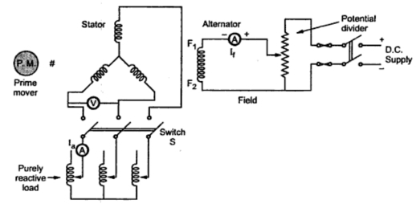
To determine armature leakage reactance (EMF) and armature reaction (MMF) separately, two tests are performed on the alternator
1. Open circuit test
2. Zero power factor test
Open circuit test
Open circuit test
Switch Open
P.M. to drive Ns
Potential Divider from 0 to Rated Value
Zero power factor test
Switch Closed
Purely Inductive Load
Purely Inductive Load has PF Cos 90

Slide 57
Open Circuit Voltage
(V_{oc})
Rated Terminal Voltage at Full load Current at
Zero pf lagging
Tangent to OCC
Airline
OCC
R
Full Load ZPF
Rated
Vph
R’
Δ PQR
Potier Triangle
Q
S
P
OA = QP
Horr Parallel
Q’
S’
P’
B
O
C
A
field current. I_{f} in Amps
Zero Terminal Voltage at SC Full load Zero pf Ia
RS Voltage Drop Armature Leakage Reactance (IX_{L})
PS Gives I_{f} necessary to overcome Demagnetizing Armature Reaction
SQ rep I_{f} required to induce an EMF balancing of leakage reactance (RS)

Slide 58
ASA Modification of M.M.F. Method
American Standards Association Method (ASA Method)
The two methods, M.M.F. method and E.M.F. method is capable of giving the reliable values of the voltage regulation
the magnetic circuit is assumed to be unsaturated.
This assumption is unrealistic as in practice.
It is not possible to have completely unsaturated magnetic circuit.
In salient pole alternators, it is not correct to combine field ampere turns and armature ampere turns.
field winding is always concentrated
Armature winding is always distributed.
Similarly the field
field and armature m.m.f. is not fully justified.

Slide 59
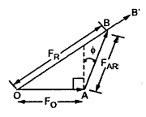
American Standards Association Method (ASA Method)
Load induced EMF calculated as was done in the ZPF method - Corresponding to this EMF, the additional field current (If3) due to saturation obtained from OCC and air gap line - If3 added to the resultant of If1 and If2 -For this total field current, Eph found from OCC and regulation calculated.

Slide 60
Open circuit Voltage Voc
Eph
OCC
B
E1
B’
Airline
E1ph
IaX_{L}
IaRa
Vph
Φ
O
field current. I_{f} in Amps

Slide 61
American Standards AssociationMethod (ASA Method)

The field currents If1 (field current requiredto produce the rated voltage of V
ph
from theair gap line).

If2 (field current required to produce thegiven armature current on short circuit)added at an angle of (90±
Φ
).
American Standards Association Method (ASA Method)
The field currents If1 (field current required to produce the rated voltage of Vph from the air gap line).
 If2 (field current required to produce the given armature current on short circuit)added at an angle of (90±Φ).

Slide 62
Synchronizing and Parallel operation
Necessary Condition for Synchronization
The process of switching of an alternator to another alternator or with a common Bus bar without any interruption is called Synchronization
CONDITIONS FOR PARALLEL OPERATION
1. The terminal voltage of the incoming machine must be same as that of bus bar Voltage.
2. The frequency of the generated voltage of the incoming machine must be same as that of bus bar frequency.
3. The phase Sequence voltage of the incoming machine must be same as that of bus bar.(R Y B).

Slide 63
Advantages of Parallel operation
Continuity of supply is possible when Breakdown or Shut down for maintenance of alternator in generating station
Repair and Maintenance of individual machine can be carried out one after the other without effecting the normal routine work
Depending upon the load requirement any number of alternator can be operated and the remaining can be put off
It is economical and improves the efficiency of the generating station
New alternator can be connected in parallel, when the demand increases. This reduces the capital cost of the system.

Slide 64
Methods of Synchronization of alternator
Three Methods
Dark lamp method.
Bright Lamp Method
Synchroscope Method
Conditions Should Satisfy
1. Voltage 2. Frequency
3. Phase Sequence

Slide 65
R
Dark lamp
method
Bus Bar
Y
B
Bus Bar Voltage
Synchronizing
Switch
V
Main Switch
L2
L1
L3
V
Incoming Voltage
Y
Y’
R
B
R’
Existing Alternator
B’
Incoming Alternator
Alternator 1
Alternator 2

Slide 66
Alternator 1 is already (Exciting) connected with the Bus Bar and Supplying power to load
Alternator 2 is Incoming Alternator
Voltage of Incoming Alternator SHOULD be same to that of Exciting Alternator
V1 = V2 Voltage SAME
Phase Sequence
3 Lamps Glowing Uniformly together and becoming dark together Phase Sequence
is correct
LAMP Flickering together in uniform
Frequency
Difference in frequency Lamp will be glow DARK and BRIGHT alternatively
Speed of alternator 2 should be adjusted
Demerits
It is not possible to judge whether the incoming alternator is fast or slow.
The lamp can be dark even through a small value of voltage may present across the
Terminals.

Slide 67
E1 voltage
E2 voltage

Slide 68
R
Bright Lamp
Method
Bus Bar
Y
B
Bus Bar Voltage
Synchronizing
Switch
V
Main Switch
L2
L1
L3
V
Incoming Voltage
Y
Y’
R
B
R’
Existing Alternator
B’
Incoming Alternator
Alternator 1
Alternator 2

Slide 69
Lamps are cross connected
Lamps will GLOW the BRIGHTEST when two voltage are in PHASE (V²)
V1 = V2 Voltage SAME
Phase sequence same LAMPS will start Flickering in uniform
Switch is closed at the middle of the Brightest period of the lamp

Slide 70
R
Synchroscope
Method
Bus Bar
Y
B
Bus Bar Voltage
Synchronizing
Switch
V
Main Switch
Slow
Fast
Synchroscope
V
Incoming Voltage
Y
Y’
R
B
R’
Existing Alternator
B’
Incoming Alternator
Alternator 1
Alternator 2

Slide 71
LAMP Flickering together in uniform
Synchroscope consists of STATOR and ROTOR
The ROTOR is connected to the INCOMING alternator
The STATOR is connected to the EXISTING alternator
The pointer is attached to the rotor. The pointer will indicate the correct time of
closing the switch. (12’O Position)
Frequency Different the pointer will rotate
Anti clock wise ---- Frequency of INCOMING alternator is LOW
Clock wise ---- Frequency of INCOMING alternator is Higher

Slide 72
Synchronizing Current, Power and Torque
E1
E1
Z1 = Ra + Xs
Z2 = Ra + Xs
Isy
Φ₁
Er
E1
E2
α
E2
E2
Synchronizing Current Isy = Er / (Z1 + Z2)
Synchronizing Power Psy = E1 x Isy Cos Φ₁
Synchronizing Torque Tsy = Psy / ( 2πNs / 60)

Slide 73
Effect of Change in Excitation of Alternator in parallel
2I
E1
Z1 = Ra + Xs
Z2 = Ra + Xs
E1
E_{r} =E1 – E2
I₁
I₂
E1
E2
90
Isy
NO LOAD
E1 = E2 NO local Current
Excitation of Alternator 1
Increasing
E1 also increases > E2
Resultant Er.= E1-E2
E2
I_{sy} lags E_{r} 90 Demagnetizing Effect REDUCES Eg Voltage
Circulating current Isy
I_{sy} leads E_{r} 90 Magnetizing Effect increases Eg Voltage

Slide 74
Effect of Change in Excitation of Alternator in parallel
Reactive Power Q
Active Power P = √3V_{L}I_{L} CosΦ kW
Reactive Power Q= √3V_{L}I_{L} SinΦ kVAR
Apparent Power S = √3V_{L}I_{L} kVA
Active Power P
Apparent Power S
Reactive Power Q
Load kVAR
kVAR 1
kVAR 2
M/C 2
M/C 2
Active Power P
kW/2
kW/2
kVA₂
Φ₂
Apparent Power S
M/C 1
M/C 1
kW/2
Φ₁
kW/2
Φ
Φ
kVA₁

Slide 75
Effect of Change in Excitation of Alternator in parallel
2I
Z1 = Ra + Xs
Z2 = Ra + Xs
Is
I₁
I₂
V
I₂’
E1
E2
I₂’ = I₂ - Is
I₁
I₂
Is
2I
I₁ = I₂ = I = 2I
Alternator 1 field excitation
Increasing the I_{F} Induced voltage Increases
There is a circulating current
I₁’
I₁’ = Is + I₁
Is = (E1 - E2) / 2Z
90 Lagging V

Slide 76
E1’
E Sin δ
I₁’X_{S}
E1 = E2
I₁X_{S} = I₂X_{S}
E2’
2I
I₂’X_{S}
Z1 = Ra + Xs
Z2 = Ra + Xs
V
2I₁=2I₂ = I
δ₁
I₁
I₂
δ
- I_{SY}
+ I_{SY}
δ₂
I1’
E1
E2
I₁=I₂
I1’
I_{SY}

Slide 77
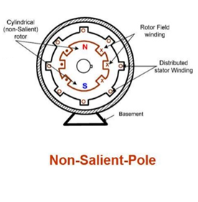
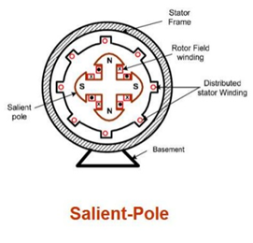
TWO REACTION THEORY
Non Salient pole alternator Air gap is uniform
Uniform air gap Field flux and Armature flux vary sinusoidally
Air gap length is constant and reactance is also constant
Field MMF and Armature MMF act upon the
same magnetic circuit can be added vectorially
Salient pole alternator Air gap is NOT uniform
Air gap length is NOT constant and
Reactance is also NOT constant
Field flux and Armature flux cannot vary sinusoidally
MMF act are different

Slide 78
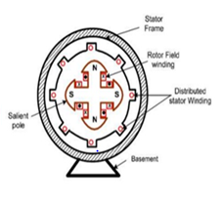
TWO REACTION THEORY
According to this theory Armature MMF can be divided into two components
1. Components acting along the pole axis is called Direct axis I_{d}
2. Components acting at right angle to the pole axis is called Quadrature axis I_{q}
Components acting along Direct axis I_{d} can be magnetizing or demagnetizing
Components acting along Quadrature axis I_{q} is Cross Magnetization
Direct Axis I_{d}
Direct Axis I_{d}
Quadrature Axis I_{q}
Quadrature Axis I_{q}

Slide 79
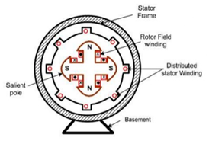
Quadrature Axis I_{q}
Direct Axis I_{d}
Quadrature Axis I_{q}
Direct Axis I_{d}
Direct Axis I_{d}
Quadrature Axis I_{q}
Quadrature Axis I_{q}
Direct Axis I_{d}

Slide 80
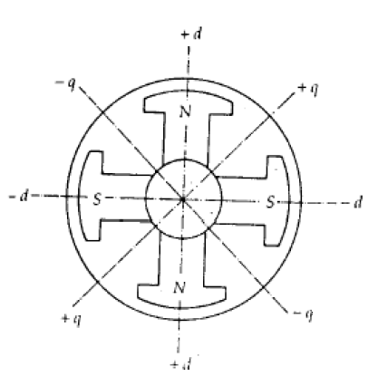
The reluctance offered to the mmf is lowest when
it is aligned with the field pole flux. Direct axis d-axis
The reluctance offered to the mmf is highest when
it is 90 to the field pole flux. Quadrature axis q-axis
F_{f} mmf wave produced by field winding along Direct axis

Slide 83
