Slide 1
Unit I Operation Research
By:
Dr. Pravin Kumar Agrawal
Assistant Professor
CSJMU

Slide 2
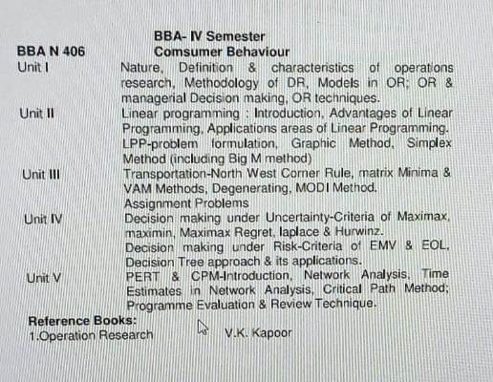

Slide 3
History
It is the method of analysis by which management receives aid for their decisions. Though the name of this method, Operation Research (O.R.) is relatively new, but the method used for this is not a new one. Operation Research is concerned with the application of the principles and the methods of science to the problems of strategy. The subject of operation research was born during Second World War in U.K., and was used for military strategy. During World War II, a group of scientists, having representatives from mathematics, statistics, physical and social sciences were entrusted to the study of various military operations.

Slide 4
History
This team was very successful and greatly contributed to the meticulous handling of entire operation and related problems of the operation.
The need for assigning such studies for operations arose because military strategies and their decisions become so important and costly and therefore, the best scientists, under the sponsorship of military organs were grouped together to provide quantitative information’s by adopting scientific techniques and methods for facilitating in taking decisions.

Slide 5
Definition
It is the application of scientific methods, techniques and tools to problems involving the operations of a system so as to provide those in the control of the system with optimum solutions to the problems.
Operation Research is a tool for taking decisions which searches for the optimum results in parity with the overall objectives and constraints of the organization.

Slide 6
Definition
O.R. is a scientific method of providing executive department with a quantitative basis of decisions regarding the operations under their control.
O.R. is a scientific approach to problem solving for management.

Slide 7
Definition
O.R. is an aid for executive in making his decisions by providing him with the needed quantitative information’s based on the scientific method of analysis.

Slide 8
Significance
It can be used for solving different types of problems, such as:
Problems dealing with the waiting line, the arrival of units or persons requiring service.
Problems dealing with the allocation of material or activities among limited facilities.
Equipment replacement problems.
Problems dealing with production processing i.e., production control and material shipment.

Slide 9
Characteristics
(i) Inter disciplinary Team Approach
This requires an inter-disciplinary team including individuals with skills in mathematics, statistics, economics, engineering, material sciences, computer etc.

Slide 10
Characteristics
(ii) Holistic Approach to the System:
While evaluating any decision, the important interactions and their impact on the whole organization against the functions originally involved are reviewed

Slide 11
Characteristics
(iii) Methodological Approach:
O.R. utilizes the scientific method to solve the problem

Slide 12
Characteristics
(iv) Objective Approach:
O.R. attempts to find the best or optimal solution to the problem under consideration, taking into account the goals of the organization
Notes:
http://www.gecj.ac.in/download/OR%20Model%20Answer%20Paper%20MBA.pdf

Slide 13
Limitations of Operations Research
Do not take into account qualitative and emotional factors.
Applicable to only specific categories of decision-making problems.
Required to be interpreted correctly.
Due to conventional thinking, changes face lot of resistance from workers and some­times even from employer.
Models are only idealized representation of reality and not be regarded as absolute.

Slide 14
Limitations of Operations Research
Time consuming and the results are difficult to control and evaluate.

Slide 15
Applications
(i) Distribution or Transportation Problems:
In such problems, various centres with their demands are given and various warehouses with their stock positions are also known, then by using linear programming technique, we can find out most economical distribution of the products to various centers from various warehouses.
(ii) Product Mix:
These techniques can be applied to determine best mix of the products for a plant with available resources, so as to get maximum profit or minimum cost of production.
(iii) Production Planning:
These techniques can also be applied to allocate various jobs to different machines so as to get maximum profit or to maximize production or to minimize total production time.

Slide 16
Applications
(iv) Assignment of Personnel:
Similarly, this technique can be applied for assignment of different personnel with different aptitude to different jobs so as to complete the task within a minimum time.
(v) Agricultural Production:
We can also apply this technique to maximise cultivator’s profit, involving cultivation of number of items with different returns and cropping time in different type of lands having variable fertility.
(vi) Financial Applications:
Many financial decision making problems can be solved by using linear programming technique.

Slide 17
Uses of operations research
Scheduling and time management
Urban and agricultural planning
Enterprise resource planning (ERP) and supply chain management (SCM)
Inventory management
Network optimization and engineering
Packet routing optimization
Risk management

Slide 18
Scope/Application
Agriculture
With the sudden increase of population and resulting shortage of food, every country is facing the problem of
Optimum allocation of land to a variety of crops as per the climatic conditions
Optimum distribution of water from numerous resources like canal for irrigation purposes
Hence there is a requirement of determining best policies under the given restrictions. Therefore a good quantity of work can be done in this direction.

Slide 19
Finance
In these recent times of economic crisis, it has become very essential for every government to do a careful planning for the economic progress of the country. OR techniques can be productively applied
To determine the profit plan for the company
To maximize the per capita income with least amount of resources
To decide on the best replacement policies, etc

Slide 20
Finance Budgeting and investments
(a) Cash flow analysis, long range capital requirements, investment portfolios, dividend policies etc.
(b) Credit policies credit risks and delinquent account procedures-claim and complaint procedures.
(c) Break even analysis, capital budgeting, cost allocation and control, and financial planning

Slide 21
Industry
If the industry manager makes his policies simply on the basis of his past experience and a day approaches when he gets retirement, then a serious loss is encounter ahead of the industry.
This heavy loss can be right away compensated through appointing a young specialist of OR techniques in business management.
Thus OR is helpful for the industry director in deciding optimum distribution of several limited resources like men, machines, material etc to reach at the optimum decision

Slide 22
Marketing
Where to allocate the products for sale so that the total cost of transportation is set to be minimum
The minimum per unit sale price
The size of the stock to come across with the future demand
How to choose the best advertising media with respect to cost, time etc?
How, when and what to buy at the minimum cost?

Slide 23
Marketing
Product selection, timing competitive actions.
Advertising strategy and choice of different media of advertising
Number of salesman frequency of calling of account etc
Effectiveness of market research
Size of the stock to meet the future demand

Slide 24
Personnel Management
A personnel manager can utilize OR techniques in
To appoint the highly suitable person on minimum salary
To know the best age of retirement for the employees
To find out the number of persons appointed in full time basis when the workload is seasonal

Slide 25
Personnel Management
Recruitment policies and assignment of jobs
Selection of suitable personnel on minimum salary
Mixes of age and skills
Establishing equitable bonus systems

Slide 26
Production Management
A production manager can utilize OR techniques in
To calculate the number and size of the items to be produced
In scheduling and sequencing the production machines
In computing the optimum product mix
To choose, locate and design the sites for the production plans

Slide 27
Production Management
Physical distribution.
(a) Location and size of warehouses distribution centers retail outlets etc.
(b) Distribution policy.
Manufacturing and facility planning.
(a) Production scheduling and sequencing
(b) Project scheduling and allocation or resources.
(c) Number and location of factories were houses hospitals and their sizes.
(d) Determining the optimum production mix.
Manufacturing
(a) Maintenance policies and preventive maintenance
(b) Maintenance crew sizes.

Slide 28
Production Management
Form all above areas of applications we may conclude that OR can be widely used in taking timely management decisions and also used as a corrective measure. The application of this tool involves certain data and not merely a personality of decision maker and hence we can say OR has replaced management by personality

Slide 29
Production Management
Besides its use in industry this new technique was also utilized in a number of socio-economic problems which came up after the war. Operations Research has come to be used in a very large number of areas such as problems of traffic question of deciding a suitable for public transport or industrial processes like ore-handling
Its use has now extended to academic spheres, such as the problems of communication of information socio-economic fields and national planning. The real development of Operation Research in the national field was carried out by prof. Mahalanobis in India when he used it in national planning.

Slide 30
Production Management
OR is also being used in Railways. Waiting or queucing problems of passengers for tickets at booking windows or trains queuing up in marshalling yard waiting to be sorted out are tackled by various OR techniques.
OR approach is also applicable to enable the L.I.C. offices of decide:
(i) What should be the premium rates for various modes of policies?
(ii) How best the profits could be distributed in the cases of with profit policies? etc.

Slide 31
Purchasing, Procurement and Exploration
Optimal buying and reordering with or without price quantity discount
• Transportation planning
• Replacement policies
Bidding policies
Vendor analysis

Slide 32
Purchasing, Procurement and Exploration
Production Management (Facilities planning)
Location and size of warehouse or new plant, distribution centers and retail outlets
Logistics, layout and engineering design
Transportation, planning and scheduling
Manufacturing
Aggregate production planning, assembly line, blending, purchasing and inventory control
Employment, training, layoffs and quality control
Allocating R&D budgets most effectively

Slide 33
Purchasing, Procurement and Exploration
Maintenance and project scheduling
Maintenance policies and preventive maintenance
Maintenance crew size and scheduling
Project scheduling and al location of resources

Slide 34
Role of Operations Research in Decision-Making
Notes:
http://www.tutorsglobe.com/homework-help/operation-research/scope-of-operation-research-7170.aspx

Slide 35
Role of Operations Research in Decision-Making
The Operation Research may be considered as a tool which is employed to raise the efficiency of management decisions.
OR is the objective complement to the subjective feeling of the administrator (decision maker).
Scientific method of OR is used to comprehend and explain the phenomena of operating system.
The benefits of OR study approach in business and management decision making may be categorize as follows

Slide 36
Better control
The management of large concerns finds it much expensive to give continuous executive supervisions over routine decisions.
An OR approach directs the executives to dedicate their concentration to more pressing matters.
For instance, OR approach handles production scheduling and inventory control.

Slide 37
Better coordination
Sometimes OR has been very helpful in preserving the law and order situation out of disorder.
For instance, an OR based planning model turns out to be a vehicle for coordinating marketing decisions with the restrictions forced on manufacturing capabilities.

Slide 38
Better system
OR study is also initiated to examine a particular problem of decision making like setting up a new warehouse.
Later OR approach can be more developed into a system to be employed frequently. As a result the cost of undertaking the first application may get better profits.

Slide 39
Better decisions
OR models regularly give actions that do enhance an intuitive decision making.
Sometimes a situation may be so complex that the human mind can never expect to assimilate all the significant factors without the aid of OR and computer analysis.

Slide 40
APPLICATIONS OF OPERATIONS RESEARCH
Some of the industrial/government/business problems that can be analyzed by the OR approach has been arranged by functional areas as follows:

Slide 41
Finance and Accounting
Dividend policies, investment and portfolio management, auditing, balance sheet and cash flow analysis
Claim and complaint procedure, and public accounting
Break even analysis, capital budgeting, cost allocation and control, and financial planning
Establishing costs for by-products and developing standard costs

Slide 42
Marketing
Selection or product-mix, marketing and export planning
• Advertising, media planning, selection and effective packing alternatives
• Sales effort allocation and assignment
• Launching a new product at the best possible time
• Predicting customer loyalty

Slide 43
Purchasing, Procurement and Exploration
Optimal buying and reordering with or without price quantity discount
• Transportation planning
• Replacement policies
Bidding policies
Vendor analysis

Slide 44
Purchasing, Procurement and Exploration
Production Management (Facilities planning)
Location and size of warehouse or new plant, distribution centers and retail outlets
Logistics, layout and engineering design
Transportation, planning and scheduling
Manufacturing
Aggregate production planning, assembly line, blending, purchasing and inventory control
Employment, training, layoffs and quality control
Allocating R&D budgets most effectively

Slide 45
Purchasing, Procurement and Exploration
Maintenance and project scheduling
Maintenance policies and preventive maintenance
Maintenance crew size and scheduling
Project scheduling and al location of resources

Slide 46
HR
Personnel Management
Manpower planning, wage/salary administration
Designing organization structures more effectively
Negotiation in a bargaining situation
Skills and wages balancing
Scheduling of training programmes to maximize skill development and retention

Slide 47
Techniques and General Management
Decision support systems and MIS; forecasting
Making quality control more effective
Project management and strategic planning Government
Economic planning, natural resources, social p l an n in g a n d en e rg y
Urban and housing problems

Slide 48
Decision-making environments

Slide 49
Decision-Making
Decision-making is needed whenever an individual or an organization (private or public) is faced with a situation of selecting an optimal (or best in view of certain objectives) course of action from among several available alternatives.
For example, an individual may have to decide whether to build a house or to purchase a flat or live in a rented accommodation; whether to join a service or to start own business; which company's car should be purchased, etc. Similarly, a business firm may have to decide the type of technique to be used in production, what is the most appropriate method of advertising its product, etc.
The decision analysis provides certain criteria for the selection of a course of action such that the objective of the decision-maker is satisfied. The course of action selected on the basis of such criteria is termed as the optimal course of action.

Slide 50
Decision Alternatives
Every decision-maker is faced with a set of several alternative courses of action A₁, A₂, ...... A_{m} and he has to select one of them in view of the objectives to be fulfilled.

Slide 51
States of Nature
These are the future conditions that are not under the control of decision maker.
A state of nature can be the state of economy (e.g. inflation), a weather condition etc. The state of nature are usually not determined by the action of an individual or an organization, These are the results of an “act of GOD”

Slide 52
Payoff
A numerical value (outcome) resulting from each possible combination of alternatives and state of nature is called pay off. The payoff values are always conditional values because of unknown states of nature.
Measured within a specified period (e.g. after one year). This period is called as the decision horizon.

Slide 53
Payoff matrix
State of Nature | Probability | Course of Action (Alternatives)
 |  | S₁ | S₂ | Sn
N₁ | P1 (0.2) | p₁₁ | P₁₂ | p_{1n}
N₂ | P2 (0.3) | P₂₁ | P₂₂ | P_{2n}
. | .
. | .
N_{m} | Pn (0.4) | P_{m1} | P_{m2} | P_{mn}

Slide 54
Payoff matrix
520
650
State of Nature | Probability | Course of Action (Alternatives)
 |  | S_{1 (Salman)} | S_{2 (Amitabh)} | Sn (Katrina)
N_{1 (low)} | P1 (0.2) | p₁₁ (100) | p₁₂ (200) | p_{1n} (300)
N_{2 (medium)} | P2 (0.3) | P₂₁ (200) | P₂₂ (400) | P_{2n} (500)
. | .
. | .
N_{m (high)} | Pn (0.4) | P_{m1} (700) | P_{m2} (900) | P_{mn (1100)}
Salman = 100*0.2+ 200*0.3 + 700*0.4 = 20+60+280 = 360

Slide 55
Steps of Decision Making Process
Identify and define the Problem.
List all possible future events, called state of nature, which can occur in the context of the decision problem. Such events are not under the control of decision maker because they are erratic in nature.
Identify all the courses of action (alternatives or decision choices) that are available to decision maker. The decision maker has control over these courses of action.
Express the payoffs (pij) resulting from each pair of course of action and state of nature. These payoffs are normally expressed in monetary value.
Apply an appropriate mathematical decision theory model to select the best course of action from the given list on the basis of some criterion (measure of effectiveness) that results in the optimal (desired) payoff.

Slide 56
Types of Decision Making Environments

Slide 57
Decision Making under Certainty
In this case decision maker has the complete knowledge of consequences of every decision choice (course of action or alternative). Obviously, he will select an alternative that yields the largest return (payoff) for the known future (state of nature).
Eg: the decision to purchase either National Saving Certificate, Kisan Vikas Patra, Fixed Deposits is one in which it is reasonable to assume complete information about the future because there is no doubt that the Indian government will pay the interest when it is due and the principal at maturity

Slide 58
Decision Making under Risk
In this case the decision maker has less than complete knowledge of the consequences of every decision choice (course of action).
This is because it is not definitely known which outcome will occur.
This means there is one state of nature (future) and for which he makes an assumption of the probability with which each state of nature will occur. Eg product demand high, low, medium.

Slide 59
Decision Making under Uncertainty
A decision problem, where a decision-maker is aware of various possible states of nature but has insufficient information to assign any probabilities of occurrence to them, is termed as decision-making under uncertainty.
A situation of uncertainty arises when there can be more than one possible consequences of selecting any course of action. In terms of the payoff matrix, if the decision-maker selects A₁, his payoff can be X₁₁, X₁₂, X₁₃, etc., depending upon which state of nature S₁, S₂, S₃, etc., is going to occur.

Slide 60
Most significant decisions made in today’s complex environment are formulated under a state of uncertainty. Conditions of uncertainty exist when the future environment is unpredictable.
The decision-maker is not aware of all available alternatives, the risks associated with each, and the consequences of each alternative or their probabilities.

Slide 61
Decision Making under Uncertainty
The manager does not possess complete information about the alternatives and whatever information is available, may not be completely reliable.
In the face of such uncertainty, managers need to make certain assumptions about the situation in order to provide a reasonable framework for decision-making.
They have to depend upon their judgment and experience for making decisions.

Slide 62
Decision making under Uncertainty
Optimism (Maximax or Minimin) criterion (2018-19)
Pessimism (Maximin or Minimax) criterion (2018-19)
Equal Probabilities (Laplace) criterion
Coefficeint of optimism (Hurwicz) criterion
Regret (Salvage) criterion

Slide 63
Optimism (Maximax or Minimin) Criterion
In this criterion the decision–maker ensures that he/she should not miss the opportunity to achieve the largest possible profit (maximax) or the lowest possible cost (minimin). Thus he selects the alternative (decision choice or course of action) that represents the maximum of the maxima (or minimum of the minima) payoffs . The working method is as follows:
Locate the maximum (or minimum) payoffs values corresponding to each alternatives (or course of action).
Select an alternative with best anticipated payoff value (maximum for profit and minimum for cost).

Slide 64
Pessimism (Maximin or Minimax) Criterion
In this criterion the decision–maker ensures that he/she would earn no less (or pay no more) than some specified amount. Thus he/she selects the alternative that represents the maximum of the minima (or minimum of the maxima in case of loss) payoffs in case of profits. The working method is as follows:
Locate the minimum (or maximum in case of profit) payoff value in case of loss (or cost) data corresponding to each alternatives.
Select an alternative with the best anticipated payoff value (maximum for profit and minimum for cost).

Slide 65
Pessimism (Maximin or Minimax) Criterion
Since in this criterion the decision-maker is conservative about the future and always anticipates the worst possible outcome (minimum for profit and maximum for cost or loss), it is called a pessimistic decision criterion. This is also known as Wald’s Criterion.

Slide 66
Equal Probabilities (Laplace) Criterion
This criterion is based on, what is known as the principle of insufficient reason. Since the probabilities associated with the occurrence of various events are unknown, there is not enough information to conclude that these probabilities will be different (this is because except in few cases, some information of the likelihood of occurences of states of nature is available). Hence it is assumed that all states of nature will occur with equal probability. That is, each state of nature is assigned an equal probability. As states of nature of mutually exclusive and collectively exhaustive, the probability of each of these must be 1/(number of states of nature)

Slide 67
Equal Probabilities (Laplace) Criterion
This criterion involves following steps
Step I Assign equal probabilities 1/(number of states of nature) to each pay off a strategy.
Step II Determine the expected pay off value for each alternative
Step III Select that alternative which corresponds to the maximum (and minimum for cost) of the above expected pay offs.

Slide 68
Coefficient of Optimism (Hurwicz) Criterion
This criterion suggests that a rational decision maker should neither be completely optimistic nor be pessimistic and therefore, must display a mixture of both.
Hurwicz, who suggests this criterion, introduced the idea of a coefficient of optimism (denoted by α) to measure the decision maker’s degree of optimism.
This coefficient lies between 0 and 1, where 0 represents a completely pessimistic attitude about the future and 1, completely optimistic attitude about the future. Thus, if it is the coefficient of optimism, then (1- α ) will represent the coefficient of pessimism. The working procedure is –

Slide 69
Hurwicz Formula
The hurwicz approach suggest that the decision maker must select an alternative that
maximizes
H (Criterion of Realism) = ᾀ (Maximum in Column) + (1- ᾀ) (Minimum in column)

Slide 70
Coefficient of Optimism (Hurwicz) Criterion
Select an alternative with value of H as maximum.
For α=1, the Hurwitz criteria is equal to the maximin or minimax criteria.
For α = 0, it is equal to maximax or minimin criteria.
A difficulty with this criteria is the appropriate selection of α between 0 and 1

Slide 71
Regret (Salvage) Criterion
While the above criterions do not take into account the cost of opportunity loses by making the wrong decision, the Savage criterion does so. The savage criterion is based on the concept of regret (or opportunity loss) and calls for selecting the course of action that minimizes the maximum regret. This criterion is assume that decision maker feels regret after adopting a wrong course of action (alternative) resulting in an opportunity loss of pay off. The working method is as follows:

Slide 72
Regret (Salvage) Criterion
Step I From the given pay off matrix, develop an opportunity loss (or regret) matrix as follows
(a) Find the best pay off corresponding to each state of nature.
(b) Subtract all other entries (payoff values) in that row from this value.
Step II: For each course of action (Strategy or alternative) identify the worst or maximum regret value. Record this number in a new row.
Step III: Select the course of action (alternative) with the smallest anticipated opportunity – loss value

Slide 73
Numerical 1
A food Product company is contemplating the introduction of a revolutionary new product with new packaging or replacing the existing product at much higher price (S1). It may even make a moderate change in the composition of existing product, with a new packaging at a small increase in price (S2), or may a small change in the composition of the existing product, backing it with the word new and the negligible increase in price (S3). The three possible state of Nature or events are:
(i) High increase in Sale N1
(ii) No Change in Sale N2
(iii) decrease in Sale N3.

Slide 74
The marketing department of the company worked out the payoffs in terms of yearly net profits for each of the strategies of three events (expected sales). This is represented in the following table:

Slide 75
 | States of Nature
Strategies | N1 (High Sales) | N2 (No Change) | N3 (Low Sales)
S1 | 7,00,000 | 3,00,000 | 1,50,000
S2 | 5,00,000 | 4,50,000 | 0
S3 | 3,00,000 | 3,00,000 | 3,00,000
Which Strategy Should be concerned executive choose on the basis of:
Maximin Criterion
Maximax Criterion
Minimax Regret Criterion
Laplace Criterion

Slide 76
(a) Maximin Criterian
 | Strategies
States of Nature | S1 | S2 | S3
N1 | 7,00,000 | 5,00,000 | 3, 00,000
N2 | 3,00,000 | 4,50,000 | 3,00,000
N3 | 1,50,000 | 0 | 3,00,000
Coloumn (Minimum) | 1,50,000 | 0 | 3,00,000
The maximum of column minima is 3,00,000 . Hence the company should adopt
Strategy S3

Slide 77
(a) Maximax Criterian
 | Strategies
States of Nature | S1 | S2 | S3
N1 | 7,00,000 | 5,00,000 | 3, 00,000
N2 | 3,00,000 | 4,50,000 | 3,00,000
N3 | 1,50,000 | 0 | 3,00,000
Coloumn (Maximum) | 7,00,000 | 5,00,000 | 3,00,000
The maximum of column maxima is 7,00,000 . Hence the company should adopt
Strategy S1.

Slide 78
Minimax Regret Criterion
 | States of Nature
Strategies | S1 | S2 | S3
N1 | 7,00,000 | 5,00,000 | 3, 00,000
N2 | 3,00,000 | 4,50,000 | 3,00,000
N3 | 1,50,000 | 0 | 3,00,000

Slide 79
Minimax Regret Criterion
 | Strategies
States of Nature | S1 | S2 | S3
N1 | 7,00,000 - 7,00,000 = 0 | 7,00,000 - 5,00,000 = 2,00,000 | 7,00,000 - 3, 00,000 = 4,00,000
N2 | 4,50,000 - 3,00,000 = 1,50,000 | 4,50,000- 4,50,000 =0 | 4,50,000 - 3,00,000 =1,50,000
N3 | 3,00,000 - 1,50,000 = 1,50,000 | 3,00,000 – 0 = 3,00,000 | 3,00,000 - 3,00,000 = 0
Coloumn (Maximum) | 1,50,000 () | 3,00,000 | 4,00,000
Minimax Regret
Hence the company should adopt minimum opportunity loss Strategy S1.

Slide 80
Laplace Criterion
Since we do not know the probabilities of State of nature, assume that they are equal. In this example we assume that each state of nature has a probability of 1/3 occurrence. Thus

Slide 81
Laplace Criterion
 | Strategies
States of Nature | S1 | S2 | S3
N1 (1/3) | 7,00,000 | 5,00,000 | 3, 00,000
N2 (1/3) | 3,00,000 | 4,50,000 | 3,00,000
N3 (1/3) | 1,50,000 | 0 | 3,00,000

Slide 82
Laplace Criterion
Strategy | Expected Return (Rs. )
S1 | (7,00,000 + 3,00,000 + 1,50,000)/3 = 3,83,333.33
S2 | (5,00,000 + 4,50,000 + 0)/3 = 3,16,666.66
S3 | (3,00,000+3,00,000+3,00,000)/3 = 3,00,000
Since the largest expected return is from strategy S1, the executive must select strategy S1.

Slide 83
A firm manufactures three types of products. The fixed and variable costs are given below: Fixed Cost Variable Cost per Unit
Product A 25 12
Product B 35 19
Product C 53 17

Slide 84
Numerical
The likely demand (units) of the products is given below:
Poor demand : 3
Moderate demand : 7
High demand : 11
If the sale price of each type of product is Rs. 25, then prepare the payoff matrix

Slide 85
Solution
Let D1, D2 and D3 be the poor, moderate and high demand, respectively
The payoff is determined as
Payoff = Sales revenue – Cost

Slide 86
Solution
The calculations for payoff for each pair of alternative demand (course of action) and the types of product (state of nature) are shown below:

Slide 87
Solution
D1A = 3 × 25 – 25 – 3 × 12 = 14 (Revenue – FC - VC)
D2A = 7 × 25 – 25 – 7 × 12 = 66
D3A = 11 × 25 – 25 – 11 × 12 = 118
D1B = 3 × 25 – 35 – 3 × 19 = 13
D2B = 7 × 25 – 35 – 7 × 19 = 77
D3B = 11 × 25 – 35 – 11 × 19 = 141
D1C = 3 × 25 – 53 – 3 × 17 = 1
D2C = 7 × 25 – 53 – 7 × 17 = 73
D3C = 11 × 25 – 53 – 11 × 17 = 145

Slide 88
Solution

Slide 89
Decision Making Under Risk
A probabilistic decision situation in which more than one state of nature exists and the decision maker has sufficient information to assign probability values to the likely occurrences of each of these states.
The best decision is to select that course of action which has the largest expected pay off value.
The expected (average) payoff of an alternative is sum of all possible payoffs of that alternative, weighted by the probabilities of the occurrence of those payoffs.
The most widely used criterion for evaluating various course of action (alternatives) under risk is the Expected Monetary Value (EMV).

Slide 90
Expected Monetary Value (EMV) (2018-19)
The expected monetary value (EMV) for a given course of action is the weighted sum of possible payoffs for each alternative. The expected (or mean) value is the long run average value that would result of the decision were repeated a large no. of times. Mathematically EMV is stated as follows:
EMV = Ʃ Ʃ pijpi
Where,
m = no. of possible state of nature
pi = Probability of occurrence of state of nature, Ni
pij = payoff associated with state of nature Ni and course of action Sj.

Slide 91
Expected Monetary Value Example I
You are managing a software development project and identified a risk related to market demand. The possibility of risk is 20% and if it occurs you will lose Rs. 10,000. Now we will calculate the EMV of this risk.

Slide 92
Example I
Probability of occurrence: 20%
Impact of risk : Rs. – 10,000
EMV = 0.2 x -10,000 = Rs. – 2,000

Slide 93
Expected Monetary Value Example II
You are managing an IT project and identified a risk related to customer’s demand. However, you also identified an opportunity which increases the sales price. The possibility of risk is 10% and if it occurs you will lose 50,000 USD, on the other hand, the possibility of opportunity is 15% and if it occurs you gain 30,000 USD. Now we will calculate the EMV of this situation.

Slide 94
Expected Monetary Value Example
I Case
Probability of occurrence : 10%
Impact of risk : – 50,000 USD
EMV = 0.1 x -50,000 = – 5,000 USD
II Case
Probability of occurrence: 15%
Impact of risk : +30,000 USD
EMV = 0.15 x 30,000 = 4,500 USD
The Expected Monetary Value of this situation is – 5,000 USD + 4,500 USD = -500 USD

Slide 95
Suppose you are a project manager of a pipeline project and your project have some risks that may cause delay and cost overruns.
Project Risk 1: There is a 25% possibility of heavy rain. This will cause a delay in the project for 3 weeks and cost Rs. 100,000.
Project Risk 2: There is a 15% percent probability of the price of rental equipment increasing, which will cost Rs. 200,000.
Project Risk 3: There is a 10% percent probability of the price of labor increases, which will cost Rs. 90,000.
Project Risk 4: There is a 30% possibility of increasing the productivity of excavators due to the ground conditions. This will enable to complete the project 2 weeks before and save Rs. 50,000.

Slide 96
Now Let’s calculate the EMV of the project
Risk | Probability | Impact (Rs.) | EMV = Probability X Impact (Rs.)
1 | 25% | -1,00,000 | -25,000
2 | 15% | -2,00,000 | -30,000
3 | 10% | -90,000 | -9,000
4 | 30% | 50,000 | 15,000
EMV of the Project |  |  | -49000
In this scenario, the project manager should add Rs. 49,000 to the project budget to
manage those risks.

Slide 97
Benefits of Expected Monetary Value (EMV) Analysis
Enables to calculate contingency reserve.
Improves statistical thinking
Improves decision making
This technique gives realistic results when there is a large number of risks in the project.
Helps to select the risk management alternative which requires less cost.
This technique does not require additional cost, it only requires an expert to make risk calculations.
It can be used in conjunction with decision tree analysis.

Slide 98
Limitations of Expected Monetary Value (EMV) Analysis
If the positive and negative risks are not identified properly, the result would be misleading.
The impact of risk calculation as a monetary value may be difficult in some cases.

Slide 99
Expected Opportunity Loss
One more way of maximizing monitory value is to minimize the expected opportunity loss or expected value of regret. The conditional EOL or regret function for a particular course of action is determined by taking the difference between payoff value of the most favorable course of action i.e. maximum pay off and pay off for each Course of action for a given state of nature. The course of action for which EOL is minimum is recommended.
EOL = Ʃ lij pi
lij = opportunity loss due to state of nature Ni and Course of Action Sj
Pi = Probability of occurrences of state of nature, Ni
Notes:
https://www.coursehero.com/file/p2losa4/Decision-Making-under-Risk-Expected-Opportunity-Loss-EOL-Another-useful-way-of/

Slide 100
Expected Value of Perfect Information(EVPI)
EVPI is the maximum amount which the decision maker can spend to obtain the perfect information on which to base a given decision is called expected value of perfect information.
EVPI = Expected Profit with perfect information[EPPI] – Expected Monetary value

Slide 101
Expected Value of Perfect Information(EVPI)
THE EVPI indicates the expected or the average return in the long run, of the best possible decision, If we have the perfect information before a decision is made .
In order to maximize his profits or minimized his losses the decision maker would be interested in basing his decisions on a perfect predictor.
In order to look out for perfect predictor, The decision maker will be interested together in some additional information about the different state of nature. This would involve some expenditure in the form of the cost of conducting some experiments or survey to obtain the perfect information.
This perfect information will reduce the opportunity losses due to uncertainty to zero.

Slide 102
Expected Value of Perfect Information (EVPI)
By perfect information we mean complete and accurate information about the various states of nature in the future.
If the businessman, say, the retailer, knows in advance about the exact demand for his daily/ weekly/monthly/ product, he will store the exact no . of goods as per demand and consequently will not incur any loses on the unsold stock.
The expected value of perfect information is the difference between the expected profit with perfect information and without perfect information.

Slide 103
Pay Off Table
Alternatives | State of Nature
 | Growing | Stable | Declining
Bonds | 20 | 20 | 20
Stocks | 70 | 30 | -13
Mutual Funds | 53 | 45 | -5
Probability | 0.2 | 0.5 | 0.3

Slide 104
Alternatives | Growing | Stable | Declining | EMV
Bonds | 20 | 20 | 20 | 20
Stocks | 70 | 30 | -13 | 25.1
Mutual Funds | 53 | 45 | -5 | 31.6
Probability | 0.2 | 0.5 | 0.3
EMV (Bonds) = 20 (0.2) + 20 (0.5) + 20 (0.3) = 20
= 70 * 0.2 + 53*0.2 + 20 = 44.6 - 31.6 = 13
Decision = Invest in Bonds

Slide 105
EVPI = EVwPI - EVwoPI
Expected Value on perfect Information
Expected Value without perfect Information =
EMV
EVwPI = 70 (0.2) – 45 (0.5) + 5 (0.3) = = 38
So EVPI = 38-32 = 6

Slide 106
Pay Off Cost Table
Alternatives | State of Nature
 | S1 | S2 | S3
D1 | 12 | 9 | 13
D2 | 15 | 11 | 8
D3 | 5 | 18 | 10
Probability | 0.3 | 0.5 | 0.2

Slide 107
Alternatives | State of Nature
 | S1 | S2 | S3 | EMV
D1 | 12 | 9 | 13 | 10.7
D2 | 15 | 11 | 8 | 11.6
D3 | 5 | 18 | 10 | 12.5
Probability | 0.3 | 0.5 | 0.2
Decision Choose d1

Slide 108
EVPI = EVwPI - EVwoPI
Expected Value on perfect Information
Expected Value without perfect Information =
EMV
EVwPI = 5 (0.3) + 9 (0.5) + 8 (0.2) = = 7.6
So EVPI = 7.6 -10.7 = -3.1 = 3.1

Slide 109
Decision Tree

Slide 110
2019-20
What are decision tree? Explain the decision tress with the help of any example.

Slide 111
Definition
A decision tree analysis involves the construction of a diagram that shows, at a glance, when decision are expected to be made – in what sequence, their possible consequences and what are the resultant payoff. The result of the computations can be shown directly on the trees.

Slide 112
Decision Tree
A decision tree is made of nodes, branches, probability estimates and payoffs. There are two types of nodes:
Decision nodes
Chance Nodes

Slide 113
Decision nodes
It is represented by a square and represent places where a decision maker must make a decision. Each branch leading away from the node indicates one of the several possible courses of action available to the decision maker.

Slide 114
Chance Node
The Chance node is indicated by a circle and represents a point at which the decision maker will discover the different possible outcomes (state of nature, competitor action etc.).
A branch leading away from a chance node represents the state of nature of a set of chance events.

Slide 115
Decision Tree depicts decision making under risk, the assumed probabilities of the states of nature are written alongside their respective chance branch.

Slide 116
The payoff can be positive (revenue or sales) or negative (expenditure or cost) and it can be associated either with decision or chance branches.

Slide 117
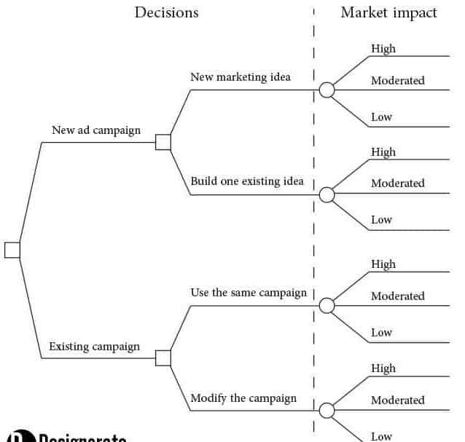

Slide 118
Decision Tree Analysis
The optimal sequence of decision in a tree is found by starting at the right hand side and rolling backwards. The aim of this operation is to maximize the return from the decision situation. At each node an expected return is calculated (called positional value. ).
If the node is a chance node, then the position value is calculated as the sum of the products of the probabilities or the branches emanating from the chance node and their respective position values.

Slide 119
Decision Tree Analysis…
If the node is decision node, then the expected return is calculated for each of its branches and the highest return is selected. The procedure continues until the initial node is reached.
The positional values for this node correspond to the maximum expected return obtained from the decision sequence.

Slide 120
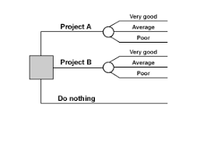

Slide 121
A, 20.2
= 70 (0.4) -13 (0.6) = 20.2
B, 18.2
= 53 (0.4) – 5 (0.6) = 18.2
C = 20*0.4 + 20* 0.6 = 20

Slide 122
A, 20.2
=70*(0.4) + -13 (0.6) = 20.2
B, 18.2
=53*(0.4) + -5 (0.6) = 18.2

Slide 123
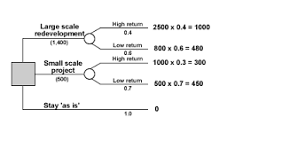
A
= 1000 + 480 = 1480 – 1400 = 80
= 300+450 =750 – 500 = 250

Slide 124
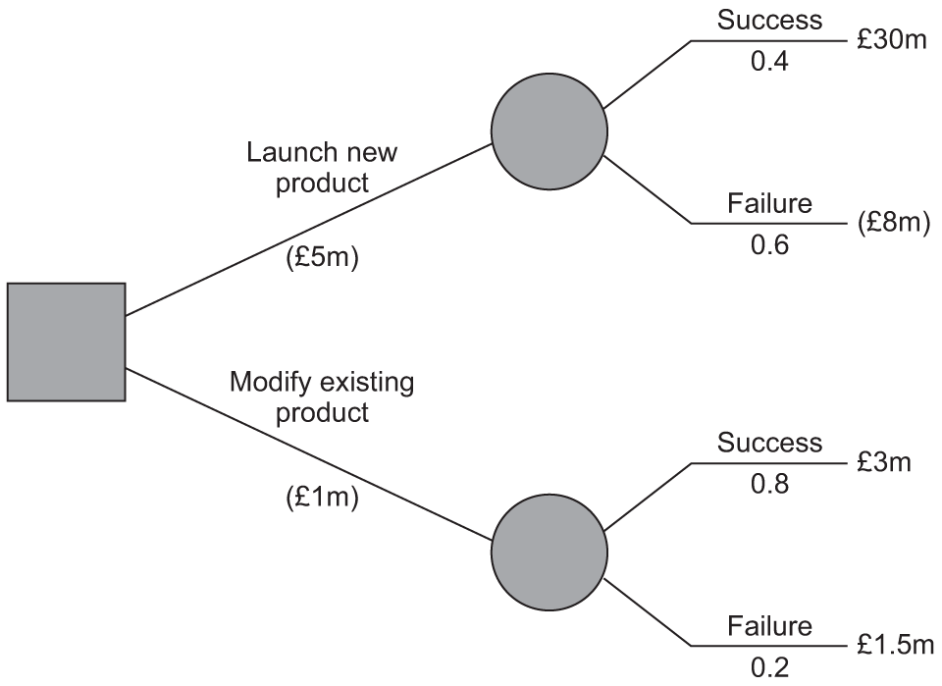

Slide 125
Numerical 1
A glass factory that specializes in crystal is developing a substantial backlog and for this the firm’s management is considering three courses of action: To arrange for subcontracting (S1), to begin overtime production (S2), and to construct new facilities (S3).
The correct choice depends largely upon the future demand, which may be low, medium, or high. By consensus, management ranks the respective probabilities as 0.10, 0.50 and 0.40.
A cost analysis reveals the effect upon the profits. This is shown in the table below:

Slide 126
Show this decision situation in the form of a decision tree and indicate the most
preferred decision and its corresponding expected value.

Slide 127
Answer
A decision tree that represents possible courses of action and states of nature is shown.
In order to analyze the tree, we start working backwards from the end branches. The most preferred decision at the decision node is found by calculating the expected value of each decision branch and selecting the path (course of action) that has the highest value.

Slide 128
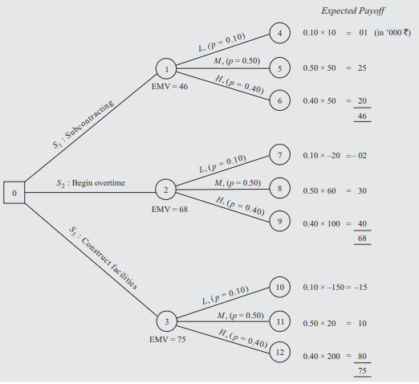

Slide 129
Advantages of Decision Tree
It structure the Decision Process and helps decision making in an orderly, systematic and sequential manner
It requires the decision maker to examine all possible outcomes whether desirable or undesirable.
It communicates the decision-making process to others in an easy and clean manner
It is especially useful in situations where the initial decision and its outcome affect the subsequent decisions. it can be applied in various fields such as introduction of new product, marketing make or buy decision, investment decision and so on.

Slide 130
Disadvantages of Decision Tree
Decision tree diagrams become more complicated as the number of decision alternative increases and more variables are introduced
It analysis the problem in terms of expected values and thus yields on average valued solution.
there is often inconsistency in assigning probabilities for different events

Slide 131
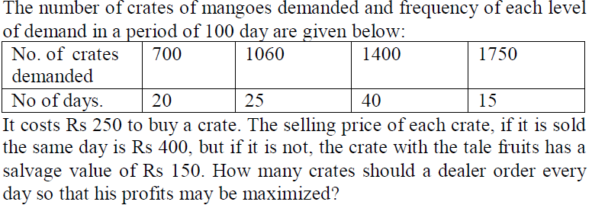

Slide 132
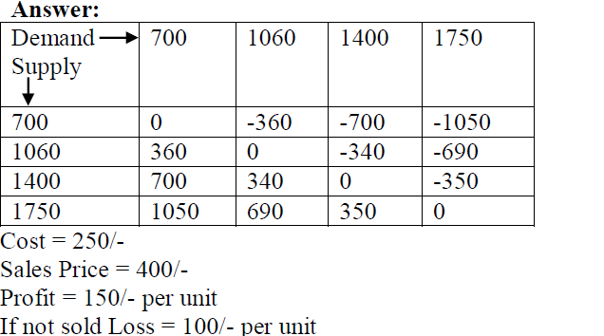

Slide 133
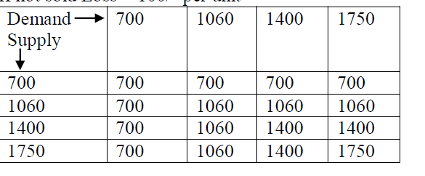

Slide 134
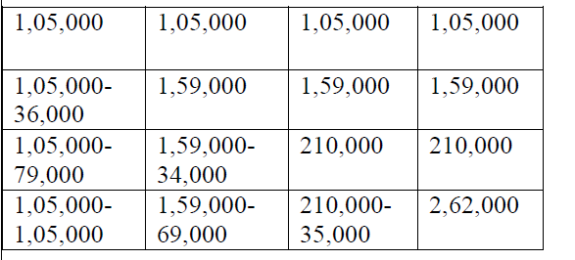

Slide 135
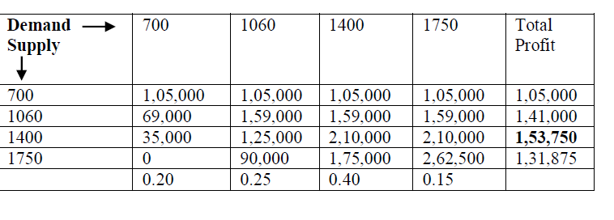

Slide 136
2017-18
Suppose a grocer is faced with a problem of how many cases of milk to stock to meet tomorrow's demand. All the cases of milk left at the end of the day are worthless. Each case of milk is sold for Rs.8 and it is purchased for Rs. 5/. Hence each case sold brings a profit of Rs.3 but if it is not sold at the end of the day it must resulting in a loss of Rs.5. The historical record of the no. of cases of milk demanded is as follows:-

Slide 137
2017-18
No. of cases of Milk Demanded | Probability of each event
13 | 0.05
14 | 0.10
15 | 0.20
16 | 0.30
17 | 0.25
18 | 0.10
TOTAL | 1.00
What should be the optimal solution for decision of the grocer concerning the no. of
Cases of milk to stock.

Slide 138
The situation facing the grocer can be structured in the form of matrix as follows

Slide 139
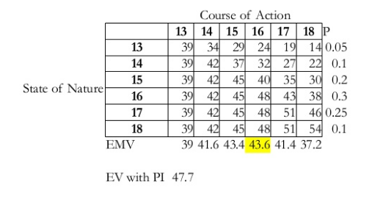
Emv = 39X0.05 + 39X0.1 + 39X0.2+39X0.3 +39X0.25 + 39X0.1 =39
dfvsdfdsfsddfdfdfdfdfdf
sdsdsdsdsdsdsdsdsdsddsdszdsdsdsdsdsdsdsdsdsddds

Slide 140
2018-19
Job | 1 | 2 | 3 | 4 | 5 | 6
Machine A | 4 | 8 | 3 | 6 | 7 | 5
Machine B | 6 | 3 | 7 | 2 | 8 | 4

