Slide 1
Unit I Portfolio Management
Dr. Pravin Kumar Agrawal
Assistant Professor
Department of Business Management
PhD (Finance)

Slide 2
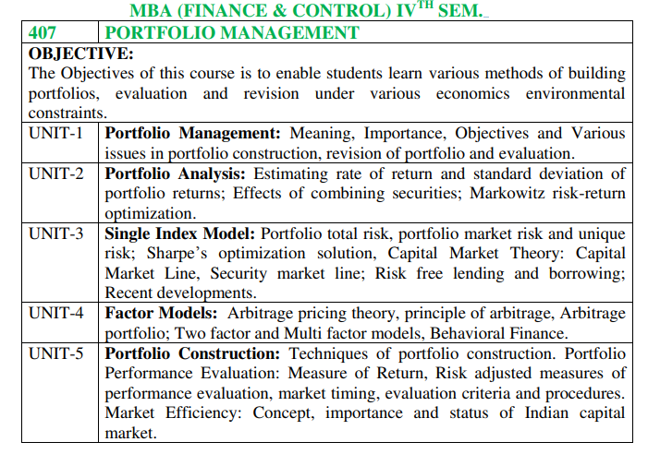

Slide 3
IAPM2021-22,AtulStanleyHermit
That part of income which is not consumed, but kept away for investment, future consumption;
Requires sacrifice of current consumption.

Slide 4
IAPM2021-22,AtulStanleyHermit
An individual’s/entity’s savings or surplus fund, utilized usually by another for productive purpose;
Usually comprising of a pre-determined / market- determined return.

Slide 5
Financial instruments enabling investment in financial (mainly capital) markets;
Provide the investor with associated financial rights, interests
Include equity stocks, debt securities (bonds, debentures), etc.

Slide 6
IAPM2021-22,AtulStanleyHermit
A market where people trade financial securities and derivatives at low transaction costs.
Comprises of stock/commodity exchanges at a physical location (such as NYSE, BSE) or primarily an electronic system (such as NSE, NASDAQ), inter-bank system and money markets, etc.

Slide 7
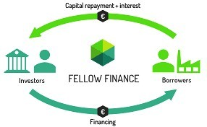
IAPM2021-22,AtulStanleyHermit
A financial market typically enables flow of funds from the savers (with surplus funds) to the users (with fund requirements) for a productive purpose.
Fund users issue securities to get funds.

Slide 8
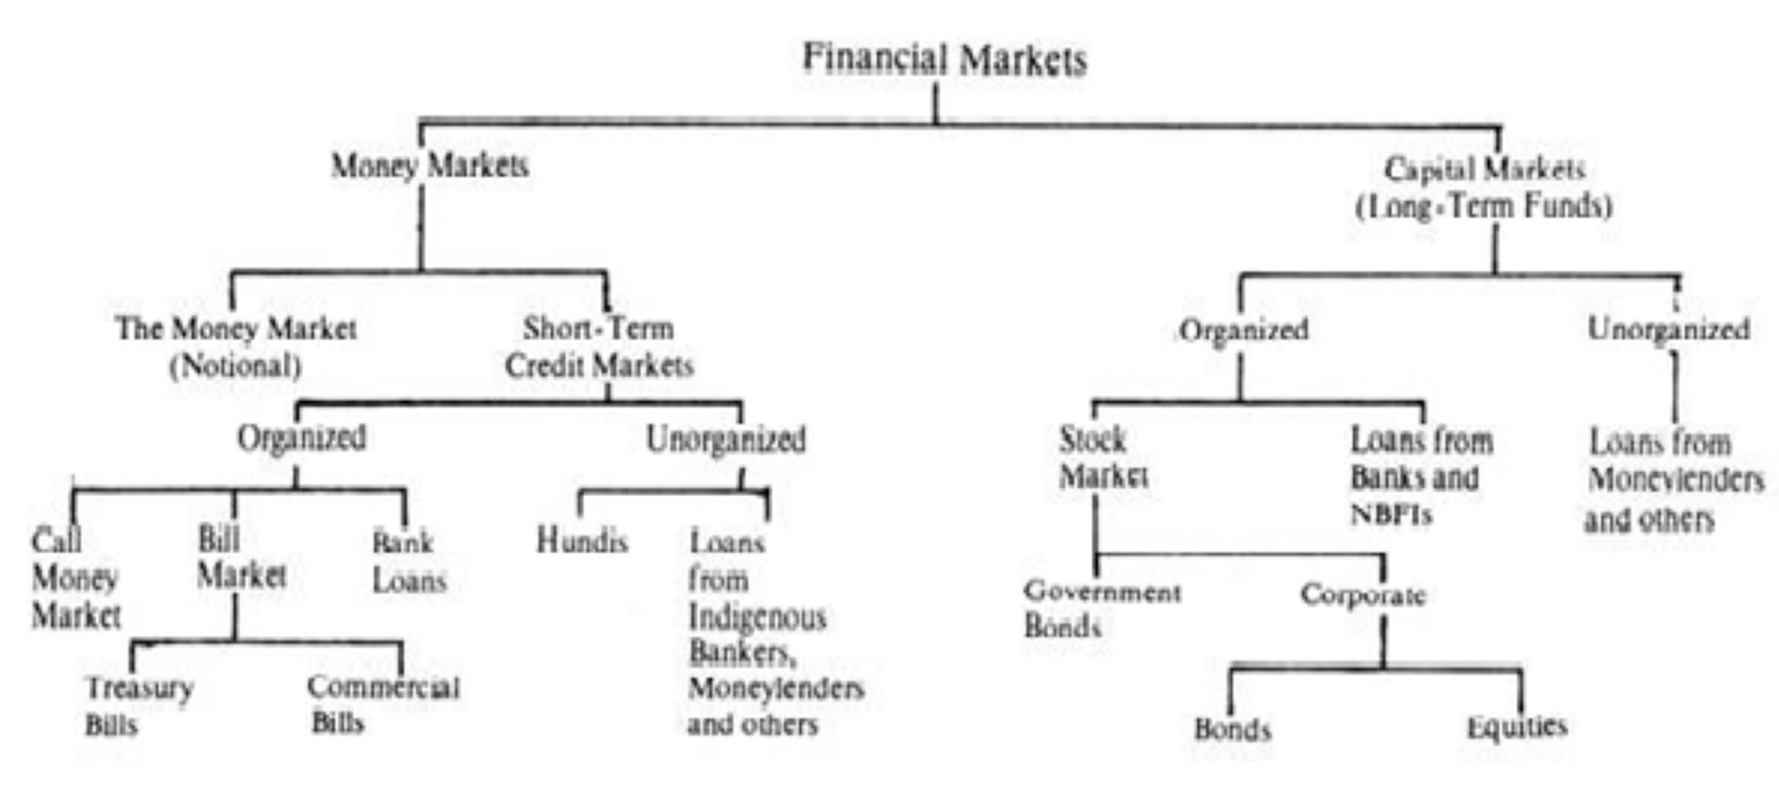
IAPM2021-22,AtulStanleyHermit

Slide 9
IAPM2021-22,AtulStanleyHermit
A capital market is a financial market in which long- term debt or equity-backed securities are bought and sold;
It is in contrast to a money market where short-term debt is bought and sold;
It seeks to improve transactional efficiencies as it brings fund suppliers (mainly banks and individual & institutional investors, HNIs) together with fund users (businesses, governments, individuals) thereby providing a basis for both to exchange securities;
Most common capital markets are the stock market and the bond market.

Slide 10
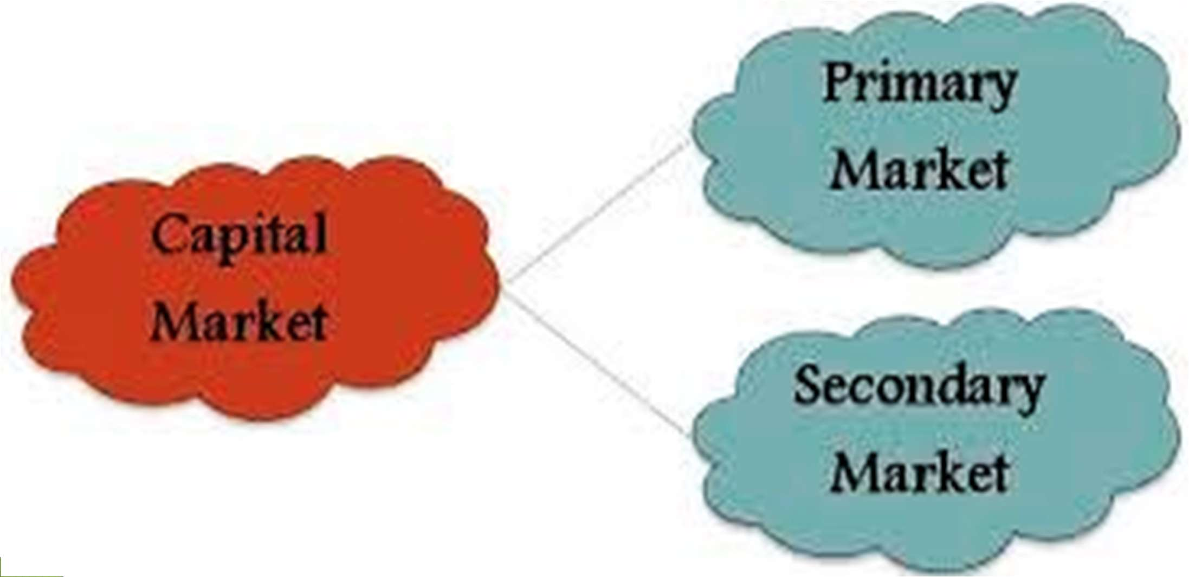
IAPM2021-22,AtulStanleyHermit

Slide 11
IAPM2021-22,AtulStanleyHermit
Facilitates the issue of new securities (equity shares, bonds or mutual fund schemes) to the investing public;
Usually utilized by public limited companies, government entities and mutual fund houses to raise funds via new securities;
New issues enable expansion of organization’s operations much beyond the financial capacities of founders, private owners.

Slide 12
IAPM2021-22,AtulStanleyHermit
Enables origination & analysis of new issue proposal;
Enables issue of new securities to public for the first time;
Enables capital formation by channelizing funds from the savers (individual, non-individual and institutional investors) into productive investments;
Enables proper distribution of a new issue of securities;
Enables underwriting of security issue to ensure the much required capital formation.

Slide 13
IAPM2021-22,AtulStanleyHermit
New Issues are managed as:
Fixed Price Issues
Book Building Issues
Main Type of New Issues are:
Initial Public Offers (IPOs)
Further Public Offers (FPOs) incl. Rights Issue

Slide 14
IAPM2021-22,AtulStanleyHermit
New issue process is tedious and expensive, with commitment of considerable efforts & financial resources;
New issue of a security needs to mandatorily comply with stringent regulatory requirements & are subject to restrictions;
Subscription response to a new issue (& hence its success/failure) is mainly dependant on the prevailing market, economic & political conditions.

Slide 15
IAPM2021-22,AtulStanleyHermit
Facilitates the trading (or purchase & sale) of listed securities (or commodities) on a regular basis;
Traded securities can include equity shares, bonds and debentures, etc. that are issued by corporate business entities, government / quasi-government entities and public sector organizations.

Slide 16
IAPM2021-22,AtulStanleyHermit
Creation of liquidity for investor to sell/purchase on a regular basis.
Clearing & Settlement of securities in dematerialized format, different to earlier physical format of securities.
Anonymous transactions for purchase and sale of securities.
Trading information displayed on electronic display terminals at exchanges and via the internet.
Highly specialized points of investment which follow well established guidelines in security trading.
Enable securities exchange at low transactional costs
with real time information.

Slide 17
IAPM2021-22,AtulStanleyHermit
Only the listed securities listed at a stock exchange can be traded at it.
Purchase & sale of securities can be done only through SEBI registered brokers who are members of the stock exchange.
The party interested in securities trading needs to mandatorily have an identified dematerialized account and a bank account to be able to give / take the delivery of securities / money.
Stock exchanges can have automated limits on value of securities traded.

Slide 18
IAPM2021-22,AtulStanleyHermit
A stock is ‘sold’ at the ‘Bid Price’, while it is ‘bought’ at the ‘Ask Price’.
‘Ask-Bid Spread’ is difference between the Ask & Bid prices.
A trading transaction is executed as per the rule of the best buy order being matched with the best sell order... The best buy order is the one with the highest price and the best sell order is the one with the lowest price.
Orders lying unmatched in the system are 'passive' orders and orders that come in to match the existing orders are called 'active' orders.

Slide 19
IAPM2021-22,AtulStanleyHermit
Securities trading enables the important stock exchange function to provide investment liquidity.
Demand and supply economics in the capital markets assist in price discovery.
Trading forms the main basis of the capital formation at the capital markets.
Active trading enables lower transaction costs due to the high volume of transactions.

Slide 20
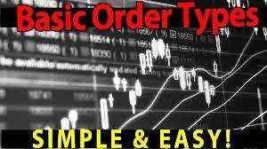
IAPM2021-22,AtulStanleyHermit
Immediate or Cancel (IOC) Order: allows Trading Member to buy/sell a security as soon as order is released into the market; failing which the order will be removed from market. Partial match of order is possible, with unmatched portion cancelled immediately.
Day Order: is valid for the entire day on which it is entered. If the order is not matched during the entire day, it is automatically cancelled at trading day end.

Slide 21
IAPM2021-22,AtulStanleyHermit
Market Order: is the order to purchase/sell securities (equity shares) immediately at current market price. A market order gets executed immediately at the stock exchange at prevailing market price, thus guarantying order execution but not the price;
Limit Order: is an order to buy/sell a security at a specific price or better. A buy limit order can only be executed at limit price or lower, and a sell limit order can only be executed at limit price or higher.
Stop Loss Order: is an order to buy or sell a security once its price reaches the specified price, known as the stop price. When the stop price is reached, a stop
order becomes a market order.


Slide 22
IAPM2021-22,AtulStanleyHermit
Margin trading involves borrowing money to buy securities. The practice includes buying an asset where buyer pays only a percentage of asset's value and borrows the rest from a bank/ broker.
Broker acts as a lender with the collateral security here usually being the securities held in the buyer’s demat account. It can also be the non-allocated credit balance on the trader’s bank account.
Margin Trading usually enables active trading of securities where main objective is to earn profits from the transaction and not to purchase/sell the security
Enables the important concept of ‘Margin Call’ to ensure maintenance of margin account balance.

Slide 23
IAPM2021-22,AtulStanleyHermit
Intra-day trading involves buying and selling of securities in one single trading session (i.e. within the same trading day).... It is the trading done within the trading hours of the same day.
The profit/loss from the same-day trade is decided at the time of squaring-off/closure of trade position.
In an Intra-day trade, the requirement/commitment of delivery of the security does not arise.
In India, Intra-day trading is enabled mainly on the basis of the concept of margin trading.

Slide 24
IAPM2021-22,AtulStanleyHermit
In India, the Securities and Exchange Board of India (SEBI) is the regulatory authority established under the SEBI Act 1992 and is the principal regulator for capital markets (mainly comprising of Stock Exchanges) in India. SEBI’s primary functions include:
Protecting investor interests,
Promoting and regulating the Indian securities markets.
All financial intermediaries that are permitted by their respective regulators to participate in the Indian capital markets are governed by SEBI regulations, whether domestic or foreign.
Foreign Portfolio Investors are required to register with DDPs (designated depository participants) in order to participate in the Indian securities markets.

Slide 25
IAPM2021-22,AtulStanleyHermit
Apart from SEBI as the regulator, the Indian Capital Markets are monitored by the Ministry of Finance and The Reserve Bank of India.
The Ministry of Finance monitors the markets through the Department of Economic Affairs (DEA) - Capital Markets Division. The division is responsible for formulating the policies related to the orderly growth and development of the securities markets (i.e. shares, debt and derivatives markets) as well as protecting the interest of the investors. In particular, it is responsible for:
Institutional reforms in the securities markets,
Building regulatory and market institutions,
Strengthening investor protection mechanism, and
Providing efficient legislative framework for securities markets.

Slide 26
Return on investment is the money earned / received on an investment by the investor.
It is the money made (or even lost) in an investment.
Usually expressed as a percentage of the original investment amount.

Slide 27
RETURN…
Return on a financial asset, generally, consists of two components. The principal component of return is the periodic income on the investment, either in the form of interest or dividends.
The second component is the change in the price of the asset— commonly called the capital gain or loss.
This element of return is the difference between the purchase price and the price at which the asset can be or is sold. The price change may bring a gain or a loss as it may be in any side.

Slide 28
Holding Period
A holding period is the time period for which the investor holds on to the asset or immovable property. It is also calculated as the time between the purchase and sale of a security.
In other words, a holding period is the amount of time the investment is held by an investor, or the period between the purchase and sale of an asset or a security.

Slide 29
Holding Period Return

Slide 30
Numerical 1
Infosys share’s price on June 10, 2019 is Rs. 900 (Pt–1) and the price on July 9, 2020 (Pt ), is Rs. 950. Dividend received is Rs. 76 (D). Determine the rate of return

Slide 31
RISK
Risk is the probability of getting return. It is measured in terms of deviation between actual return and expected return.
Return is the outcome of an investment.
All investment assets have some amount or type of risk associated with them. Even the bank fixed deposits perceived to not having any risk, do actually bear the risk of real returns becoming negative due to high inflation.!!

Slide 32
…RISK
Degree/extent of risk associated with the expected returns or even with the investment amount varies with type of investment instrument, mode of investment, financial solvency of the issuer of security and features of the asset underlying the security.
Some investment risks can be controlled by the investors, while other risks can be controlled by the issuers of the security and even the government of the concerned country, through proper planning, coordination and control. However, there are some investment risks which cannot be controlled by anyone and hence have to borne by the investors.

Slide 33
Risk Vs. Uncertainty
Risk is different from uncertainty. In risk, the outcomes or the expected deviations to the outcomes are known before-hand. However, uncertainty involves a situation where the outcome is not known.
Basically, whether the outcome is known or not to the investor, all of the investment avenues and asset classes have some (even if negligible) amount of risk and uncertainty involved in them.

Slide 34
Systematic/ Market Risk
The systematic risk is the risk arising due to the external and uncontrollable factors associated with the inherent nature of the security, the financial markets, the industry trends, and the state of the economies of a region or world.
Systematic risk is usually the risk inherent to the entire market or market segment. Hence, this risk affects the entire market / industry and not a particular business.
This risk occurs due to the influence of external factors on an organization. Such factors are normally uncontrollable from an organization's point of view. These risks can hence not be controlled or managed by a specific organization.

Slide 35
Examples
1. Market Risk – arises due to changes in market conditions, mainly the change in demand and supply forces in the market as well as unforeseen changes in investor perception and subjective factors which are uncontrollable by a single firm.
2. Interest Rate Risk – arises due to changes in interest rate, mainly on account of the changes in monetary and credit policies which cannot be controlled by specific/individual firms. A change (increase) in the interest rate can possibly result in an increase in the cash outflow for a firm to service the debt taken by it.
3. Inflation or Purchasing Power Risk – Inflation causes the production costs to rise, as it reduces the purchasing power of the firm to purchase the production inputs. Inflation ultimately results in reducing the overall profits for a firm.
4.Risks pertaining to trade cycles or business conditions – are also associated with the macro economic scenario in a country/region & hence beyond the control of an individual firm.

Slide 36
Unsystematic/Diversifiable Risk
The type of risks that emerge out of known and controllable factors, internal to the concerned organization or the issuer of the investment security.
Unsystematic risk occurs due to the influence of internal factors prevailing within an organization. Such factors are normally controllable from an organization's point of view.
Because these risks are micro in nature, these affect only a particular organization. Therefore, organisations can effectively plan & action on the mitigation (reduction of the effect) of these risks.

Slide 37
Examples of Unsystematic Risk
Business risk: Business risk relates to the variability of the sales, income, profits etc., which in turn depend on the market conditions for the product mix, input supplies, strength of competitors, etc. The business risk is sometimes external to the company due to changes in government policy or strategies of competitors or unforeseen market conditions.
They may be internal due to fall in production, labour problems, raw material problems or inadequate supply of electricity etc. The internal business risk leads to fall in revenues and in profit of the company, but can be corrected by certain changes in the company’s policies.

Slide 38
Examples of Unsystematic Risk
(ii) Financial Risk: This relates to the method of financing, adopted by the company; high leverage leading to larger debt servicing problems or short-term liquidity problems due to bad debts, delayed receivables and fall in current assets or rise in current liabilities. These problems could no doubt be solved, but they may lead to fluctuations in earnings, profits and dividends to share holders. Sometimes, if the company runs into losses or reduced profits, these may lead to fall in returns to investors or negative returns.

Slide 39
Examples of Unsystematic Risk
Default or insolvency risk: The borrower or issuer of securities may become insolvent or may default, or delay the payments due, such as interest installments or principal repayments. The borrower’s credit rating might have fallen suddenly and he became default prone and in its extreme form it may lead to insolvency or bankruptcies. In such cases, the investor may get no return or negative returns.
Eg: YES BANK

Slide 40
Examples of Unsystematic Risk
R&D failures
Unsuccessful marketing
Losing major contracts

Slide 41
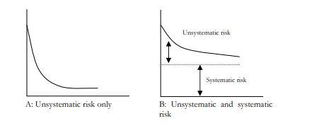
I
II

Slide 42
Systematic Vs Unsystematic Risk
The figure above illustrates this concept that the total risk is the combined risk of the unsystematic and the systematic risk. The unsystematic risk is the risk that can be lowered and minimized with a diversification strategy, but it can not lower the systematic risk even with a highly diversified portfolio

Slide 43
Risk
Risk tied to an individual asset is measured in its variance and standard deviation from the mean return.
The variance is comprised of both systematic and unsystematic risk, hence the whole risk of an asset cannot be diversified away, only the risk associated with firm specifics.

Slide 44
IAPM2021-22,AtulStanleyHermit
most common measure of risk.
tandard Deviation measures the dispersion of data from its expected value.
In investment/financial terms, concept of standard deviation is used to measure the amount/extent of volatility or risk, historically associated with a specific investment mainly in terms of its rate of return.
This concept is helpful in making investment decision as it indicates the extent of deviation possible from the expected normal returns, based on the historical experience.

Slide 45
Standard Deviation
For example, an equity stock that has a high standard deviation can be expected to have highly volatile returns (with high risks), which could be very different from the stock’s historic returns. Here, higher the standard deviation, higher is the expected volatility and hence a higher level of risk associated with the stock.

Slide 46
Standard deviation
denoted by the Greek alphabet σ
suggested by Karl Pearson as a measure of dispersion in 1893.
It is defined as the positive square root of the mean of the square of the deviations of the given observations from their arithmetic mean. If X₁,X₂,---, X_{n} is a set of n observations then its standard deviation is given by :

Slide 47
Question 1: Calculate Standard Deviation (S.D.) from the following set of observations:
X | 10 | 11 | 17 | 25 | 7
X | X-X = X -14 | (X-X)
10 | -4 | 16
11 | -3 | 9
17 | 3 | 9
25 | 11 | 121
7 | -7 | 49
Sum X = 70, Mean = 14 |  | Sum = 204
2

Slide 48
Question 6: Calculate Standard Deviation (S.D.) from the following set of observations:
X | 10 | 11 | 17 | 25 | 7
X | X-X | (X-X)
10 | -4 | 16
11 | -3 | 9
17 | 3 | 9
25 | 11 | 121
7 | -7 | 49
Sum X = 70 |  | Sum = 204
2

Slide 49
Standard Deviation = √ (204/5) = 6.38

Slide 50
IAPM2021-22,AtulStanleyHermit
is the statistical measure of the directional relationship between the returns of two or more investments or different assets.
It is usually calculated by multiplying the correlation between the two variables by the standard deviation of each variable.
In finance, Covariance is a measure of the degree to which returns on two investment assets move in tandem. A positive covariance means that asset returns move together, while a negative covariance means that the returns move inversely or in the opposite direction.
When two security prices tend to move together, they are seen as having a positive covariance; when they move inversely, the covariance is negative.


Slide 51
Covariance- Importance and Applicability
Diversification of investments: To diversify investments in nonrelated asset classes (to enjoy diversified earnings or just reduce the investment risks), the investors need to invest in securities/assets that have a very low covariance amongst themselves.

Slide 52
Covariance- Importance and Applicability
A hedging component: By enabling an investment in assets whose returns have negative covariance. This way, the negative returns in one investment asset will get compensated (even if to some extent) by the positive return in another investment asset.... For example, investments in equity shares and gold help in hedging the overall risk as the return movements in these two asset classes are usually opposite to each other. Hence, risk and volatility can be reduced in a portfolio by pairing assets that have a negative covariance.
Covariance is a significant tool in modern portfolio theory used to ascertain what securities to put in a portfolio.

Slide 53
Covariance

Slide 54
X | Y | X- X | Y- Y | (X-X )(Y-Y )
1 | 9 | -4 | -3 | 12
3 | 10 | -2 | -2 | 4
5 | 11 | 0 | -1 | 0
7 | 14 | 2 | 2 | 4
9 | 15 | 4 | 1 | 4
2 | 8 | -3 | -4 | 12
4 | 12 | -1 | 0 | -1
6 | 13 | 1 | 1 | 1
8 | 16 | 3 | 4 | 12
45 | 108 | 0 | 0 | ∑(X-X )(Y-Y ) = 48
Mean X = 5, Mean Y = 12

Slide 55
IAPM2021-22,AtulStanleyHermit
is a numerical measurement of the statistical relationship between two variables.... It is a measure of how closely two variables are associated with one another.
Correlation Coefficient hence enables the prediction in the change of value of a variable, on the basis of the change in value of another related / associated variable.
Conceptualized by Karl Pearson, correlation coefficient is a measure of the strength and direction of the linear relationship between two variables. The concept is defined as the covariance of the variables divided by the product of their standard deviations.

Slide 56
Karl Pearson Coefficient of Correlation
Karl Pearson, the great biologist and statistician has given a formula for the calculation of coefficient of correlation. According to it the coefficient of correlation of two variables is obtained by the, products of the corresponding deviations of the various items of two series from their respective means by the product of their standard deviations and the number of pairs of observations.
Karl Pearson’s measure, known as Correlation Coefficient between two variables X and Y, usually denoted by r(X,Y) or r_{xy} or simply r is a numerical measure of linear relationship between them and is defined as the ratio of the covariance between X and Y, to the product of the standard deviations of X and Y.

Slide 57
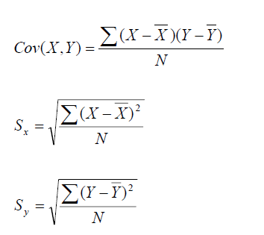
Karl Pearson Coefficient of Correlation…
when, ( X1,Y1 );(X2 ,Y2 );..................( Xn, Yn) are N pairs of observations of the variables X and Y in a bivariate distribution,

Slide 58
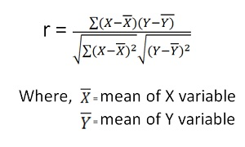
Karl Pearson Coefficient of Correlation by Actual Mean Method

Slide 59
Beta – As a Measure of Risk
Beta is a measure of a stock's volatility in relation to the market.
the sensitivity of an asset’s price compared to a specific index or benchmark.
The market has a beta of 1.0, and individual stocks are ranked according to how much they deviate from the market.

Slide 61
Beta – As a Measure of Risk
A stock that swings more than the market over time has a beta above 1.0. If a stock moves less than the market, the stock's beta is less than 1.0. High-beta stocks are supposed to be riskier but provide a potential for higher returns; low-beta stocks pose less risk but also lower returns.
if a stock's beta value is 1.3, it means, theoretically this stock is 30% more volatile than the market.

Slide 62
IAPM2021-22,AtulStanleyHermit
The beta coefficient can be interpreted as follows:
β =1 exactly as volatile as the market
β >1 more volatile than the market
β <1>0 less volatile than the market
β =0 uncorrelated to the market
β <0 negatively correlated to the market
Formula for calculating the beta of a stock
Beta = Covariance / Variance

Slide 63
Beta of a Portfolio
Add up the value (number of shares multiplied by the share price) of each stock you own and your entire portfolio.
Based on these values, determine how much you have of each stock as a percentage of the overall portfolio.
Multiply those percentage figures by the appropriate beta for each stock. For example, if Infosys makes up 25% of your portfolio and has a beta of 1.43, it has a weighted beta of 0.3575.
Add up the weighted beta figures.

Slide 64
Beta of a Portfolio
Stock | Value (Rs.) | Share of Portfolio | Beta | Weighted Beta
Infosys | 25,000 | 0.25 | 1.43 | 0.3575
HDFC | 22,000 | 0.22 | 0.63 | 0.1386
Tata Steel | 20,000 | 0.2 | 1.51 | 0.302
SBI | 18,000 | 0.18 | 0.6 | 0.108
ITC | 9,000 | 0.09 | 0.42 | 0.0378
HUL | 6,000 | 0.06 | 1.22 | 0.0732
 |  |  |  | 1.0171
That means this portfolio’s volatility is very much in line with the Nifty 50 or market

Slide 65
Portfolio
The portfolio is a collection of investment instruments like shares, mutual funds, bonds , FDs and other cash equivalents, etc. Portfolio management is the art of selecting the right investment tools in the right proportion to generate optimum returns with a balance of risk from the investment made.
When different assets are added to the portfolio the total risk tends to decrease. In the case of common stocks, diversification reduces the unsystematic risk.
Analysts opine that if 15 stocks are added to the portfolio of an investor the unsystematic risk can be reduced to zero but at the same time if the number exceeds 15, additional risk reduction cannot be ensured.
However diversification cannot reduce this systematic risk

Slide 66
Portfolio Management
The process of selecting the right financial products to maximize returns while minimizing risks is known as portfolio management. It considers individual requirements to achieve an ideal portfolio mix.

Slide 67
Objectives of Portfolio management
Creating wealth through capital appreciation
Protecting your earnings from market volatility
Maximizing returns on investment (ROI)
Offering flexibility within your investment portfolio
Improving the proficiency of your investments
Allocating available resources optimally
Optimizing the risk

Slide 68
Importance
Helps in rebalancing the asset composition so that investors can get the most out of their existing investments.
Enables quick customization based on immediate financial needs and market conditions.
Mitigating investment-oriented risks and increases the scope to generate higher returns.
The best way to build a strong investment portfolio is to determine its financial objective and rebalance its components frequently. Thereafter, investors should focus more on diversifying their resources to obtain the best possible rewards at manageable risks in all situations.
To know which investments work best in which market conditions and how to distribute resources across different asset classes.

Slide 69
Markowitz Portfolio Theory

Slide 70
History
Harry Markowitz came up with MPT and won the Nobel Prize for Economic Sciences in 1990 for it.

Slide 71
Definition
It is an investment theory based on the idea that risk-averse investors can construct portfolios to optimize or maximize expected return based on a given level of market risk, emphasizing that risk is an inherent part of higher reward.

Slide 72
How it works
MPT assumes that investors are risk averse, meaning that given two portfolios that offer the same expected return, investors will prefer the less risky one. Thus, an investor will take on increased risk only if compensated by higher expected returns.
Conversely, an investor who wants higher expected returns must accept more risk. The exact trade-off will be the same for all investors, but different investors will evaluate the trade-off differently based on individual risk aversion characteristics.

Slide 73
The Markowitz Model
Most people agree that holding two stocks is less risky than holding one for example holding stocks of textile, banking and IT companies is better than investing all the money in a textile companies stock. But building up an optimal portfolio is very difficult. Markowitz provides an answer by analyzing the risk and return relationship.

Slide 74
Assumptions of the Model
An investors decision is based solely on the expected return and variance of returns
For a given level of risk, an investor prefers higher returns to lower returns likewise for a given level of Return and investor papers lower risks to higher risks

Slide 75
Diversification
An investor can reduce portfolio risk simply by holding combinations of instruments that are not perfectly positively correlated.

Slide 76
Expected Return of a Portfolio
The expected return of a portfolio of assets is simply the weighted average of the return of the individual securities held in the portfolio. The weight applied to each return is the fraction of the portfolio invested in that security

Slide 77
Example
Let us consider a portfolio of two equity shares P and Q with expected returns of 15 per cent and 20 per cent respectively.
If 40 per cent of the total funds are invested in share P and the remaining 60 per cent, in share Q, then the expected portfolio return will be: (0.40 x 15) + (0.60 x 20) = 18 per cent
The formula for the calculation of expected portfolio return may be expressed as shown below:

Slide 78
Formula
i=n
E (R_{p} )= ∑X_{i}R_{i}
i=1
R_{p}= Return on the Portfolio
X_{i} = Proportion of Total Portfolio Invested in Security i
R_{i} = Expected Return on Security i

Slide 79
Expected Return for an Individual Asset

Slide 80
Computation of the Expected Return for a Portfolio of Risky Assets
Weight (Percent of Portfolio) Xi ‘s | Expected Return (Security) Ri | Expected Portfolio Return Xi Ri
0.20 | .10 | 0.0200
0.30 | .11 | 0.0330
0.30 | .12 | 0.0360
0.20 | .13 | 0.0260
 |  | E(Rp) = 0.1150

Slide 81
Portfolio Risk
The variance of return and standard deviation of return are alternative statistical measures that are used for measuring risk in investment. These statistics measure the extent to which returns are expected to vary around an average over time

Slide 82
Portfolio Risk
The variance or standard deviation of an individual security measures the riskiness of a security in absolute sense. For calculating the risk of a portfolio of securities, the riskiness of each security within the context of the overall portfolio has to be considered.

Slide 83
Portfolio Risk
This depends on their interactive risk, i.e. how the returns of a security move with the returns of other securities in the portfolio and contribute to the overall risk of the portfolio.
Covariance is the statistical measure that indicates the interactive risk of a security relative to others in a portfolio of securities. In other words, the way security returns vary with each other affects the overall risk of the portfolio.

Slide 84
Portfolio Risk
The covariance between two securities X and Y may be calculated using the following formula:
COVxy = 1 ∑ (Rx - Rx) (Ry - Ry)
Cov xy = Covariance between x and y.
Rx = Return of security x.
R y = Return of security y
Rx = Expected or mean return of security x.
Ry = Expected or mean return of security y.
N = Number of observations.
N

Slide 85
Calculation of Covariance
Year | Rx | Rx - Rx | Ry | Ry – Ry | (Rx - Rx ) (Ry – Ry )
1 | 10 | -4 | 17 | 5 | -20
2 | 12 | -2 | 13 | 1 | -2
3 | 16 | 2 | 10 | -2 | -4
4 | 18 | 4 | 8 | -4 | -16
 | Sum = 56 |  | Sum = 48 |  | Sum = -42

Slide 87
Covariance
The covariance is a measure of how returns of two securities move together. If the returns of the two securities move in the same direction consistently the covariance would be positive. If the returns of the two securities move in opposite direction consistently the covariance would be negative. If the movements of returns are independent of each other, covariance would be close to zero.

Slide 88
Covariance
Covariance is an absolute measure of interactive risk between two securities. To facilitate comparison, covariance can be standardized. Dividing the covariance between two securities by product of the standard deviation of each security gives such a standardized measure. This measure is called the coefficient of correlation. This may be expressed as:

Slide 89
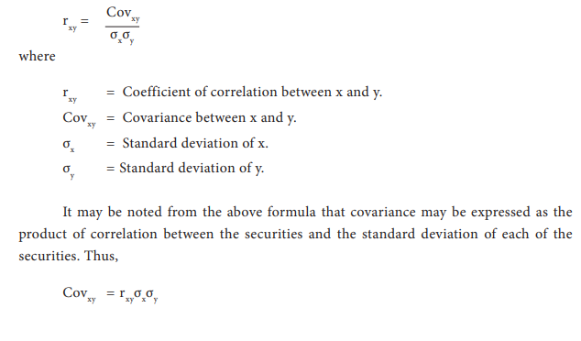

Slide 90
Correlation Coefficients
The correlation coefficients may range from - 1 to 1. A value of -1 indicates perfect negative correlation between security returns, while a value of +1 indicates a perfect positive correlation. A value close to zero would indicate that the returns are independent.

Slide 91
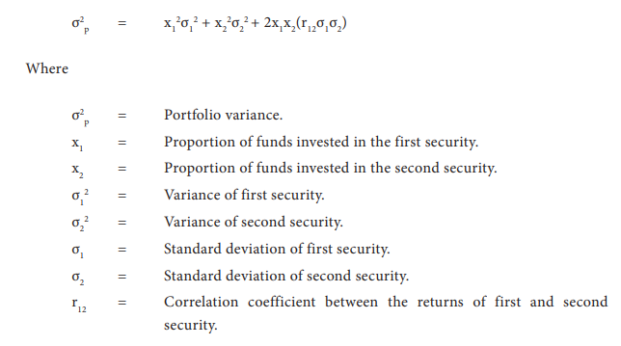
Variance of a Portfolio
The variance of a portfolio with only two securities in it may be calculated with the following formula.

Slide 92
Numerical
Two securities P and Q generate the following sets of expected returns, standard deviations and correlation coefficient:
P | Q
r = 15 percent | 20 percent
σ = 50 percent | 30 percent
r = -0.60
A portfolio is constructed with 40 per cent of funds invested in P and the remaining
60 per cent of funds in Q.

Slide 93
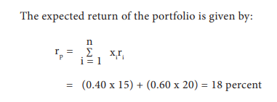

Slide 94
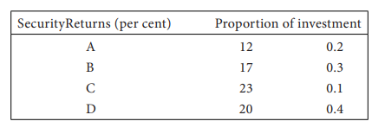
Numercial
Let us consider a portfolio with four securities having the following characteristics

Slide 95
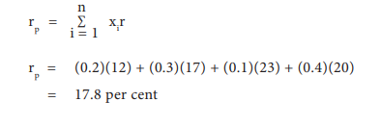
Solution
The expected return of this portfolio may be calculated using the formula:

