Slide 1
PERT and CPM

Slide 2
Introduction
One of the most challenging jobs that any manager can take on is the management of a large-scale project that requires coordinating numerous activities throughout the organization.
A myriad of details must be considered in planning how to coordinate all these activities, in developing a realistic schedule, and then in monitoring the progress of the project.

Slide 3
Introduction
Fortunately, two closely related operations research techniques, PERT (program evaluation and review technique) and CPM (critical path method), are available to assist the project manager in carrying out these responsibilities.
These techniques make heavy use of networks to help plan and display the coordination of all the activities. They also normally use a software package to deal with all the data needed to develop schedule information and then to monitor the progress of the project. Project management software, such as MS Project is widely available for these purposes.

Slide 4
Introduction
PERT and CPM are basically time-oriented methods in the sense that they both lead to determination of a time schedule for the project.
The significant difference between two approaches is that the time estimates for the different activities in CPM were assumed to be deterministic while in PERT these are described probabilistically. These techniques are referred as project scheduling techniques

Slide 5
Applications of CPM / PERT
Construction of a dam or a canal system in a region
Construction of a building or highway
Maintenance or overhaul of airplanes or oil refinery
Space flight
Cost control of a project using PERT / COST
Designing a prototype of a machine
Development of supersonic planes

Slide 6
Network Diagram Representation

Slide 7
Activity
Any individual operation which utilizes resources and has an end and a beginning is called activity. An arrow is commonly used to represent an activity with its head indicating the direction of progress in the project. These are classified into four categories

Slide 8
Types of Activity
Predecessor activity – Activities that must be completed immediately prior to the start of another activity are called predecessor activities.
Successor activity – Activities that cannot be started until one or more of other activities are completed but immediately succeed them are called successor activities.

Slide 9
…Types of Activity
Concurrent activity – Activities which can be accomplished concurrently are known as concurrent activities. It may be noted that an activity can be a predecessor or a successor to an event or it may be concurrent with one or more of other activities.
2
1
3
4

Slide 10
…Types of Activity
Dummy activity – An activity which does not consume any kind of resource but merely depicts the technological dependence is called a dummy activity.
It is represented by dotted line arrow. It is used only when it is necessary , there is no restriction of no. of dummy activity used. There should be no looping and dangling on network diagram.

Slide 11
…Types of Activity
The dummy activity is inserted in the network to ESTABLISH THE given precendence relationship among the activities of the project. It is needed when
(a) two or more parallel activities in a project have same head and tail events
(b) two or more activities have some (but not all) of their immediate predecessor activities in common.

Slide 12
…Types of Activity
For example, consider a situation where A and B are concurrent activities. C is dependent on A and D is dependent on A and B both. Such a situation can be handled by using a dummy activity as shown in the figure.

Slide 13
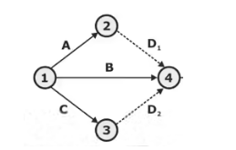
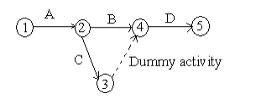

Slide 14
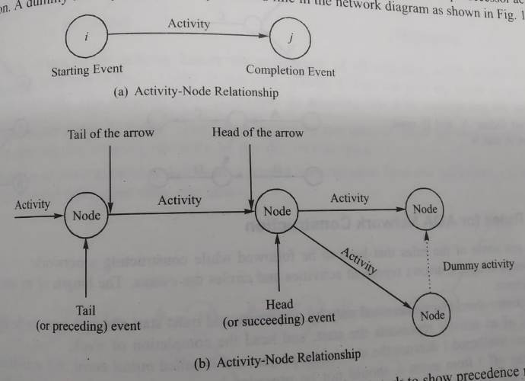
PERT/CPM

Slide 15
no two activities can be identified by the same beginning and end event in such cases a dummy activity is introduced to resolve the problem

Slide 16
Notes:
https://www.slideshare.net/DrMahmoudAlNaimi1/network-construction

Slide 17
Network
A network is a graphic representation of a project’s operations and a composed of activities and events that must be completed to reach the end objective of a project, showing the planning sequence of time accomplishment, their dependence and inter-relationship. The basic components of a network are

Slide 18
Activity-
An activity is a task, or item of work to be done, that consume time, effort, money or other resources. An activity is represented by an arrow with its head indicating the sequence in which the events are to occur.

Slide 19
Event- An event represents the start (beginning) or completion (end) of some activity and as such it consume no time. It has no time duration and does not consume any resources. It is also known as a node. An event is generally represented on the network by a circle.

Slide 20
Event (Milestone)
The beginning and end points of an activity are called as event or nodes. event is a point in time and does not consume any resources. It is represented by a number circle. the head even called as jth event always a number higher than the tale event called the ith eventevent
The events are classified in to three categories
1
2

Slide 21
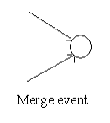
Merge event: When more than one activity comes and joins an event such an event is known as merge event.

Slide 22
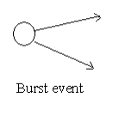
Burst event – When more than one activity leaves an event such an event is known as burst event

Slide 23
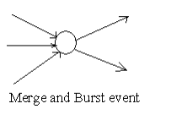
Merge and Burst event – An activity may be merge and burst event at the same time as with respect to some activities it can be a merge event and with respect to some other activities it may be a burst event.

Slide 24
The activity can be further classified into the following three categories
Notes:
https://rajkumar2850.weebly.com/uploads/1/4/9/8/14980396/cpm_pert.pdf good notes

Slide 25
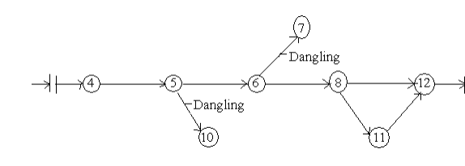
Common Errors in Drawing Networks
1. Dangling
To disconnect an activity before the completion of all activities in a network diagram is known as dangling. As shown in the figure activities (5 – 10) and (6 – 7) are not the last activities in the network. So the diagram is wrong and indicates the error of dangling

Slide 26
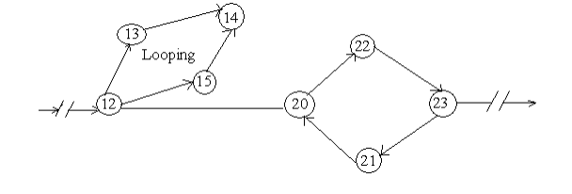
Looping or Cycling:
Looping error is also known as cycling error in a network diagram. Drawing an endless loop in a network is known as error of looping as shown in the following figure

Slide 27
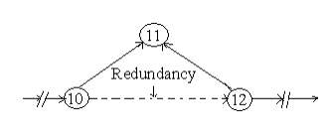
Redundancy: Unnecessarily inserting the dummy activity in network logic is known as the error of redundancy as shown in the following diagram

Slide 28
Rules for Network Representation
Three rules are available for constructing the network
1. Each activity is represented by one, and only one arrow (arc)
2. Each activity must be identified by two distinct end nodes & no two or more activities can have the same tail.
3. To maintain the correct precedence relationships, the following questions must be answered as each is added to network:
(a) What activities must immediately precede the current activity?
(b) What activities must follow the current activity?
(c) What activities must occur concurrently with the current activity? The answer of these questions may require the use of dummy activities to ensure correct precedences among the activities.

Slide 29
Numbering the events- Fulkerson Rule
After the network is drawn in a logical sequence, every event is assigned a number. The number sequence must be such as to reflect the flow of the network. In event numbering, the following rules should be observed, which is also known as Fulkerson’s rule.
(a) Event numbers should be unique
(b) Event numbering should be carried out on a sequential basis from left to right
(c) The initial event which has all outgoing arrows with no incoming arrow is numbered 0 or 1
(d) The head of an arrow should always bear a number higher than the one assigned at the tail of the arrow
(e) Gaps should be left in the sequences of event numbering to accommodate subsequent inclusion of activities, if necessary.

Slide 30
CPM/PERT
CPM/PERT are network based models designed to assist in the planning, scheduling and control of projects.
Project- A project is defined as a collection of interrelated activities with each activity consuming time and resources

Slide 31
CPM/PERT
The objective of CPM/PERT is to provide analytic means for scheduling the activities. Followings are the steps of the techniques

Slide 32
CPM/PERT
1. We define the activities of the project, their precedence relationship and their time requirements.
2. The precedence relationship among the activities are represented by a network
3. Specific computations to develop the time schedule for the project. During the actual execution of the project things may not proceed as planned, as some of the activities may be expedited or delayed. When this happens, the schedule must be revised to reflect the realities on the ground. This is the reason for including a feedback loop between the time schedule phase and the network phase, as shown in following diagram.

Slide 33
CPM/PERT
The two techniques, CPM and PERT, which were developed independently, differ in that CPM assumes deterministic activity duration and PERT assumes probabilistic durations.

Slide 34
CPM
It is commonly used for those projects which are repetitive in nature & where one has prior experience of handling similar projects. It is a deterministic model and places emphasis on time & cost for activities of a project.

Slide 35
PERT
PERT (Program evaluation & review Technique)- it is generally used for those projects where time required to complete various activities are not known as a prior. It is probabilistic model & is primarily concerned for evaluation of time. It is event oriented.

Slide 36
PERT/CPM Advantages
A PERT/CPM chart explicitly defines and makes visible dependencies (precedence relationships) between the elements,
PERT/CPM facilitates identification of the critical path and makes this visible,
PERT/CPM facilitates identification of early start, late start, and slack for each activity,
PERT/CPM provides for potentially reduced project Duration due to better understanding of dependencies leading to improved overlapping of activities and tasks where feasible.

Slide 37
PERT/CPM disadvantages
There can be potentially hundreds or thousands of activities and individual dependency relationships,
The network charts tend to be large and unwieldy requiring several pages to print and requiring special size paper,
The lack of a timeframe on most PERT/CPM charts makes it harder to show status although colours can help (e.g., specific colour for completed nodes),
When the PERT/CPM charts become unwieldy, they are no longer used to manage the project.

Slide 38
Rules for AOA network construction
Following are some of the rules that have to be followed while constructing a network:
1. In network diagram, arrows represent activities and circles the events. The length of an arrow is of no significance.

Slide 39
Rules for AOA network construction
Each activity should be represented only by one Arrow and must start and end in a circle called event. The tail of an activity represent the start, and head the completion of work

Slide 40
Rules for AOA network construction
The event numbered 1 denote the start of the project and is called initial event. All activities emerging from event 1 should not be preceded by any other activity or activities. an event carrying the highest number denote the completion event. A network should have only one initial event and only one terminal event

Slide 41
Rules for AOA network construction
The general rule for numbering the event is that the head even should always be number larger than the number at its tail that is event should be number such that for each activity (I,j), i<j.

Slide 42
Rules for AOA network construction
An activity must be uniquely identified by its starting and completion event which implies that
An event number should not get repeated or duplicated
two activity should not be identified by the same completion event
Activities must be represented either by their symbols or by the corresponding ordered pair of starting completion event

Slide 43
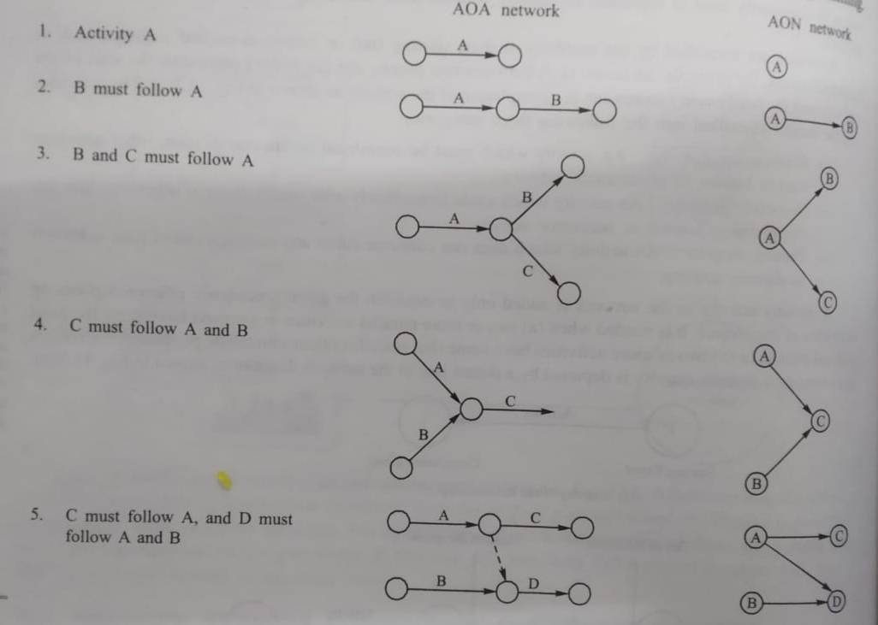

Slide 44
Example
Draw the logic network for the following:
Activities C and D both follow A , activity E follows C , activity F follows D , activity E and F precedes B.

Slide 45
A
1
2

Slide 46
C
3
A
1
2
D
4

Slide 47
C
3
E
A
1
2
5
D
F
4

Slide 48
C
3
E
A
B
1
2
5
6
D
F
4

Slide 49
Construct a network for a project whose activities and their predecessor
relationship are given in table
Activity | A | B | C | D | E | F | G | H | I | J | K
Predecessor | - | - | - | A | B | B | C | D | E | H,I | F,G

Slide 50
A
112
2
1
B
2
3
C
4
4

Slide 51
D
A
112
5
2
1
B
E
2
3
6
C
G
7
4
4

Slide 52
G
A
112
5
2
1
B
E
2
3
6
C
F
G
7
4
4

Slide 53
A
2
1
D
H
5
8
A
112
2
I
J
1
B
E
2
3
6
9
C
F
G
7
K
4
4

Slide 54
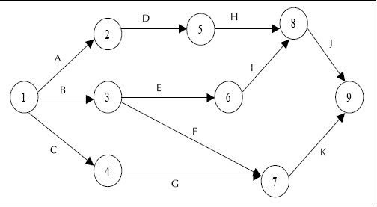

Slide 55
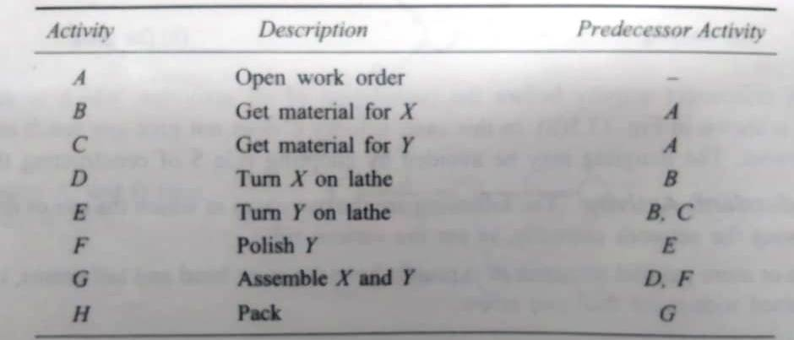
Numerical 2
The sequence of activities together with their predecessor is given below . Draw a network diagram of activities for the project

Slide 56
A
1
2

Slide 57
B
3
A
1
2
C
4

Slide 58
B
3
D
A
1
2
6
F
C
E
4
5

Slide 59
B
3
D
A
G
H
1
2
6
7
8
F
C
E
4
5

Slide 60
Critical Path Analysis
The objective of critical path analysis is to estimate the total project duration and to assign starting and finishing time to all activities involved in the project. This helps to check the actual progress against the scheduled duration of the project.
Having done this the following factor should be known in order to prepare the project scheduling.
Total completion time of the project
Earlier and latest start time of each activity
Critical activities and critical path
Float for each activity that is the amount of time by which the completion of non critical activity can be delayed without deleting the total project completion time

Slide 61
Critical Path in Network Analysis
The notations used are
(i, j) = Activity with tail event i and head event j
Ei = Earliest occurrence time of event, i. This is the earliest time for an event to occur immediately after all the preceding activities have been completed without delaying the entire project
Li = Latest allowable time of event i. This is the latest time at which an event can occur without causing a delay in already determined project completion time

Slide 62
notations
tij = duration of an activity (i, j)
ESij = Earliest starting time of activity (i, j). this is the earliest time an activity can possibly start without affecting the project completion.
(Ef)ij = Earliest finishing time of activity (i, j). this is the earliest time an activity can possibly finish without affecting the project completion
LSij = Latest starting time of activity (i, j). this is the latest time an activity can possibly start without affecting the project completion.
(Lf)ij = Latest finishing time of activity (i, j). this is the latest time an activity must finish without delaying the project completion

Slide 63
Forward Pass method (For earliest event time)
Set the earliest occurrence time of initial event 1 to zero. That is E1 = 0, for i=1
Calculate the earliest start time for each activity that begins at the even i(=1). This is equal to the earliest ocurrence time of event, i. That is
ESij = Ei for all activities (i,j) starting at event i.
Calculate the earliest finish time for each activity that begins at the even i. This is equal to the earliest start time of the activity + the duration of the activity That is
Efij = Esij +tij = Ei + tij, for all activities (i,j) beginning at event i.

Slide 64
Forward Pass method (For earliest event time)
Calculate the earliest occurrence time for event j. This is the maximum of the earliest finish time of all activities ending into the event that is,
Ej = Max (Efij) = Max (Ei + tij) for all immediate predecessor activities

Slide 65
Backward Pass Method (For latest Allowable Event time)
Set the latest occurrence time of last event, N equal to its earliest occurrence time (known from forward pass method)
That is L_{N} = E_{N}, j =N.
Calculate the latest finish time for each activity that ends at the event j. This is equal to the latest ocurrence time of final event That is
Lf_{ij} = L_{i}, for all activities (i,j) ending at event j.
Calculate the latest start time for each activity ending at the even j. This is obtained by subtracting the duration of the activity from the latest time of the activity That is
Lf_{ij} = L_{j}
LSij = LFij - tij = Lj - tij, for all activities (i,j) ending at event i.
Notes:
https://www.youtube.com/watch?v=kj-CxhG7XBw

Slide 66
Backward Pass Method (For latest Allowable Event time)
Calculate the latest occurrence time of event I (i<j). This is the minimum of the latest start time of all activities from the event. That is
Li = Min (LSij) = Min (Lj - tij) for all immediate predecessor activities

Slide 67
Backward Pass Method (For latest Allowable Event time)
If j =1 (initial event) then the latest finish time for project, i.e. latest occurrence time L1 for the initial event is given as
L1 = Min (LSij)
=Min (Lj – tij ) for all immediate successor activities

Slide 68
Float
The term “Float” implies “Fluid”, which in turn implies “Flexibility“. In Project Scheduling, Float refers to the amount of scheduling flexibility. Float is also popularly called “Slack“.

Slide 69
Float (Slack) of an Activity
The float or free time is the length of time in which in non-critical activity and/or of an event can be delayed or extended without delaying the total project completion time.

Slide 70
Slack of an Event
The slack(s) also called float of an event is the difference between its latest occurrence time and its earliest occurrence time. That is
Event float = Li-Ei
If L=E, for certain events, then such events are called critical events.

Slide 71
Slack of an Activity
It is the amount of time that an activity can be delayed without delaying project completion, it is calculated as the difference between the latest finish time and the earliest finish time for the activity. in other words,
the computation of activity float tell us how long an activity time may be increased without increasing the project completion time. mainly 3 types of floats are defined for each non-critical activity of the project.

Slide 72
Total Float
That a schedule activity can be delayed or extended from its early start date without delaying the project ﬁnish date or violating a schedule constraint.
Total float is the amount of time an activity can be delayed without delaying the project completion date. This is the type of Float that is commonly referred to as “Float”.

Slide 73
Total Float
Total Float is about flexibility at the project level. It is about the flexibility that an activity has in its execution without delaying the Project finish date.

Slide 74
Example
If activity 1 has a duration of 6 days and is occurring concurrently with activity 2 which has a duration of 9 days, activity 1 has 3 days of total float. Meaning, it can be delayed up to three days without any effect on the project.
However, if activity 1 is delayed by 5 days, there is now a negative float situation: -2 days. This reflects the fact that the project will now take two days longer than anticipated.

Slide 75
Total Float
Total float is calculated by subtracting the Early Start date of an activity from its Late Start date (Late Start date (LS) – Early Start date (ES)), or Early Finish date (EF) from its Late Finish date (LF) (Late Finish date – Early Finish date).
Total Float or Float = LS – ES or LF – EF

Slide 76
Total Float
The time within which an activity must be scheduled computed from LS and ES values for each activities start Event and end event. That is, for each activity (i,j) the total float is equal to the latest allowable time for the event at the end of the activity minus the earliest time for an event at the beginning of the activity minus the activity duration that is
Total Float (TFij) = (Lj – Ei) – tij (late start – early start)
= Lsij – Esij
= Lfij- Efij (late finish – early finish)

Slide 77
Total Float
The total float is the difference between project completion date and the total duration of critical path activities.
In other words, you have a project to finish in 25 days. Your calculated critical path activities on the schedule network diagram will take 22 days. So you have a project float of +3 days. Here you can see, afloat can be a positive or negative number.

Slide 78
Free Float
how much and activities completion time may be delayed without causing any delay in its immediate successor activities
The amount of time – that a schedule activity can be delayed without delaying the early start date of any successor or violating a schedule constraint

Slide 79
Free Float
Free Float is about flexibility at the activity level. It is about the flexibility that an activity has in its execution without delaying its successor activity

Slide 80
Free Float
consider one activity A, have total duration of 6 days, and its successor activity B is starting 3 days after completing of activity A than the free float between the activities is 3 .means there will not be any impact on activity B even activity A gets delayed by 3 Days.

Slide 81
Free Float
Free float is calculated by subtracting the Early Finish date of current activity from the Early Start date of its successor activity (ES of successor Activity – EF of current Activity).
Free Float = ES (of successor) – EF (of current)

Slide 82
Free float
Free float of a non critical activity is defined as the time by which the completion of an activity can be delayed without causing any delay in its immediate succeeding activities. Free float values for each activity (i,j) are computed as
Free Float (FFij) = (Ej-Ei)-tij
Notes:
ES (of successor) – EF of current activity

Slide 83
Total Float vs Free float
While Total Float is how much an activity can be delayed without affecting the project Finish date, Free Float is about how much an activity can be delayed without affecting its successor activity.

Slide 84
Numerical
A project has the following characteristics:
Activity | Days
1-2 | 4
1-3 | 1
2-4 | 1
3-4 | 1
3-5 | 6
4-9 | 5
5-6 | 4
5-7 | 8
6-8 | 1
7-8 | 2
8-10 | 5
9-10 | 7

Slide 85
4
2
1
1
4
1
1
3

Slide 86
555
9
4
2
1
5
1
4
1
1
3
5
6

Slide 87
555
7
9
4
2
1
10
5
1
4
2
5
7
8
1
8
8
1
3
5
6
1
6
4
6

Slide 88
E9 =10
L1 = 15
E2 =4
L2 =9
E1 =22
L1 = 22
555
7
9
E1 =0
L1 =0
E4 =5
L1 =10
10
4
2
1
5
E7 =15
L1 =15
1
4
2
5
7
8
1
8
8
1
3
E8 =17
L1 =17
6
5
1
E3 =1
L1 =9
6
4
6
E5 = 7
L1 =7
E6 = 11
L1 =16

Slide 89
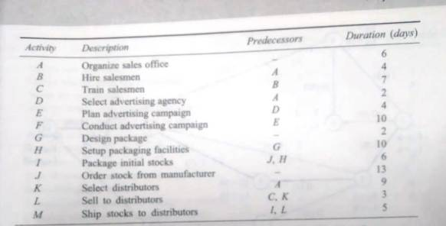
Numerical 2

Slide 90
Construct a Network Diagram
Compute the total float, free float and Independent Float for each activity.
Find the Critical path and total project duration.

Slide 91
Numerical 2
Activity | Predecessors | Duration (days)
A | - | 6
B | A | 4
C | B | 7
D | A | 2
E | D | 4
F | E | 10
G | - | 2
H | G | 10
I | J,H | 6
J | - | 13
K | A | 9
L | C,K | 3
M | I,L | 5

Slide 92
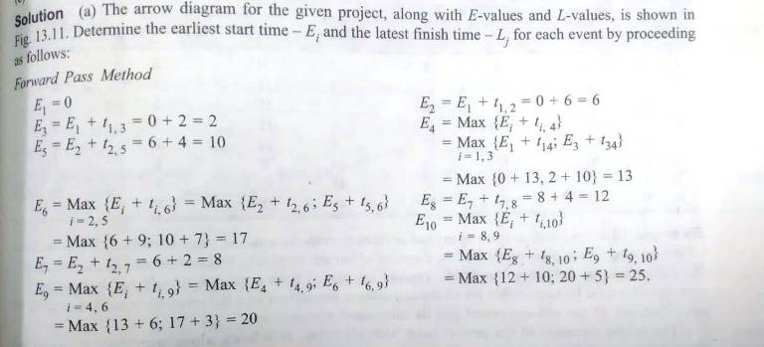
Solution

Slide 93
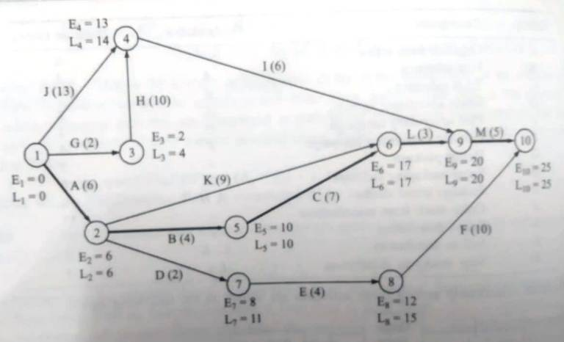

Slide 94
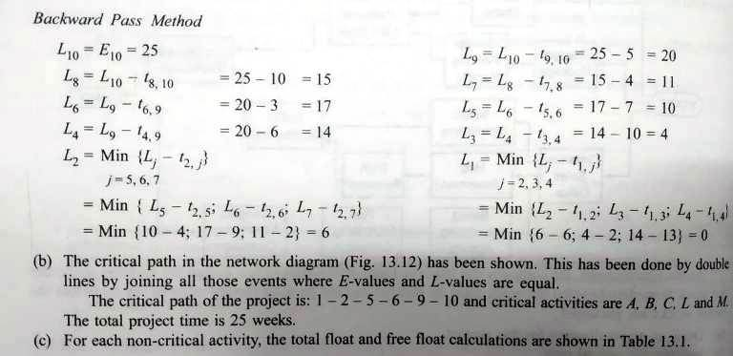

Slide 95
Activity I,j | Duration | Earliest Time |  | Latest Time |  | Float
 | tij (1) | Start Ei (2) | Finish Ei +tij (3) | Start Lj – tij (4) (5-1) | Finish Lj (5) | Total Float (Lj – tij) - Ei (4-2) | Free Float (Ej -Ei) - tij
1 (i)-3 (j) | 2 | 0 | 2 | 2 | 4 | 2 | 0
1-4 | 13 | 0 | 13 | 1 | 14 | 1 | 0
2-6 | 9 | 6 | 15 | 8 | 17 | 2 | 2
2-7 | 2 | 6 | 8 | 9 | 11 | 3 | 0
3-4 | 10 | 2 | 12 | 4 | 14 | 2 | 1
4-9 | 6 | 13 | 19 | 14 | 20 | 1 | 1
7-8 | 4 | 8 | 12 | 11 | 15 | 3 | 0
8-10 | 10 | 12 | 22 | 15 | 25 | 3 | 3

Slide 96
Numerical 2
Activity | Predecessors | Duration (days)
A | - | 2
B | A | 3
C | A | 4
D | B,C | 6
E | - | 2
F | E | 8

Slide 97
Construct a Network Diagram
Compute the total float, free float for each activity.
Find the Critical path and total project duration.

Slide 98
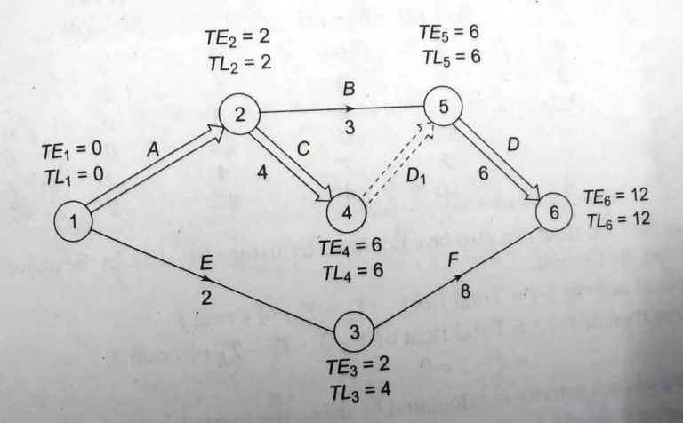
The critical path is represented by double lines in the network. The project duration is
12 days The various float for each activity are calculated and represented in the following table

Slide 99
Using forward pass computations , the earliest time Ei is calculated for each node as follows:
Set E1 = 0
E2 = E1+2 = 0+2 =2
E3 = E1+2 = 0+2 =2
E4 = E2+4 = 2+4 =6
E5 = Max(E2+3, E4+0) = maX (2+3, 6+0) =6
E6 = Max(E5+6, E3+8) = maX (6+6, 2+8) =12

Slide 100
Using BACKWARD pass computations , the LATEST occurrence time Ei is calculated for each node as follows:
Set L6 = E6 =12
L5 = L6 – 6 = 12-6= 6
L3 = L6 – 8 = 12 -8 = 4
L4 = L5 – 0 = 6
L2 = Min (L 5 – 3, L4 -4) = (6-3, 6-4) = 2
L1 = Min (L2 – 2, L3 -2) = (2-2, 4-2) = 0

Slide 101
Activity I,j | Duration | Earliest Time |  | Latest Time |  | Float
 | tij | Start Ei | Finish Ei +tij | Start Lj – tij | Finish Lj | Total (Lj – tij) - Ei | Fre (Ej -Ei) - tij
A(1-2) | 2 | 0 | 2 | 0 | 2 | 0 | 0
B(2-5) | 3 | 2 | 5 | 3 | 6 | 1 | 1
C(2-4) | 4 | 2 | 6 | 2 | 6 | 0 | 0
D(5-6) | 6 | 6 | 12 | 6 | 12 | 0 | 0
E(1-3) | 2 | 0 | 2 | 2 | 4 | 0 | 0
F(3-6) | 8 | 2 | 10 | 4 | 12 | 2 | 0

Slide 102
PERT (Program Evaluation and Review Technique)
PERT was developed to handle project where the time duration for each activity is no longer just a single time estimate that is decision makers best guess but is a random variable that is characterized by some probability distribution usually a beta distribution.
To estimate the parameters of the beta distribution that is mean and variance the path model requires three time estimates for each activity. From these time estimates a single value is estimated for future consideration. The three time estimates that are required are as under:

Slide 103
PERT
Optimistic time (t₀ or a ): the shortest possible time in which an activity can be performed assuming that everything goes well.
Pessimistic time (tp): The longest possible time required to perform an activity under extremely bad conditions However such conditions do not include natural calamities like earthquake, flood etc.
Most likely time (tm): the time that would occur most often to complete an activity if the activity was repeated under exactly the same conditions many time obviously it is the completion time that would occur most frequently

Slide 104
Expected time of an activity te = to+ 4tm + tp
6
t₀==optimistic time, tm: Most likely time, tp = pessimistic time
Variance of an activity

Slide 105
The probability distribution of times for completing an event can be approximated by the normal distribution due to the central limit theorem. Thus the Probability of completing the project in the scheduled time, Ts is given as
Z = Ts - Te
σ_{i}
Notes:
Page 446

Slide 106
Te = Expected Completion time of the project
σ_{i}² ⁼ σ₁²+σ₂²+…………σ_{n}²
The desired completion time of the project can be calculated as : Ts = Zσ + Te, where value of Z corresponds to the probability of project completion time.

Slide 107
The expected completion time of the project is obtained by adding the expected time of each activity lying on the critical path.
Since it is assumed that the two activities are independent, therefore the variance of the critical path can be known by adding the variance of critical activities.

Slide 108
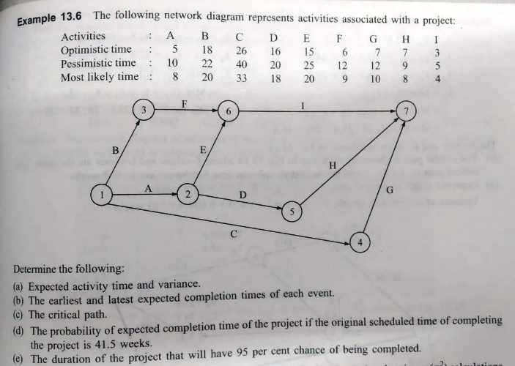

Slide 109
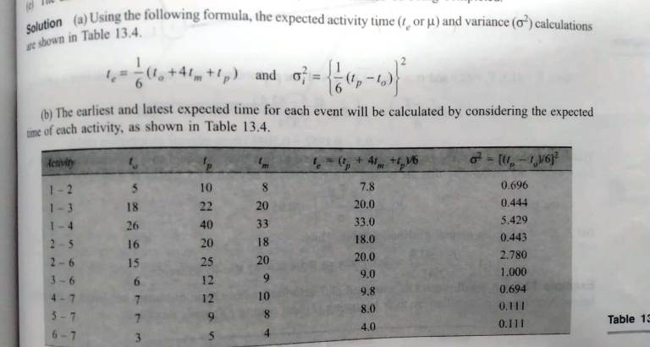

Slide 112
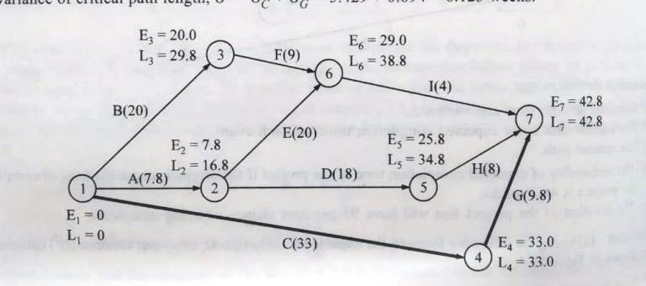

Slide 113
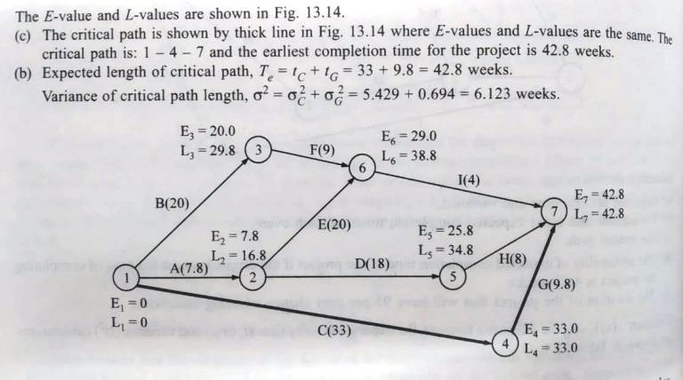

Slide 115
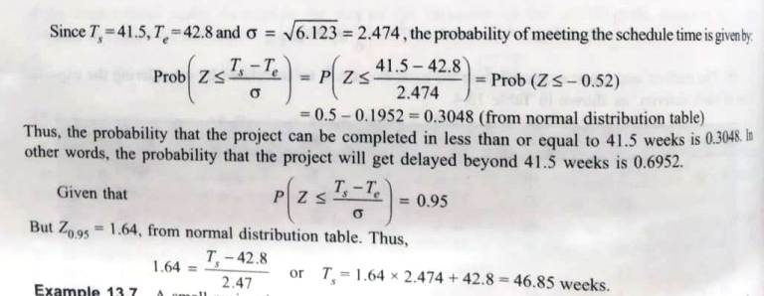

Slide 116
expected completion time of the project is obtained by adding the expected time of each activity lying on the critical path since it is assumed that the two activities are independent there for the variance of the critical path can be known by adding the variance of selectivity

Slide 138
refernces
https://www.srividyaengg.ac.in/coursematerial/CSE/104745.pdf

