Slide 1
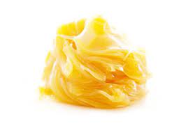
Wool fat
Dr. Anju Singh
Assistant Professor
SPS, CSJMU, Kanpur

Slide 2
description
Raw wool contains considerable quantities of 'wool grease' or crude lanolin, the potassium salts of fatty acids and earthy matter.
Wool fat is a pale yellow, tenacious substance with a faint but characteristic odour.
It is insoluble in water and a high proportion of water may be incorporated with it by melting (m.p. 36-42°C) and stirring.
Soluble in ether and chloroform.

Slide 3
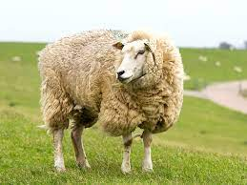
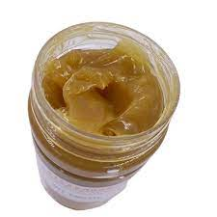
Source of Wool fat
Wool fat (anhydrous lanolin) is a purified fat-like substance prepared from the wool of the sheep, Ovis aries (Bovidae).

Slide 4
Chemical constituent
The chief constituents of wool fat are cholesterol and iso-cholesterol, unsaturated monohydric alcohols of the formula C27H45OH, both free and combined with lanoceric, lanopalmitic, carnaubic and other fatty acids. Wool fat also contains aliphatic alcohols such as cetyl, ceryl and carnaubyl alcohols.
Butylated hydroxytoluene, up to 200 p.p.m., may be added as an antioxidant. Wool alcohols are prepared by the saponification of crude lanolin and the separation of the alcohol fraction. The product consists of steroid and triterpene alcohols, including cholesterol (not less than 30%) and isocholesterol.

Slide 5
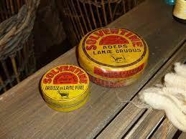
Preparation
Raw lanolin is separated by 'cracking' with sulphuric acid from the washings of the scouring process and purified to fit it for medicinal use.
Purification may be done by centrifuging with water and by bleaching.

Slide 6
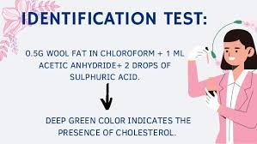
Evaluation
To test for cholesterol dissolve 0.5 g in 5 ml of chloroform, add 1 ml acetic anhydride and two drops of sulphuric acid; a deep-green colour is produced,

Slide 7
Storage
It is stored in closed containers away from light and in cool place.
Wool fat is used as an emollient base for creams and ointments.
uses

Slide 8
THANK YOU

