Slide 1
Biomedical Waste Management

Slide 2
Biomedical Waste
Definition:
Wastes that are generated during the laboratory diagnosis, treatment or immunization of human beings or animals, or in research activities pertaining thereto, or in the production of biologicals.

Slide 3
Waste Generated in Hospitals
General waste (80%)
Pathological and infectious waste (15%)
Chemical and pharmaceutical waste (3%)
Sharp waste (1%)
Less than 1% accounts for special waste such as cytotoxic drug, radioactive waste, broken thermometers and used batteries.

Slide 4
Situation in India
According to the Ministry of Environment and Forests gross generation of biomedical waste in India is about 4,05,702 kg/day
Of which only 2,91,983 kg/day is properly disposed
28% of the wastes is left untreated and not disposed, finding its way in dumps or water bodies and re-enters our system.
Karnataka tops the chart among all the states in generation of biomedical waste.

Slide 5
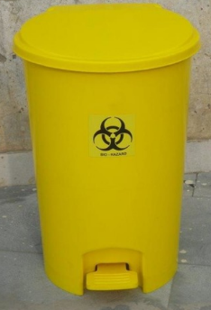
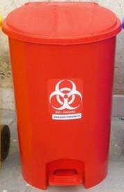
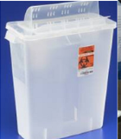
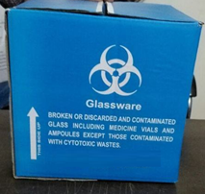
Biomedical waste Management Rule, India 2016
Category | Type of waste | Type of Bag/ container | Treatment/ Disposal options
Yellow infectious non- plastic waste | Human anatomical waste | Yellow coloured non chlorinated plastic bags | Incineration/ Plasma pyrolysis/ deep burial
 | Animal anatomical waste
 | Soiled waste |  | Incineration/ Plasma Pyrolysis/ deep burial/ autoclaving or hydroclaving + shredding/mutilation
 | Expired/ discarded medicines- pharmaceutical waste, cytotoxic drugs | Yellow coloured containers/ non chlorinated plastic bags | Incineration (cytotoxic drugs at temperature > 1200⁰C)
 | Chemical waste | Yellow coloured containers/ non chlorinated plastic bags | Incineration or Plasma pyrolysis or Encapsulation

Slide 6
Biomedical waste Management Rule, India 2016
Category | Type of waste | Type of Bag/ container | Treatment/ Disposal options
Yellow infectious non- plastic waste | Chemical liquid waste | Separate collection system leading to effluent treatment system | Pre-treated before mixing with other wastewater
 | Discarded linen contaminated with blood/ body fluids | Non-chlorinated yellow plastic bags/ suitable packing material | Non- chlorinated chemical disinfection followed by incineration/ plasma pyrolysis
 | Microbiology, other clinical lab waste, blood bags, live/ attenuated vaccines | Autoclave safe plastic bag/ container | Pre-treat to sterilize with non-chlorinated chemicals on-site as per NACO/ WHO guidelines + Incineration.

Slide 7
Biomedical waste Management Rule, India 2016
Category | Type of waste | Type of Bag/ container | Treatment/ Disposal options
Red | Infectious plastic waste (Recyclable) | Red coloured non-chlorinated plastic bags or containers | Autoclaving/ micro-waving/ hydroclaving + shredding Mutilation/ sterilization+ shredding. Treated waste sent to registered or authorized recyclers or for energy recovery or plastics to diesel or fuel oil or for road making,

Slide 8
Biomedical waste Management Rule, India 2016
Category | Type of waste | Type of Bag/ container | Treatment/ Disposal options
White (Translucent) | Waste sharps including metal sharp | Puncture proof, Leak proof, tamper proof containers | Autoclaving/ dry heat sterilization+ shredding/ mutilation Encapsulation in metal container or cement concrete Sanitary landfill/ designated concrete waste sharp pit

Slide 9
Biomedical waste Management Rule, India 2016
Category | Type of waste | Type of Bag/ container | Treatment/ Disposal options
Blue | Glassware Metallic body implants | Cardboard boxes with blue colored marking | Disinfection (by soaking the washed glass waste after cleaning with detergent and Sodium Hypochlorite treatment)/ through autoclaving/ microwaving/ hydroclaving + recycling

Slide 10
TREATMENT AND DISPOSAL METHODS- Incineration
Method of choice of disposal of biomedical waste.
High temperature dry oxidation process that reduces organic and combustible waste into nonorganic incombustible matter, resulting in a very significant reduction of waste volume and weight

Slide 11
Incineration
Incineration done for:
Those wastes that cannot be reused, recycled or disposed off in a landfill site, for example, human and animal anatomical waste, microbiological waste, solid non-plastic infectious waste
Incineration should not be done for:
Pressurized gas containers
Reactive chemical waste
Halogenated plastics such as PVC (polyvinyl chloride)
Waste with heavy metals such as mercury, silver salts, radiographic waste, broken thermometers.

Slide 12
Autoclave
For ease and safety in operation, the system should be horizontal type and exclusively designed for the treatment of biomedical waste.
For optimum results, pre-vacuum-based system is preferred against the gravity type system.
Tamper-proof control panel with efficient display and recording devices for critical parameters such as time, temperature, pressure, date and batch number, etc.

Slide 13
Chemical Disinfection
Chemicals such as sodium hypochlorite (1–2%) are added to waste to kill or inactivate the pathogens within it.

Slide 14
Effluent Treatment Plant
Liquid effluent generated during the process of washing containers, vehicles, floors, etc. is first subjected to chemical treatment and then disposed in effluent treatment plant.

Slide 15
Microwaving
In microwaving, microbial inactivation occurs as a result of the thermal effect of electromagnetic radiation.
Intermolecular heating process
Heating occurs inside the waste material in the presence of steam
Efficacy should be monitored regularly.

Slide 16
Shredder
Waste are deshaped or cut into smaller pieces so as to make the wastes unrecognizable.
Helps in prevention of reuse of biomedical waste
Acts as identifier that the waste has been disinfected and is safe to dispose off.

Slide 17
Sanitary Landfill
Small deep burial pit of 2 meters depth.
Should be half filled with waste, then covered with lime within 50 cm of the surface, before filling the rest of the pit with soil.
Designed for disposal of hospital waste.

Slide 18
Encapsulation
Involves filling containers with waste, adding immobilizing material and sealing the containers
To prevent the access to unscrupulous activities.

Slide 19
Inertization
Involves mixing waste with cement and other substances before disposal
To minimize the risk of toxic substances contained in the waste migrating into surface or ground water.

Slide 20
Plasma Pyrolysis
Makes use of an ionized gas in the plasma state to convert electrical energy to temperatures of several thousand degrees using plasma arc torches or electrodes.

